Slide 1
Explorer → Strategist
Talk to AI. Make it remember.
Notes:
Workshop 1 of 2 in the AI Academy series. 1 hour, hands-on. Everyone needs Claude open on their laptop.

Slide 2
Skeptic
→
Explorer
→
Whisperer
→
Strategist
→
Operator
→
Orchestrator
→
Builder
Two levels in one session
Notes:
Don't dwell on the spectrum — it's context, not content. Point out where they are (Explorer) and where they'll be (Strategist). Energy: "We're moving fast today."

Slide 3
Today we change the words
AND the information
Notes:
Level set: AI apps respond based on what you put in. First half changes the words (prompt engineering). Second half changes the information (context engineering). The second jump is bigger.

Slide 4
Open Claude on your laptop
Pick a real task from your work
a proposal, an email, a summary, a plan
Or use: "Make me a presentation about making a cup of tea"
Notes:
60 seconds to open Claude and think of a task. Offer both free choice and the prescribed option. Walk the room — make sure everyone's ready. This task carries through the entire session and into Workshop 2.

Slide 5
Type your natural prompt
Don't overthink it
Notes:
This is the "before" photo. It needs to be mediocre so the transformation lands. Don't help them write a good prompt — let them write their natural one. Give 2 minutes. Then ask: "Sound familiar? Generic. Surface-level. Could be for any company."

Slide 6
Assign a Role
One sentence changes everything
Make me a presentation about making tea
You are a senior office manager at a mid-size tech company. Make me a presentation about making tea
Notes:
One sentence of setup changes everything — tone, depth, perspective, terminology. The AI stops being a generic assistant and starts being a domain expert.

Slide 7
Add this to your prompt:
"You are a senior [your role]
at [your company]."
Notes:
2 minutes. Then compare: "Notice the terminology? The frameworks? The level of detail? One sentence did that."

Slide 8
Be Specific
Specificity in = specificity out
Make a presentation about making tea
A 10-slide deck for new hires. British-style loose-leaf tea. Cover equipment, steeping time, and milk-first debate.
Notes:
Specificity in = specificity out. WHO is it for, WHAT are the constraints, HOW long should it be. The output now addresses a real situation, not a generic one.

Slide 9
Add to your prompt:
WHO it's for
WHAT the constraints are
HOW long it should be
Notes:
2 minutes. Compare: the output now addresses their specific situation. It's no longer interchangeable with any other company's proposal.

Slide 10
One Task at a Time
Structure in = structure out
Make a presentation about tea, cover equipment, technique, preferences, and cleanup
1. Outline the key steps in order
2. Cover equipment needed
3. Walk through the process
4. Note team preferences
Notes:
The kitchen-sink prompt tries everything, nails nothing. Structure your request and the AI mirrors your organisation. Numbered sections or clear steps work best.

Slide 11
Structure your prompt:
Add numbered sections
or clear steps
Notes:
2 minutes. Compare: the AI's output now has the same structure they gave it. Organisation in = organisation out.

Slide 12
Power Keywords
Words that change AI behaviour
Don't you think tea is great and everyone should learn it?
Be radically honest.
Think step by step.
Challenge my assumptions.
Notes:
These keywords change the AI's behaviour more than you'd expect. "Be radically honest" stops sycophancy. "Think step by step" improves reasoning. "Challenge my assumptions" surfaces blind spots.

Slide 13
Add 2–3 power keywords:
"Be radically honest."
"Think step by step."
"Challenge my assumptions."
Notes:
2 minutes. Compare: notice the AI pushing back, flagging uncertainty, being more thoughtful. It's no longer just agreeing with everything.

Slide 14
Define the Output
Tell AI exactly what you need
Write something about making tea
Format: billboard slides, max 15 words.
Tone: friendly but practical.
Audience: new hires, zero tea knowledge.
Notes:
You wouldn't ask a designer for "something nice." Tell the AI the format, tone, length, and audience. The output should be immediately usable — right format, right tone, right length.

Slide 15
Add to your prompt:
Format, tone, length,
and audience
Notes:
2 minutes. This is the final technique. The output should now be immediately usable — something you could send, not something you'd need to rewrite.

Slide 16
Same task. Same information.
Just better words.
Notes:
First emotional peak. "Open your first output and your last output side by side." Give a full beat — don't rush past. The transformation is visceral because they did it themselves. Ask: "Would you have sent the first version to your boss? What about this one?"

Slide 17
Skeptic
→
Explorer
→
Whisperer
→
Strategist
→
Operator
→
Orchestrator
→
Builder
Notes:
Quick flash — 5 seconds. "You just crossed from Explorer to Whisperer. Five techniques, one task, dramatic improvement. But we haven't changed what the AI knows yet." Don't linger. Move on.

Slide 18
We never changed
what the AI knew
Notes:
The pivot. Five techniques, dramatic improvement. But every round changed the words — never the information. "Watch what happens when we do." This sets up the biggest conceptual shift in the workshop.

Slide 19
Add 3–4 sentences of real context:
Equipment. Tea types.
Team preferences. Who's it for.
Notes:
Take the prompt from Technique 5. Add real detail — numbers, names, constraints. Coach the room to be specific: not "we have tea" but "Our office has a Sage Smart Kettle on the third floor. Loose-leaf collection in the blue tin — mostly Earl Grey and oolong. Dave in accounting is militant about warming the pot first. The audience is new hires who've never used the office kitchen." Then compare. Ask: "Which made a bigger difference — five techniques or four sentences of context?"

Slide 20
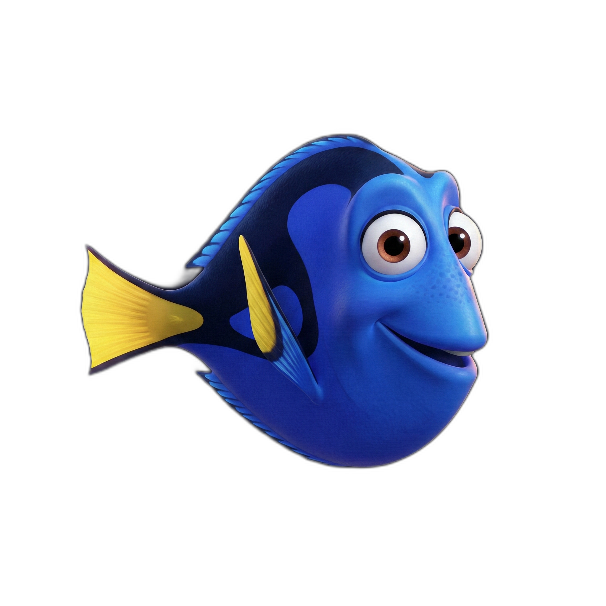
Brilliant. Helpful.
Remembers nothing.
Notes:
The Dory image should get a laugh — let it land. "Every conversation starts from scratch. She doesn't know your company, your role, or what you told her yesterday." This is the memory problem that rules and Skills solve.

Slide 21
Add to your prompt:
"Before you start, ask me
clarifying questions about
anything you'd need to know."
Notes:
This is the single highest-leverage technique in the workshop. Point out what the AI asked that the attendee hadn't thought to provide — budget constraints, stakeholder concerns, timeline, success criteria. "Did it surface things you hadn't thought of?"

Slide 22
Next conversation?
You'll type it all again.
Notes:
Pivot to the pain. They just pasted all that context manually — role, company, preferences, constraints. Next conversation, they'll do it all again. Let the frustration build. "What if the AI already knew?"

Slide 23
Settings
→
General
→
Personal preferences
Notes:
Screen-share this walkthrough. Wait for everyone to find it. "This is where you tell Claude who you are — once. These are your rules." Verify the exact path before the session — Claude may move this periodically.

Slide 24
Write your personal preferences:
"I work at [company]. My role is [role].
Be radically honest. Challenge my assumptions."
Notes:
3 minutes to write. Walk the room. Help anyone stuck. Template: "I work at [company]. My role is [role]. Be radically honest. Challenge my assumptions. Flag uncertainty. When I ask for presentations, default to billboard design — max 15 words per slide, with speaker notes." Quick test: open a NEW conversation and ask a question about your work — it already knows your role. Rules = who you are.

Slide 25
Rules
• Billboard design
• British English
• Be concise
• No jargon
Her entire memory.
Notes:
"You just wrote your rules. Here's what that actually looks like." One piece of A4 paper. That's it. Everything she knows right now — your rules, your request, the conversation — fits on this one page. Your rules go on this page. They're always there, grounding every conversation. That's powerful. But the page is small — you need to be selective about what earns a permanent spot. "So what happens to all those brilliant workflows that don't fit on the page?"

Slide 26
Skills live in the drawer.
Pulled onto the page
when needed.
Gone when done.
Notes:
Skills. Instructions kept in a drawer, pulled onto the page only when the task needs them. They don't take up memory between tasks. She pulls one out, uses it, puts it back. The page stays clean. Rule example (always on the page): 'All presentations use billboard design.' Skill example (from the drawer): 'How to write a project proposal' — step-by-step workflow loaded when you ask for a proposal, back in the drawer when you don't. Navigate to Customize → Skills. Show the built-in Anthropic Skills: presentations, documents, spreadsheets.

Slide 27
Enable the Presentation skill
Then type: "Make me a presentation
about making a cup of tea"
One sentence. It already knows the rest.
Notes:
Have them enable the presentation Skill in Customize → Skills, then use it. The aha: they typed one bare sentence and got output that knows who they are (rules on the page) AND how to build a proper presentation (Skill pulled from the drawer). "The page told her who you are. The drawer told her how to work."

Slide 28
The page stays clean.
The drawer holds the rest.
Notes:
The landing line. Rules earn a permanent spot on the page — only the essentials. Everything else lives in the drawer as Skills, pulled out when relevant. This is the distinction that separates someone who 'uses AI' from someone who has built a system. The page doesn't fill up because Skills come and go. The heuristic: "Does this apply to every conversation? Yes — it goes on the page. Only sometimes — it goes in the drawer." Personal preferences = the page. Skills = the drawer. Both compound. Both stack.

Slide 29
Same task. Each one dramatically better.
Vague
Well-prompted
Rules + Skills
Explorer
Whisperer
Strategist
Notes:
Second emotional peak — bigger than the first. The three-way comparison shows the full journey. If time is tight, this can be a facilitator demo. Point out: column 1 to 2 was five techniques. Column 2 to 3 was rules + Skills. The second jump required zero effort per conversation.

Slide 30
Skeptic
→
Explorer
→
Whisperer
→
Strategist
→
Operator
→
Orchestrator
→
Builder
You’re now a Strategist
Notes:
Graduation moment — the spectrum fills in. "You don't just talk to AI well — you've set up its playbook." But keep it short — this is the halfway point, not the finish line.

Slide 31
But who's doing
all the work?
Still you.
Notes:
The cliffhanger. "You search, you paste, you copy, you apply. Every step has 'you' in it." This should sting — they just felt the power of rules + Skills, but they're still the bottleneck. "Next time: Strategist → Orchestrator. We hand the AI the keys — and build it a team." Plant the seed: "Rules tell Claude who you are. Skills tell Claude how to work. Next time, each step in a chain gets its own specialized Skill — a whole team." Remind: save your prompt, preferences, and enabled Skills — they carry forward.

