Slide 1
AZ-203.5 Module 01: Azure Monitor
Subtitle or speaker name
Notes:
In this module, you will cover:
Microsoft Azure Monitor

Slide 2
Topics
Azure Monitor
Notes:
This is the topic that will be covered in this module.

Slide 3
Lesson 01: Azure Monitor
Notes:
In this lesson, you will cover:
Azure Monitor
Data sources
Application Insights
Alerts

Slide 4
Azure Monitor
Centralized platform for telemetry
Collecting data
Analyzing data
Acting on data
Supports cloud and on-premises environments
Single consolidated “pane of glass”
Log Analytics
Application Insights
Notes:
Azure Monitor maximizes the availability and performance of your applications by delivering a comprehensive solution for collecting, analyzing, and acting on telemetry from your cloud and on-premises environments. It helps you understand how your applications are performing and proactively identifies issues affecting them and the resources they depend on.

Slide 5
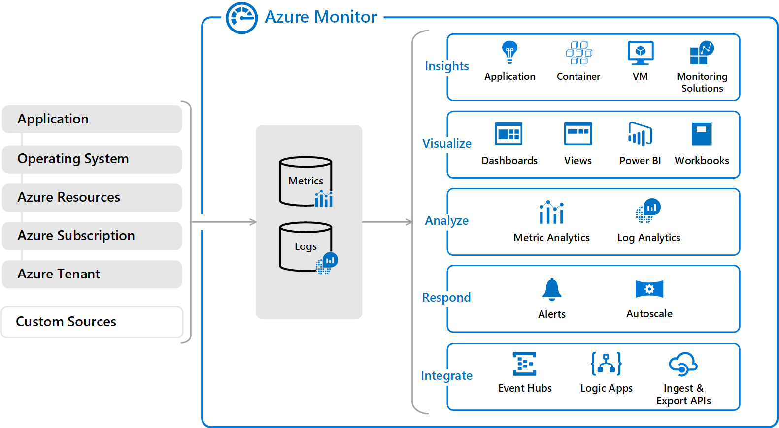
Azure Monitor overview
Notes:
The following diagram gives a high-level view of Azure Monitor. At the center of the diagram are the data stores for metrics and logs, which are the two fundamental types of data use by Azure Monitor. On the left are the sources of monitoring data that populate these data stores. On the right are the different functions that Azure Monitor performs with this collected data such as analysis, alerting, and streaming to external systems.

Slide 6
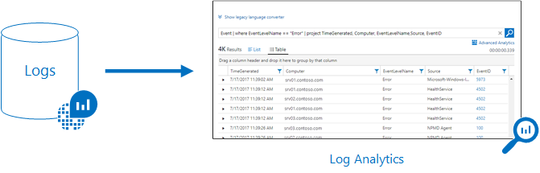
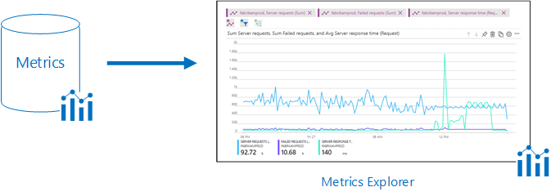
Monitoring data platform
Notes:
All data collected by Azure Monitor fits into one of two fundamental types, metrics and logs. Metrics are numerical values that describe some aspect of a system at a particular point in time. They are lightweight and capable of supporting near real-time scenarios. Logs contain different kinds of data organized into records with different sets of properties for each type. Telemetry such as events and traces are stored as logs in addition to performance data so that it can all be combined for analysis.
Log data collected by Azure Monitor is stored in Log Analytics, which includes a rich query language to quickly retrieve, consolidate, and analyze collected data. You can create and test queries by using the Log Analytics page in the Azure portal and then either directly analyze the data by using these tools or save queries for use with visualizations or alert rules.

Slide 7
What data does Azure Monitor collect?
Azure Monitor collects data from many sources:
Application monitoring data
Guest OS monitoring data
Azure resource monitoring data
Azure subscription monitoring data
Azure tenant monitoring data
Notes:
Azure Monitor can collect data from a variety of sources. You can think of monitoring data for your applications in tiers ranging from your application, any operating system and services it relies on, down to the platform itself. Azure Monitor collects data from each of the following tiers:
Application monitoring data: Data about the performance and functionality of the code you have written, regardless of its platform.
Guest OS monitoring data: Data about the operating system on which your application is running. This could be running in Azure, another cloud, or on-premises.
Azure resource monitoring data: Data about the operation of an Azure resource.
Azure subscription monitoring data: Data about the operation and management of an Azure subscription, as well as data about the health and operation of Azure itself.
Azure tenant monitoring data: Data about the operation of tenant-level Azure services, such as Azure Active Directory.

Slide 8
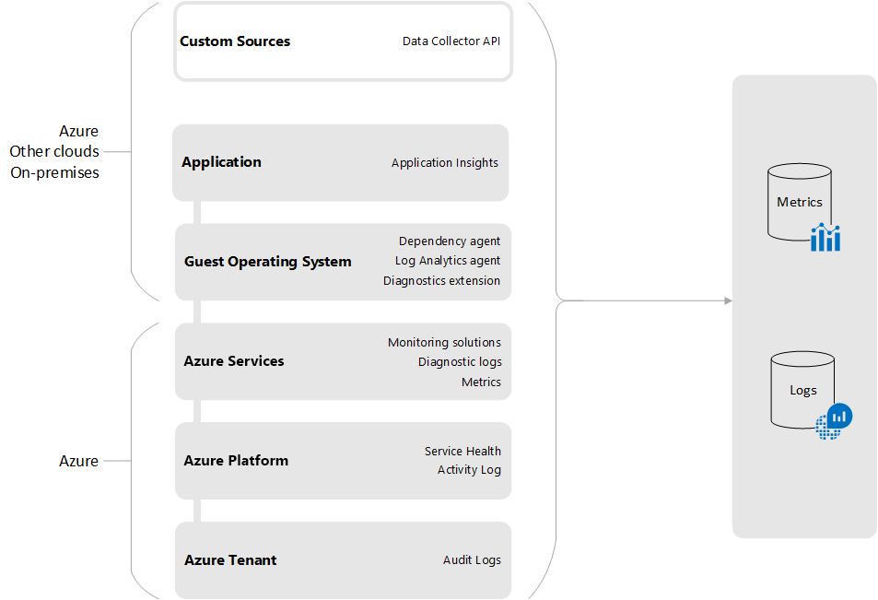
Data sources
Notes:
Monitoring data in Azure comes from a variety of sources that can be organized into tiers, the highest tiers being your application and any operating systems and the lower tiers being components of Azure platform.
Azure tenant: Telemetry related to your Azure tenant is collected from tenant-wide services such as Azure Active Directory.
Azure platform: Telemetry related to the health and operation of Azure itself includes data about the operation and management of your Azure subscription. It includes service-health data stored in the Azure Activity log and audit logs from Azure Active Directory.
Guest operating system: Compute resources in Azure, in other clouds, and on-premises have a guest operating system to monitor. With the installation of one or more agents, you can gather telemetry from the guest into the same monitoring tools as the Azure services themselves.
Applications: In addition to telemetry that your application may write to the guest operating system, detailed application monitoring is done with Application Insights. Application Insights can collect data from applications running on a variety of platforms. The application can be running in Azure, another cloud, or on-premises.
Custom sources: Azure Monitor can collect log data from any REST client using the Data Collector API. This allows you to create custom monitoring scenarios and extend monitoring to resources that don't expose telemetry through other sources.

Slide 9









Azure Monitor sources
Autoscale
Notifications Engine
Application
Insights
Resource
Log Analytics
Metrics
Event Hubs
Azure Infrastructure
Azure Storage
Azure Portal
Azure PowerShell
Azure CLI
REST API
3rd Party Tools
Notes:
All data collected by Azure Monitor fits into one of two fundamental types, metrics and logs.
Metrics are numerical values that describe some aspect of a system at a particular point in time. They are lightweight and capable of supporting near real-time scenarios.
Logs contain different kinds of data organized into records with different sets of properties for each type. Telemetry such as events and traces are stored as logs in addition to performance data so that it can all be combined for analysis.

Slide 10
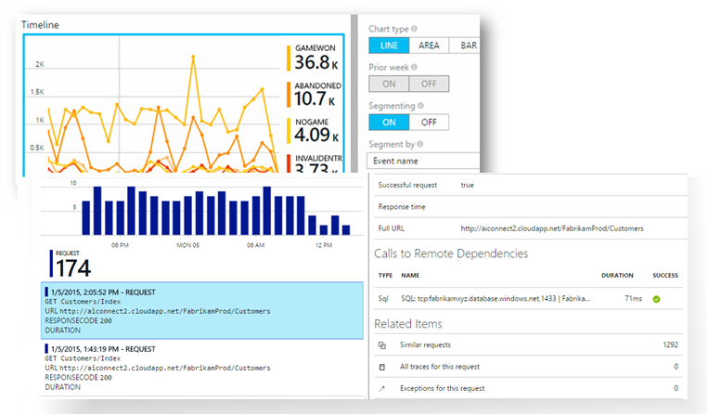
Application Insights
Extensible application performance monitoring (APM) service for developers building and managing apps on multiple platforms
Can be used to:
Monitor a live web application
Automatically detect performance anomalies
Diagnose issues by using analytical tools
Understand real-world user behavior by using custom queries and metric visualizations
Notes:
Application Insights is an extensible application performance management (APM) service for web developers on multiple platforms. Use it to monitor your live web application. It will automatically detect performance anomalies. It includes powerful analytics tools to help you diagnose issues and understand what users actually do with your app.

Slide 11
Monitored metrics
Request rates, response times, and failure rates
Find out which pages are most popular, what times of day are most popular, and where your users are. Observe which pages perform the best. If your response times and failure rates go high when there are more requests, you might have a resourcing problem.
Dependency rates, response times, and failure rates
Find out whether external services are slowing you down
Exceptions
Analyze the aggregated statistics, or pick specific instances and drill into the stack trace and related requests. Both server and browser exceptions are reported.
Page views and load performance
Directly reported by your users' browsers
User and session counts
Notes:
Application Insights is aimed at the development team, to help you understand how your app is performing and how it's being used. It monitors:
Request rates, response times, and failure rates – Find out which pages are most popular, at what times of day, and where your users are. Observe which pages perform best. If your response times and failure rates go high when there are more requests, you might have a resourcing problem.
Dependency rates, response times, and failure rates – Find out whether external services are slowing you down.
Exceptions - Analyze the aggregated statistics, or pick specific instances and drill into the stack trace and related requests. Both server and browser exceptions are reported.
Page views and load performance – Reported by your users' browsers.

Slide 12
Monitored metrics (continued)
Asynchronous JavaScript and XML (AJAX) calls
Rates, response times, and failure rates for these webpage-based calls
Performance counters
Measured from your Windows Server or Linux server machines, such as counters for CPU, memory, and network usage
Host diagnostics
Ingested from Docker or Azure
Diagnostic trace logs
Logs from your app so that you can correlate trace events with requests
Custom events and metrics
Custom metrics that you write yourself in the client or server code to track business events, such as the number of items sold or games won
Notes:
AJAX calls from webpages – rates, response times, and failure rates.
User and session counts.
Performance counters from your Windows or Linux server machines, such as CPU, memory, and network usage.
Host diagnostics from Docker or Azure.
Diagnostic trace logs from your app – so that you can correlate trace events with requests.
Custom events and metrics that you write yourself in the client or server code, to track business events such as items sold or games won.

Slide 13




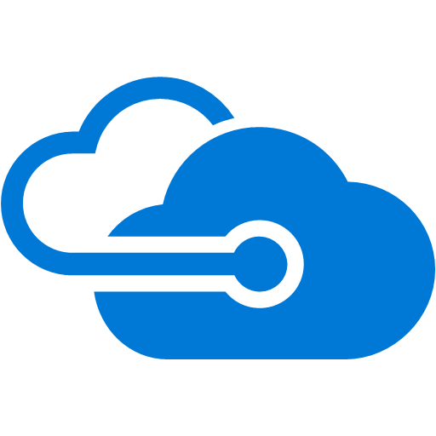
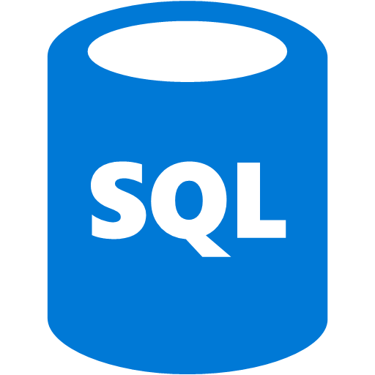
Application Insights architecture
Web Applications
Alerts
AI
Power BI
Application Insights
HTTP Requests
Visual Studio
AI
Server-Side Code
REST API
Dependency Calls
Continuous Export
External Services
Background Services
AI
Notes:
You install a small instrumentation package in your application, and set up an Application Insights resource in the Microsoft Azure portal. The instrumentation monitors your app and sends telemetry data to the portal. (The application can run anywhere—it doesn't have to be hosted in Azure.)
You can instrument not only the web service application but also any background components and the JavaScript in the webpages themselves.
In addition, you can pull in telemetry from the host environments such as performance counters, Azure diagnostics, or Docker logs. You can also set up web tests that periodically send synthetic requests to your web service.
All these telemetry streams are integrated in the Azure portal, where you can apply powerful analytic and search tools to the raw data.

Slide 14
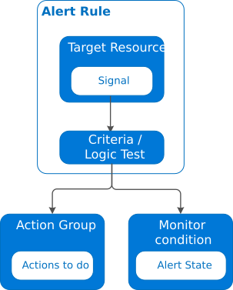
Alerts
Proactively notify you when conditions are met
Defined in alert rules
Now unified across multiple services
Application Insights
Log Analytics
Azure Monitor
Notes:
Alerts proactively notify you when important conditions are found in your monitoring data. They allow you to identify and address issues before the users of your system notice them.
Note: The new unified alert experience in Azure Monitor now includes Log Analytics and Application Insights. The previous alert experience and alert types are called classic alerts.
Alert rule – The alert rule captures the target and criteria for alerting. The alert rule can be in an enabled or a disabled state. Alerts only fire when enabled.

Slide 15






Alerts workflow
Resource
OMS Alerts
Diagnostic Logs
Azure Monitor Alerts
Rule
Azure Infrastructure
Criteria Met
Resource Metrics
Automation
Email
Automation Runbook
SMS
Function
Webhook
Activity Logs
Logic App
3rd Party URL
Notes:
The key attributes of an alert rule are:
Target Resource – Defines the scope and signals available for alerting. A target can be any Azure resource. Example targets: a virtual machine, a storage account, a virtual machine scale set, a Log Analytics workspace, or an Application Insights resource. For certain resources (like virtual machines), you can specify multiple resources as the target of the alert rule.
Signal Signals are emitted by the target resource and can be of several types. Metric, Activity log, Application Insights, and Log.
Criteria – Criteria is the combination of Signal and Logic applied on a Target resource. Examples:
Percentage CPU > 70%
Server Response Time > 4 ms
Result count of a log query > 100
Alert Name – A specific name for the alert rule configured by the user.
Alert Description – A description for the alert rule configured by the user.
Severity – The severity of the alert once the criteria specified in the alert rule is met. Severity can range from 0 to 4.
Action – A specific action taken when the alert is fired.

Slide 16
Alert state
State | Description
New | The issue has just been detected and has not yet been reviewed.
Acknowledged | An administrator has reviewed the alert and started working on it.
Closed | The issue has been resolved. After an alert has been closed, you can reopen it by changing it to another state.
Notes:
You can set the state of an alert to specify where it is in the resolution process. When the criteria specified in the alert rule is met, an alert is created or fired, and it has a status of New. You can change the status when you acknowledge an alert and when you close it. All state changes are stored in the history of the alert.
Alert state is different and independent of the monitor condition. Alert state is set by the user. Monitor condition is set by the system. When an alert fires, the alert's monitor condition is set to fired. When the underlying condition that caused the alert to fire clears, the monitor condition is set to resolved. The alert state isn't changed until the user changes it.

Slide 17
Demo: Create an alert
Notes:
This revision of the course does not ship with demo instructions. For each demo, you will be given a list of specific tasks you should demonstrate to your students. The flow, content and structure of your demo is left to you to decide as an instructor.
In this demo, you should show students how to:
Create a new metric alert in the Azure Portal
Observe metadata about the metric alert with the Azure CLI
Test the alert and observe the notification (e-mail, etc) associated with the alert

Slide 18
Review
Azure Monitor
Notes:
The topic that we discussed in this module.

