Slide 1

Discrete optimization and decision making
UNIVERSITY OF VERONA
Master’s degree in Data Science
Course project: The Examination Timetabling Problem
Michael Fidanza
2022/2023

Slide 2

Examination Timetabling Problem (ETP)
Let us consider a set E of exams, to be scheduled during an examination period at the end of the semester, and a set S of students. Each student is enrolled in a non-empty subset of exams. The examination period is divided into T ordered time-slots.
Given two exams $e1, e2∈E$, let $n_{e1,e2}$ be the number of students enrolled in both.
Two exams $e1, e2∈E$ are called conflicting if they have at least one student enrolled in both, i.e., if $n_{e1,e2}>0$.
Rules and regulations impose that conflicting exams cannot take place in the same time- slot. Moreover, to promote the creation of timetables more sustainable for the students, a penalty is assigned for each pair of conflicting exams scheduled up to a distance of 5 time-slots. More precisely, given two exams $e1, e2∈E$ scheduled at distance $i$ of time-slots, with $1≤i≤5$, the relative penalty is
$$2^{(5−i)}∙\frac{n_{e1,e2}}{|S|}$$
The ETP aims at assigning exams to time-slots ensuring that:
Each exam is scheduled exactly once during the examination period.
Two conflicting exams are not scheduled in same time-slot.
The total penalty resulting from the created timetable is minimized.

Slide 3

Base ILP formulation Input data
$E=\left\{e_{1}, e_{2}, …, e_{n}\right\}$ set of n exams
$S=\{s_{1}, s_{2}, …, s_{m}\}$ set of m students
$T=\left\{t_{1}, t_{2}, …, t_{l}\right\}$ set of l time-slots
$n_{ee′}$ number of students which are enrolled in both exams $e$ and $e′$, $∀ e,e^{′}∈E$

Slide 4

$x_{et}=1$ if exam $e$ is scheduled in time-slot $t$, $∀ e∈E, t∈T$
$y_{ete′t′}=1$ if exam $e$ is scheduled in time-slot $t$ and exam $e′$ is scheduled in time-slot $t′$, $∀ e,e^{′}∈E,n_{ee^{′}}>0, t,t′∈T$
Base ILP formulation Decision variables

Slide 5

$$min(\sum_{\begin{aligned}e,e′∈E \\ e′>e \\ n_{ee′}>0 \end{aligned}}{\sum_{\begin{aligned}t,t′∈T \\ \left|t−t′\right|≤5\end{aligned}}{\frac{2^{5−|t−t′|}∙n_{ee′}∙y_{ete′t′}}{m}}})$$
Base ILP formulation Objective function

Slide 6

Each exam is scheduled exactly once during the examination period.
$\sum_{t∈T}{x_{et}}=1 ∀e∈E$
Two conflicting exams can not be scheduled in same time-slot.
$x_{et}+x_{e^{′}t}≤1 ∀ e, e^{′}∈E, e^{′}>e, n_{ee^{′}}>0, ∀ t∈T$
Link variable $y$ to variable $x$.
$y_{ete′t′}≥x_{et}+x_{e^{′}t^{′}}−1 ∀ e, e^{′}∈E,n_{ee^{′}}>0, ∀ t, t^{′}∈T$
$y_{ete′t′}≤x_{et} ∀ e, e^{′}∈E, n_{ee^{′}}>0, ∀ t, t^{′}∈T$
$y_{ete′t′}≤x_{e^{′}t^{′}} ∀ e, e^{′}∈E, n_{ee^{′}}>0, ∀ t, t^{′}∈T$
Domain constraints
$x_{et}∈\{0, 1\} ∀ e, ∈E, ∀ t∈T$
$y_{ete′t′}∈\left\{0, 1\right\} ∀ e, e^{′}∈E,n_{ee^{′}}>0,∀ t,t′∈T$
Base ILP formulation Constraints

Slide 7
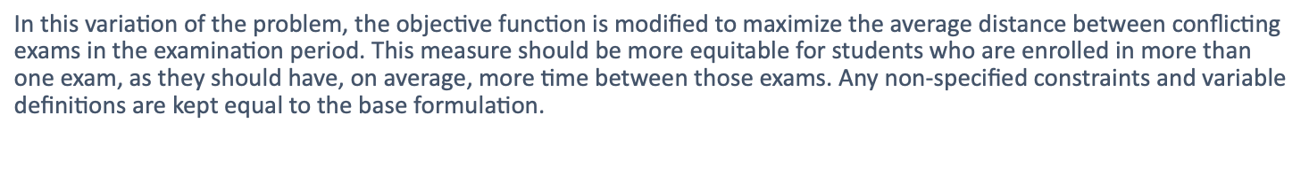
Variation on equity measure
Maximum average distance between conflicting exams
$$\text{In} \text{this} \text{variation} \text{of} \text{the} \text{problem}\text{, }\text{the} \text{objective} \text{function} \text{is} \text{modified} \text{to} \text{maximize} \text{the} \text{average} \text{distance} \text{between} \text{conflicting} \text{exams} \text{in} \text{the} \text{examination} \text{period}\text{.} \text{This} \text{measure} \text{should} \text{be} \text{more} \text{equitable} \text{for} \text{students} \text{who} \text{are} \text{enrolled} \text{in} \text{more} \text{than} \text{one} \text{exam}\text{, }\text{as} \text{they} \text{should} \text{have}\text{, }\text{on} \text{average}\text{, }\text{more} \text{time} \text{between} \text{those} \text{exams}\text{.} \text{Any} \text{non}\text{−}\text{specified} \text{constraints} \text{and} \text{variable} \text{definitions} \text{are} \text{kept} \text{equal} \text{to} \text{the} \text{base} \text{formulation}\text{.}$$
1

Slide 8

$$max(\sum_{\begin{aligned}e,e′∈E \\ e′>e \\ n_{ee′}>0 \end{aligned}}{\sum_{\begin{aligned}t,t′∈T\end{aligned}}{\frac{|t−t^{′}|∙y_{ete′t′}}{num_conflicts}}})$$
$$\text{Define} num_conflicts \text{as} \text{the} \text{total} \text{number} \text{of} \text{conflicts} \text{between} \text{all} \text{possible} \text{pair} \text{of} \text{exams}\text{.}$$
Equity measure 1 Objective function

Slide 9
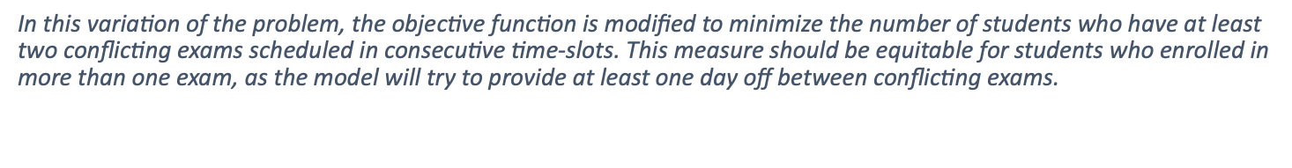
Variation on equity measure
Minimum number of students with back-to-back exams
$$\text{In} \text{this} \text{variation} \text{of} \text{the} \text{problem}\text{, }\text{the} \text{objective} \text{function} \text{is} \text{modified} \text{to} \text{minimize} \text{the} \text{number} \text{of} \text{students} \text{who} \text{have} \text{at} \text{least} \text{two} \text{conflicting} \text{exams} \text{scheduled} \text{in} \text{consecutive} \text{time}\text{−}\text{slots}\text{.} \text{This} \text{measure} \text{should} \text{be} \text{equitable} \text{for} \text{students} \text{who} \text{enrolled} \text{in} \text{more} \text{than} \text{one} \text{exam}\text{, }\text{as} \text{the} \text{model} \text{will} \text{try} \text{to} \text{provide} \text{at} \text{least} \text{one} \text{day} \text{off} \text{between} \text{conflicting} \text{exams}\text{.}$$
2

Slide 10

$z_{s}=1$ $\text{if} \text{student} s \text{is} \text{enrolled} \text{at} \text{least} \text{in} \text{two} \text{exams} \text{which} \text{are} \text{scheduled} \text{in} \text{consecutive} \text{time} \text{slots}\text{, }∀ s∈S\text{.}$
Equity measure 2 Decision variables

Slide 11

$$min(\sum_{s∈S}{z_{s}})$$
Equity measure 2 Objective function

Slide 12

Define ${enr}_{s}$ as the list of exams in which student $s$ is enrolled.
Link variable $z$ to $y$
$z_{s}≥y_{ete′t′}$
$$∀s∈S ∀e,e^{′}∈{enr}_{s}, e≠e′, t∈\left\{1,2,…, \left|T\right|−1\right\}, t^{′}=t+1$$
Domain constraints
$z_{s}∈\{0, 1\} ∀ s∈S$
Equity measure 2 Constraints

Slide 13
Variation on equity measure
Maximize minimum distance between any two conflicting exams
In this variation of the problem, the objective function is modified to maximize the minimum distance between any two conflicting exams.
This measure should be equitable for students who enrolled in more than one exam, as the model will provide a certain minimum number of time slots (based on the length of the examination period and on the number of conflicts) between any two conflicting exams.
3

Slide 14

$w$ integer variable representing the minimum distance between any two conflicting exams.
Equity measure 3 Decision variables

Slide 15

$$max (w)$$
Equity measure 3 Objective function

Slide 16

Define ${enr}_{s}$ as the list of exams in which student $s$ is enrolled.
Define $w$ as
$w≤\sum_{t,t′∈T}{|t−t^{′}|∗y_{ete′t′}}$ $∀e,e^{′}∈E, e^{′}>e, n_{ee^{′}}>0$
Domain constraints
$w≥0 Integer$
Equity measure 3 Constraints

Slide 17
Variation on equity measure
Maximize average distance between conflicting exams adjusted with Mean Absolute Deviation
In this variation of the problem, the objective function is modified to maximize the average distance between conflicting exams trying also to minimize the value of the mean absolute deviation.
This measure should provide an improvement to the equity measure considering only average distance, as it will try to keep the variability of the distances between conflicting exams low.
The mean absolute deviation refers to the average value of the absolute difference between a specific data point and the mean of all the data points.
4

Slide 18

$d_{ee′} ∀e,e^{′}∈E e^{′}>e, n_{ee^{′}}>0,$ is an integer variable representing the absolute value of the difference between the distance among conflicting exams $e$ and $e′$and the average distance among all conflicting exams.
Equity measure 4 Decision variables

Slide 19
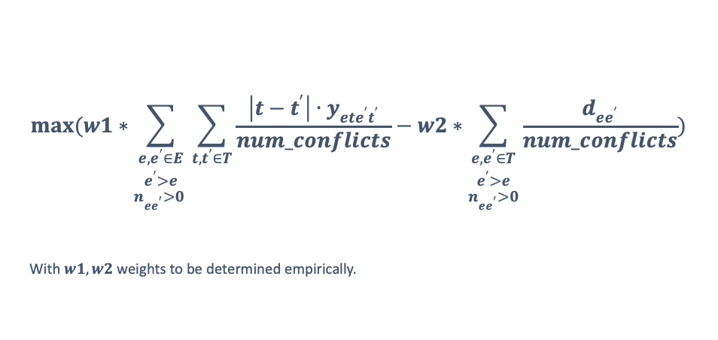
Equity measure 4 Objective function
$$max(w1∗\sum_{\begin{aligned}e,e^{′}∈E \\ e^{′}>e \\ n_{ee^{′}}>0 \end{aligned}}{\sum_{\begin{aligned}t,t^{′}∈T\end{aligned}}{\frac{\left|t−t^{′}\right|∙y_{ete^{′}t^{′}}}{num_conflicts}}}−w2∗\sum_{\begin{aligned}e,e^{′}∈T \\ e^{′}>e \\ n_{ee^{′}}>0\end{aligned}}{\frac{d_{ee^{′}}}{num_conflicts}})$$
With $w1, w2$ weights to be determined empirically.

Slide 20

Define $d_{ee′}$ as
$d_{ee′}≥\sum_{t,t^{′}∈T}{\left|t−t^{′}\right|∗y_{ete^{′}t^{′}}}− \sum_{\begin{aligned}e,e^{′}∈E \\ e^{′}>e \\ n_{ee^{′}}>0 \end{aligned}}{\sum_{\begin{aligned}t,t^{′}∈T\end{aligned}}{\frac{\left|t−t^{′}\right|∙y_{ete^{′}t^{′}}}{num_{conflictis}}}}$
$∀e,e^{′}∈E, e^{′}>e, { n}_{ee^{′}}>0$
$d_{ee′}≥\sum_{\begin{aligned}e,e^{′}∈E \\ e^{′}>e \\ n_{ee^{′}}>0 \end{aligned}}{\sum_{\begin{aligned}t,t^{′}∈T\end{aligned}}{\frac{\left|t−t^{′}\right|∙y_{ete^{′}t^{′}}}{num_{conflictis}}}}− \sum_{t,t^{′}∈T}{\left|t−t^{′}\right|∗y_{ete^{′}t^{′}}}$
$∀e,e^{′}∈E, e^{′}>e, { n}_{ee^{′}}>0$
Domain constraints
$d_{ee′}≥0 Integer ∀e,e^{′}∈E,e^{′}>e, { n}_{ee^{′}}>0$
Equity measure 4 Constraints

Slide 21
Additional restriction
At most 3 consecutive time slots with conflicting exams
Add a new restriction which limits the number of consecutive time slots with conflicting exams to a maximum of 3.
Here we are interested in looking for conflicts only in consecutive time slots.
1

Slide 22

$k_{tt′}=1 ∀ t∈\left\{1, 2, …,\left|T\right|−1\right\}, t^{′}∈\left\{t1+1, …,\left|T\right|\right\}$
if at least a pair of conflicting exams is scheduled in time slots $t$ and $t′$.
Additional restriction 1 Decision variables

Slide 23

Link variable $k$ to $y$
$k_{tt′}≤\sum_{\begin{aligned}e,e^{′}∈E \\ n_{ee^{′}}>0\end{aligned}}{y_{ete^{′}t^{′}}} ∀ t∈\{1, 2, …, |T|−1\}, t′∈\{t+1, 2, …, |T|\}$
$k_{tt′}≥\frac{\sum_{\begin{aligned}e,e^{′}∈E \\ n_{ee^{′}}>0\end{aligned}}{y_{ete^{′}t^{′}}}}{num_{conflicts}} ∀ t∈\{1, 2, …, |T|−1|\}, t′∈\{t+1, 2, …, |T|\}$
Can’t have more than 3 consecutive time slots with conflicting exams.
$k_{t+2,t+3}≤2−(k_{t,t+1}+ k_{t+1,t+2}) ∀ t∈\{1,2,…, \left|T\right|−3\}$
$k_{t+3,t+4}≤2−(k_{t,t+1}+ k_{t+1,t+2}) ∀ t∈\{1,2,…, \left|T\right|−4\}$
Domain constraints
$k_{tt′}∈\{0,1\} ∀t,t^{′}∈T$
Additional restriction 1 Constraints

Slide 24
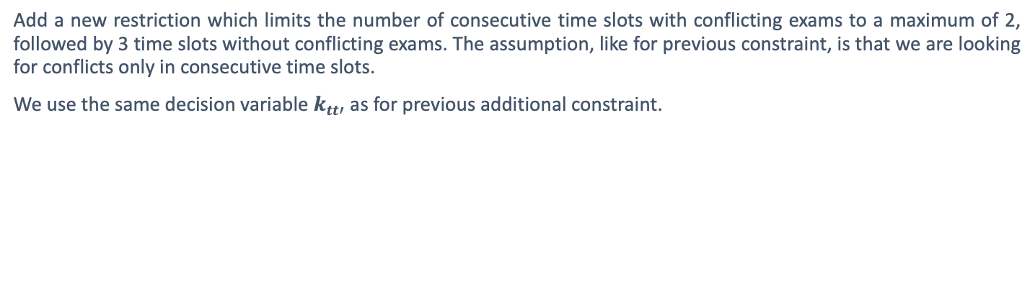
Additional restriction
If two consecutive time slots contain conflicting exams, then no conflicting exams scheduled in the next 3 time slots
Add a new restriction which limits the number of consecutive time slots with conflicting exams to a maximum of 2, followed by 3 time slots without conflicting exams. The assumption, like for previous constraint, is that we are looking for conflicts only in consecutive time slots.
We use the same decision variable $k_{tt′}$ as for previous additional constraint.
2

Slide 25

2 consecutive time slots with conflicting exams must be always followed by 3 consecutive time slots without conflicting exams.
$k_{t+1,t+2}≤1−k_{t,t+1} ∀ t∈\{1,2,…, \left|T\right|−2\}$
$k_{t+2,t+3}≤1−k_{t,t+1} ∀ t∈\{1,2,…, \left|T\right|−3\}$
$k_{t+3,t+4}≤1−k_{t,t+1} ∀ t∈\{1,2,…, \left|T\right|−4\}$
$k_{t+4,t+5}≤1−k_{t,t+1} ∀ t∈\{1,2,…, \left|T\right|−5\}$
Additional restriction 2 Constraints

Slide 26
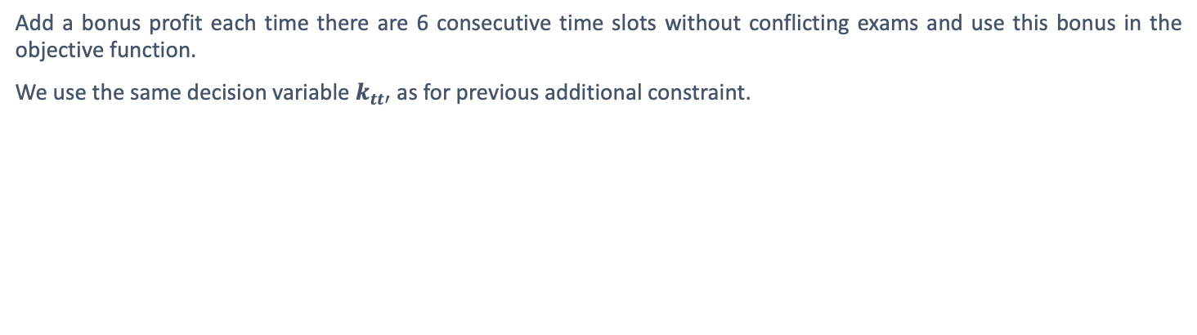
Additional restriction
Bonus profit each time no conflicting exams are scheduled for 6 consecutive time slots
Add a bonus profit each time there are 6 consecutive time slots without conflicting exams and use this bonus in the objective function.
We use the same decision variable $k_{tt′}$ as for previous additional constraint.
3

Slide 27

$b_{t}=1 ∀ t∈\left\{1, 2, …,\left|T\right|−5\right\}$if no conflicting exams are scheduled in time slots between $t$ and $t+5$ included (every possible combination of time slots within the range is checked).
Additional restriction 3 Decision variables

Slide 28

$$min(\sum_{\begin{aligned}e,e^{′}∈E \\ e^{′}>e \\ n_{ee^{′}}>0 \end{aligned}}{\sum_{\begin{aligned}t,t^{′}∈T \\ \left|t−t^{′}\right|≤5\end{aligned}}{\frac{2^{5−\left|t−t^{′}\right|}∙n_{ee′}∙y_{ete′t′}}{m}}}−\sum_{t∈\{1,2,…, \left|T\right|−5\}}{b_{t}})$$
Additional restriction 3 Objective function

Slide 29

Each time no conflicting exams are scheduled for 6 consecutive time slots, a bonus score is added
$b_{t}≥1−\sum_{\begin{aligned}t^{′}∈\left\{t, t+1,…,t+4\right\} \\ t^{′′}∈\{t^{′}+1,…,t+5\}\end{aligned}}{k_{t′t′′}} ∀ t∈\{1,2,…, \left|T\right|−5\}$
$b_{t}≤1−\frac{\sum_{\begin{aligned}t^{′}∈\left\{t, t+1,…,t+4\right\} \\ t^{′′}∈\{t^{′}+1,…,t+5\}\end{aligned}}{k_{t′t′′}}}{\begin{aligned}15\end{aligned}} ∀ t∈\{1,2,…, \left|T\right|−5\}$
Domain constraints
$b_{t}∈\{0,1\} ∀t∈T$
Additional restriction 3 Constraints

Slide 30
Additional restriction
At most 3 conflicting pairs of exams can be scheduled in same time slot
Modify the original constraint that impose that no conflicting exams can be scheduled in the same time slot, to allow at most 3 conflicting pair of exams in the same time slot.
4

Slide 31

At most 3 conflicting pairs of exams can be scheduled in the same time slot.
$\sum_{\begin{aligned}e,e^{′}∈E \\ e^{′}>e \\ n_{ee′}>0\end{aligned}}{y_{ete′t}}≤3 ∀ t∈T$
Additional restriction 4 Constraints

Slide 32
Conclusions
Base formulation results
Name | Benchmark | Found results
 |  | Base formulation | Restriction 1 | Restriction 2 | Restriction 3 | Restriction 4
Instance01 | 157,033 | 158,241 | N.A. | N.A. | 211,920 | 162,687
Instance02 | 34,709 | 46,627 | N.A. | N.A. | N.A | 56,141
Instance03 | 32,627 | 47,449 | N.A. | N.A. | N.A | 54,276
Instance04 | 7,717 | 11,422 | N.A. | N.A. | N.A | 15,700
Instance05 | 12,901 | 19,490 | N.A. | N.A. | 31,491 | 21,156
Instance06 | 3,045 | N.A. | N.A. | N.A. | N.A | N.A.
Instance07 | 10,050 | 16,081 | N.A. | N.A. | N.A | 13,855
Instance08 | 24,869 | 30,629 | N.A. | N.A. | 38,255 | 28,572
Instance09 | 9,818 | 14,420 | N.A. | N.A. | N.A | 23,936
Instance10 | 3,707 | N.A. | N.A. | N.A. | N.A | N.A.
Instance11 | 4,395 | N.A. | N.A. | N.A. | N.A | N.A.

Slide 33
Conclusions
Equity measure variation results
A toy instance has been created to study the behavior of different equity measures with the following input data:
Exams: {e1, e2, e3, e4, e5, e6}
Students: {s1, s2, s3, s4, s5, s6, s7, s8}
Enrollments table
Student | e1 | e2 | e3 | e4 | e5 | e6
S1 | ✓ | ✓ | ✓ |  | ✓ | ✓
S2 | ✓ |  | ✓ |  | ✓ | ✓
S3 |  |  |  | ✓ | ✓ | ✓
S4 |  |  | ✓ |  | ✓ | ✓
S5 | ✓ |  | ✓ |  | ✓ | ✓
S6 |  |  |  | ✓ | ✓ | ✓
S7 |  | ✓ | ✓ |  | ✓ | ✓
S8 | ✓ | ✓ |  |  | ✓ | ✓

Slide 34
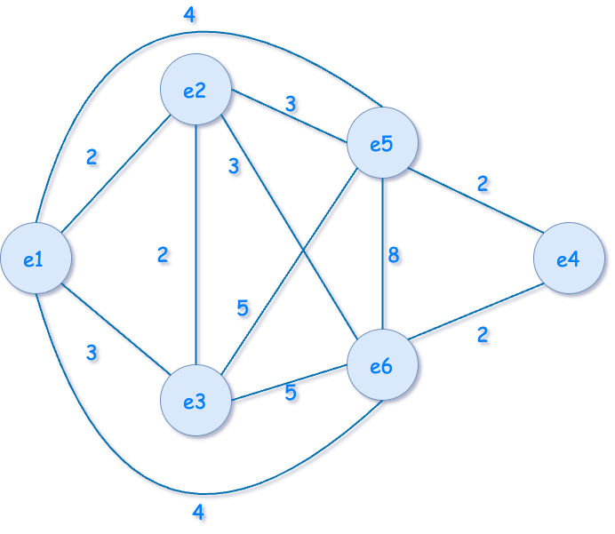
Conclusions
The conflict graph for the created toy instance is the following

Slide 35
Conclusions
The different models behavior has been analyzed for different values of available time slots from 5 to 20 and one optimal solution for each combination is displayed in the following table
Equity measure | t1 | t2 | t3 | t4 | t5 | t6 | t7 | t8 | t9 | t10 | t11 | t12 | t13 | t14 | t15 | t16 | t17 | t18 | t19 | t20
Available time slots: 5
Base | e5 | e1 | e3,e4 | e2 | e6
1 | e6 | e5 | e2 | e3 | e1,e4
2 | e5 | e1 | e6 | e2 | e3,e4
3 | e6 | e5 | e3 | e2 | e1,e4
4 | e6 | e2 | e1,e4 | e3 | e5
Available time slots: 10
Base | e6 |  |  | e1 | e4 | e3 |  | e2 |  | e5
1 | e5 | e6 |  | e2 |  |  |  |  | e3 | e1, e4
2 | e1 |  |  | e3,e4 |  | e2 |  | e6 |  | e5
3 | e6 |  | e3 |  |  | e1 | e4 | e2 |  | e5
4 | e5 |  | e6 |  |  | e3 |  | e4 | e1 | e2
Available time slots: 15
Base | e6 |  |  |  | e2 |  | e4 | e3 |  |  | e1 |  |  |  | e5
1 | e6 | e5 | e2 |  |  |  |  |  |  |  |  |  |  | e3 | e1,e4
2 | e1,e4 |  | e5 |  |  | e3 |  |  |  |  |  |  | e2 |  | e6
3 |  | e3,e4 |  |  | e6 |  |  | e2 |  |  |  | e5 |  |  | e1
4 | e5 |  |  | e1 |  |  |  | e3,e4 |  |  | e2 |  |  |  | e6
Available time slots: 20
Base | e5 |  |  |  |  |  | e6 |  |  |  |  |  | e3 |  |  |  | e2 |  |  | e1,e4
1 | e6 | e5 |  |  |  |  |  |  |  |  |  |  |  |  |  |  | e2 |  | e3 | e1,e4
2 |  | e6 |  |  | e2 |  |  |  | e4 |  | e3 |  |  |  |  | e5 |  |  | e1
3 | e1 |  |  |  |  |  |  | e2 | e4 |  |  | e3 |  |  |  | e5 |  |  |  | e6
4 | e6 |  |  |  | e5 |  |  |  |  |  | e2 |  |  |  | e1,e4 |  |  |  |  | e3

