Slide 1

Programming and Database
Database project
Michael Fidanza – VR472909
2021/2022

Slide 2
Requirements and assumptions
Boyscout/Adult birthdate not explicitly required but needed to identify scout category and if it can be an adult (older than 21)
Adults have same attributes as boyscouts but we don’t store payment information since they’re part of the organization/scout group (supposition)
Activities organized by group and organization have the same attributes

Slide 3
We want to store payment information about several years, not just the current year, so we use a dedicated relation (Year) in relationship N:M with boyscout
Added attribute description to zone to have more information
Scout groups belonging to an organization and nation is represented through a chain of relationships (no direct relationships)
Added id to activity relation as primary key to be able to store more than one activity organized by the same group/organization on the same day (not possible using a weak entity)

Slide 4
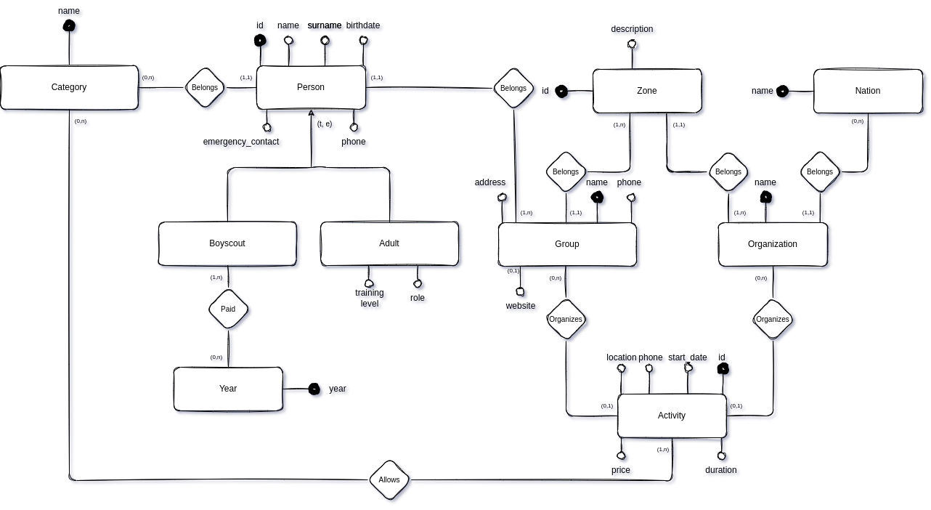
Conceptual schema

Slide 5
Logical schema
Year (year)
Boyscout (id, name, surname, birthdate, emergency_contact, phone, category_name, group_name)
Adult (id, name, surname, birthdate , emergency_contact, phone, training_level, role, head_of_category, group_name)
Category (name)
Group (name, phone, address, website, zone_id)
Zone (id, description, organization_name)

Slide 6
Organization (name, nation_name)
Nation (name)
Group_activity (id, start_date, duration, location, phone, price, group_name)
Organization_activity (id, start_date, duration, location, phone, price, organization_name)
Group_activity_category (group_activity_id, category_name)
Organization_activity_category (organization_activity_id, category_name)
Boyscout_annual_fee (year, boyscout_id)

Slide 7
Constraints
Scout category must be one between
L/C
E/G
R/S
Boyscouts must be between 9 and 21 and must be assigned to a category according to their age
Before assigning a boyscout to a category of a certain group, there must be at least an adult assigned as head to that category
Adult must be older than 21

Slide 8
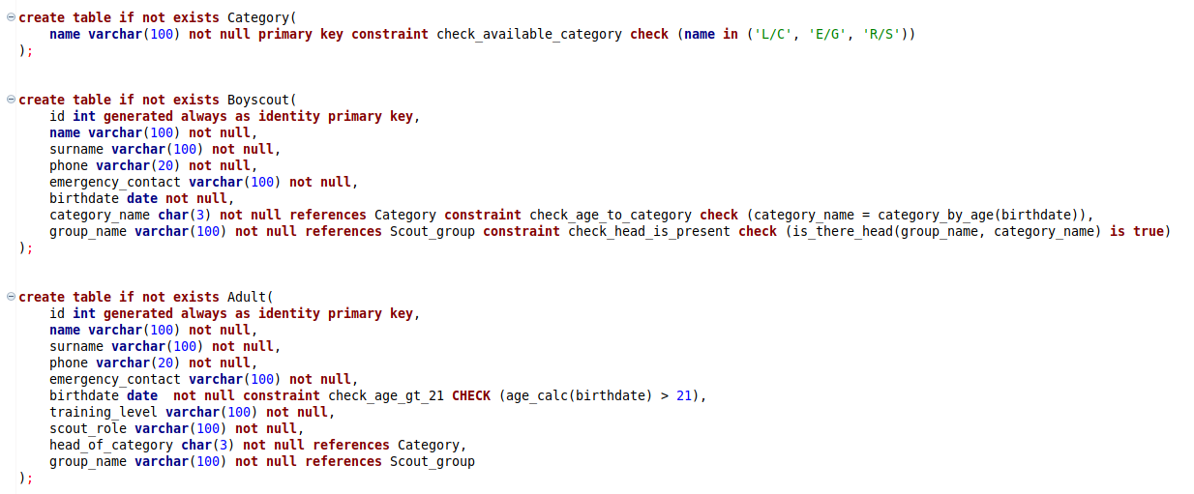
SQL – Tables definition

Slide 9
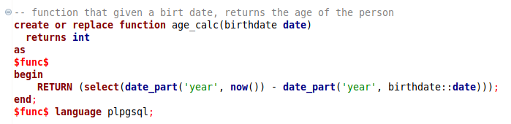
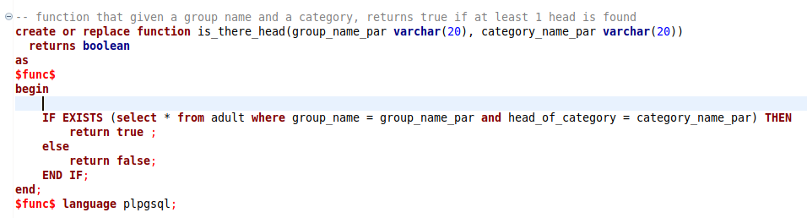
SQL – Check functions definition

Slide 10
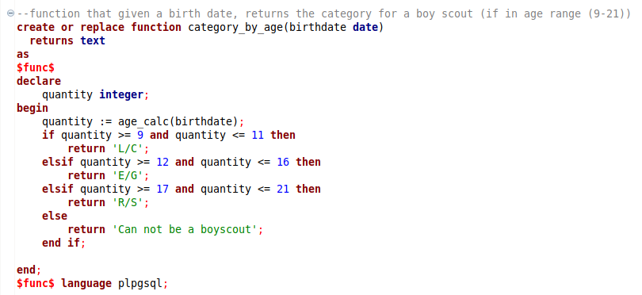
SQL – Check functions definition

Slide 11
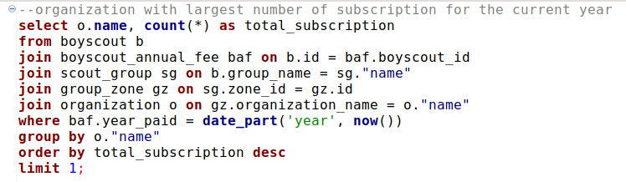

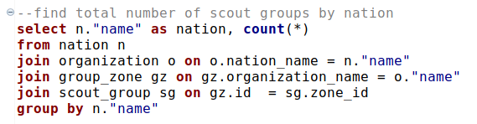
SQL – Relevant queries

Slide 12
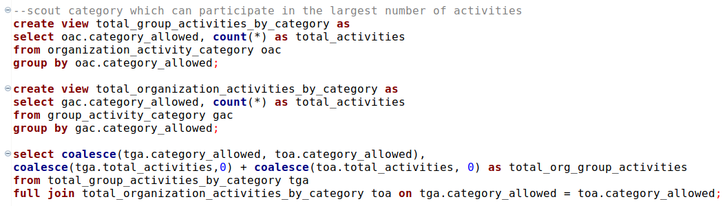
SQL – Relevant queries

Slide 13
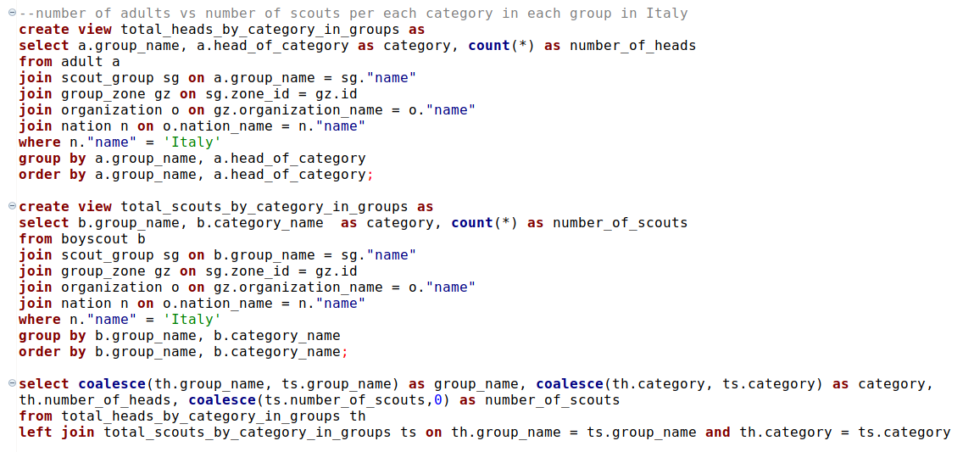
SQL – Relevant queries

Slide 14
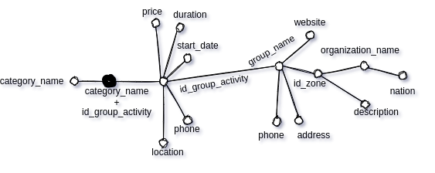
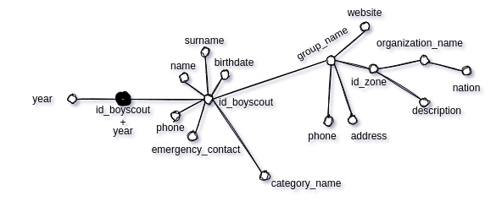
Attributes Trees
grafting
pruning
Statistics about activies organized by groups
Statistics about boyscouts subscription

Slide 15
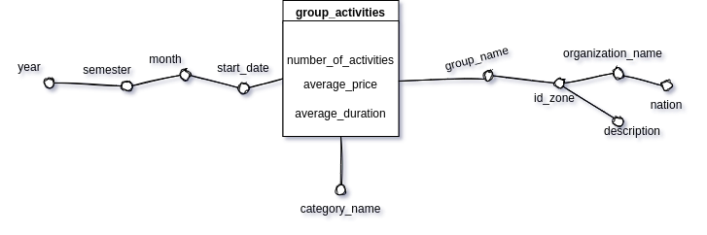
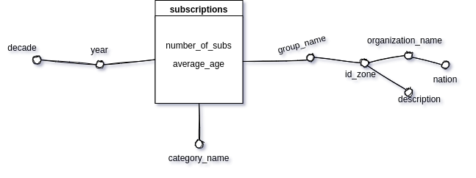
Fact schema
Statistics about activies organized by groups
Statistics about boyscouts subscription

Slide 16
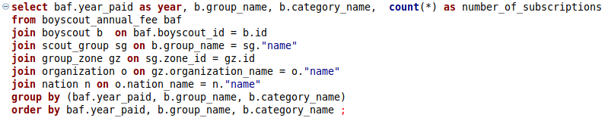
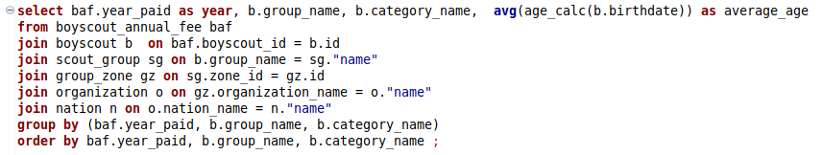
Glossary

Slide 17
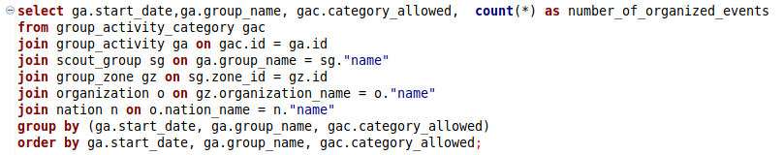
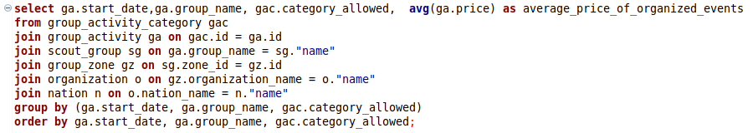
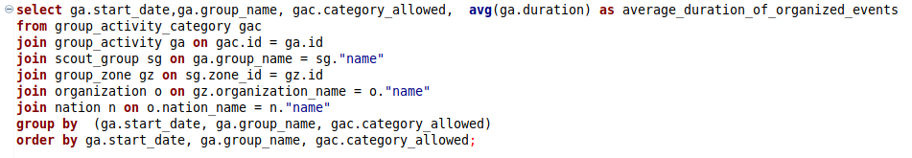
Glossary

