Slide 1
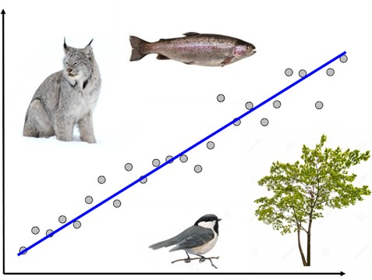
NRC 290b Introduction to Quantitative Ecology Week 7 – Tests for differences
Meg Graham MacLean, PhD
Department of Environmental Conservation
mgmaclean@umass.edu
2019 - Fall

Slide 2
This week
Tuesday (Monday)
MAP!
Share our plots with structured feedback
Finish reports and plots with edits
Wednesday
Difference tests!
Test for normally distributed data
t-test/paired t-test
Tests for skewed data
U-test
Wilcoxon matched-pairs test

Slide 3
Plot feedback
What your group should present (no longer than 3 minutes):
Your question and your hypotheses
The year of your data
What your plot visualizes
Feedback:
What did we learn from the plot (and what about the plot helped us learn it)?
What one thing could be improved to better visualize the answer to the question?

Slide 4
Week 7 – Tests for differences
Part II - Wednesday

Slide 5

Statistical testing
Which statistical test is right if you are looking for differences between two samples where you have less than 30 paired samples and the samples are normally distributed?
Kruskal-Wallis Test for multiple samples
Z-test for matched pairs
T-test for matched pairs
Mann-Whitney U-Test

Slide 6
Statistical testing
Using a t-test to test the difference between two samples, you calculate a p-value of 0.02. If you using a 5% significance (alpha) level – what do you conclude?
You reject the null hypothesis
You accept the null hypothesis
You don’t reject the null hypothesis
You reject the alternative hypothesis
You don’t reject the alternative hypothesis

Slide 7

Why do we conduct difference tests?

Slide 8
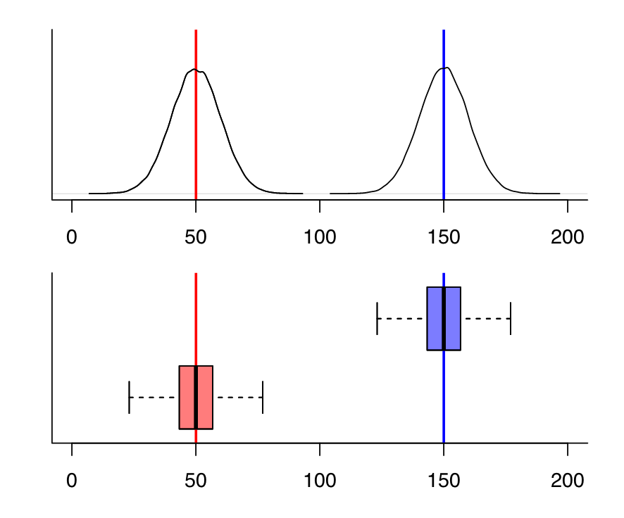
Tests for differences
Ask the questions:
Are the sample means different?
Are the sample medians different?
Are those differences statistically significant?

Slide 9
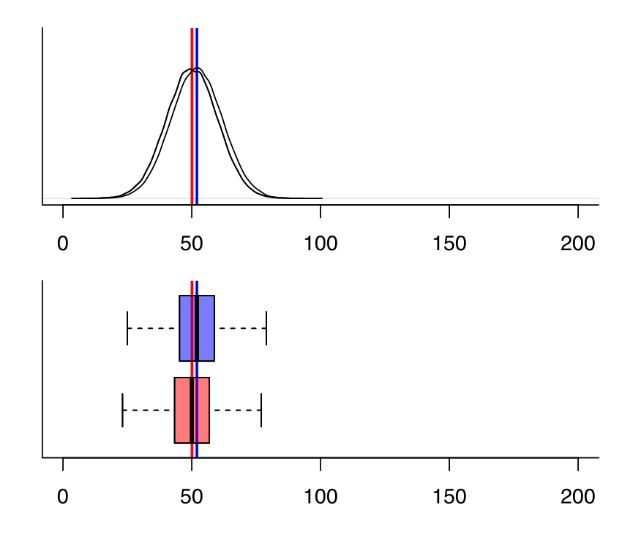
Tests for differences
Ask the questions:
Are the sample means different?
Are the sample medians different?
Are those differences statistically significant?

Slide 10
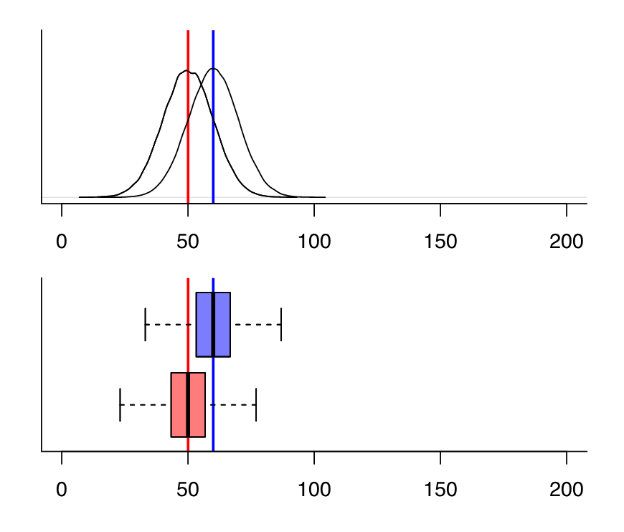
Tests for differences
Ask the questions:
Are the sample means different?
Are the sample medians different?
Are those differences statistically significant?
Statistical tests:
T-test (normally distributed data)*
U-test (skewed data)

Slide 11
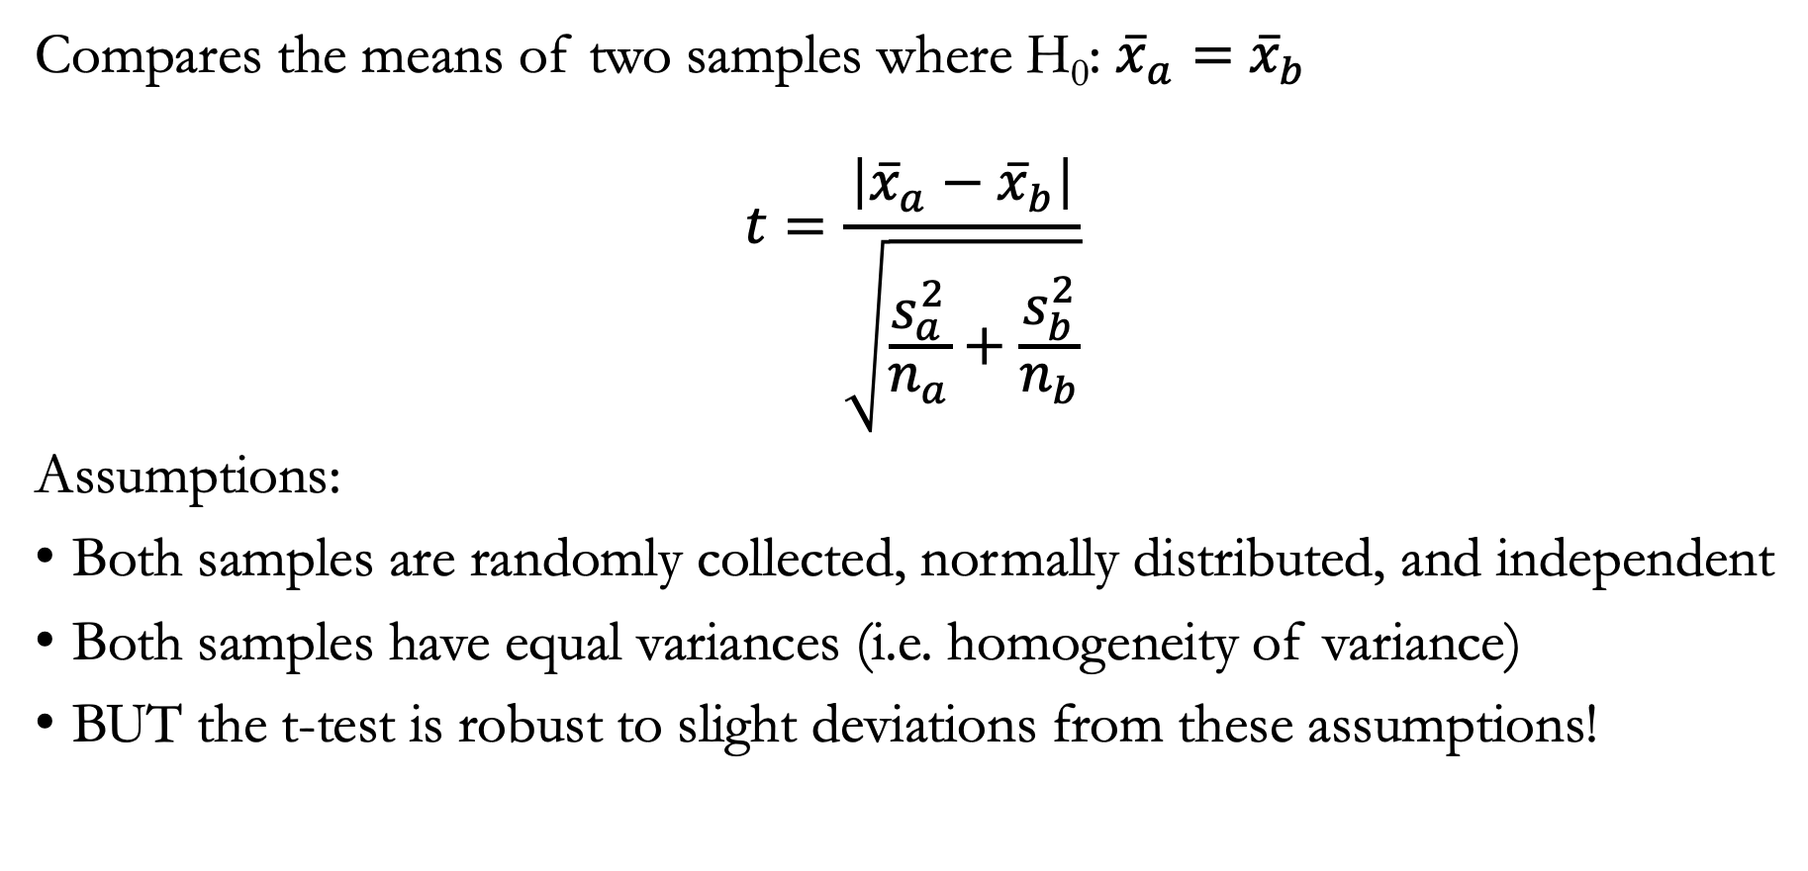
Student’s t-test
Compares the means of two samples where H₀: ${\overline{x}}_{a}=$ ${\overline{x}}_{b}$
$$t=\frac{\left|{\overline{x}}_{a}−{\overline{x}}_{b}\right|}{\sqrt{\frac{s_{a}^{2}}{n_{a}}+\frac{s_{b}^{2}}{n_{b}}}}$$
Assumptions:
Both samples are randomly collected, normally distributed, and independent
Both samples have equal variances (i.e. homogeneity of variance)
BUT the t-test is robust to slight deviations from these assumptions!

Slide 12
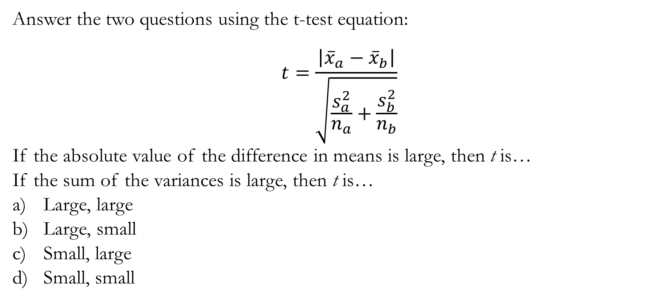
T-test
Answer the two questions using the t-test equation:
$$t=\frac{\left|{\overline{x}}_{a}−{\overline{x}}_{b}\right|}{\sqrt{\frac{s_{a}^{2}}{n_{a}}+\frac{s_{b}^{2}}{n_{b}}}}$$
If the absolute value of the difference in means is large, then t is…
If the sum of the variances is large, then t is…
Large, large
Large, small
Small, large
Small, small

Slide 13
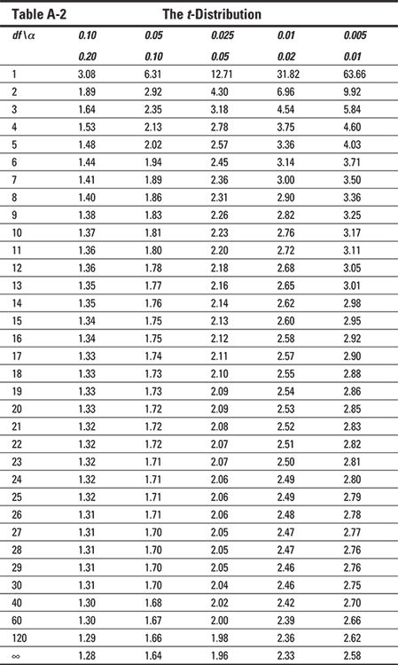
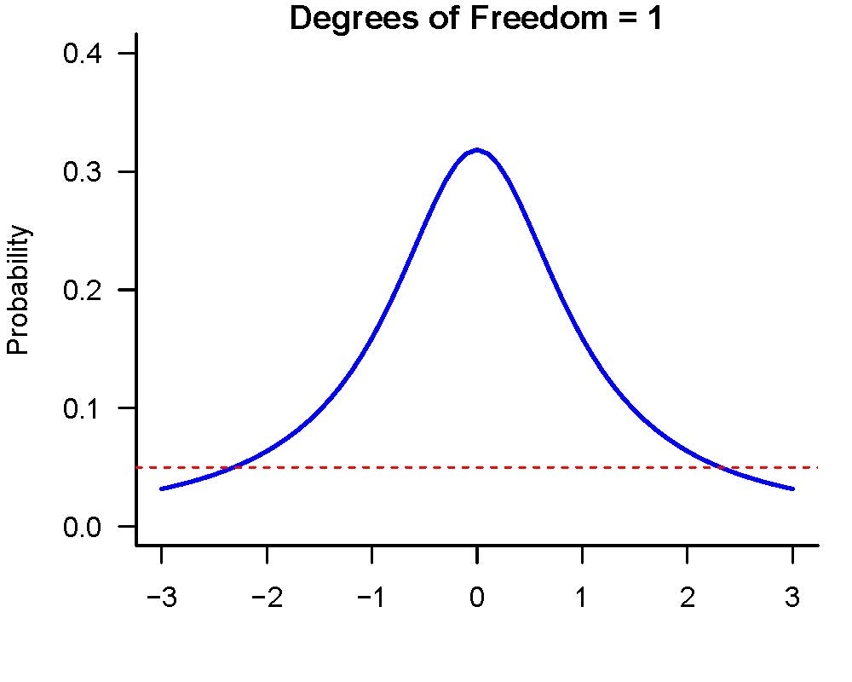
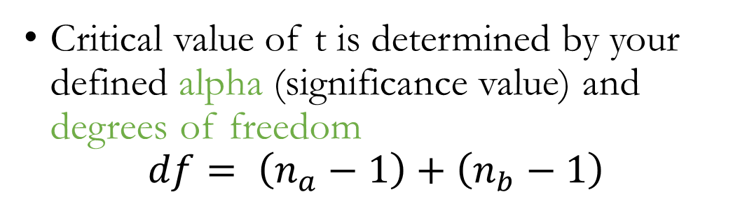
T-test
Critical value of t is determined by your defined alpha (significance value) and degrees of freedom
$$df= \left(n_{a}−1\right)+\left(n_{b}−1\right)$$

Slide 14
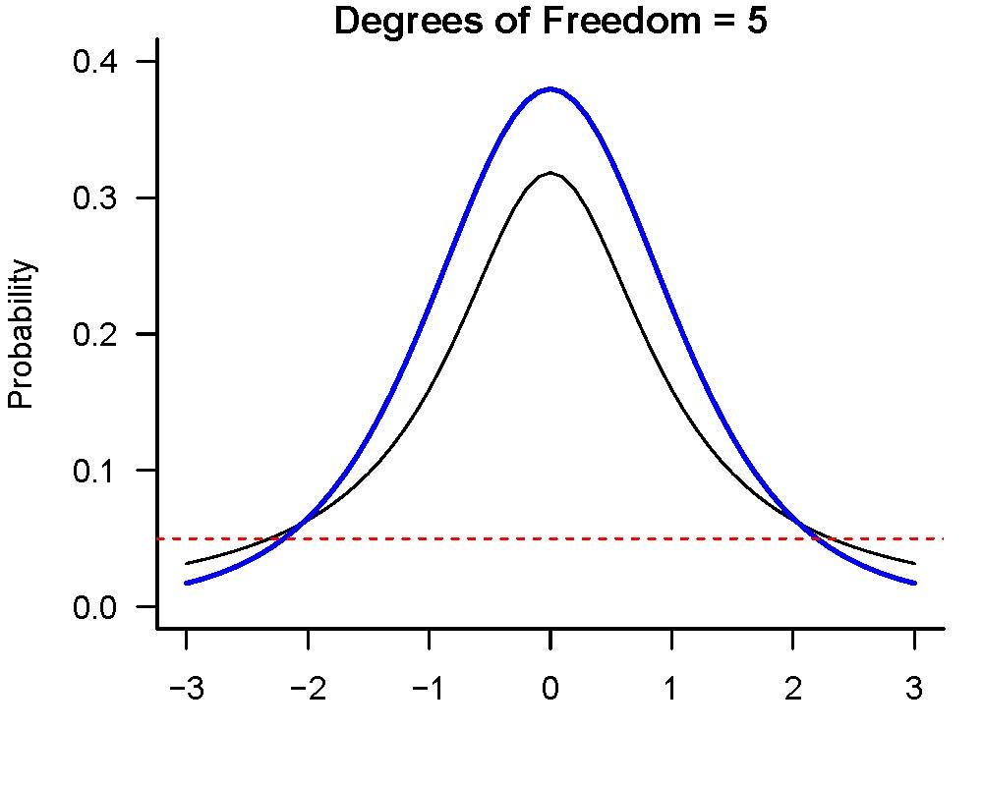
T-test
Critical value of t is determined by your defined alpha (significance value) and degrees of freedom
$$df= \left(n_{a}−1\right)+\left(n_{b}−1\right)$$

Slide 15
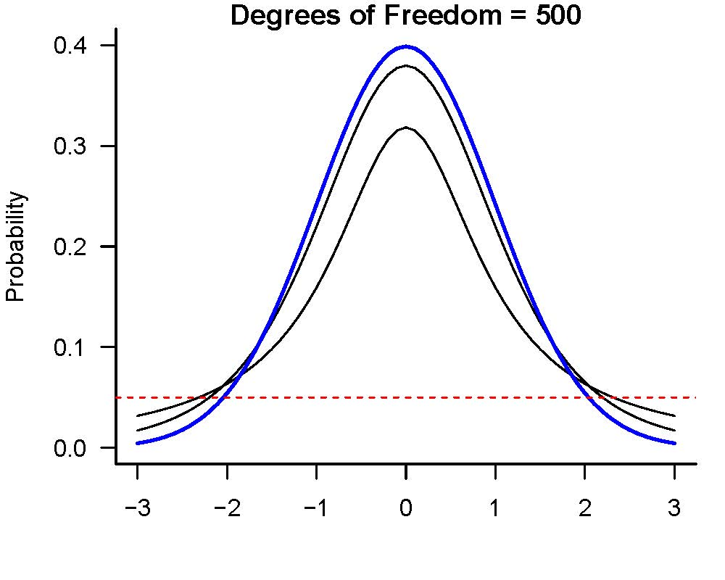
T-test
Critical value of t is determined by your defined alpha (significance value) and degrees of freedom
$$df= \left(n_{a}−1\right)+\left(n_{b}−1\right)$$

Slide 16
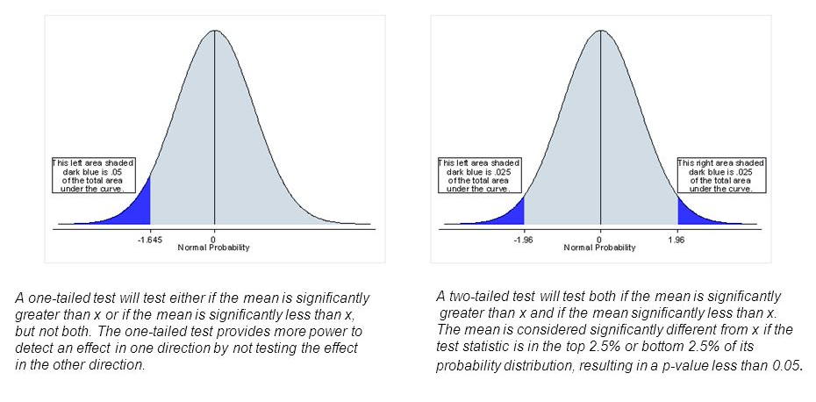
T-test
Critical value of t is determined by your defined alpha (significance value) and degrees of freedom
$$df= \left(n_{a}−1\right)+\left(n_{b}−1\right)$$

Slide 17
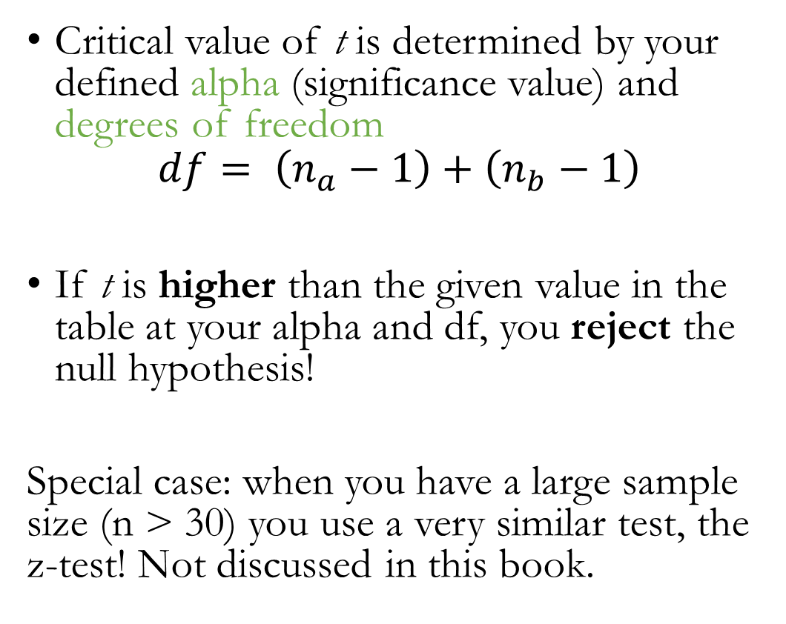
T-test
Critical value of t is determined by your defined alpha (significance value) and degrees of freedom
$$df= \left(n_{a}−1\right)+\left(n_{b}−1\right)$$
If t is higher than the given value in the table at your alpha and df, you reject the null hypothesis!
Special case: when you have a large sample size (n > 30) you use a very similar test, the z-test! Not discussed in this book.

Slide 18
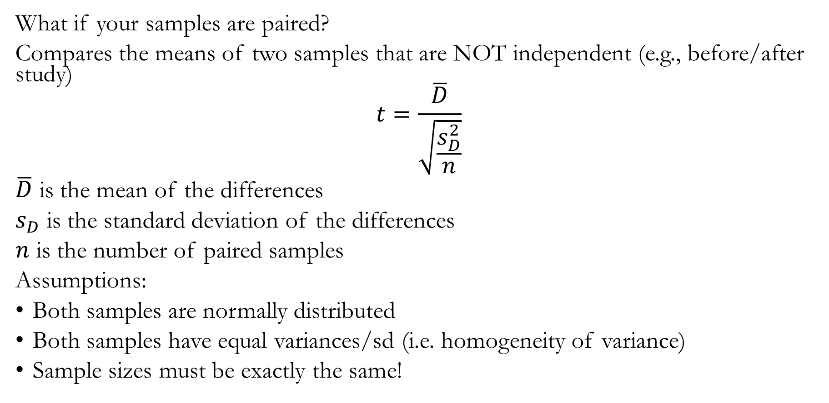
Paired t-test
What if your samples are paired?
Compares the means of two samples that are NOT independent (e.g., before/after study)
$$t=\frac{\overline{D}}{\sqrt{\frac{s_{D}^{2}}{n}}}$$
$\overline{D}$ is the mean of the differences
$s_{D}$ is the standard deviation of the differences
$n$ is the number of paired samples
Assumptions:
Both samples are normally distributed
Both samples have equal variances/sd (i.e. homogeneity of variance)
Sample sizes must be exactly the same!

Slide 19
Paired t-test
Let’s say you have a group of tree frogs you gave a vaccine to and you are trying to see if there is a difference in mucus production of those frogs before and after the vaccine… however, one of your treated frogs was eaten by a predator between your first measurement and your second – what do you do with the initial mucus value you recorded for this frog when conducting your paired t-test?
Get rid of it
Use it, no problem there
Use it and duplicate another similar frogs’ second reading
Use it for both before and after treatment

Slide 20
What happens when our data aren’t normally distributed?

Slide 21
Difference tests for skewed data
U-test (for unpaired samples)
Like the t-test but uses ranks, median, and range to determine how much overlap there is between samples
LOWER U-values are more significant (opposite from t-test)
Wilcoxon matched-pairs test (for paired samples)
Based on ranked differences (calculated differences first, then rank them)
Again, lower W-values are more likely to be significant

Slide 22
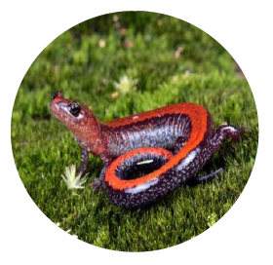
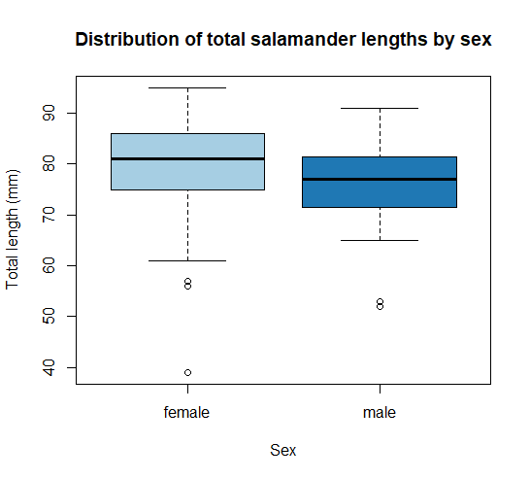
Today’s Exercise
Back to the redbacked salamander (Plethodon cinereus) data! We’re trying to answer the question:
Is the average length of salamanders significantly different between salamanders identified as male or female?
To do so:
Download my code from moodle labeled mander_sex_differences.R
Go through the code and add comments each place you see a hashtag and code where it needs code. The comments should tell me:
What each section of of code does
Answer the questions outlined in the code
Upload your individual code to moodle

Slide 23
Quick aside – outliers?
In R (and many other places), data points that are >1.5x the interquartile range (IQR) from the .25 and .75 quartiles are identified as possible outliers (something to explore)
Plotted here as the open circles
Identifying data points as possible outliers doesn’t mean they are “bad data”!

Slide 24

For Monday:
Read Ch 10 (Skip 10.2) in Gardner (2017) – Differences between more than 2 samples
Answer the individual evaluation questions on moodle
All before 11:55pm on Sunday

