Slide 1
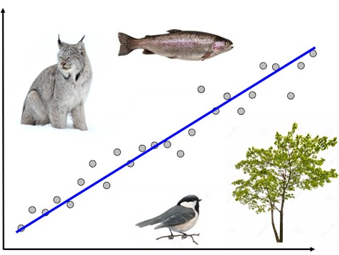
NRC 290b Introduction to Quantitative Ecology Week 10 – Regression
Meg Graham MacLean, PhD
Department of Environmental Conservation
mgmaclean@umass.edu
2019 - Fall

Slide 2
This week
Monday
Regression
Multiple regression
How does this relate to other tests?
Wednesday
Group exercise
Voles! Multiple regression

Slide 3

Statistical testing
When doing a regression – what is the H₀ the p-value is testing?
The slope is no different from 0
The explanatory variable is no different than the response variable
The explanatory variable is significantly correlated with the response variable
There is no significant difference between groups

Slide 4
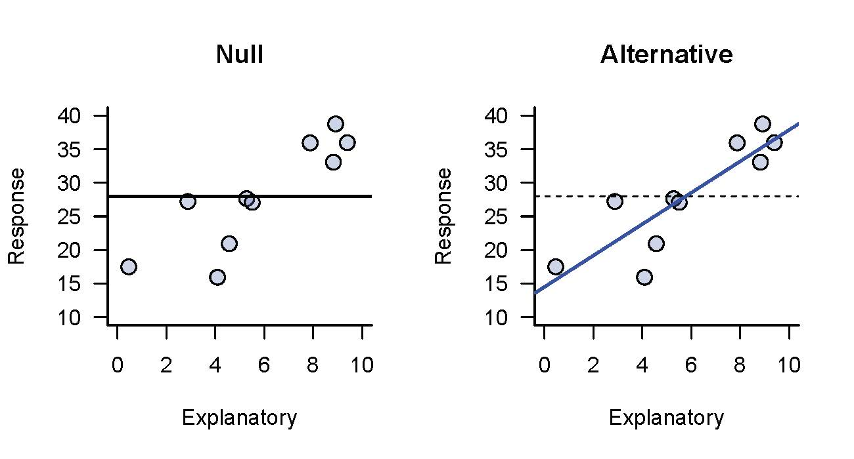

Regression vs. Correlation
Simple linear regression at its core is no different than a simple correlation!
$$y=mx+c$$
Except:
H₀: slope is no different from 0
So, the p-value tells you something about the slope, rather than the strength of the correlation

Slide 5
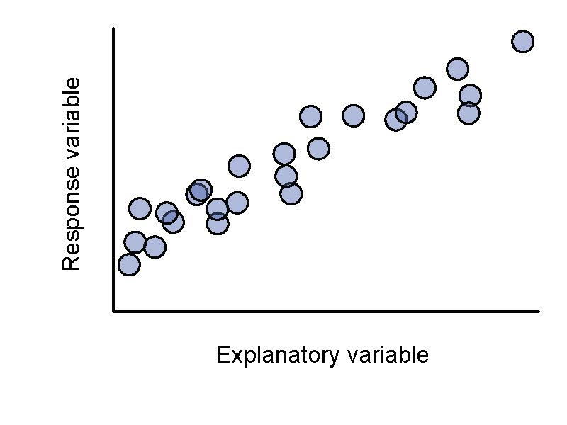
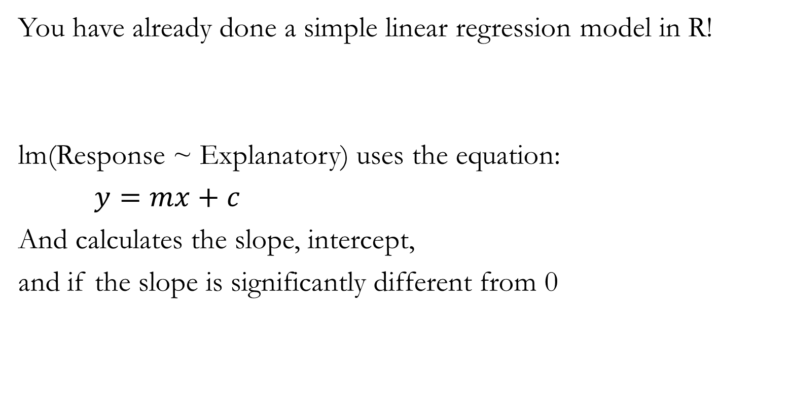
Regression
You have already done a simple linear regression model in R!
lm(Response ~ Explanatory) uses the equation:
$y=mx+c$
And calculates the slope, intercept,
and if the slope is significantly different from 0

Slide 6
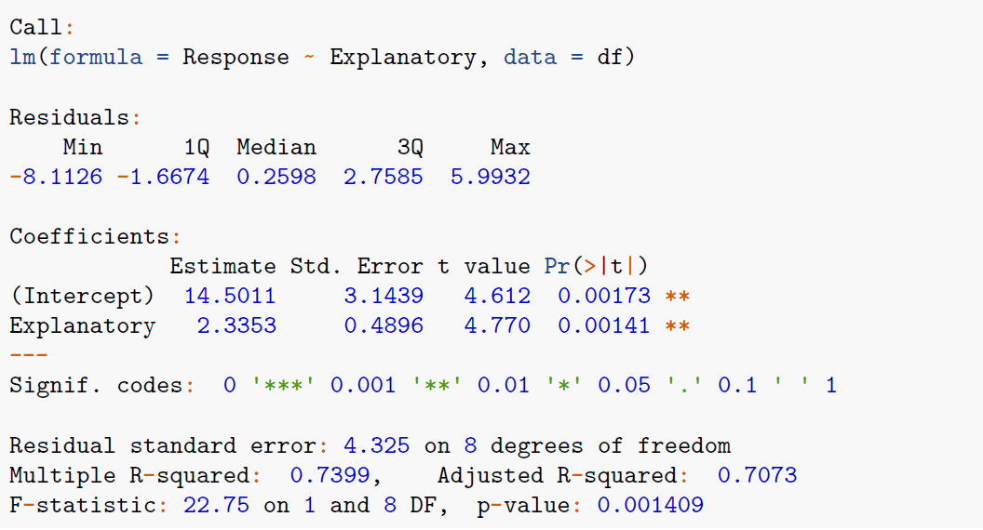
Slope ≠0
Slope

Slide 7
?

Slide 8
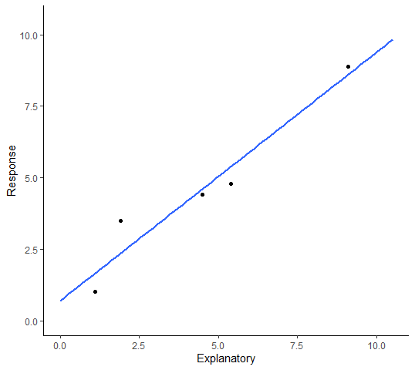
Correlation = simple Regression
R-squared (R²) = (Pearson’s correlation coefficient)²
R² = how much of the variation in the response variable is explained by the explanatory variable

Slide 9
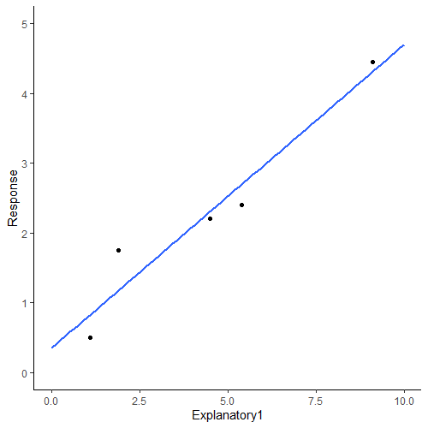
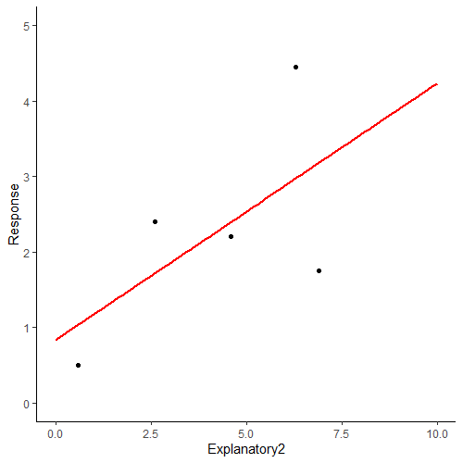
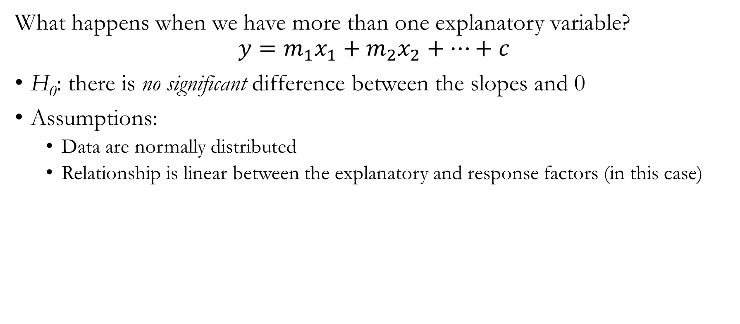

Multiple Regression
What happens when we have more than one explanatory variable?
$$y=m_{1}x_{1}+m_{2}x_{2}+…+c$$
H₀: there is no significant difference between the slopes and 0
Assumptions:
Data are normally distributed
Relationship is linear between the explanatory and response factors (in this case)
$$b_{y12}^{′}=\frac{\left(r_{1y}−r_{2y}r_{12}\right)}{\left(1−r_{12}^{2}\right)}$$
Beta coefficient is a standardized way of comparing the effect of each individual explanatory variable on the response variable

Slide 10
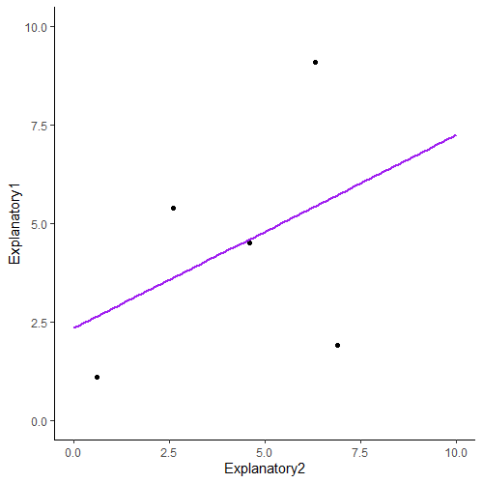
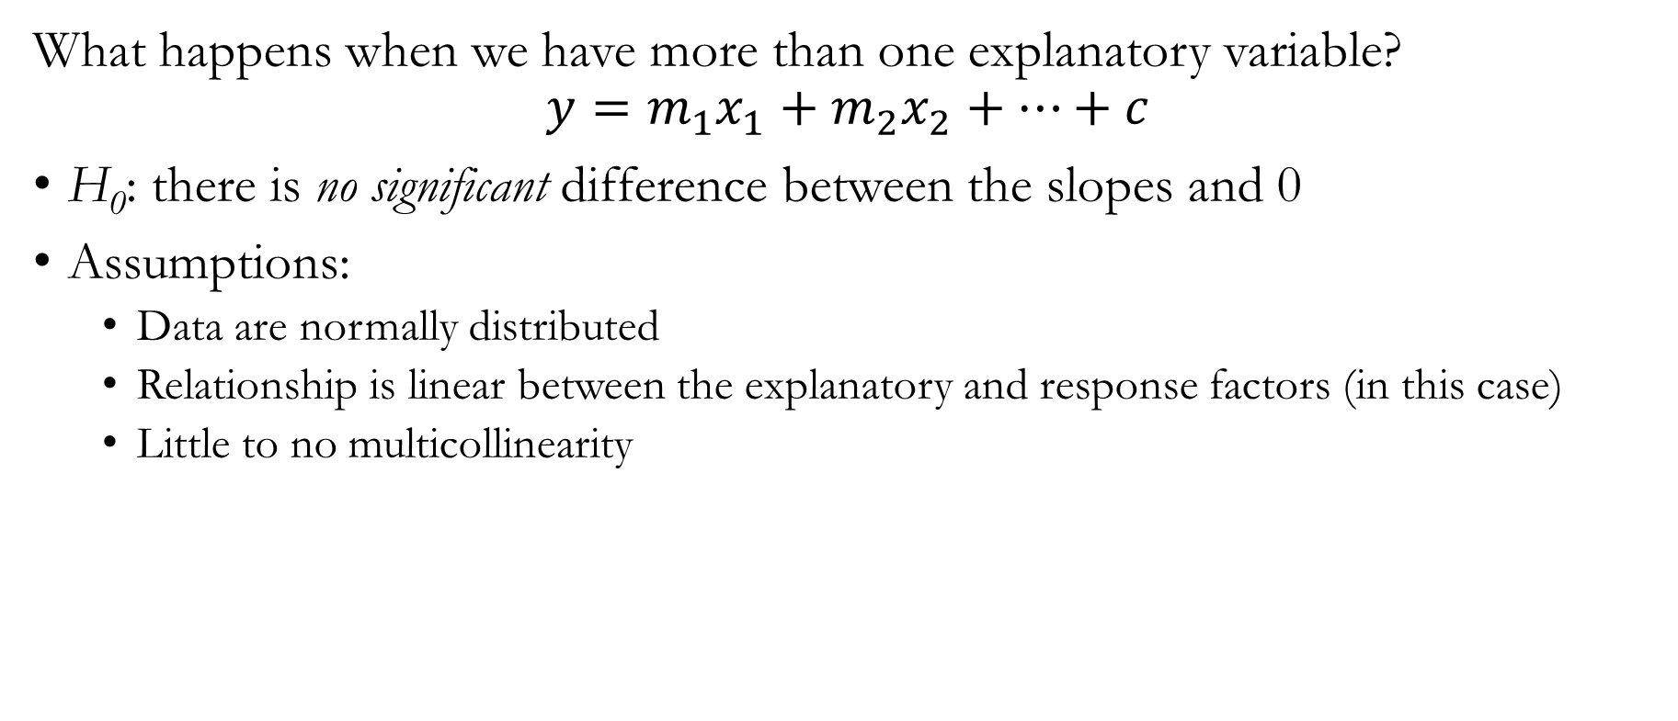
Multiple Regression
What happens when we have more than one explanatory variable?
$$y=m_{1}x_{1}+m_{2}x_{2}+…+c$$
H₀: there is no significant difference between the slopes and 0
Assumptions:
Data are normally distributed
Relationship is linear between the explanatory and response factors (in this case)
Little to no multicollinearity

Slide 11
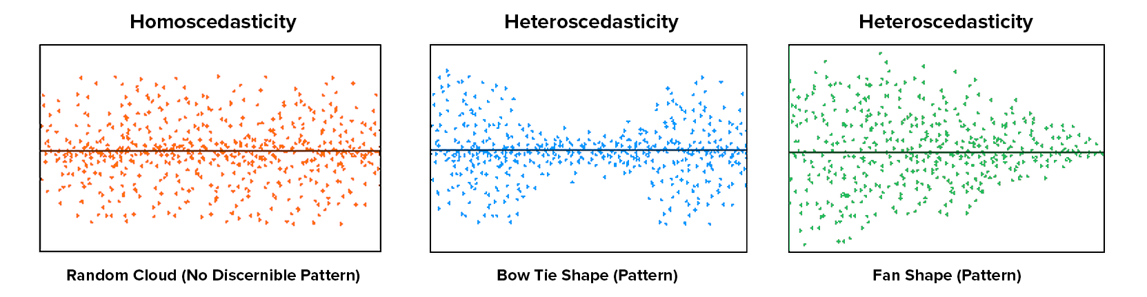
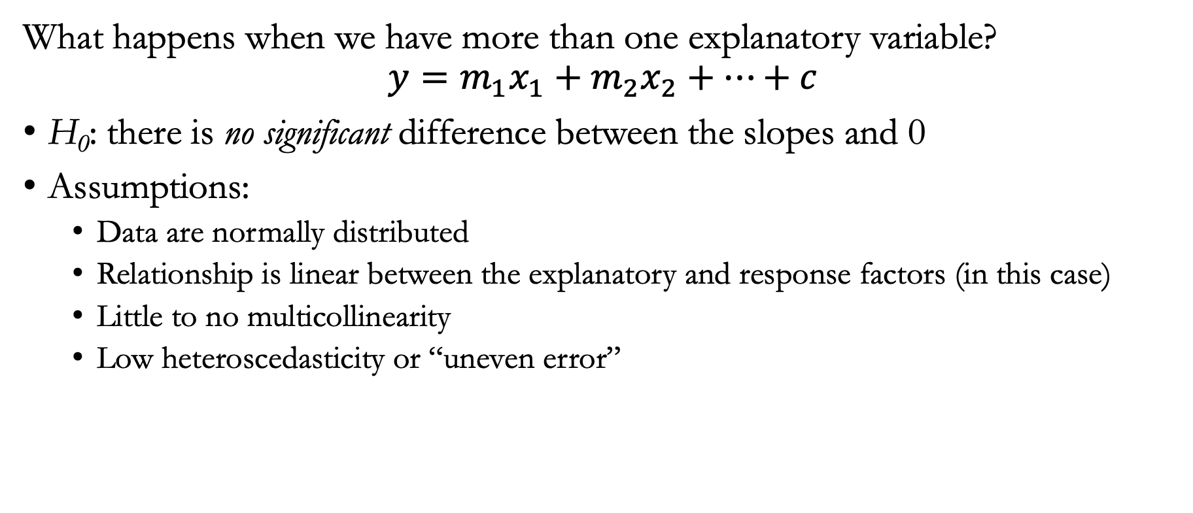
Multiple Regression
What happens when we have more than one explanatory variable?
$$y=m_{1}x_{1}+m_{2}x_{2}+…+c$$
H₀: there is no significant difference between the slopes and 0
Assumptions:
Data are normally distributed
Relationship is linear between the explanatory and response factors (in this case)
Little to no multicollinearity
Low heteroscedasticity or “uneven error”

Slide 12
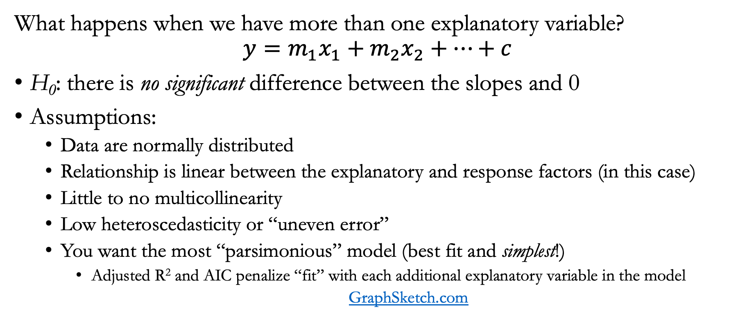
Multiple Regression
What happens when we have more than one explanatory variable?
$$y=m_{1}x_{1}+m_{2}x_{2}+…+c$$
H₀: there is no significant difference between the slopes and 0
Assumptions:
Data are normally distributed
Relationship is linear between the explanatory and response factors (in this case)
Little to no multicollinearity
Low heteroscedasticity or “uneven error”
You want the most “parsimonious” model (best fit and simplest!)
Adjusted R² and AIC penalize “fit” with each additional explanatory variable in the model
GraphSketch.com

Slide 13
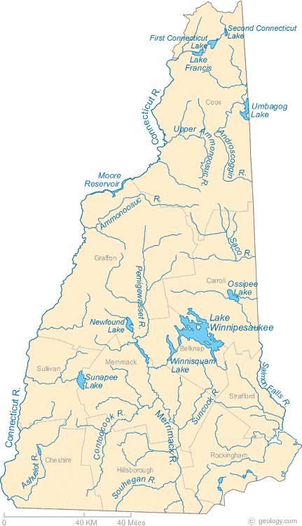

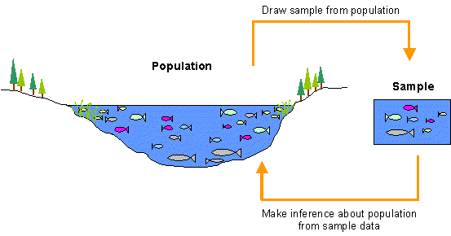
Multiple Regression - example

Slide 14
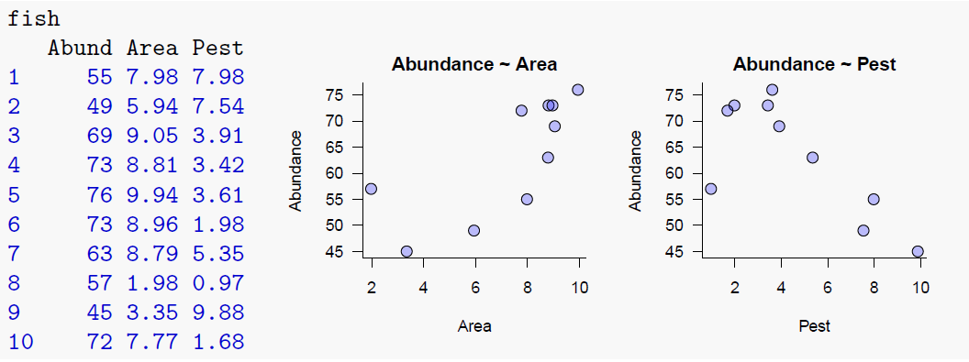
Multiple Regression - example

Slide 15
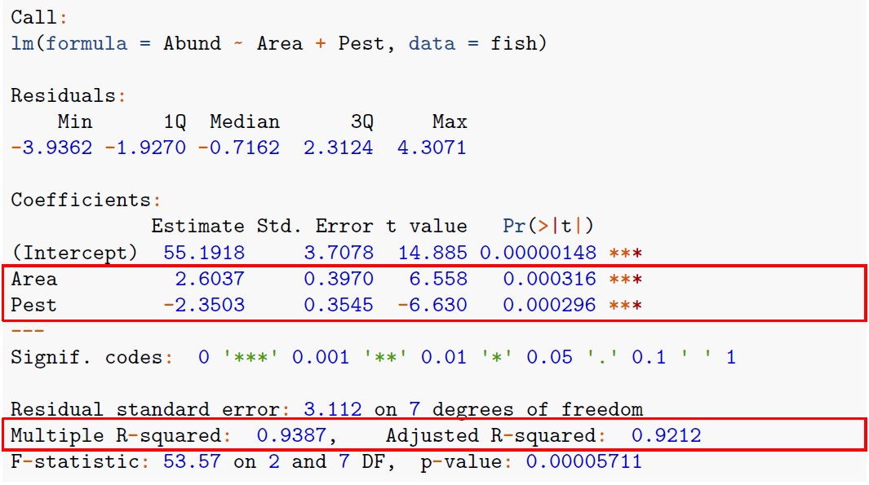

Slide 16
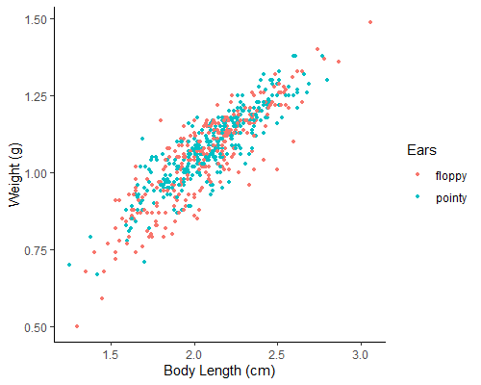
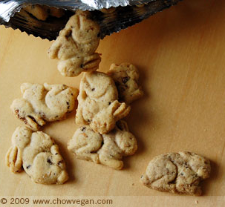
Picking the best explanatory variables
Akaike Information Criterion (AIC)
AIC penalizes when you add too many factors!
Is a measure of how “bad” your model is
So the higher the AIC the worse the model
Let’s try the bunny data!

Slide 17
Picking the best explanatory variables
bunnies.glm_weight
Call:
glm(formula = Floppy ~ Weight, family = "binomial", data = bunnies)
Coefficients:
(Intercept) Weight
1.953 -1.915
Degrees of Freedom: 613 Total (i.e. Null); 612 Residual
Null Deviance: 849.9
Residual Deviance: 840 AIC: 844
bunnies.glm_length
Call:
glm(formula = Floppy ~ BodyLength, family = "binomial", data = bunnies)
Coefficients:
(Intercept) BodyLength
1.1057 -0.5736
Degrees of Freedom: 613 Total (i.e. Null); 612 Residual
Null Deviance: 849.9
Residual Deviance: 846.3 AIC: 850.3

Slide 18
Picking the best explanatory variables
Weight only model: AIC = 844; Length only model: AIC = 850.3
summary(bunnies.glm)
Call:
glm(formula = Floppy ~ Weight + BodyLength, family = "binomial", data = bunnies)
Deviance Residuals:
Min 1Q Median 3Q Max
-1.5492 -1.1149 -0.9526 1.2166 1.5181
Coefficients:
Estimate Std. Error z value Pr(>|z|)
(Intercept) 1.7304 0.6753 2.562 0.01039 *
Weight -3.7348 1.2501 -2.988 0.00281 **
BodyLength 1.0370 0.6166 1.682 0.09262 .
---
Signif. codes: 0 ‘***’ 0.001 ‘**’ 0.01 ‘*’ 0.05 ‘.’ 0.1 ‘ ’ 1
(Dispersion parameter for binomial family taken to be 1)
Null Deviance: 849.91 on 613 degrees of freedom
Residual Deviance: 837.10 on 611 degrees of freedom
AIC: 843.1
∆AIC < 2
models aren’t different

Slide 19
How is it all regression?
Statistical test | Question | Regression version
T-test | Are these two samples different? | Response variable is categorical and explanatory variable is continuous (logistic regression)
ANOVA | Are these three (or more) samples different? | response variable is continuous and explanatory variables are categorical
Correlation (Pearson’s) | Is there a link between these two continuous factors? | Simple 1 factor with only continuous variables
Association (Chi-square) | Is there a link between the categorical factors? | All categorical variables

Slide 20
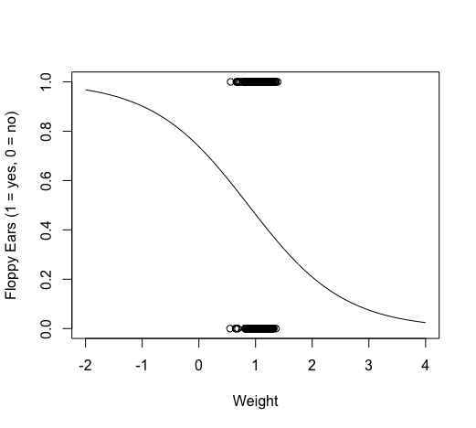
Logistic Regression
glm(formula = Floppy ~ Weight, family = "binomial", data = bunnies)
xweight <- seq(-2, 4, 0.01)
yweight <- predict(bunnies.glm_weight, list(Weight = xweight), type = "response")
plot(bunnies$Weight, bunnies$Floppy, xlab = "Weight", ylab = "Floppy Ears (1 = yes, 0 = no)", xlim = c(-2,4))
lines(xweight, yweight)

Slide 21
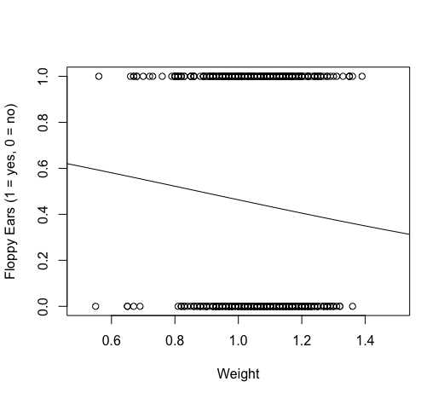
Logistic Regression
glm(formula = Floppy ~ Weight, family = "binomial", data = bunnies)
xweight <- seq(-2, 4, 0.01)
yweight <- predict(bunnies.glm_weight, list(Weight = xweight), type = "response")
plot(bunnies$Weight, bunnies$Floppy, xlab = "Weight", ylab = "Floppy Ears (1 = yes, 0 = no)", xlim = c(0.5,1.5))
lines(xweight, yweight)
Dangerous to extrapolate beyond sampled range!

Slide 22
Week 10 – Regression
Part II - Wednesday

Slide 23

Today’s Exercise
New data! Vole population data where we have counts and some landscape information on where they were found. We’re trying to answer the question:
Does percent vegetation (PercVeg) or distance to road (Dist2Road) influence vole population locations?
To do so – split yourselves into 3 teams and create one .R script with everything below to turn in before the end of today:
Data exploration team
How do each of the explanatory variables influence the response variable
Create scatter plots for each explanatory variable vs response variable and guess what you think the relationship is and make notes in your R comments
Multiple regression team
What hypotheses are you testing?
Create a model with both explanatory variables
Which variable(s) seems to explain some of the variation of the vole population?
Model choice team
Use the add1() function and AIC to pick the best model for explaining vole population
Which model is the best? Why?

Slide 24

For Monday:
Review all of your notes
Send me at least one question you would like me to try to review next week!
All before 11:55pm on Sunday

