Slide 1




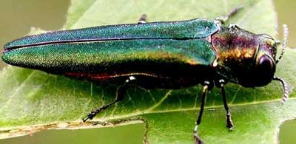
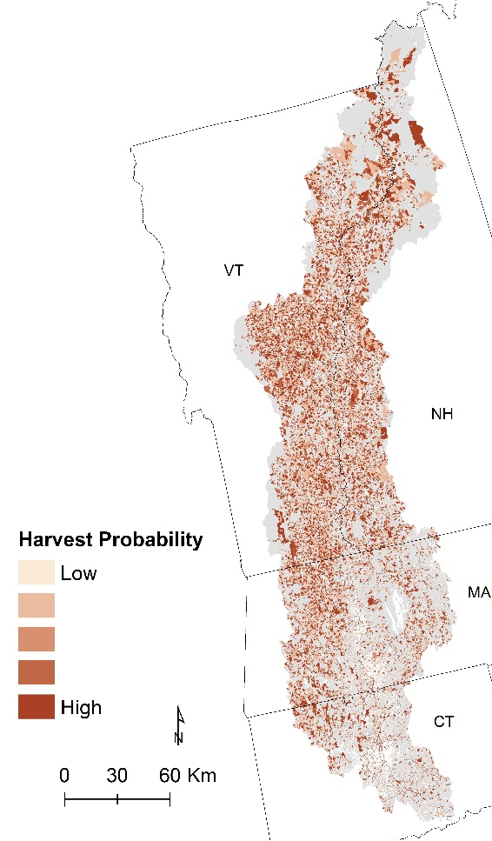
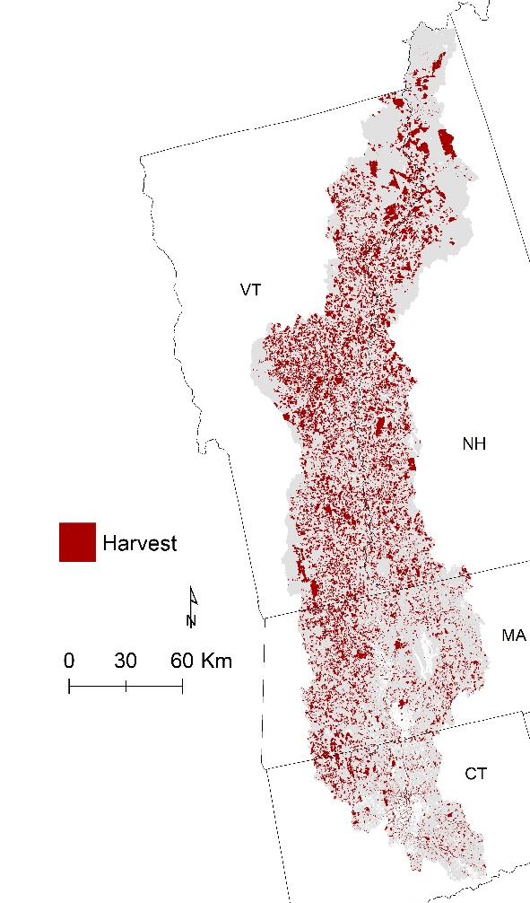
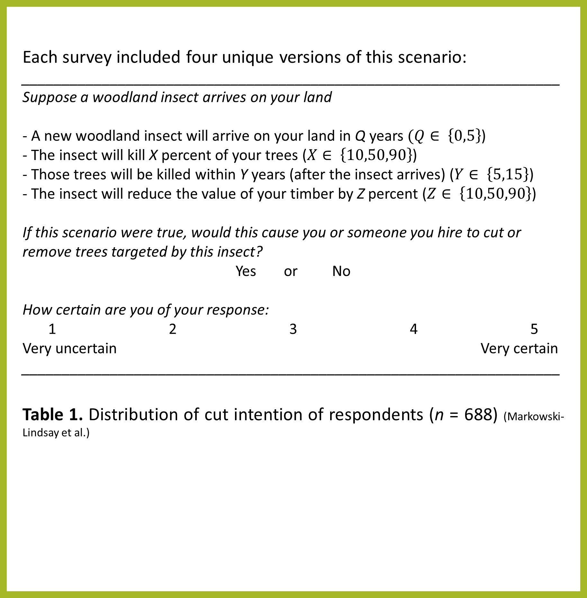
Potential impacts of insect-induced salvage harvests in mixed forests of New England
Meghan Graham MacLean^{*1,} Marla Markowski-Lindsay³, Jonathan Holt², Brett J. Butler⁴, David B. Kittredge¹, Mark Borsuk²,
Matthew J. Duveneck¹, Danelle Laflower¹, David A. Orwig¹, David R. Foster¹, Jonathan R. Thompson¹
*Corresponding author: megmaclean@fas.harvard.edu
1
2
3
4
Introduction
Predicting who will Salvage harvest
Salvage harvest impacts
Forest insects and pathogens (FIPs) have significant impacts on U.S. forests, each year affecting an area nearly three times the area of wildfires and timber harvesting combined. In 2017, we surveyed family forest owners (FFOs) in the northeastern U.S. on their intent to harvest in response to FIPs, and 84% of respondents indicated they would harvest host trees in at least one of the presented FIP infestation scenarios. This harvest response represents a potentially significant shift in the timing, extent, and species selection of harvesting in the Northeast.
Here we used the landowner survey, regional forest inventory data, and characteristics of the emerald ash borer (EAB, Agrilus planipennis) invasion to examine the potential for a rapidly spreading FIP to alter harvest regimes and alter rest conditions.
Using the survey responses, three agent functional types (AFTs) were created (Holt et al.):
Cutter – intend to cut in every presented scenario;
Responsive cutter – intend to cut in some scenarios; and
Non-cutter – intend to cut in none of the presented scenarios.
We developed a model from continuous spatial data to assign AFTs to all FFO parcels in the CT River Watershed and used predictors of cut intent to assign harvest probabilities.
Table 2. Breakdown of parcels in each AFT. 25%±0.07% of the total eligible parcels are predicted to harvest, equaling 37%±0.7% of the forested area in the CTRW FFO parcels.
We created 3 scenarios of harvest to capture some of the potential harvest responses of FFOs to EAB. Harvest intensities and species preferences both are calculated from remeasured Forest Inventory and Analysis (FIA) data.
Table 3. Merchantable timber removed in each scenario. For reference, there is 4.1 Tg C of ash on FFO parcels in the CT River Watershed, 99% of which we expect to eventually die from EAB. 2.2 Tg C of that timber was removed in all scenarios.
Creating Agent Functional Types for FFO response to FIPs
Scenario 1
Typical harvest intensities and no species preferences
Scenario 2
Typical harvest intensities and species preferences
Scenario 3
Decreased harvest intensities and increased species preferences
no
Landowner with > 20 ha or in NH?
yes
Objective
Use the landowner survey, regional forest inventory data, and characteristics of the emerald ash borer (EAB, Agrilus planipennis) invasion to examine the potential for a rapidly spreading FIP to alter harvest regimes and regional forest conditions.
Small
Large + NH
Figure 1. The model for assigning AFTs and harvest probabilities to parcels in the CT River Watershed. The relationships between probability of being classified as a Cutter landowner type or with higher probability of harvest are shown in parenthesis.
We assume EAB is an exogenous force that initiates typical FFO harvests, but there are no species preferences in removal
Again, we assume that EAB initiates typical FFO harvests, but certain species are preferentially removed (based on FIA data)
We examine the possibility that salvage harvests are more reactionary and fewer have harvest volumes as a planned objective
Assignment into landowner type class, probabilities based on:
Acres of forest owned (+)
Acres of forest in the town (+)
Assignment into landowner type class, probabilities based on:
Acres of forest owned (+)
Michigan State University
AFTs
Family Forest Owner Survey
Non-cutter
Responsive Cutter
Cutter
Each survey included four unique versions of this scenario:
___________________________________________________________________
Suppose a woodland insect arrives on your land
- A new woodland insect will arrive on your land in Q years $(Q∈ \left\{0,5\right\}$)
- The insect will kill X percent of your trees ($X∈ \left\{10,50,90\right\}$)
- Those trees will be killed within Y years (after the insect arrives) ($Y∈ \left\{5,15\right\}$)
- The insect will reduce the value of your timber by Z percent ($Z∈ \left\{10,50,90\right\}$)
If this scenario were true, would this cause you or someone you hire to cut or remove trees targeted by this insect?
Yes or No
How certain are you of your response:
1 2 3 4 5
Very uncertain Very certain
___________________________________________________________________
Table 1. Distribution of cut intention of respondents (n = 688) (Markowski-Lindsay et al.)
Probability:
1-certainty distribution
Probability based on:
% of trees infested (+)
Years to tree mortality (-)
Probability from certainty distribution
 | % removed of total merch. timber | Timber removed of species other than ash (Tg C) | Species most affected by harvest
Scenario 1 | 13%±0.8% | 9.4 | Co-occurring species
Scenario 2 | 13%±0.8% | 9.4 | Co-occurring species and those preferentially harvested
Scenario 3 | 7%±0.5% | 4.5 | Weighted higher toward those preferentially harvested
Harvest Probability
EAB Salvage Harvesting Case Study
Figure 2. We applied the AFT model to FFO parcels in the CT River Watershed using characteristics of the EAB invasion to predict which FFOs will likely salvage harvest in response to EAB.
Responsive cutter AFT harvest probabilities were computed for each parcel based on:
Relative abundance of ash (EAB’s host) in that parcel
8 years to mortality
EAB Case Study Conclusions
25% of FFO parcels in the CT River Watershed are predicted to harvest due to EAB within 10 years.
Harvest frequencies could increase from 2.9%/yr to 3.7%/yr on FFO woodlands in those 10 years.
At typical harvest intensities, 13% of the total aboveground merchantable timber carbon is removed through these salvage harvests and 81% of that carbon is from species other than ash.
This represents a forest disturbance that is over twice the magnitude of the disturbance from EAB alone.
Harvest
probability
Harvest
Low
High
Response | Response frequency (%)
Respondent would cut under every scenario (Very certain or Certain) | 196 (28.5%)
Respondent cut intention and/or certainty varies across scenarios | 435 (63.2%)
Respondent would not cut under every scenario (Very certain or Certain) | 57 (8.3%)
AFT | % of FFO parcels | Average probability of harvest | % of all harvests
Cutters | 42%±0.2% | 0.89±0.003 | 77%±0.3%
Responsive cutters | 44%±0.1% | 0.22±0.004 | 19%±0.3%
Non-cutters | 14%±0.1% | 0.12±0.004 | 4%±0.1%
2x

