Slide 1
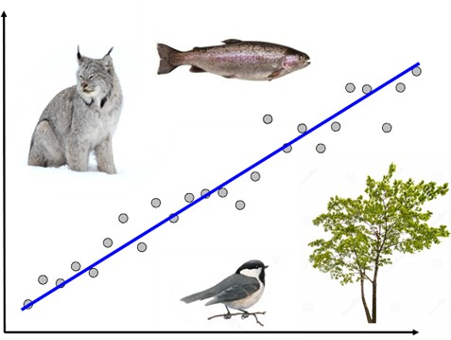
NRC 290b Introduction to Quantitative Ecology Week 12 – Reporting results
Meg Graham MacLean, PhD
Department of Environmental Conservation
mgmaclean@umass.edu
2019 - Fall

Slide 2
This week
Monday
Reporting results
Important components
Houle et al. 2015
Let’s pick apart one of my posters!
Pick one of your papers to create a poster
Wednesday
Group exercise
Finish posters
Present!

Slide 3

Statistical testing
What is the importance of knowing your H₀?
It determines which statistical test you should do
It defines your alpha level
It helps you interpret your calculated p-value
It defines your dataset

Slide 4
Reporting your results
What is usually NOT in a published article/report?
Acknowledgements
Keywords
References
Plagiarism

Slide 5
Houle et al. 2015
What did you like about the reporting?
What could have been improved?

Slide 6
Posters
Let’s look at one of my posters!
What is one thing I did well?
What is one thing I could have improved?

Slide 7
Group exercise
As a group:
Each member: explain the paper you chose, the stats, and why it might make a good poster
Come to a consensus about which you will turn into a poster
Each group member should read the paper
Create a poster for Wednesday!
Use PowerPoint (you can use my poster as a template if you want, but please modify it to make it look nicer)
Each group will present their poster
All members of the group should go up to explain the paper and poster
EXCEPT: the person who originally picked the paper should not present!
We will as a class on Wednesday discuss the best aspects of each of the posters

Slide 8
Week 12 – Reporting Results
Part II - Wednesday

Slide 9
Group exercise
As a group:
Each member: explain the paper you chose, the stats, and why it might make a good poster
Come to a consensus about which you will turn into a poster
Each group member should read the paper
Create a poster for Wednesday!
Use PowerPoint (you can use my poster as a template if you want, but please modify it to make it look nicer)
Each group will present their poster
All members of the group should go up to explain the paper and poster
EXCEPT: the person who originally picked the paper should not present!
We will as a class on Wednesday discuss the best aspects of each of the posters

Slide 10

For Monday (12/2):
We start your group projects!!
Read the documentation that goes along with your assigned dataset
BY FRIDAY – please submit your data choices (top three, with a question you could ask)!
This Photo by Unknown Author is licensed under CC BY-NC-ND

