Slide 1
0
1

Slide 2
Difference Amp In RAMP
0.6V
Ref
A0
From Mic
A3
To ADC
A2
A4
Difference Amp In RAMP
1.024V
A0
From Mic
A3
To ADC
A2
0.6V
Ref
A4

Slide 3
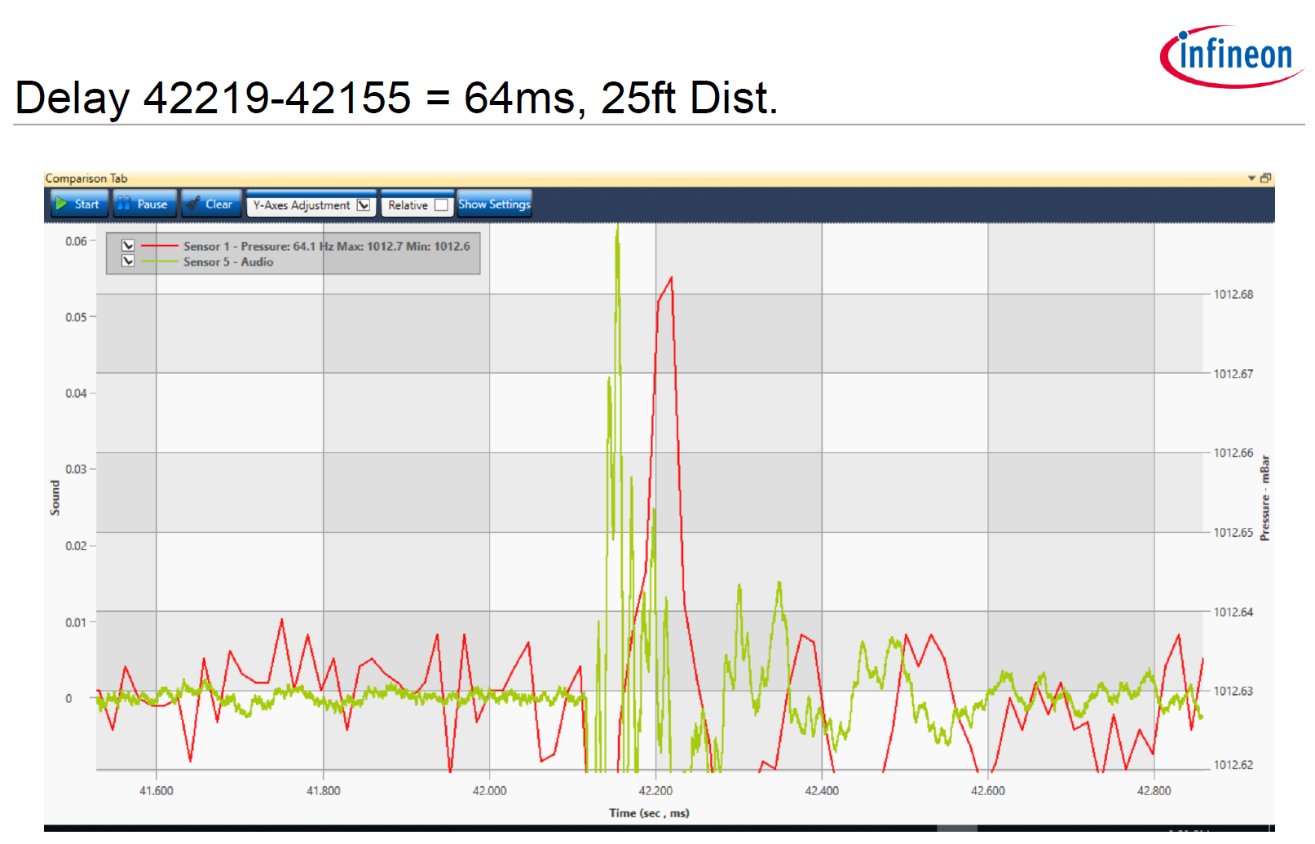
General timeline
32sps
64sps
Event start

Slide 4
Time details
43-83ms
t=0
Pk_{audio}
Pk_{press}
PS_{trig,max}
PS switches sampling rate 6ms after RAMP detection
PS_{trig} = L_{press}+6ms
Assume that events are rejected if PS not switched before PS_{trig,min}

Slide 5
