Slide 2
Nested function code generated figure

Slide 4
De-Bounced

Slide 5
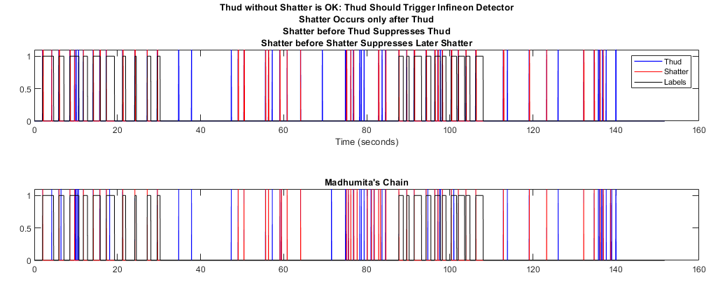
Versus Madhumita’s Chain

Slide 6
Code
I broke down the code to isolate the operators to be chained
%AspBox%\engr\sig_proc\Projects\External\Infineon\IAS_glassbreak\mgf\detectors
See:
glassBreakRampDevFunctionalForm.m

Slide 7
Preconstructed operators
HANG_CMPMID = HANG > CMPMID;
VALIDTHUD = [HANG > CMPMID > NOT;
PASS] > AND;
Use of VALIDTHUD:
zcr_thud = [hangZCR thresholdedThud];
validThud = VALIDTHUD(t,zcr_thud);
also AMPpt4, AND, NOT

Slide 8
Chain Logic
thresholdedThud = CMPpt5(t,ynnThud);
thresholdedZCR = CMPpt5(t,ynnZCR);
hangZCR = HANG_CMPMID(t,thresholdedZCR);
zcr_thud = [hangZCR thresholdedThud];
validThud = VALIDTHUD(t,zcr_thud);
hangValidThud = HANG_CMPMID(t,validThud);
validZCR = AND(t,[hangValidThud thresholdedZCR ]);
declareThud = AMPpt4(t,PULSE(t,validThud));
declareShatter = AMPpt4(t,PULSE(t,validZCR));

Slide 9
Nested Chain
declareThud = AMPpt4(t,PULSE(t,VALIDTHUD(t,[HANG_CMPMID(t,CMPpt5(t,ynnZCR)) CMPpt5(t,ynnThud)])));
declareShatter = AMPpt4(t,PULSE(t,AND(t,[HANG_CMPMID(t,VALIDTHUD(t,[HANG_CMPMID(t,CMPpt5(t,ynnZCR)) CMPpt5(t,ynnThud)])) CMPpt5(t,ynnZCR)])));

Slide 10
Topology
Declare Thud
ynnThud
CMP
VALIDTHUD
AND
HANG
ynnZCR
CMP
HANG
Declare Shatter
How to use passthrough correctly?
How to transpose neural network output?

Slide 11
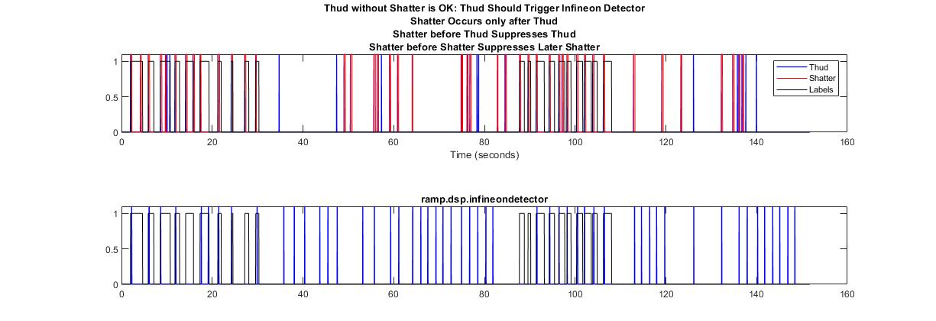
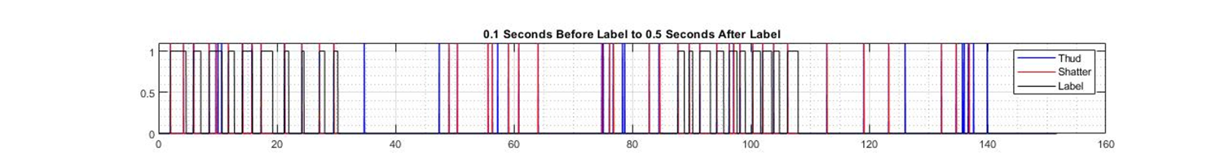
Log before (top) and after (bottom) noise removal

Slide 12
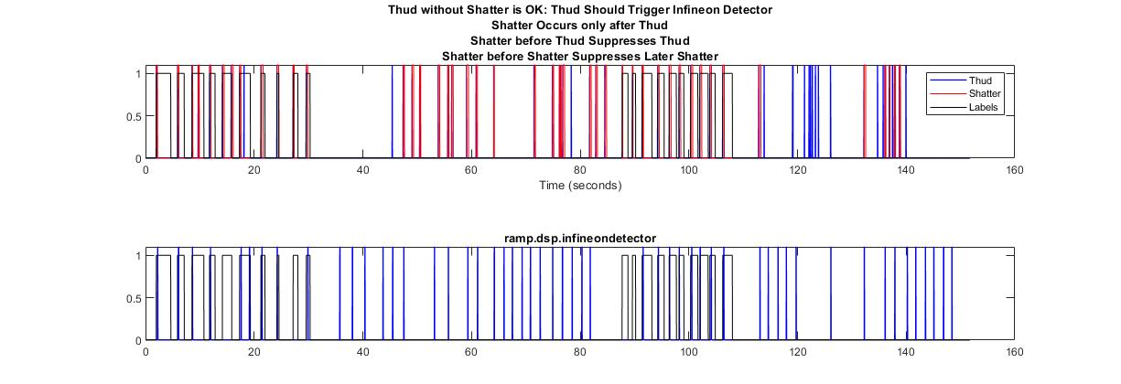
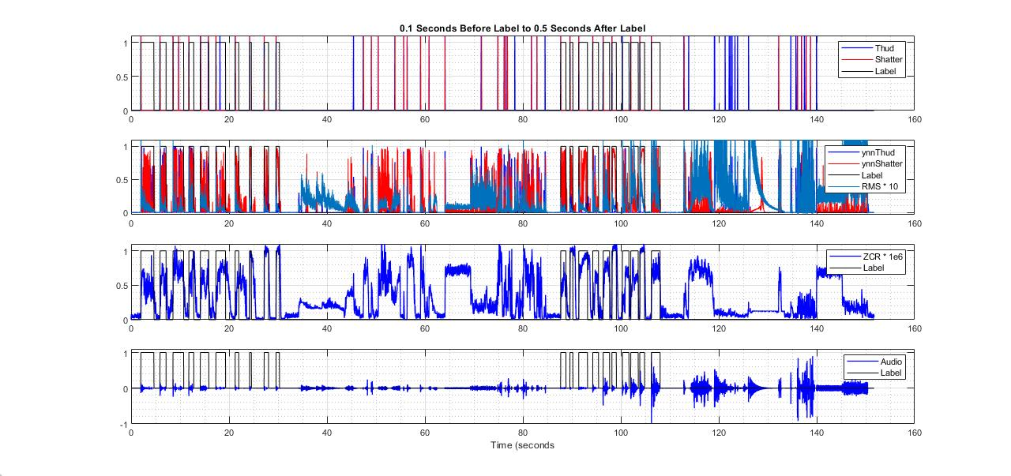
Tanh before (top) and after (bottom) noise removal

Slide 13

Log after rules and debouncing

Slide 14
Tanh after rules and debouncing

