Slide 1
10/15/2020

Slide 2
Notes
Has updated the SPL extraction to use a window, will resent the spreadsheet
Almost all of the cases where we missed glassbreak and IAS triggered it where CNNbackground
NG – non-glass breaking

Slide 3
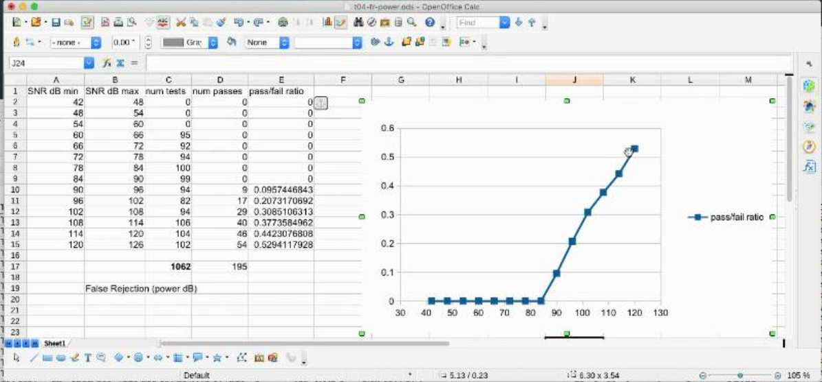
All

Slide 4
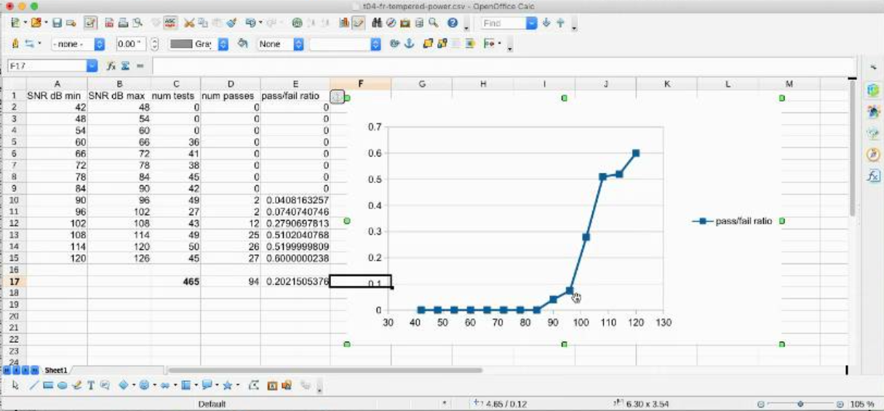
Tempered

Slide 5
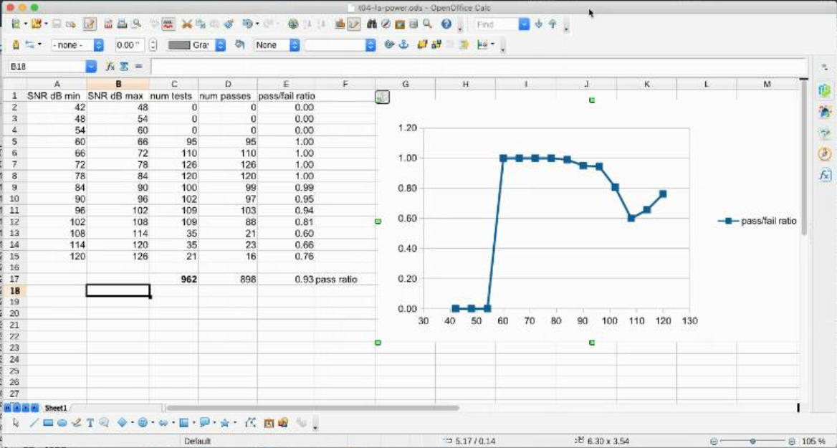
Overall false accept

