Slide 1
Diet Manager Project Presentation
GROUP 3
Michael, Helena, Felicio, Luka, Zarko

Slide 2
OUTLINE
Diet Manager in Action
Diet Manager Explained
Final Notes
Part of the Solution We Are Most Proud of
What Could Have Been Done Better?

Slide 3
Diet Manager in Action

Slide 4
Diet Manager Explained

Slide 5
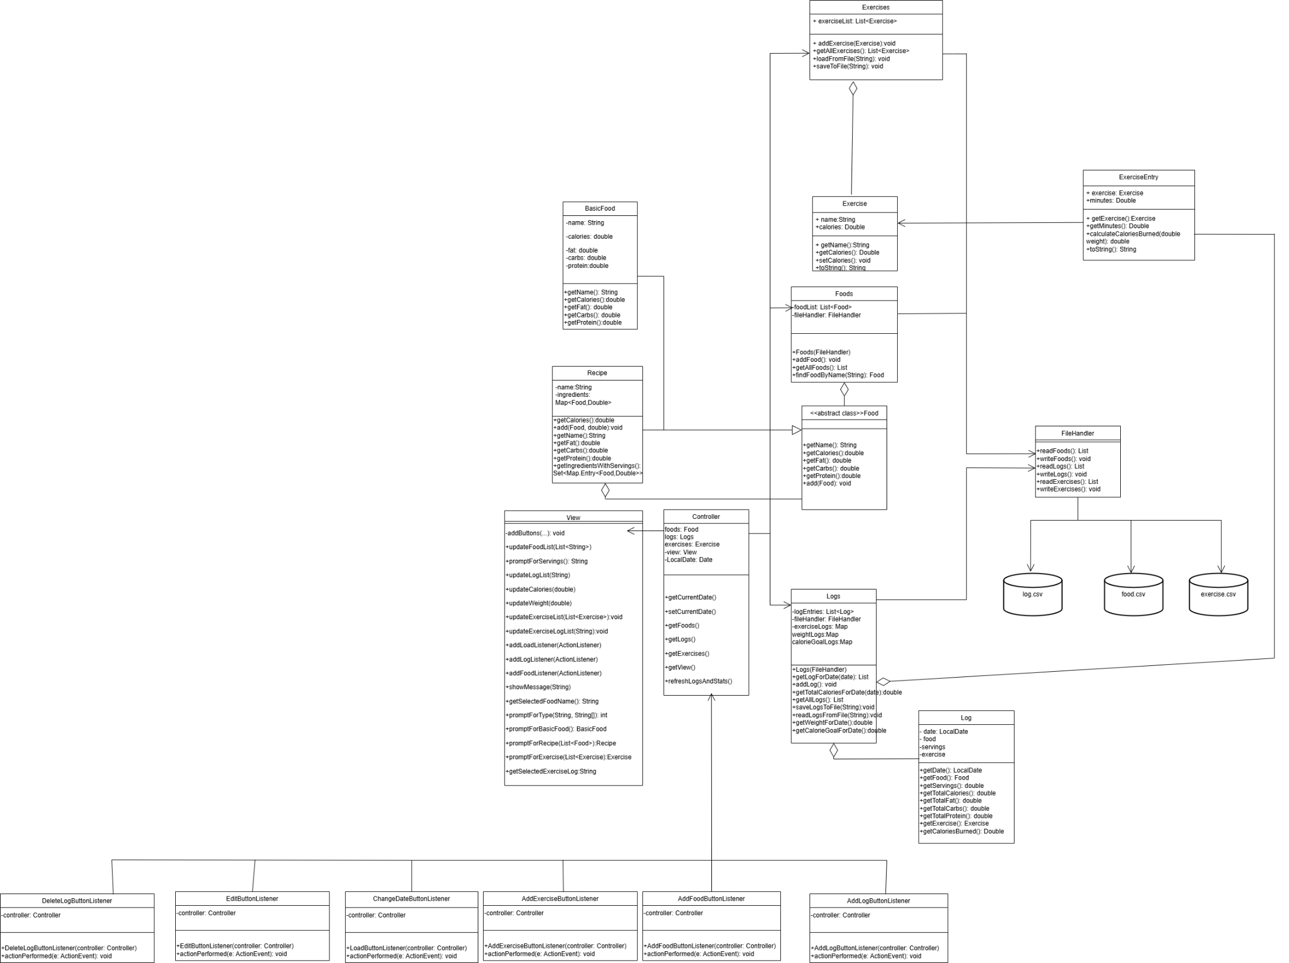
Notes:
UML Class Diagram Overview – Diet Manager V2
Architecture:
Follows Model-View-Controller (MVC) pattern for separation of concerns.
Implements Composite Design Pattern for handling simple foods and complex recipes uniformly.
Model Subsystem:
Food (abstract class):
Defines a common interface for nutritional data (calories, fat, carbs, protein).
Enables treating BasicFood and Recipe the same.
BasicFood:
Represents individual food items.
Stores and returns static nutrient values.
Recipe:
Aggregates other Food objects (basic or recipe).
Computes total nutrients recursively, supporting nested recipes.
Exercise:
Represents a physical activity.
Stores calories burned per kg per hour for accurate calorie expenditure calculations.
Foods:
Maintains a list of all Food and Exercise instances.
Supports adding, searching, and saving foods/exercises via FileHandler.
Log:
Represents a food consumption entry.
Stores the food item, servings, and date.
ExerciseEntry:
Represents an exercise log entry.
Stores exercise performed, minutes, weight, and calories burned.
Logs:
Holds all Log and ExerciseEntry objects.
Filters by date and computes total nutrients and calories burned.
FileHandler:
Handles reading/writing of:
foods.csv for foods/recipes.
exercise.csv for exercises.
log.csv for food/exercise logs.
Supports reconstruction of foods, recipes, and exercises on startup.
View Subsystem:
View Class:
Implements the Java Swing GUI.
Displays:
Food list.
Exercise list.
Current logs (foods and exercises).
Nutrient totals, calories burned, and pie chart.
Prompts user for:
Adding foods/recipes.
Logging exercises.
Setting calorie goals and weight.
Deleting and editing exercise logs.
Contains no business logic—only UI responsibilities.
Controller Subsystem:
Controller Class:
Connects Model and View.
Initializes Foods, Logs, Exercises, and View.
Manages current date for logging.
Sets up event listeners.
Refreshes logs and stats in the view.
Listener Classes:
AddFoodButtonListener:
Prompts user to add a basic food or recipe.
Saves new foods to foods.csv.
AddLogButtonListener:
Allows logging of food or exercise entries.
Updates logs, exercise logs, and view stats.
AddExerciseButtonListener:
Prompts user to create a new exercise (name + calories burned per kg per hour).
Saves exercises to exercise.csv.
ChangeDateButtonListener:
Lets user navigate between dates.
Refreshes logs and stats automatically.
DeleteLogButtonListener:
Supports deletion of food or exercise logs for the current date.
Updates logs and view accordingly.
EditExerciseButtonListener:
Allows editing of exercise definitions (e.g., adjust calories burned per kg per hour).
Key Design Highlights:
MVC Pattern:
Model manages data and business logic.
View handles UI presentation and user prompts.
Controller coordinates updates and interactions.
Composite Pattern:
Supports nested recipes by treating BasicFood and Recipe uniformly.
Exercise Tracking Extension:
Introduced ExerciseEntry and Exercise classes.
Logs exercises alongside foods.
Calories burned are integrated into daily stats.
Modular Listener Classes:
Isolate user interaction logic.
Make the system flexible and adaptable.

Slide 6
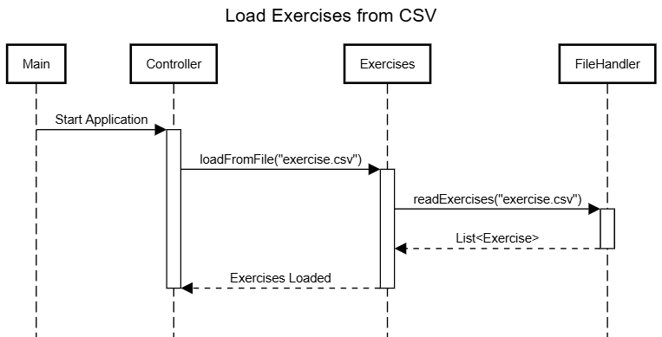
Sequence Diagram
Loading the exercise.csv file into the internal data structure.
Notes:
This sequence diagram illustrates the process of loading exercises from a CSV file when the Diet Manager application starts. The interaction begins with the Main component, which triggers the Controller by sending a Start Application signal. The Controller initiates the loading process by calling the loadFromFile("exercise.csv") method on the Exercises class. The Exercises class, responsible for managing all exercise data, delegates the file reading task to the FileHandler by invoking readExercises("exercise.csv"). The FileHandler reads the exercise data from the CSV file and returns a List of Exercise objects back to the Exercises class. Once the exercises are loaded into memory, the Exercises class signals back to the Controller with an Exercises Loaded message, completing the loading process and ensuring that the exercise data is ready for use within the application.

Slide 7
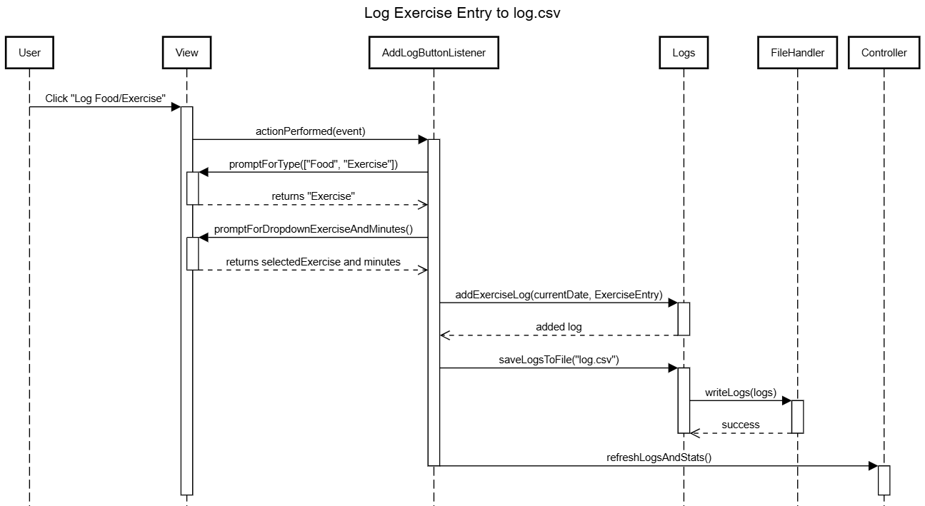
Sequence Diagram
Adding an exercise to the log for the current date.
Notes:
When the user selects "Log Food/Exercise" from the interface, the system first prompts them to choose between logging a food or an exercise. If the user selects exercise, a dropdown appears listing all available exercises along with a field to enter the number of minutes performed. Once the user provides this information, the AddLogButtonListener creates a new ExerciseEntry containing the selected exercise and minutes. This entry is passed to the Logs model via the addExerciseLog() method, where it is stored internally under the selected date. Immediately after, the saveLogsToFile() method is triggered, which calls FileHandler.writeLogs() to persist all logs—including food entries, exercise entries, weight, and calorie goals—into log.csv. For exercises, the system writes lines formatted as yyyy,mm,dd,e,ExerciseName,Minutes. This ensures that the log is consistently saved with the correct structure. Finally, the controller invokes refreshLogsAndStats() to recalculate nutrient totals, calories burned, net calories, and to update the view, including the food and exercise log lists, nutrient statistics, and the pie chart, providing immediate feedback to the user.

Slide 8
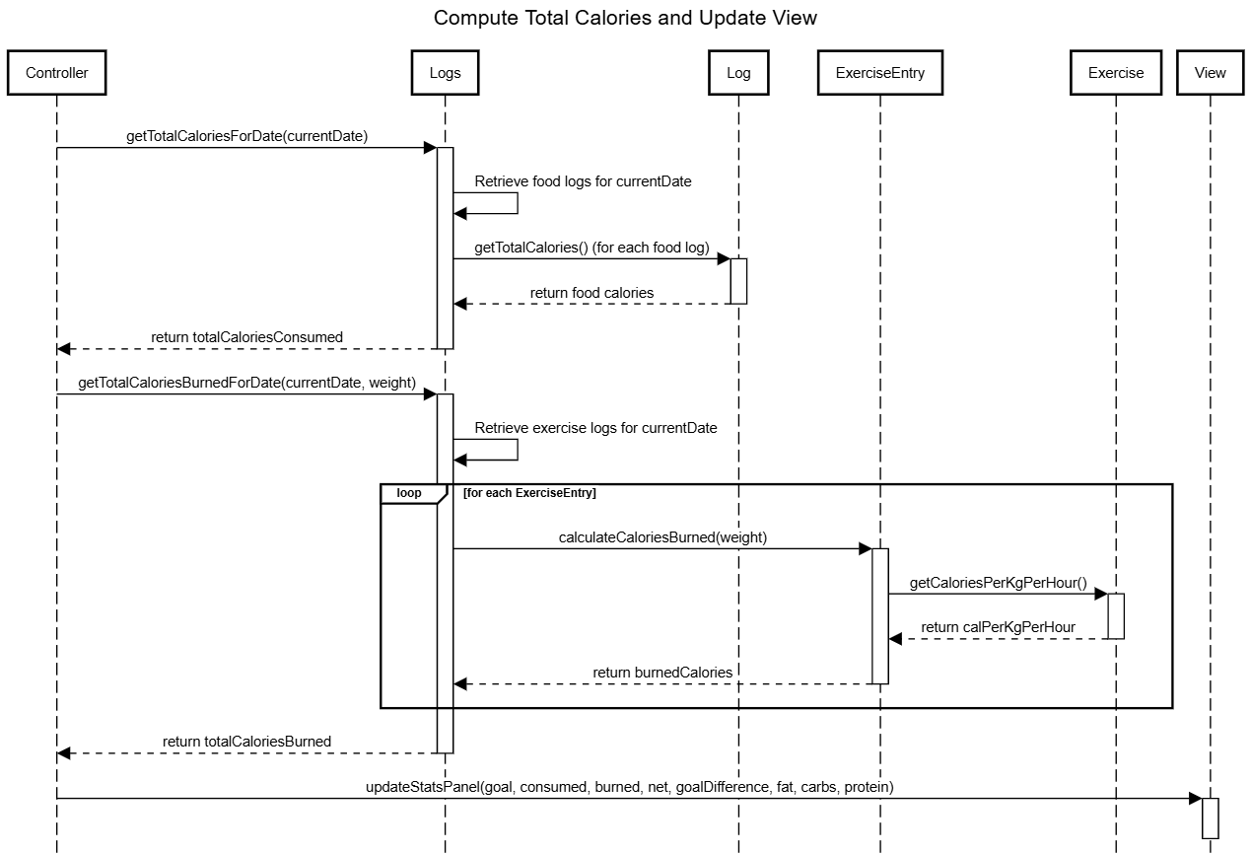
Sequence Diagram
Computing the total number of calories for the current date (in relation to the calories expended via the exercise) and updating the view accordingly.
Notes:
When the controller needs to refresh the daily stats, it begins by requesting the total calories consumed for the selected date from the Logs model using getTotalCaloriesForDate(currentDate). The Logs model filters all food logs for that date and, for each one, calls getTotalCalories() from the Log class to retrieve the calories for that food entry, summing them to get the total consumed. Once returned to the controller, the process continues by calculating the total calories burned via exercise through getTotalCaloriesBurnedForDate(currentDate, weight), passing the user's weight. The Logs model retrieves all ExerciseEntry logs for that date, and for each entry, it calls calculateCaloriesBurned(weight) to compute the calories burned. This calculation uses the exercise’s calories burned per kg per hour, retrieved via getCaloriesPerKgPerHour() from the associated Exercise object. The controller then calculates the net calories (consumed - burned) and the goal difference (calorie goal - net). Finally, the controller calls updateStatsPanel() on the View, passing the calorie goal, calories consumed, calories burned, net calories, goal difference, and total fat, carbs, and protein for that day. The view updates the nutrient stats and pie chart, providing the user with the current day's dietary summary.

Slide 9
Final Notes

Slide 10
Final Notes
Part of the Solution We Are Most Proud of
What Could Have Been Done Better?

