Slide 1

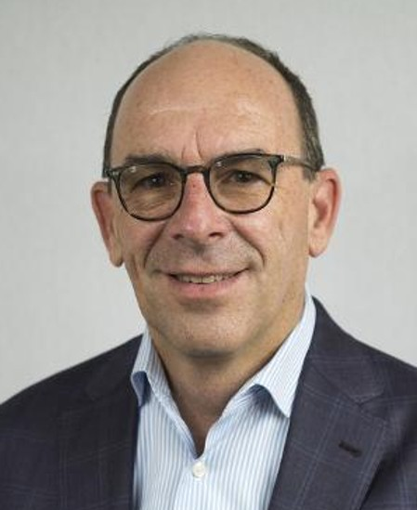
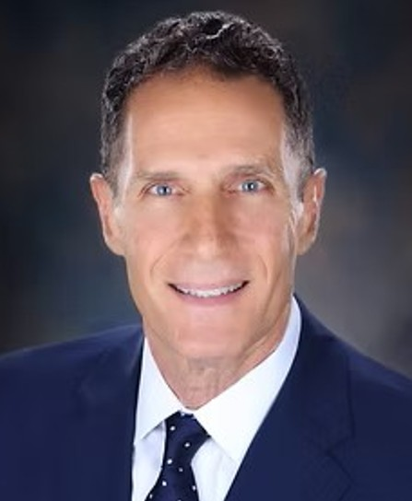
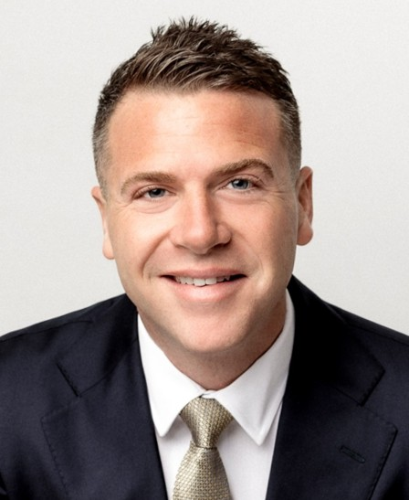

Why work with us
Decades of Experience. Representing Naples' Most Exceptional Properties.
Paul Arpin
Peter Reppucci
Michael Giacalone
Local Expertise. Global Connections.
Together, Paul Arpin, Peter Reppucci, and Michael Giacalone represent the pinnacle of luxury real estate service in Naples, Florida. Blending decades of combined experience, record-breaking results, and unmatched local insight, this team delivers a concierge-level experience for buyers and sellers of exceptional properties.
As part of Premier Sotheby’s International Realty, these three unite local expertise with global reach. Whether representing a Gulf-front estate, a bespoke new build, or a treasured family residence, the team is dedicated to excellence—defined by integrity, discretion, and truly exceptional results.
390 Broad Ave S, Naples, FL 34102 | 239.431.0321 | www.ARGnaples.com

Slide 2


Paul Arpin
GLOBAL REAL ESTATE ADVISOR
C.239.877.4450
Paul.Arpin@PremierSIR.com
www.ARGnaples.com
Premier Sotheby’s International Realty
Broad Avenue Office
Naples, Florida
Originally from Michigan, Paul Arpin brings over 25 years of luxury real estate sales and marketing experience to his role at Premier Sotheby's International Realty. He helps buyers and sellers of world-class, high-end real estate find and sell condominiums and homes from Pelican Bay to Port Royal. Paul found his passion and quickly became one of the top producers in selling apartment buildings in the Chicago marketplace at Inland Real Estate, one of the largest real estate and financial groups in Chicago.
Prior to joining Premier Sotheby's International Realty, Paul was an associate at another real estate firm, where he was recognized as one of the best in Southwest Florida. He ranked in the top three percent of all associates in Naples and #4 out of over 650 associates. By providing accurate and up-to-date information, skilled analysis and sound real estate advice, he always represents and serves his customers with excellence, professionalism, honesty and their best interests in mind. Paul is a member of the Naples Area Board of REALTORS®.
Paul is passionate about giving back to the local charities through his personal time and contributions. He is a boating enthusiast and enjoys spending time on the wide-open water with his wife, two sons and daughter.

Slide 3

PR
Pete Reppucci
GLOBAL REAL ESTATE ADVISOR
C.239.595.6500
Pete.Reppucci@PremierSIR.com
www.ARGnaples.com
Premier Sotheby’s International Realty
Broad Avenue Office
Naples, Florida
Peter Reppucci, global real estate advisor in Premier Sotheby’s International Realty’s Broad Avenue office, began his career in Naples in 1993 and quickly became active in the development and marketing of luxury real estate in the exclusive neighborhoods of Port Royal, Old Naples, The Moorings and Park Shore.
He is respected by customers and colleagues alike for his knowledge and expertise in the Naples luxury home market, and for his skill in understanding the needs of the homebuyer and the seller. Peter has consistently participated in many of the larger sales transactions in Collier County, earning him numerous sales awards throughout his career.
Peter is as equally knowledgeable in the construction of ultra-luxury homes as he is in marketing and selling them. His general contractor’s license has led him to participate in and coordinate the construction of many of Naples beachfront and waterfront homes. This valuable experience in the design, permitting and building of luxury homes gives Peter the ability to negotiate sales when his customers are purchasing a new home or gives them guidance when building or remodeling their dream home.
Luxury homebuyers prefer to collaborate with Peter because he is one of Naples successful and experienced REALTORS®. He has earned the trust and confidence of his customers through his honesty and integrity, and by the dedication he puts into every transaction. His level of success has been achieved through hard work, effective communication, expert negotiating skills and exceptional customer service. Customers continually return to Peter for their future real estate needs and frequently refer him to family and friends looking for their dream home in Naples as well.

Slide 4

MG
Michael Giacalone
GLOBAL REAL ESTATE ADVISOR
C.239.431.0321
Michael.Giacalone@PremierSIR.com
www.ARGnaples.com
Premier Sotheby’s International Realty
Broad Avenue Office
Naples, Florida
With more than 17 years of distinguished experience and over 350 successful transactions, Michael Giacalone is a trusted global real estate advisor with Premier Sotheby’s International Realty Broad Avenue office in Naples. Originally from New Jersey, Michael has been consistently recognized among the industry’s top performers, earning membership in the RE/MAX Hall of Fame and ranking among the Top 100 RE/MAX Agents in New Jersey.
Renowned for his straightforward, results-driven approach, Michael excels at structuring complex transactions, negotiating strategically, and delivering exceptional outcomes for his clients. Guided by his Northeast drive and disciplined work ethic, he brings a distinctive blend of determination, professionalism, and finesse to the Naples luxury real estate market, where discerning clientele value discretion, expertise, and white-glove service. His ability to combine tenacity with a refined, client-centered approach ensures an experience that is both highly personalized and results-oriented.
Michael’s background in advertising and construction provides a unique professional advantage, shaping his comprehensive understanding of marketing, property presentation, and the built environment. This multidimensional expertise allows him to confidently guide clients through new construction opportunities, renovation potential, and strategic staging designed to maximize a property’s value and appeal.
Backed by the global reach of Sotheby’s International Realty, Michael offers world-class marketing, powerful international exposure, and an elevated level of service built on trust, communication, and concierge-level attention.

Slide 5
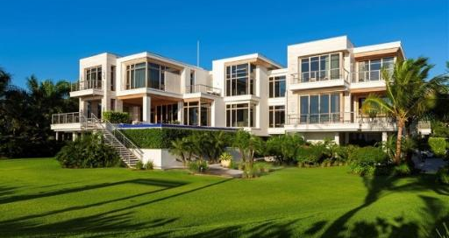
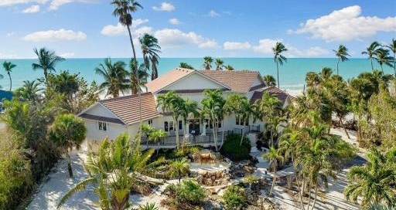
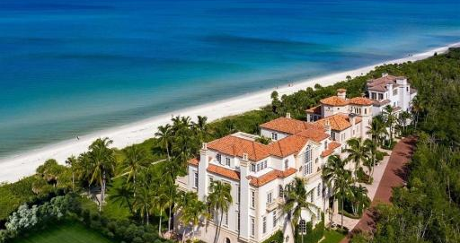
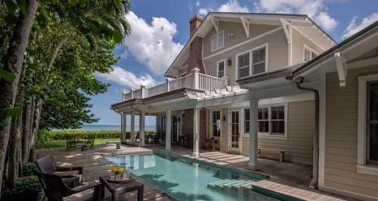
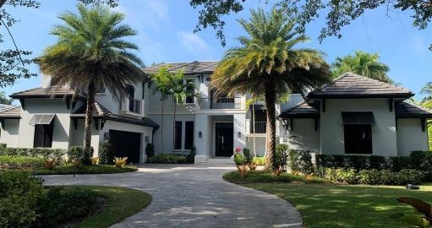
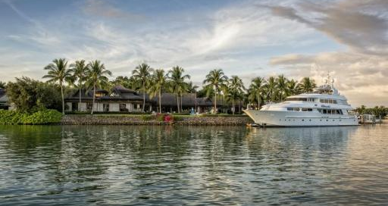
SIGNIFICANT SALES
25 16th Avenue South
1804 Gulf Shore Boulevard South
Sold | $62,000,000 | Represented Seller & Buyer
Sold | $32,500,000 | Represented Seller as Co-list
7613 Bay Colony Drive
1144 Gulf Shore Boulevard South
Sold | $18,500,000 | Represented Seller
Sold | $17,900,000 | Represented Seller
1200 Galleon Drive
3845 Fort Charles Drive
Sold | $15,350,000 | Represented Buyer
Sold | $15,150,000 | Represented Seller & Buyer
1 of 4

Slide 6
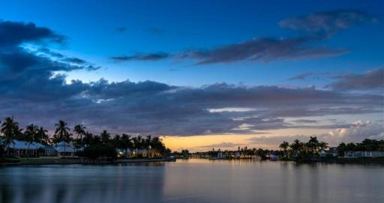
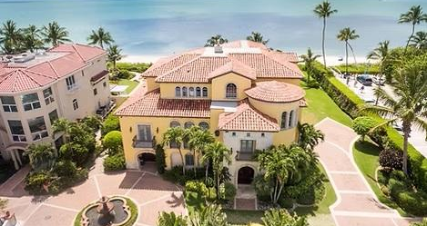
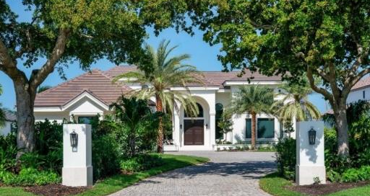
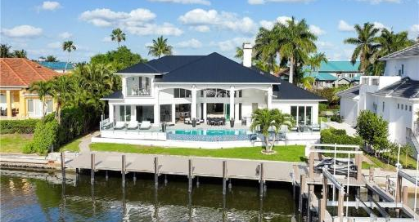
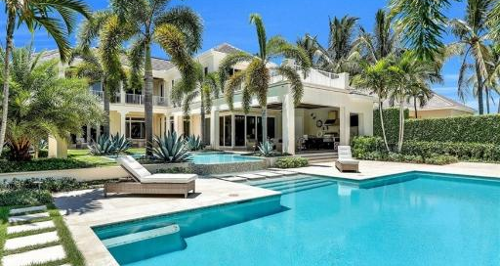
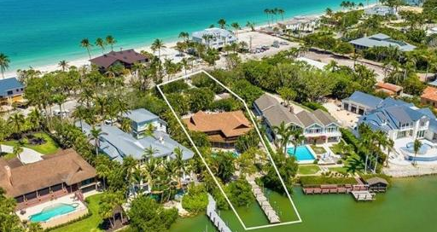
SIGNIFICANT SALES
3696 Nelsons Walk
649 Gulf Shore Blvd North
Sold | $13,500,000 | Represented Seller
Sold | $13,000,000 | Represented Seller
3540 Gin Lane
311 Neapolitan Way
Sold | $12,900,000 | Represented Buyer
Sold | $10,525,000 | Represented Buyer
1055 Spyglass Lane
3625 Gordon Dr
Sold | $10,500,000 | Represented Seller
Sold | $9,850,000 | Represented Seller
2 of 4

Slide 7
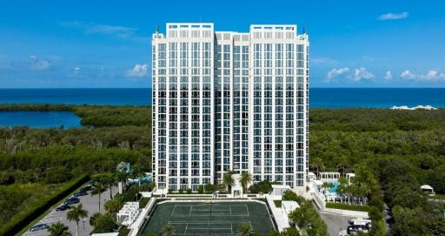
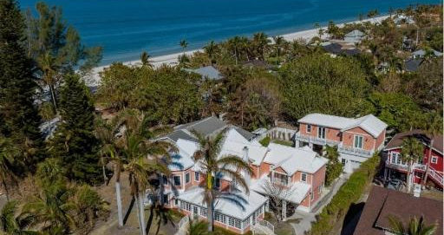
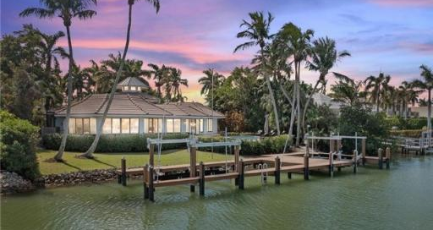
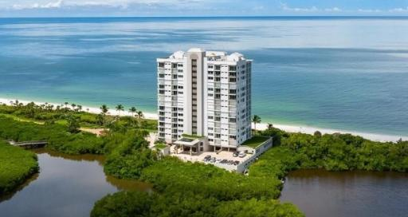
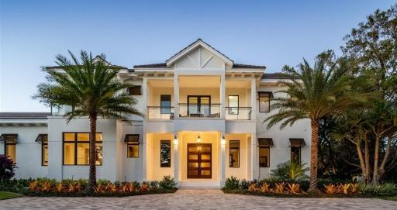
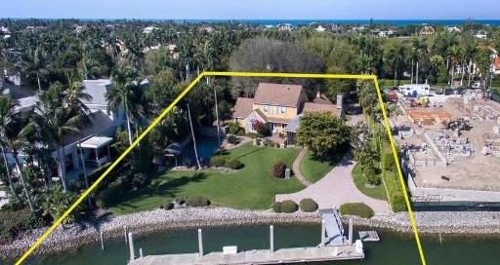
SIGNIFICANT SALES
6897 Grenadier Boulevard #704
53 Broad Avenue South
Sold | $9,250,000 | Represented Seller
Sold | $9,250,000 | Represented Buyer
989 Admiralty Parade East
10 Seagate Drive #6 North
Sold | $8,500,000 | Represented Seller & Buyer
Sold | $8,375,000 | Represented Buyer
375 Kings Town Drive
3675 Fort Charles Drive
Sold | $8,100,000 | Represented Buyer
Sold | $8,025,000 | Represented Buyer
3 of 4

Slide 8
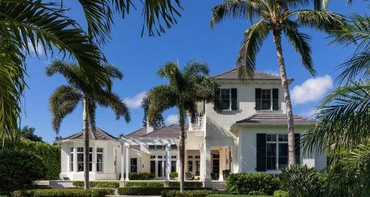
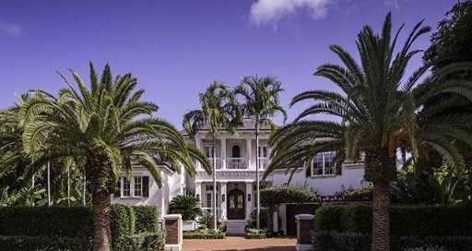
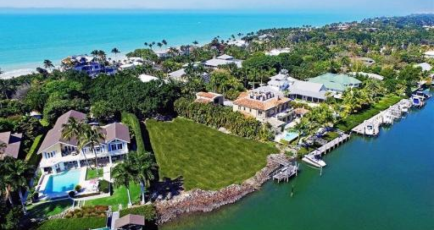
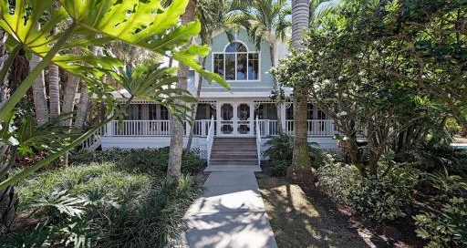
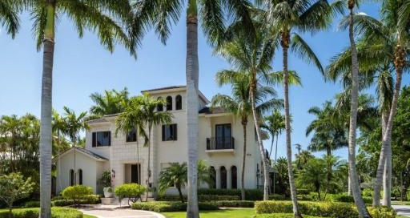
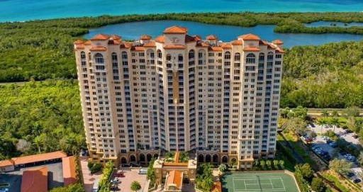
SIGNIFICANT SALES
1203 Spyglass Lane
1009 Admiralty Parade East
Sold | $7,800,000 | Represented Seller
Sold | $7,500,000 | Represented Seller
3575 Gordon Drive
78 Broad Ave South
Sold | $7,360,000 | Represented Seller
Sold | $6,450,000 | Represented Buyer
382 Gulf Shore Boulevard North
6597 Nicholas Boulevard #704
Sold | $6,200,000 | Represented Buyer
Sold | $5,050,000 | Represented Seller
4 of 4

Slide 9
What Our Clients Say
“
Pete was incredibly professional and went out of his way to assist me. He is by far the most professional and knowledgeable representative I have ever worked with.
— Greg N.
“
Paul is the person you want in your corner — whether buying or selling. We always found him to be trustworthy, knowledgeable and responsive.
— Anonymous Seller
“
During the past 18 years, Peter has helped us on 6 different occasions. He is the most trustworthy and loyal representative we know. He has earned our trust and our friendship.
— Mary S. & Durand P.
“
Michael is very knowledgeable about the areas he represents. He's honest, straightforward, and patient. His goal is to add value and make sure you make the best decision possible.
— John & Ashley S.
“
Our entire family has utilized Peter in the buying and selling of Port Royal real estate throughout the years. I would be happy to refer Pete to any one of my friends or colleagues.
— Chip H.
“
Paul is a consummate professional and quite frankly the best realtor I've ever worked with. He sold my home in a tight market at the price we needed. Paul is my go-to guy.
— CW (Bill) Colburn
“
Mike is the most persistent and patient realtor I ever worked with. He let us decide which house was right without pressure. He also sold our home quickly. Highly recommended!
— Tom & Marci K.
We take pride in delivering exceptional results for every client we serve. Whether you're buying, selling, or simply exploring the market, we’re committed to providing a seamless experience backed by local expertise and proven success.
Paul 239.877.4450, Pete 239.595.6500, Michael 239.431.0321
We’re here to help you navigate the market with confidence and achieve exceptional results.

