Slide 1
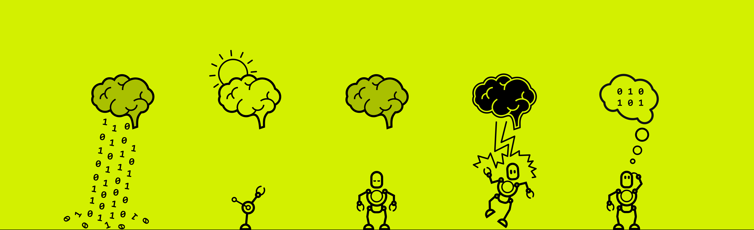


Slide 2

UNIBROWSER
GROUP 7
Li Wei
Michael Golden
Moritz Moeller
James Wilsenach

Slide 3
INTRODUCTION
Idea 1: Locked-in dude wants to see movie/travel, forgot name. How vcould we help em? Ask cl;ever questions to narrow down quickly
Machine finds out wehat user wnat qwuickly
Needs two parts: question asking intell;igence, and readout.
Idea 2: 20 questions?

Slide 4
IDEA/SOLUTION…
Questions such that they ,maximally reduce uncertainty (example, think number between 1 and 100. Then ask: below ett/c.)
Can generalise that to almost everything, using fancy ass [prob bayseian nn quantum model]
Hard to ask right questions, but also hard to interpret answerts! Users are ignoramnt, and eeg is noisy.
All this can be taken care of.
Secomndly, need read out answers using EEG. One=quick way to do it SSVEP.
Look at both things

Slide 5
Our ssvep work
Interface
Data
Result
Result from internet data
Picture of flashing stimulus

Slide 6
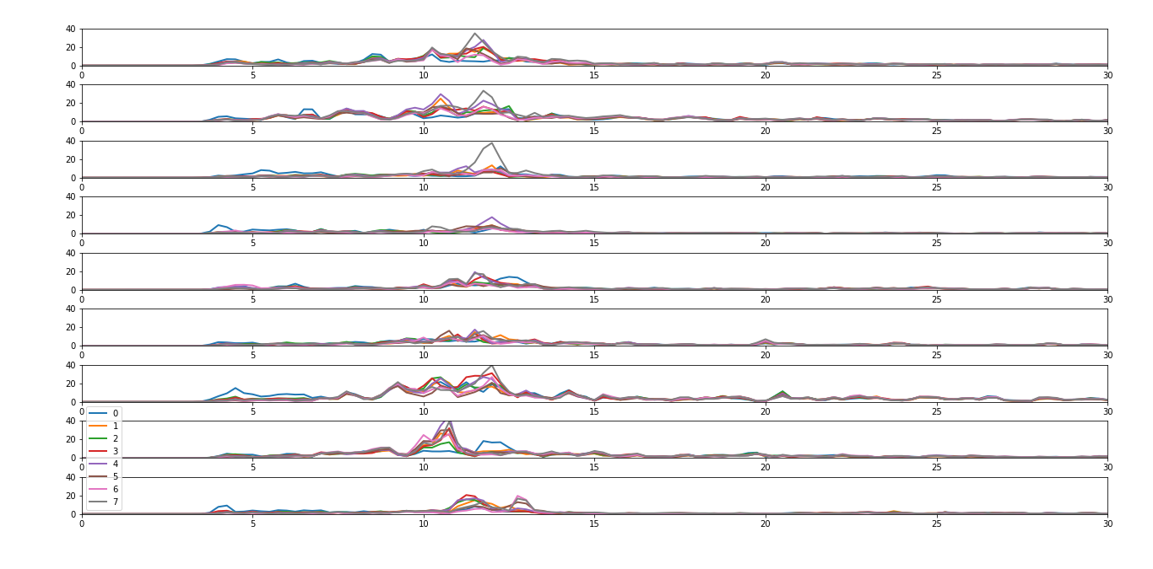
Results ssvep so far
baseline
baseline
baseline
6Hz
6Hz
10Hz
10Hz
15Hz
15Hz
Show both imnterfaces
Show picture of leeway
Method works for web data

Slide 7
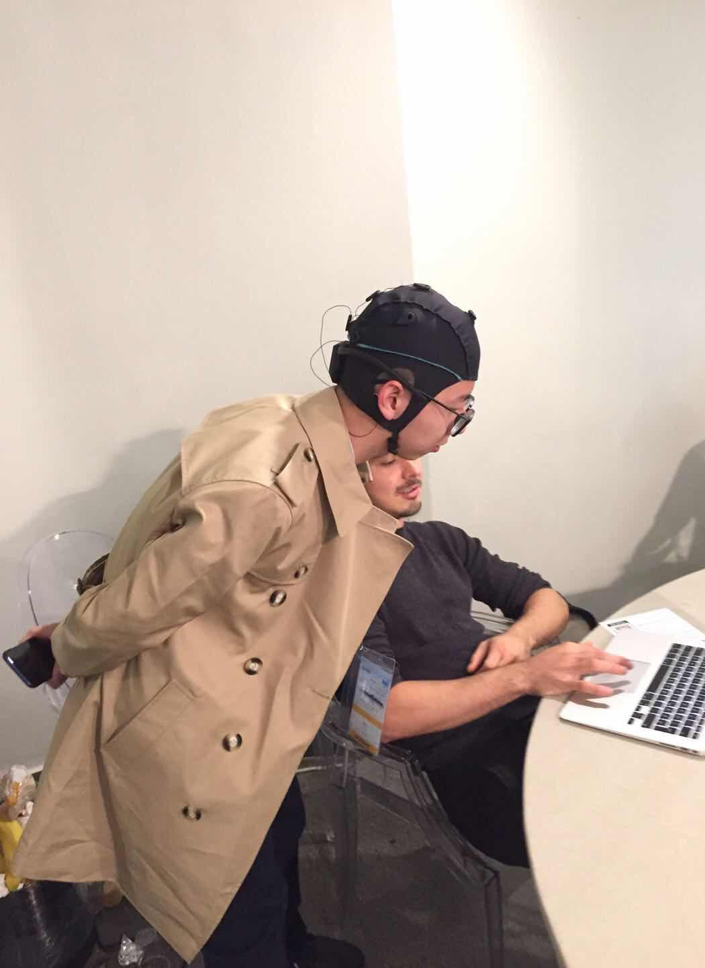
VIDEO…

Slide 8
REFLECTION…
Challenges:
-SSVEP Yes/No classification difficulties
Keyboard/Mouse Faster - Limits User Base
Strengths:
- Makes navigating/exploring UIs simpler from an input perspective
Optimal exploration
- Gameification - Increases data availability
Future Developments:
Learn And Cluster Questions That Produce Strong/Unusual EEG Responses
Make it possible to add new data by answering questions
Adapt Model for Making Recommendations

Slide 9
GROUP PICTURE PICS OF YOU WORKING…

Slide 10
UNIBROWSER
NAMES OF GROUP MEMBERS

