Slide 1
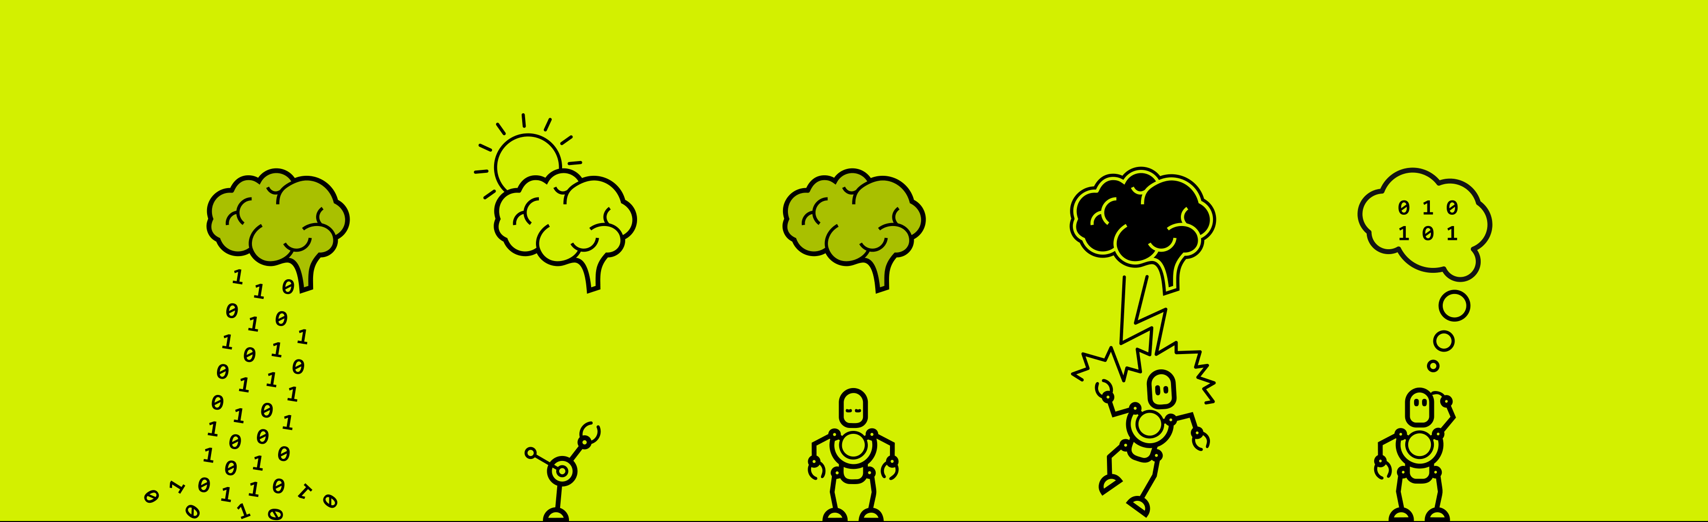


Slide 2

UNIBROWSER
GROUP 7
Li Wei
Michael Golden
Moritz Moeller
James Wilsenach

Slide 3
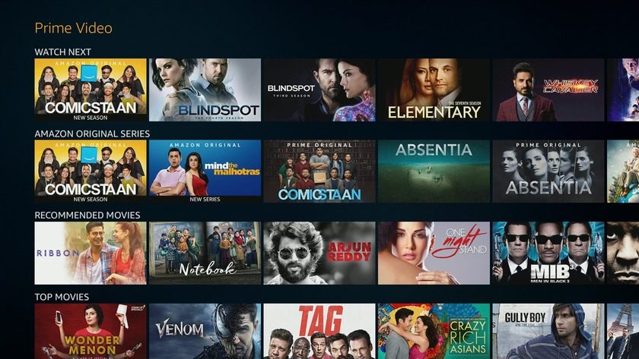
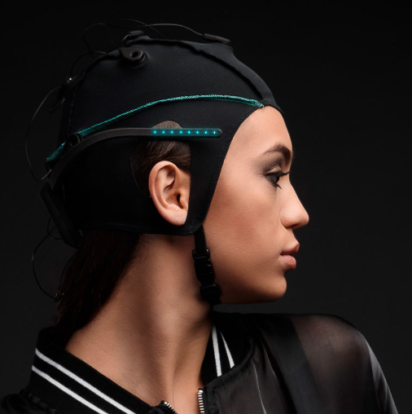


Slide 5
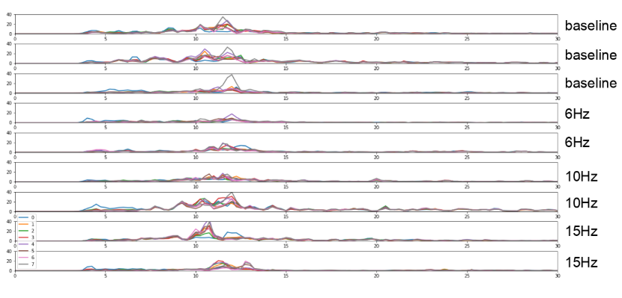
Our ssvep work
Interface
Data
Result
Result from internet data
Picture of flashing stimulus

Slide 6
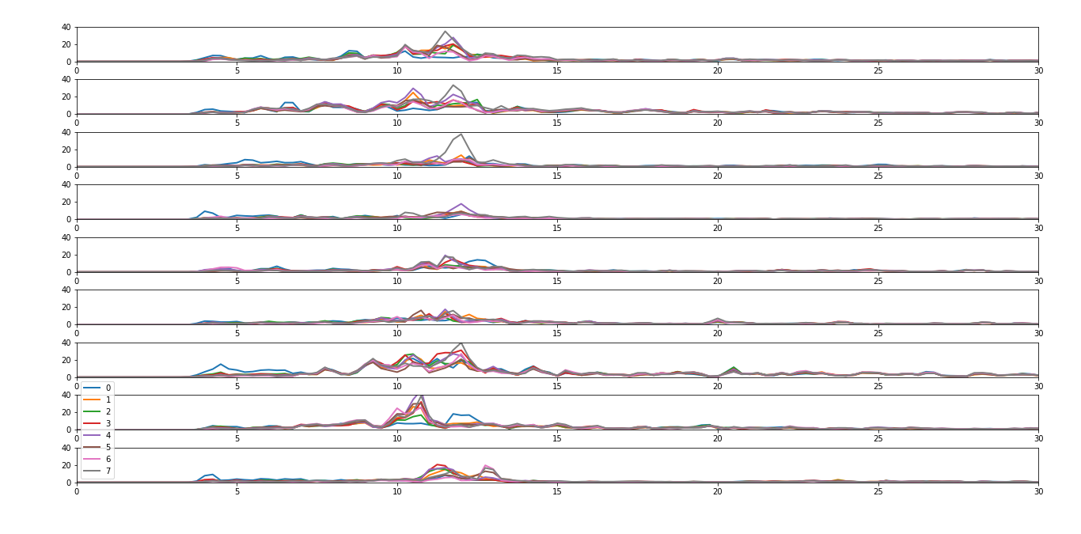
Results ssvep so far
baseline
baseline
baseline
6Hz
6Hz
10Hz
10Hz
15Hz
15Hz
Show both imnterfaces
Show picture of leeway
Method works for web data

Slide 7
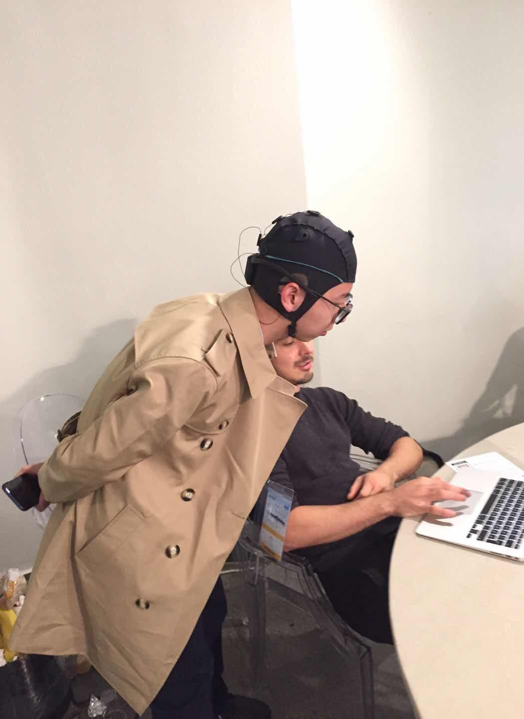
VIDEO…

Slide 8
REFLECTION…
Challenges:
-SSVEP Yes/No classification difficulties
Keyboard/Mouse Faster - Limits User Base
Strengths:
- Makes navigating/exploring UIs simpler from an input perspective
Optimal exploration
- Gameification - Increases data availability
Future Developments:
Learn And Cluster Questions That Produce Strong/Unusual EEG Responses
Make it possible to add new data by answering questions
Adapt Model for Making Recommendations

Slide 9
GROUP PICTURE PICS OF YOU WORKING…

Slide 10
UNIBROWSER
NAMES OF GROUP MEMBERS

