Slide 1
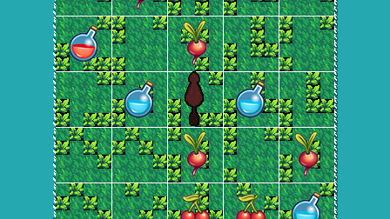
PointyGame
Varying World Size
Michael Guel, Michael Gutierrez, Chad Larsen, Paul Lee

Slide 2
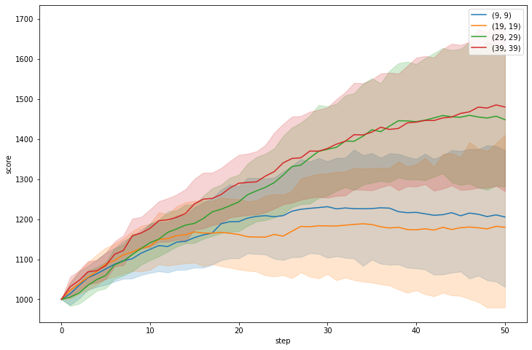
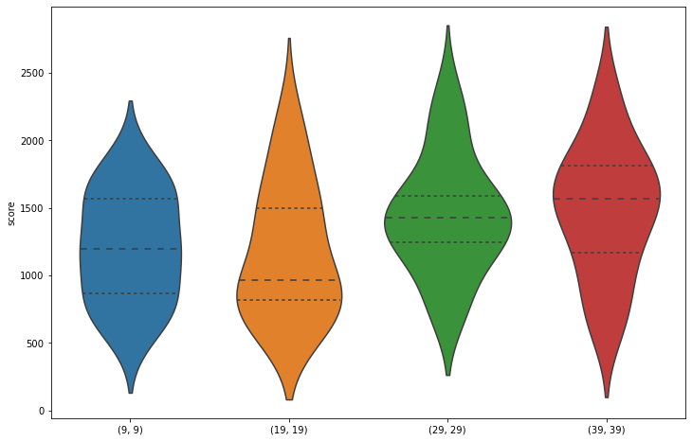
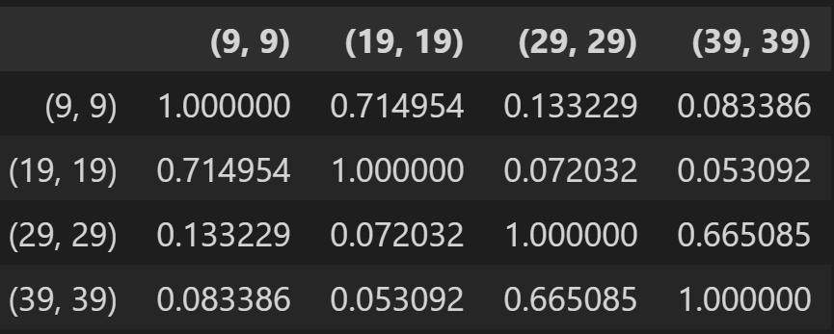
Results
Can’t conclude with confidence that there is a statistically significant relationship (p > 0.05).
To maximize your score, the best choice would be maximizing world size.

Slide 3
Process
Played Game 20 Times with each World Size
Creature Moves 50 Times
Varying World Size (9,9), (19,19), (29,29), (39,39)
Square World
Greedy Strategy
Starting in Corner

Slide 4
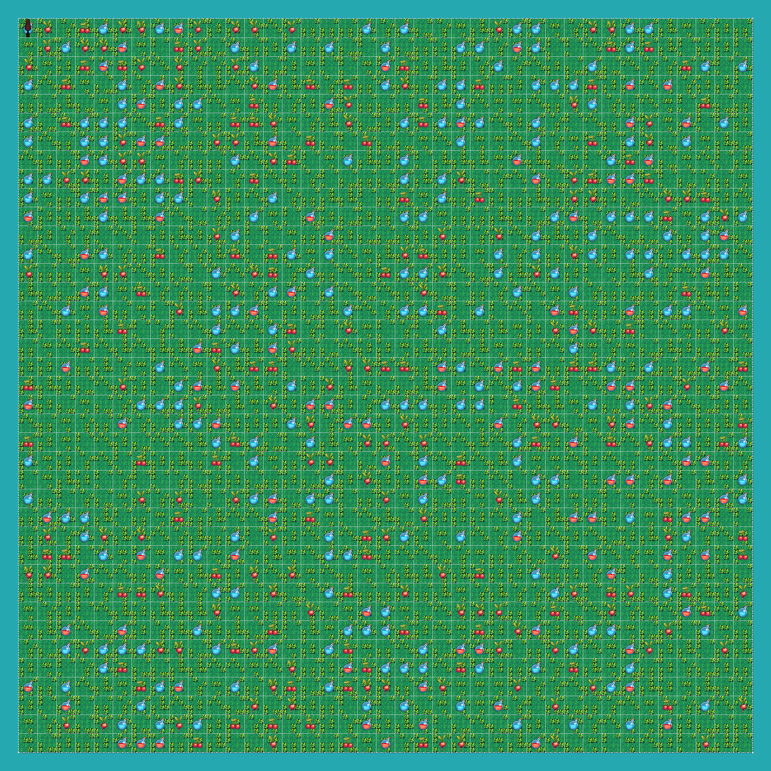
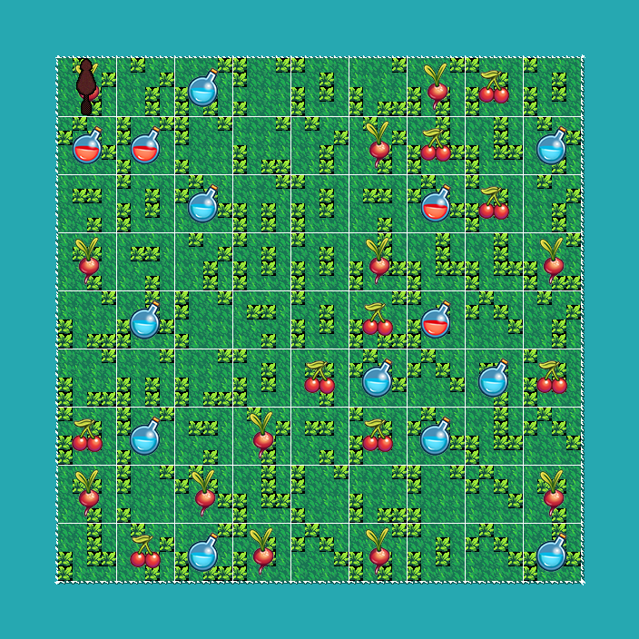
Average Score (39,39) = 1306.49
Average Score (9,9) = 1174.36

