Slide 1

Crypto Price Prediction
Peter Imoukhuede & Michael Guel
STT 890 MLOps

Slide 2
Problem Statement
Volatility in cryptocurrency presents opportunities and risks, is it possible to capitalize on this?

Slide 3
Problem Statement
Volatility in cryptocurrency presents opportunities and risks, is it possible to capitalize on this?
YES!

Slide 4
Problem Statement
Volatility in cryptocurrency presents opportunities and risks, is it possible to capitalize on this?
YES!
Can we reliably anticipate short-term BTC price movements?

Slide 5
Problem Statement
Volatility in cryptocurrency presents opportunities and risks, is it possible to capitalize on this?
YES!
Can we reliably anticipate short-term BTC price movements?
Kind of?

Slide 6
Problem Statement
Volatility in cryptocurrency presents opportunities and risks, is it possible to capitalize on this?
YES!
Can we reliably anticipate short-term BTC price movements?
Kind of?
Is there a ML model that can predict BTC price movement with high accuracy to make millions?

Slide 7
Problem Statement
Volatility in cryptocurrency presents opportunities and risks, is it possible to capitalize on this?
YES!
Can we reliably anticipate short-term BTC price movements?
Kind of?
Is there a ML model that can predict BTC price movement with high accuracy to make millions?
NO!

Slide 8
Problem Statement
Volatility in cryptocurrency presents opportunities and risks, is it possible to capitalize on this?
YES!
Can we reliably anticipate short-term BTC price movements?
Kind of?
Is there a ML model that can predict BTC price movement with high accuracy to make millions?
NO!
What can we do?

Slide 9

Project Objective
Build a real-time prediction system for hourly BTC price direction
Supply necessary information to make informed decision
Deliver predictions through a user-friendly app
Model monitor behavior over time to alert for revaluation

Slide 10
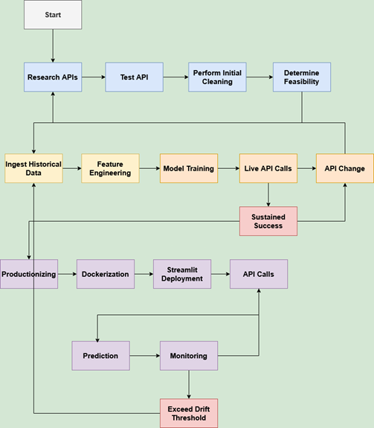
End-to-End Pipeline Overview
Most Time Spent
Research API / Test API
API Change

Slide 11
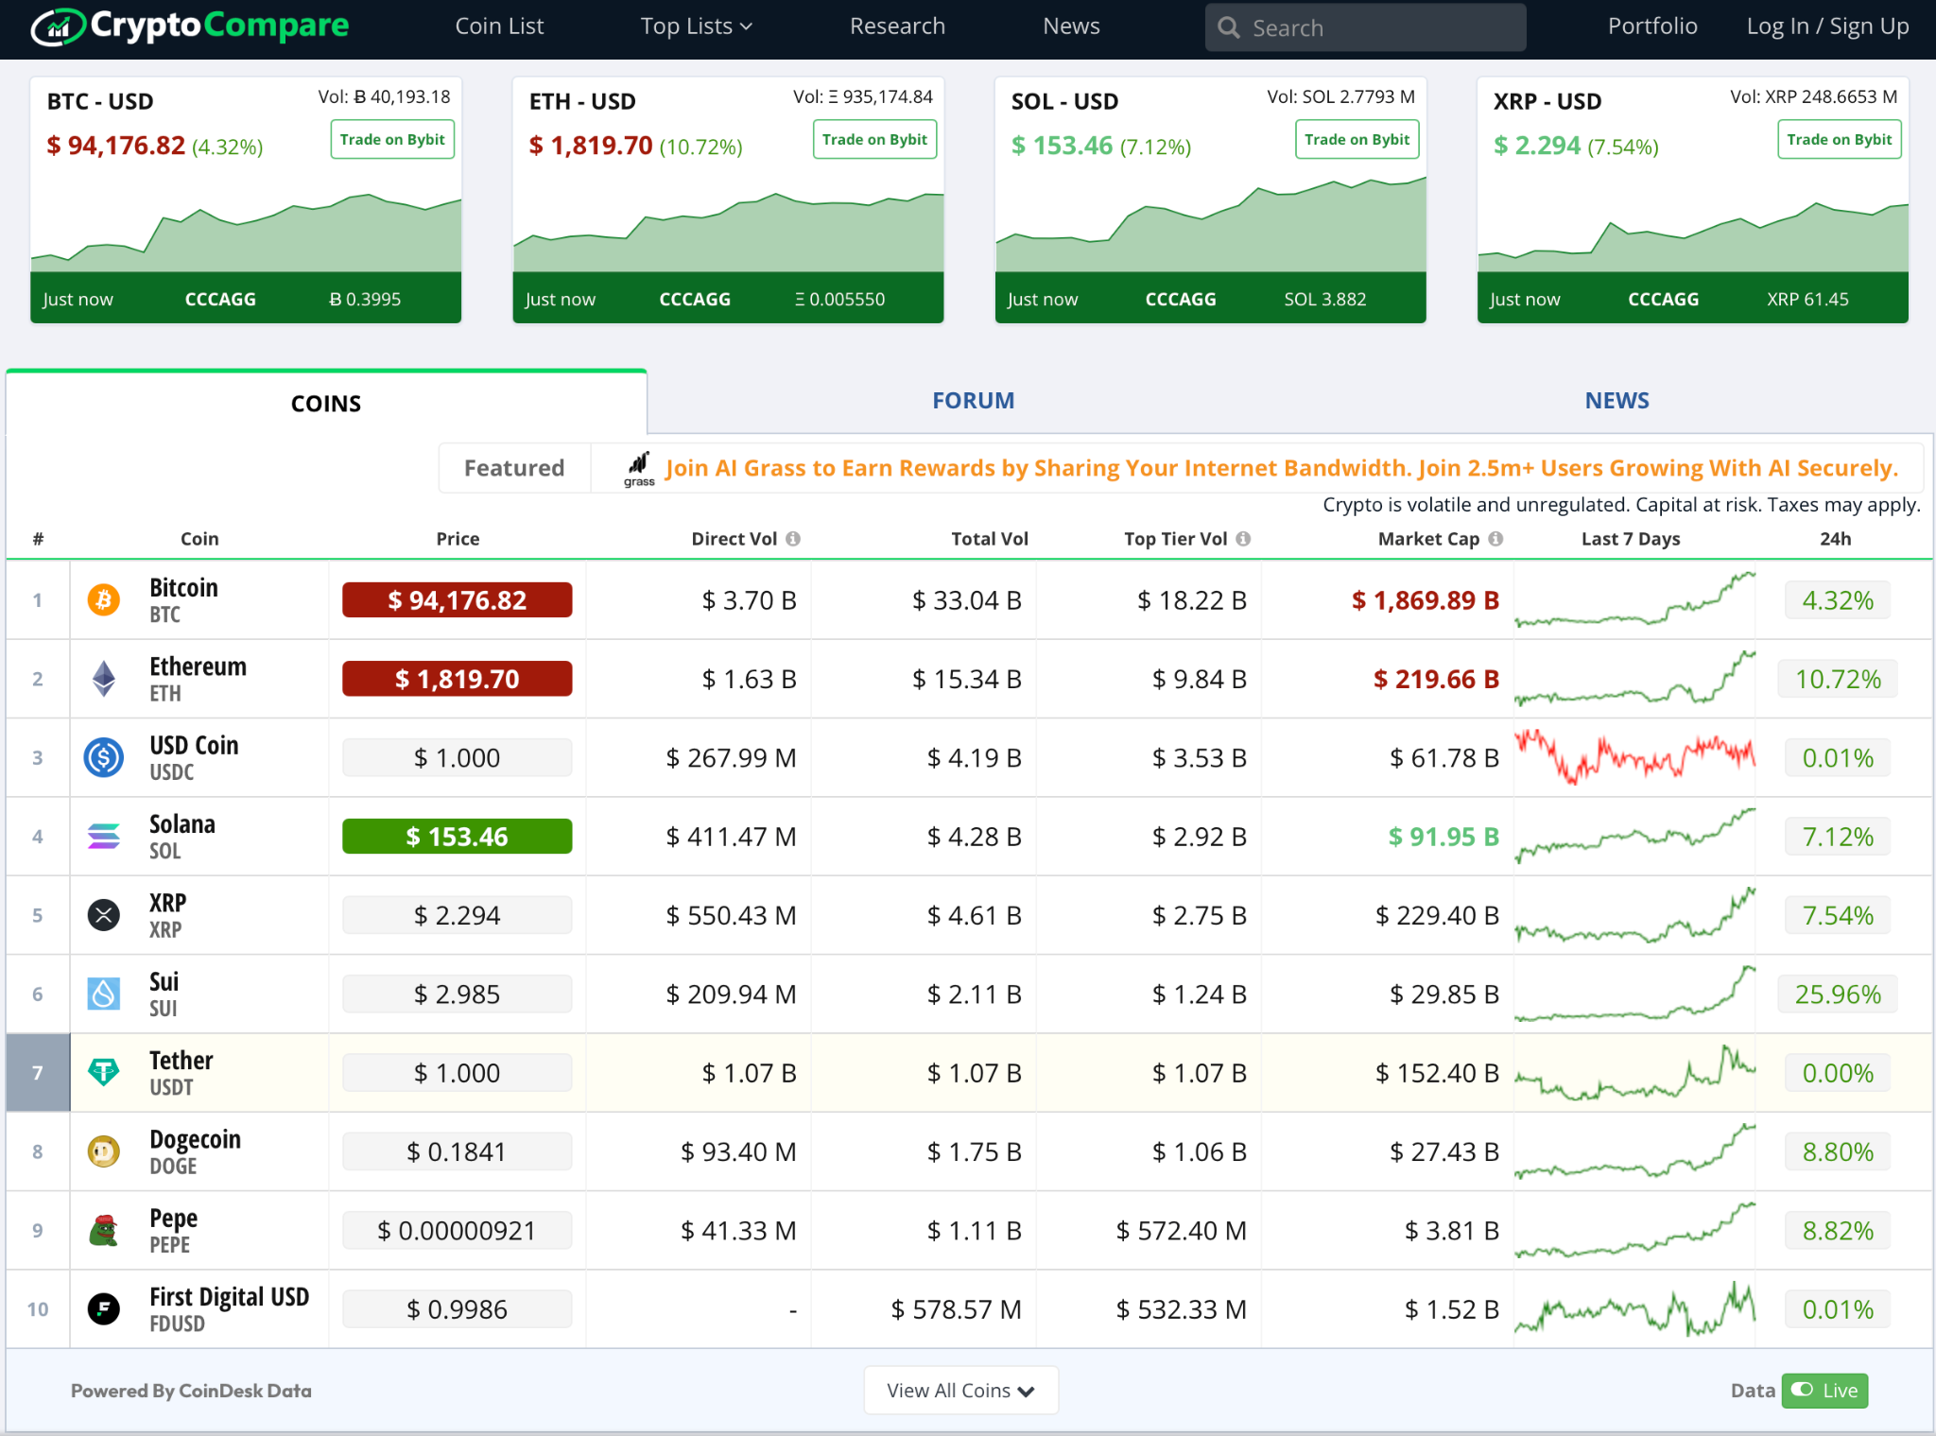
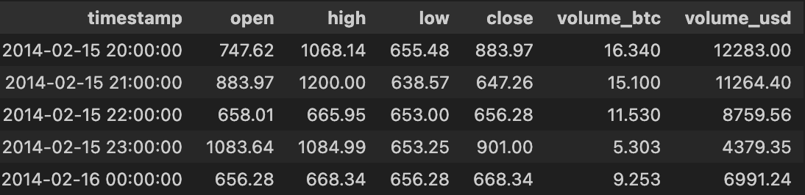
Data Ingestion
Data is ingested from CryptoCompare API
Hourly OHLC, Real-Time BTC Price + Volume
2012-Present

Slide 12
Feature Engineering
Momentum
Rolling Volatility
SMA-24, SMA-168
Hourly return (1hr, 3hr, 6hr)
Binary Classification: (Close - Close t-1) + threshold
Additional features for monitoring (volume percent change, log returns close, log returns open, momentum, 1hr, 2hr)

Slide 13
Model Overview
XGBoost Binary Classifier
N_estimators = 1000, eval_metric=‘logloss’
Experimented with other models (LSTM, RNN) (TradeOff)

Slide 14
Streamlit Application
Live BTC Price, Volume, Change
Parital (currently in-progress) Data
Model making live hourly predictions
Confidence Score for Prediction
Most Recent 10 Predictions for
On board model monitoring actively fetching new data from API

Slide 15
Model Monitoring
Performance Monitoring
Accuracy, Precision, Recall, F1 score and ROC AUC
Rolling Percentage of Ups in the Last 24-hours (Predicted vs Actual)
Confusion matrix: Visual breakdown of actual vs. predicted directions

Slide 16
Model Monitoring
Data Drift Monitoring
Population Sample Index & Kolmogorov-Smirnov tests on key features to flag distribution shifts
Distribution overlays: Side-by-side density plots of baseline vs. recent data for each feature
Prediction Monitoring
Confidence histogram: Distribution of model confidence scores to monitor calibration and aggressiveness

Slide 17

Docker Deployment
Dockerized for portability and reproducibility
Runs in any environment with Docker
Can be deployed locally or in cloud

Slide 18
Risks and Considerations
API availability (#1 Issue)
Data Drift
Market Volatility
Confidence Calibration
Potential trading implications
Retraining Frequency

Slide 19
Takeaways
End-to-end ML pipeline from live data to real-time prediction
Fully deployable and extensible
Future: add sentiment, trading integration, retraining loop

Slide 20
Demo

