Slide 1
Firebase + KMM Steup
In build.gradle.kts of shared:
Under plugins, add the following if it is not already there (it probably is)
kotlin("plugin.serialization")
Under
sourceSets {
val commonMain by getting {
dependencies {
Add:
implementation("dev.gitlive:firebase-auth:1.8.0")
implementation("dev.gitlive:firebase-firestore:1.8.0")
Then Sync Gradle

Slide 2
Annotate FrogData class with @Serializable

Slide 3
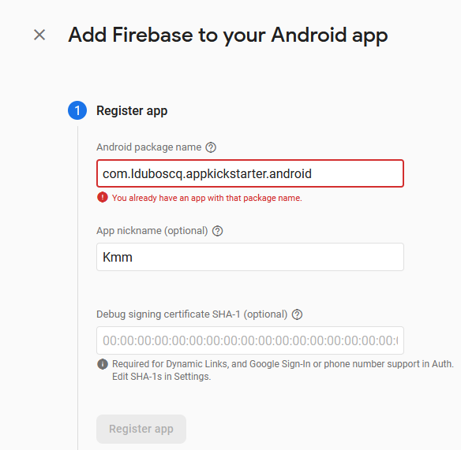
Add Firebase to an Android app
Enter your package name, but also add .android at the end

Slide 4
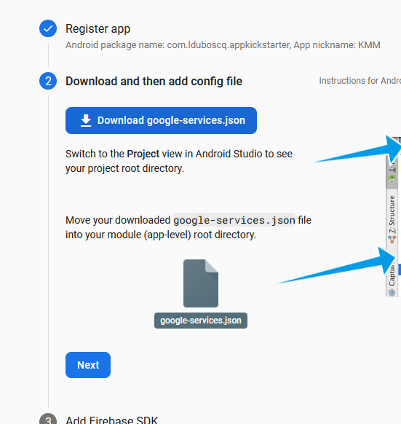
Register App
Download google-services.json
Put it in the androidApp folder of your KMM project
In androidApp/build.gradle.kts
Put this in plugins
id("com.google.gms.google-services")
Put this in sourceSets
implementation(platform("com.google.firebase:firebase-bom:32.1.1"))

Slide 5
In build.gradle.kts in androidApp, delete the word .android from the package name in "applicationId"
In google-services.json, delete .android from the package name as well.
Sync gradle and rebuild.
This was a hack to get around an error having to do with the extra .android that Kotlin Multiplatform adds.

Slide 6
Exercise 9 – Flutter and Firestore
Worth 0.5%
In this exercise, you will integrate Google's Firestore in your project from Exercise 7 and learn how to read and write data to the online database.
Make sure to Git commit and push before making changes.

Slide 7
Firebase
Follow the steps on the following slides to setup your flutter project to use Google's Firestore.
Additional info:
These links provide good information on how to connect your Flutter project to Firestore. The second link in particular is good to follow. (However, it requires a bit more advanced knowledge
https://firebase.google.com/codelabs/firebase-get-to-know-flutter
https://firebase.google.com/codelabs/get-started-firebase-emulators-and-flutter#0
https://firebase.google.com/docs/firestore/quickstart#dart
Go to Dart/Flutter tab
The second codelab walks you through initial setup similar to what is the next slides.
Key difference is that I recommend that you install firebase cli using npm, not the indicated method
This will let things run more easily from the Terminal in Android Studio (the other approach has setting-the-path issues).

Slide 8
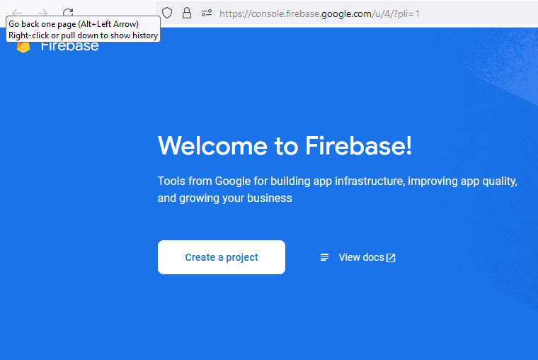
https://console.firebase.google.com/u/0/?pli=1
Add a project
Give it a name
Say "no" to analytics (otherwise there are more/unnecessary steps to setup)

Slide 9
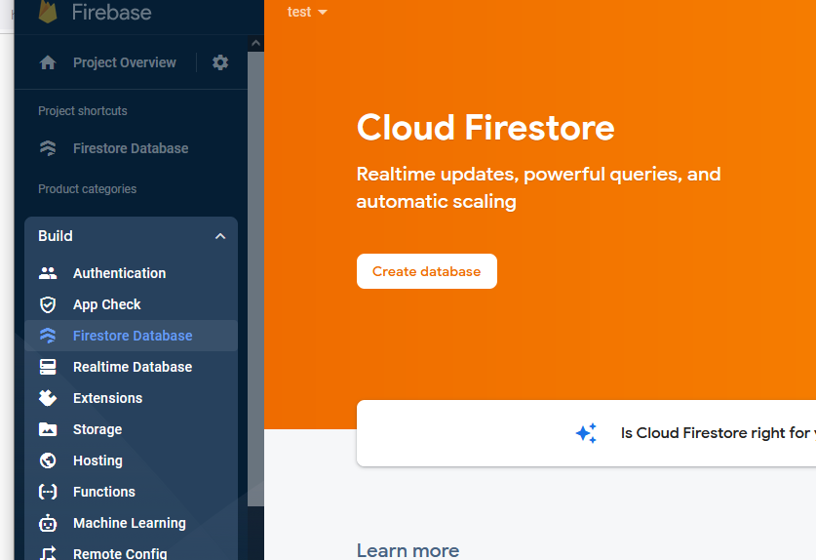
In the build menu on the left panel, select "Firestore Database"
Choose "Create Database"
Choose Test Mode

Slide 10
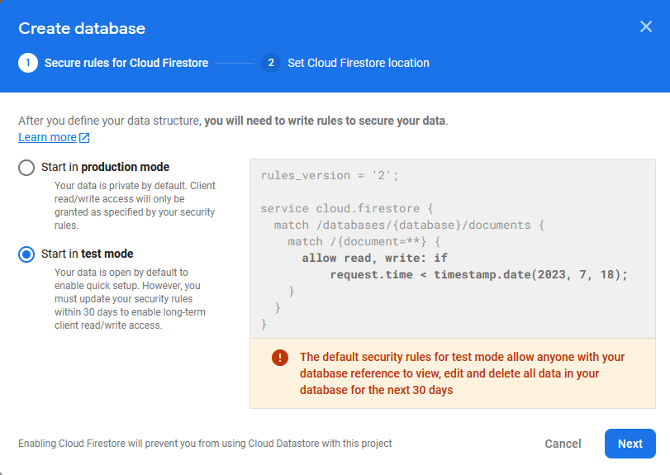
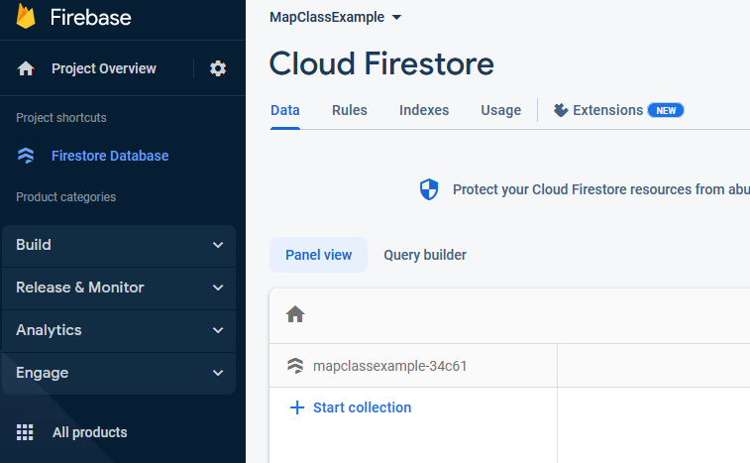

Slide 11
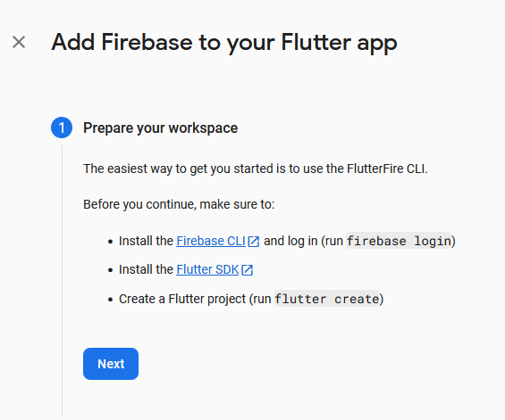
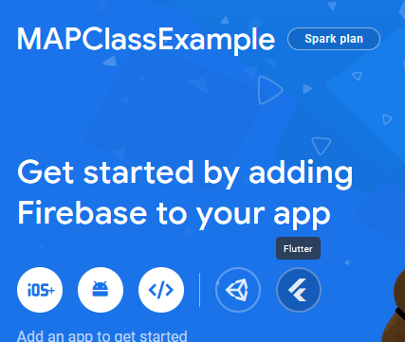
On the Firebase project page, click the Flutter icon
This will walk you through some steps
to set things up.

Slide 12
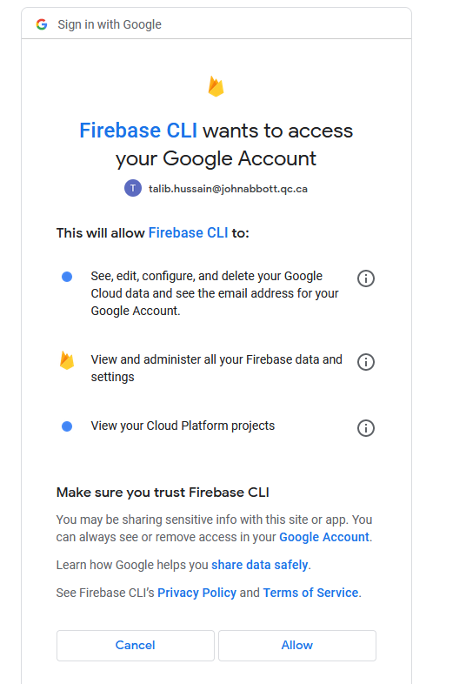
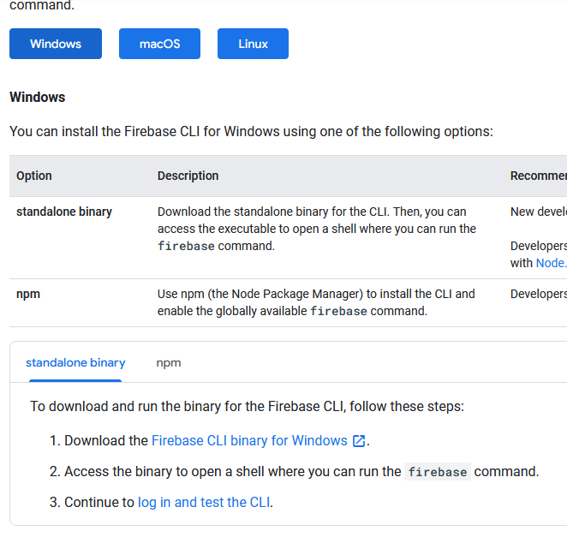
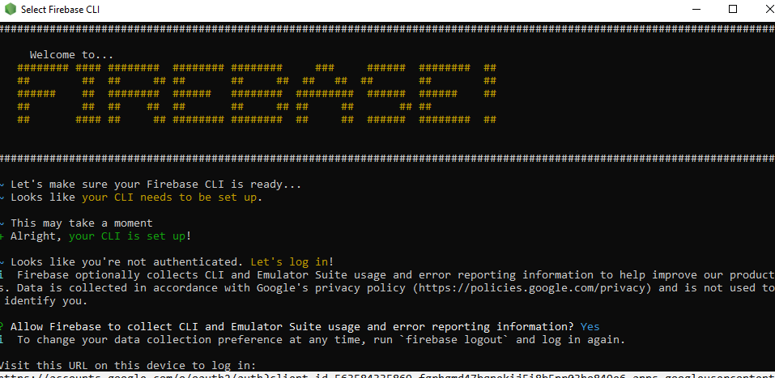
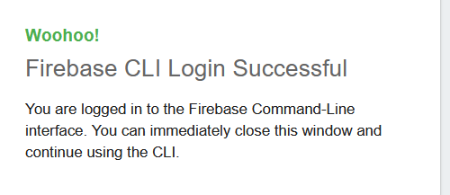
Click the "npm" tab and follow instructions to install the CLI using npm. In a terminal in your Android Studio, type:
npm install -g firebase-tools
If you don't have Node.js installed, then follow instructions to do so first.
Go to the next step ("Continue to login in and test the CLI")
Login to firebase. In the terminal, type the following:
Firebase login
You may get a security error. In that case, type the following in the terminal first, then login again.
Set-ExecutionPolicy -Scope Process -ExecutionPolicy Bypass
From: https://www.petenetlive.com/KB/Article/0001417#:~:text=Execute%20the%20following%20command%3B%20Set-ExecutionPolicy%20-Scope%20Process%20-ExecutionPolicy,if%20you%20are%20running%20a%20lot%20of%20scripts.
Eventually this should prompt you to provide the Firebase CLI with access to your google account in the web browser. Click 'Allow'

Slide 13
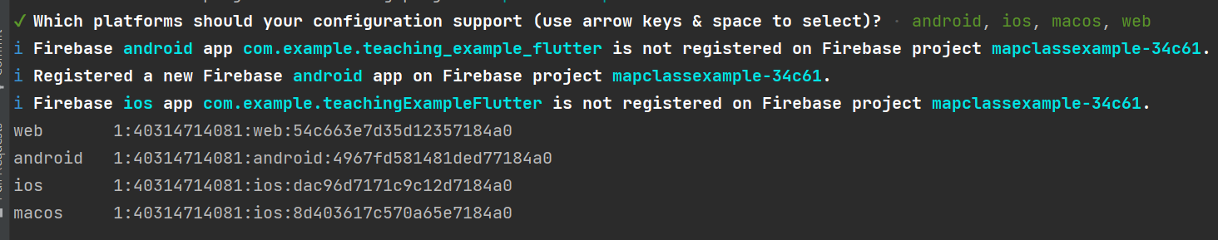
Continue to follow directions for Step 2 on the "Add Firebase to your Flutter App page"
From the terminal in Android Studio: Install and run the FlutterFire CLI
From any directory, run this command: dart pub global activate flutterfire_cli
Add flutterfire to your path
E.g., Environment variables on PC.
E.g., For me it is: C:\Users\Main\AppData\Local\Pub\Cache\bin
For you it will have a different username (not "Main")
After setting the new path, restart android studio so it will recognize the new path.
Then, at the root of your Flutter project directory, run this command:
flutterfire configure --project==mapclassexample-34c61
The part in bold above will be different for your project. Copy the details of the above line from your webpage since it is specific to your project.
This automatically registers your per-platform apps with Firebase and adds a lib/firebase_options.dart configuration file to your Flutter project.

Slide 14
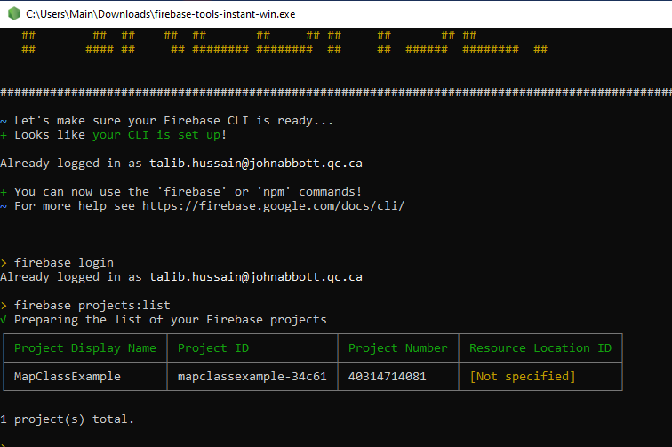
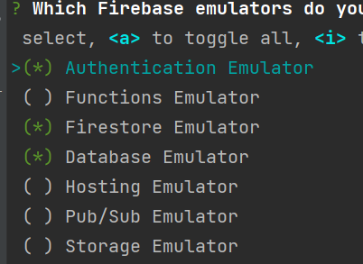
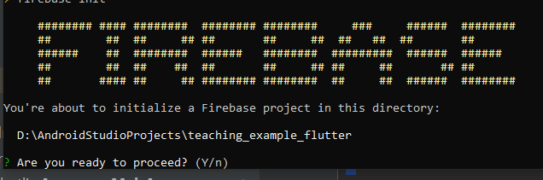
Back in your terminal window, make sure you are in the root folder of your project
Or, open a new terminal window in Android Studio and you should be in the right root folder automatically.
Type 'firebase init'
Make sure the folder in the prompt is correct and say Y if it is.
Choose both Firebase Realtime and Firestore.
You can also choose emulators which should save setup time later on.
https://firebase.google.com/docs/database/rtdb-vs-firestore

Slide 15
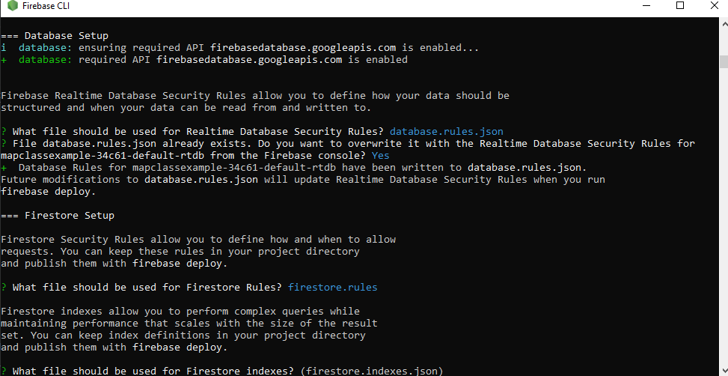

Slide 16
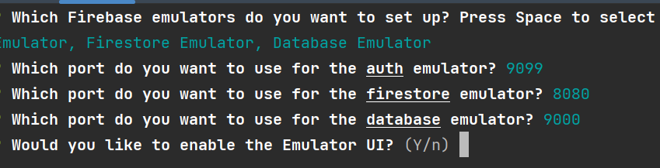
If you chose to add emulators now, you should see a prompt like the following:

Slide 17
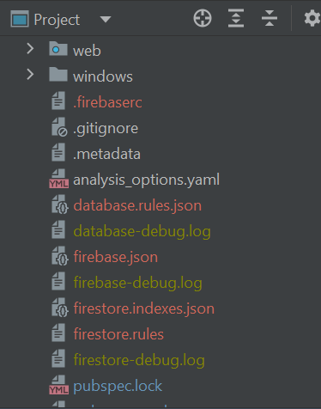
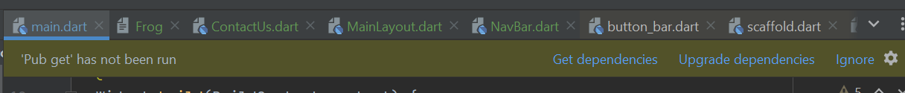
If you've done everything properly, you should see a number of firebase related files in your flutter project
You may need to shift to "Project" view (not Android) in order to see them more easily.
You may or may not see a banner near the top saying to get dependencies. If so, Click "Get dependencies".

Slide 18
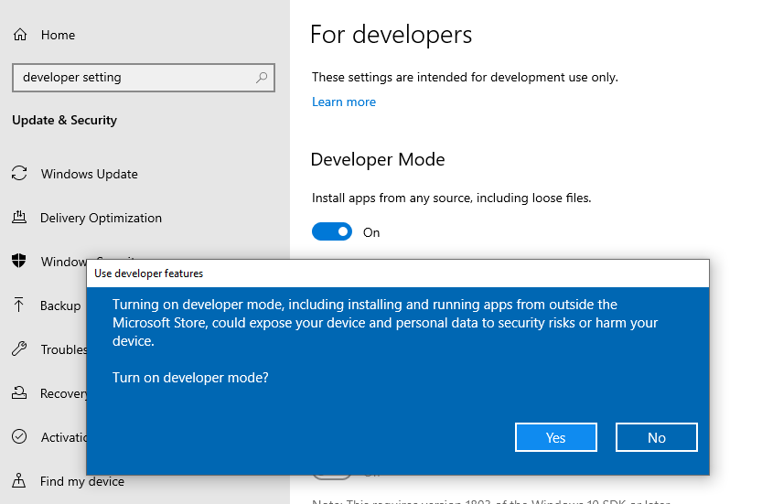
Type the following in the terminal
flutter pub add cloud_firestore
You may get the following message:
Building with plugins requires symlink support.
Please enable Developer Mode in your system settings. Run
start ms-settings:developers
to open settings.
On PC, type "developer settings" in the search box /Cortana and activate Developer Mode
On Mac, following any indicated instructions.

Slide 19
Capture a screenshot showing the file structure of your project with all the files added by the installation/configuration process above.

Slide 20
Now, let's write and read some data
We are roughly following the coding approach on this page beginning at the "Initialize Cloud Firestore" section.
https://firebase.google.com/docs/firestore/quickstart#dart
In your main.dart, you need to initialize Firebase as follows:
import 'package:firebase_core/firebase_core.dart';
void main() async {
await Firebase.initializeApp(
options: DefaultFirebaseOptions.currentPlatform,
);
runApp(MyApp());
}
Create a new folder in lib called model (i.e., lib/model)
Create a file called XXXRepository (e.g., UserRepository) in the model folder

Slide 21
Now, let's write and read some data
In your repository, create an "add" function.
void readData () async {
var db = FirebaseFirestore.instance;
await db.collection("users").get().then((event) {
for (var doc in event.docs) {
print("${doc.id} => ${doc.data()}");
}
});
}

Slide 22
Now, let's write and read some data
Create write function
void writeData() {
var db = FirebaseFirestore.instance;
// Create a new user with a first and last name
final user = <String, dynamic>{
"first": "Ada",
"last": "Lovelace",
"born": 1815
};
// Add a new document with a generated ID
db.collection("users").add(user).then((DocumentReference doc) =>
print('DocumentSnapshot added with ID: ${doc.id}'));

Slide 23
Wrap-Up Exercise 9
Take screenshots of your database on Firestore and the console outputs
Upload together with other screenshots for Exercise 9 to Lea.
Commit and push changes to git.

Slide 24
Groupwork

