Slide 1

Related Technologies for Multiplatform Applications
420-731-AB
Instructor: Talib Hussain
Day 1: Introduction
Notes:
Image from: https://img.freepik.com/premium-photo/phone-mobile-application-development-concept-mobile-internet-3d-illustration_76964-5164.jpg?size=626&ext=jpg

Slide 2
Objectives
Meet and Greet
Course Outline
Intro to Kotlin Multiplatform Mobile and Compose Multiplatform
Kotlin Basics
Functions
Variables
Types

Slide 3
Welcome!
You'll be learning:
How to program in a new language – Kotlin – that is based on Java but uses a more concise syntax
How to use a new multiplatform technology – Kotlin Multiplatform Mobile (in beta) - to create projects that use a single codebase and can be deployed on both Android and iOS
How to create user interfaces in a very new multiplatform technology - Compose Multiplatform (in alpha) – to produce app UIs that work in both Android and iOS
How to use appropriate design principles, tools and techniques to produce robust mobile code
How to work together in groups to design and create a multi-platform app
You’ll be learning both individually and together
Encourage critical thinking, exploratory learning-by-doing, and collaborative learning
You’ll be making many design decisions of your own

Slide 4
Critical Thinking Challenge for Course How do I efficiently build something that is useful, usable and effective?

Slide 5
Do you love:
Helping others be productive
How could you help make their life easier? What kinds of assistance could you provide? What tools could help with keeping organized, performing tasks, staying on top of things, etc.?
Helping others connect?
How would they meet each other? What type of activities would they be involved in? How would they communicate with each other? How could you help them collaborate better?
Running a business?
How would you attract customers? What information and services would you provide? How would you maintain the interest of your customers? How would you make money?
Having fun?
What kind of entertainment could you provide? How would they interact and stay interested? How would they be able to choose or influence what happens?
Keeping others informed?
How would you get the information they need? How would you display the information so it is easy to understand quickly? How would they explore that information?
What is the purpose, how is it relevant to the end user, and how do you ensure it is appealing and works well?

Slide 6
Meet and Greet
Cameras on, please.
Introduce yourselves
What excites you about learning about multiplatform mobile development?
What's the main thing you hope to learn/achieve in this course (or program)?
Tell me something interesting about you
One (or more) cool/interesting fact(s) about you (e.g., a hobby, life experience, favourite food/movie/song/other, places visited, sport played, etc.)
Describe an activity you'd love to build an app around
We'll try to use this activity (or another preferred one) to give focus to your assignments and your final project

Slide 7
A little bit about me
A little bit about me
https://www.talibhussain.com
Wanted to be a "Computerist" when I grew up (My mother was a Systems Analyst)
Did Pure & Applied Science at JAC (graduated 1988) and Ph.D. in Computer Science at Queen's University
Where I worked: https://en.wikipedia.org/wiki/BBN_Technologies
Worked on Artificial Intelligence, Serious Games, Logistics and more
Where I've taught: JAC, McGill, Queen's, Tufts, Various workshops
Play Ultimate Frisbee/Badminton/Soccer/Curling; Am a Singer.
Cool fact: Worked with the person who invented e-mail! Ray Tomlinson https://en.wikipedia.org/wiki/Ray_Tomlinson
Any Questions?

Slide 8
Course Outline
Course Outline posted on Teams Class Materials folder
My email: talib.hussain@johnabbott.qc.ca
Contact via Teams or email (more urgent) or MIO messaging (less urgent or "official")
Official Ponderation: 2 hours lecture + 4 hours lab + 3 hours homework
At ContEd speed, that means 2.5 hours of homework per weeknight on average…!

Slide 9
Go Over Course Outline…

Slide 10
Weekly Goals
Week 1: Build a simple single-screen app in Kotlin with a UI
Android or iOS
Exercises: Learn Kotlin, get completely setup & with git, initial app
Assignment 1: Basic App
Project: Form Teams & Determine type of app
Week 2: Build a multi-screen app that connects to a database
Android & iOS
Exercises: Navigate, Connect to database, Integrated App
Assignment 2: Multi-screen App
Milestone 1: Design Document & Design Presentation
Week 3: Build an app with error handling, user authentication, 3rd party api, and good UI layout
Android & iOS
Self-guided exercises, Test prep & Test
Milestone 2: Preliminary demo
Week 4: Complete project & demo in Android & iOS
Final project: Final demo

Slide 11
Class Format
Important to learn on your own too! Look up things you’re not sure about, explore concepts introduced in class, and try to find out more about techniques discussed in class.
Introduce new concepts/techniques
Expectation: Cameras on while teaching new content so I can detect quickly when people are confused or having issues.
I will poll for progress/issues using the Teams “Raise Hand” feature
Walk-through code examples and/or Try It! Exercises
Walkthroughs: Students code along on your systems too while I share my screen
Try It!: Short coding exercise on your own (e.g., 5 – 10 min)
Expectation: Cameras optional for walkthroughs/Try It! (Teacher too).
I will ask for submission of your exercise content – Important that you do all activities and keep up. Class is too fast-paced!
Lab Exercises
Larger exercises to complete individually (Some worth marks as indicated)
We will use all classtime. If you finish an activity earlier than the rest of the class, then…
Work on making your solution more elaborate/creative and try new things out.
Research more details about technique online (often some links will be provided)
Work on the assignment/project
Or, help a friend – you can learn a lot by teaching
Collaborative sessions
Work together in groups in meeting rooms on group assignments/project
Test / Review sessions
30 minute break (no work assigned during break) plus short breaks to move around as needed (~1 to 1.5 hours apart).
Learning by Doing!

Slide 12
Tools
We’ll be using several tools to learn, coordinate and collaborate
Teams - For classes and for communication (time-critical) outside of class
We'll use screen share to show your work
Class slides will be posted to Teams. Sometimes beforehand, always after.
MIO - For communicating (non-time-critical)
Email - For communicating (time-critical). Will aim for <24hr response.
Lea - For receiving & submitting exercises/assignments/project and getting marks
Google Forms – For test
Android Studio
We use this for development and debugging.
Github – For maintaining and sharing codebase
Online document share (e.g., Google Docs) for shared project documentation

Slide 13
AI, Stack Overflow, Help, etc.
There are lots of cool tools and resources out there to help us as programmers.
Recently, AI tools are in focus. Here, for example, we have autocomplete/code generation tools in our IDEs. ChatGPT and other such tools are also available.
Bottom-line – you're here to learn. You learn by doing things yourself, not by having them done for you or told to you. It is best to think of these tools as aids for speeding up doing what you already know.
So, for example, if you find yourself looking for an autocomplete suggestion or code generation in order to figure out what you're supposed to do… stop yourself.
save yourself typing - ok
save yourself thinking – not ok
As for other resources online or getting help from someone else, they are all great for researching solutions for how to do things. But, in the end, you need to be able to do it yourself.
Don't: Borrow solutions you don't understand.
Don't: Copy lots of code and expect it to all work out.
Do: If you get an idea or suggestions from a source (including another person), put a reference to it in your comments
Do: If you do happen to copy a portion of code exactly, put a clear indication of what isn't yours in the comments → otherwise cheating/plagiarism (which = mark of 0 and reported to college).
You don't have to give a source for my code provided in class/slides. But, if I or another student help you figure out how to do something complex, always nice to given a shout out in the comments.

Slide 14
Poll
Who's usually on PC?
Who's usually on Mac?

Slide 15
Useful Links
Intro to Kotlin
https://developer.android.com/teach#teach-a-class
https://www.w3schools.com/KOTLIN/index.php
https://eecs441.eecs.umich.edu/
https://www.slideshare.net/GoogleDevelopersLeba/android-development-with-kotlin-course
https://kotlinlang.org/docs/home.html
https://student.cs.uwaterloo.ca/~cs346/1231/learning-kotlin/index.html
Null safety: https://developer.android.com/codelabs/basic-android-kotlin-compose-nullability
Lambdas: https://www.baeldung.com/kotlin/lambda-expressions
Data classes: https://antonioleiva.com/data-classes-kotlin/
Kotlin Multiplatform
https://lp.jetbrains.com/kmm-for-crossplatform-developers/
https://kotlinlang.org/docs/multiplatform.html
Expects vs actual: https://medium.com/@uwaisalqadri/kotlin-multiplatform-mobile-concept-of-expect-actual-f967d2e948ce
Compose Multiplatform
Now in alpha: hot off the presses: https://blog.jetbrains.com/kotlin/2023/05/compose-multiplatform-for-ios-is-in-alpha/
Getting started: https://www.jetbrains.com/lp/compose-multiplatform/
Component-Based UI
@Composable: https://medium.com/androiddevelopers/composable-functions-a505ab20b523
Modifiers: https://developer.android.com/jetpack/compose/modifiers
https://medium.com/@dheerubhadoria/compose-multi-platform-login-screen-android-ios-desktop-app-1df1dd424932
https://developer.android.com/jetpack/compose/tutorial
https://github.com/JetBrains/compose-multiplatform/tree/master/tutorials/Image_And_Icons_Manipulations#loading-images-from-device-storage-or-network-asynchronously
https://www.kodeco.com/books/kotlin-multiplatform-by-tutorials/v1.0/chapters/5-developing-ui-compose-multiplatform

Slide 16
Useful Links
Gradle
https://www.kodeco.com/books/kotlin-multiplatform-by-tutorials/v1.0/chapters/2-getting-started
https://kotlinlang.org/docs/multiplatform-mobile-dependencies.html#add-a-multiplatform-dependency
Navigating between screens
https://developer.android.com/codelabs/basic-android-kotlin-compose-navigation#0
Using intents? https://developer.android.com/codelabs/basic-android-kotlin-training-activities-intents#0
Connect to Database
https://www.mongodb.com/developer/products/realm/getting-started-kmm-flexiable-sync/
https://medium.com/realm/getting-started-with-kotlin-multiplatform-mobile-kmm-with-flexible-sync-a6b7cbdd56f3
https://michaelstromer.nyc/books/kotlin-multiplatform-mobile/koin-and-kmongo
Koin = dependency injection
https://medium.com/@mukuljangir372/dependency-injection-in-kotlin-multiplatform-mobile-5e60c45c5010
https://insert-koin.io/docs/quickstart/android-annotations/
https://michaelstromer.nyc/books/kotlin-multiplatform-mobile/koin-and-kmongo
Event Handling
Sealed classes
https://www.freecodecamp.org/news/how-to-handle-ui-events-in-jetpack-compose/
https://medium.com/swlh/simplify-your-ui-interactions-with-events-java-kotlin-any-language-5062c1b1e0e4

Slide 17
Useful Links
Design/Architecture
https://developer.android.com/jetpack/compose/architecture
Single Activity:
https://levelup.gitconnected.com/modernize-your-android-app-with-the-single-activity-pattern-1526407a7d4
https://betterprogramming.pub/single-activity-apps-with-jetpack-compose-bba4938ad630
Unidirectional Data Flow: https://developer.android.com/topic/architecture
https://developer.android.com/design
https://m3.material.io/develop/android/jetpack-compose
https://developer.android.com/courses/pathways/android-development-with-kotlin-13
Authenticate users
https://www.mongodb.com/docs/realm/sdk/kotlin/users/authenticate-users/
https://auth0.com/blog/android-authentication-jetpack-compose-part-1/
https://auth0.com/blog/android-authentication-jetpack-compose-part-2/
Kotlin Misc:
Error handling: https://www.baeldung.com/kotlin/exception-handling
https://kotlinlang.org/docs/java-interop.html#how-to-enable-java-synthetic-property-references
Extensions: https://kotlinlang.org/docs/extensions.html#extensions-are-resolved-statically
Coroutines, async: https://www.simplilearn.com/tutorials/kotlin-tutorial/ultimate-guide-on-kotlin-coroutines
Destructuring: https://www.tutorialspoint.com/kotlin/kotlin_destructuring_declarations.htm
https://proandroiddev.com/zero-to-hero-in-kmm-with-compose-and-swiftui-d8951f7d80b7
https://cesarmorigaki.medium.com/replace-livedata-with-stateflow-4f3c89214b04
Async https://student.cs.uwaterloo.ca/~cs346/1231/building-software/async-programming/index.html
Calling Java from Kotlin: https://www.javatpoint.com/kotlin-java-interoperability-calling-java-from-kotlin

Slide 18
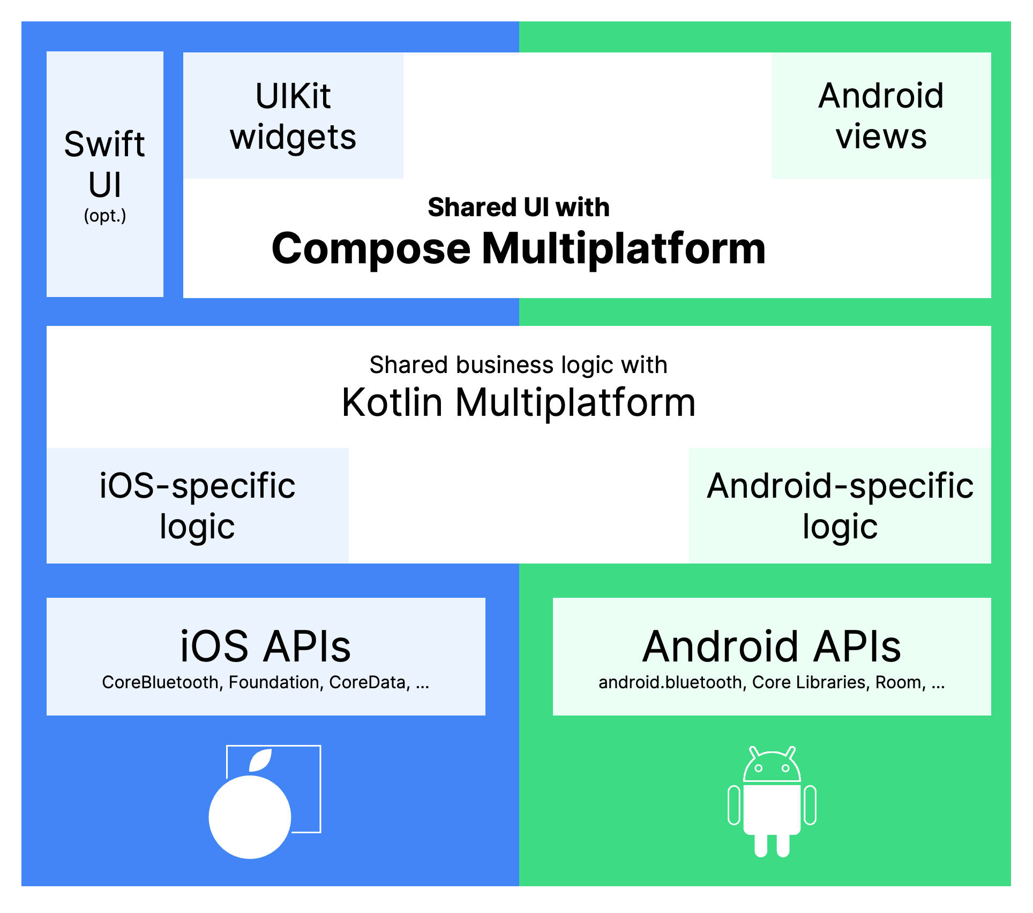
Kotlin Multiplatform & Compose Multiplatform
Hot off the presses: https://blog.jetbrains.com/kotlin/2023/05/compose-multiplatform-for-ios-is-in-alpha/

Slide 19
Let's jump right in
😱But I don't know Kotlin….!
No worries – just getting a feel for things.

Slide 20
Lab #1
Worth 0.5%
At key points, capture screenshots as indicated. Zip those up and upload to Lea.

Slide 21
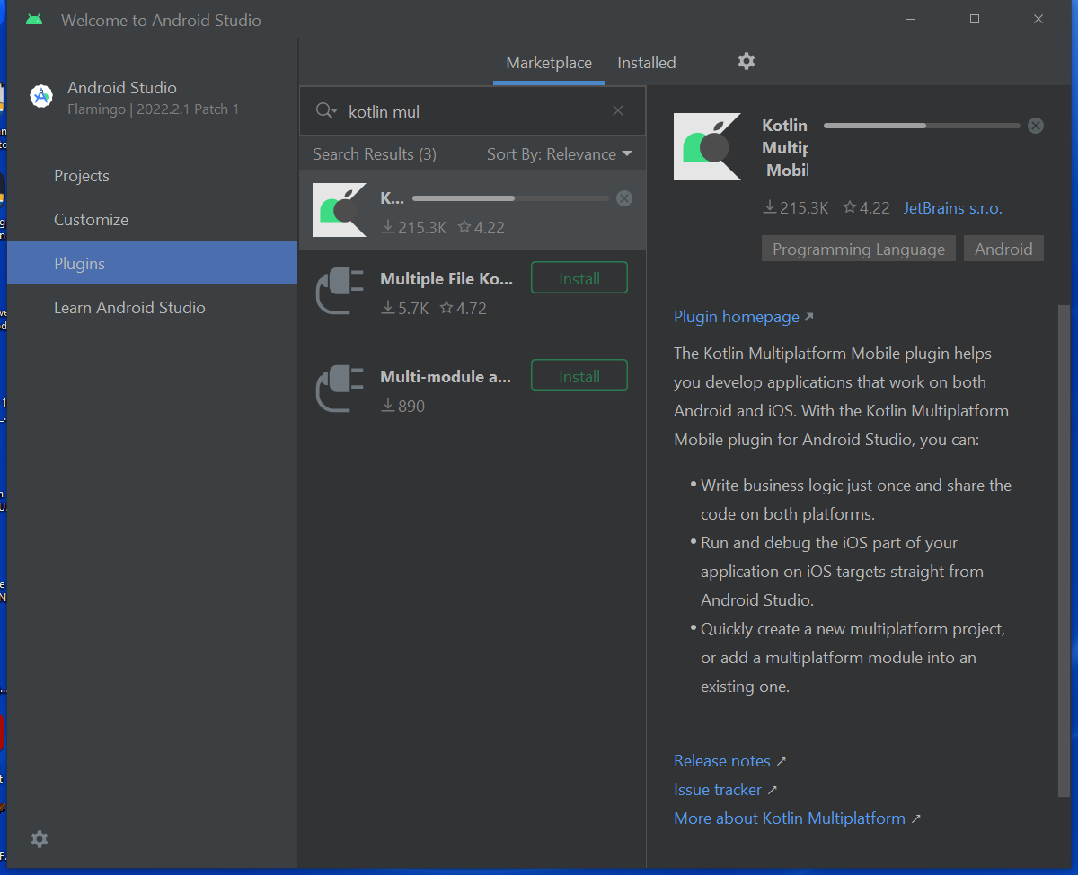
Setup
https://kotlinlang.org/docs/multiplatform-mobile-setup.html
Just Step 1.
Install Android Studio
https://developer.android.com/studio
Choose standard setup when asked
Install JDK
https://www.oracle.com/ca-en/java/technologies/downloads/
In Android Studio, install these plugins:
Kotlin Multiplatform Mobile Plugin (then Restart IDE)
Compose Multiplatform Plugin
On Mac at home: Xcode, Homebrew, kdoctor, cocoapods (see next slide)
Macs at JAC should be properly setup…
Make sure you have a GitHub account and are signed in.

Slide 22
Mac instructions (Only on your own home machine)
Install Java JDK: https://www.oracle.com/ca-en/java/technologies/downloads/
Install Homebrew from terminal:
/bin/bash -c "$(curl -fsSL https://raw.githubusercontent.com/Homebrew/install/HEAD/install.sh)"
Optional: Run a recommended sudo command (shown on screen after homebrew install)
Install kdoctor from terminal
brew install kdoctor
Optional if you are on your own Mac: Run recommended sudo/setup commands (shown on screen after kdoctor command)
sudo chown -R $(whoami) /usr/local/share/zsh /usr/local/share/zsh/site-functions /usr/local/var/homebrew/locks
chmod u+w /usr/local/share/zsh /usr/local/share/zsh/site-functions /usr/local/var/homebrew/locks
sudo chown -R $(whoami) /usr/local/var/homebrew
Open Xcode (because it needs to be launched at least once)
Run the following sudo command in a terminal to get rid of "first launch" warning in kdoctor if it still appears:
sudo xcode-select -s /Applications/Xcode.app/Contents/Developer
(from https://github.com/JetBrains/compose-multiplatform/issues/3186)
sudo gem install activesupport -v 6.1.7.3
sudo gem install cocoapods
Run kdoctor in the terminal. You will probably get the following notice
✖ CocoaPods requires your terminal to be using UTF-8 encoding. Consider adding the following to ~/.bash_profile export LC_ALL=en_US.UTF-8
In your user folder (cd ~), create a .bash_profile with the contents: export LC_ALL=en_US.UTF-8
Upgrade Android Studio to the latest version (Flamingo 2022.2.1) if you have an older version installed.
On a Mac with M1 chip, you need to use rvm:
https://jeffreymorgan.io/articles/ruby-on-macos-with-rvm/
https://rvm.io/rvm/install
https://kotlinlang.org/docs/native-cocoapods.html#22e3fe9e

Slide 23
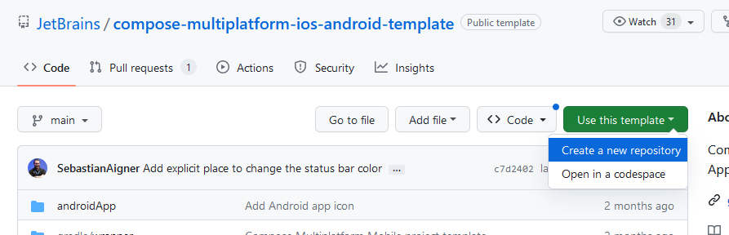
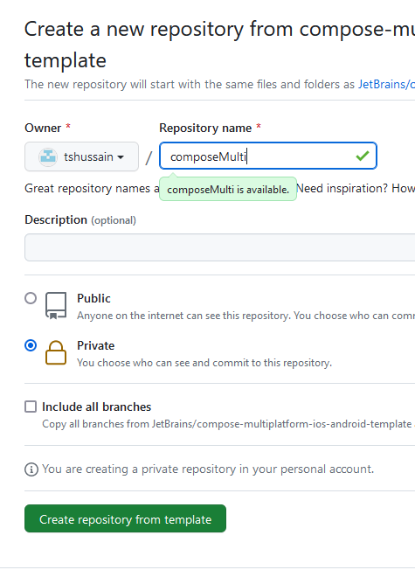
Compose Multiplatform
https://www.jetbrains.com/lp/compose-multiplatform/
Since Compose Multiplatform is in Alpha for iOS, we'll grab a template project that JetBrains has created for us.
Go to https://github.com/JetBrains/compose-multiplatform-ios-android-template#readme
Choose "Use this Template"
Then "Create a new repository"
Give the repository a name
Suggest you make it "Private"

Slide 24
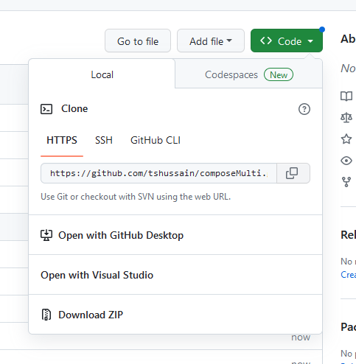
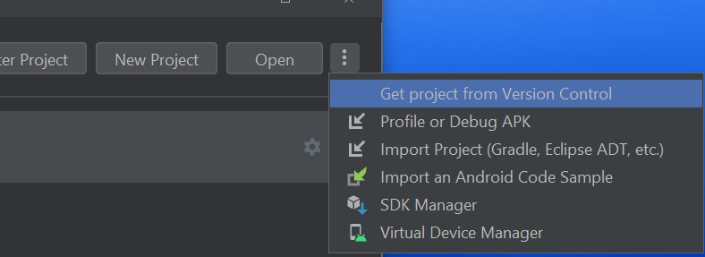
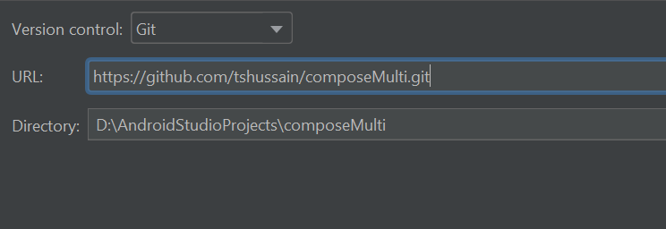
Load project in Studio
Copy the git clone link for your project.
In Android Studio, create a new project by "Get Project from Version Control"
It will take some time to build the project

Slide 25
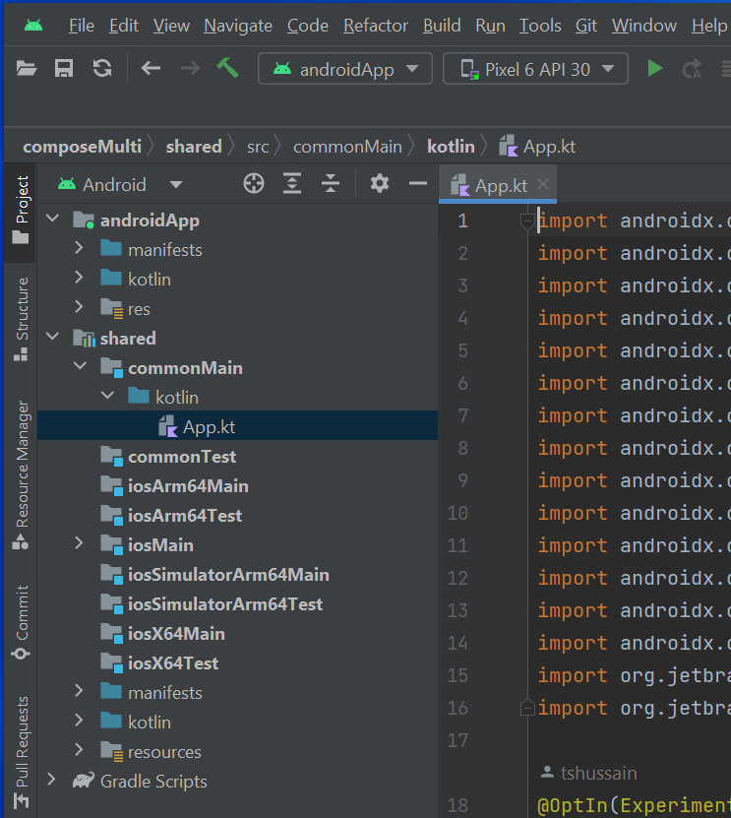
Let's Explore
Open the Project pane and explore the directory structure
Notice the 'shared' folder – This will hold our code that will be in common for both platforms (Android and iOS)
If you are all setup properly, you should be able to click the green Run arrow.
Note: You need to have an emulator installed
If not, load Device Manager pane and "Create Device"
You should see your app running in the emulator in the "Running Devices" tab
Click the "Hello World" button

Slide 26
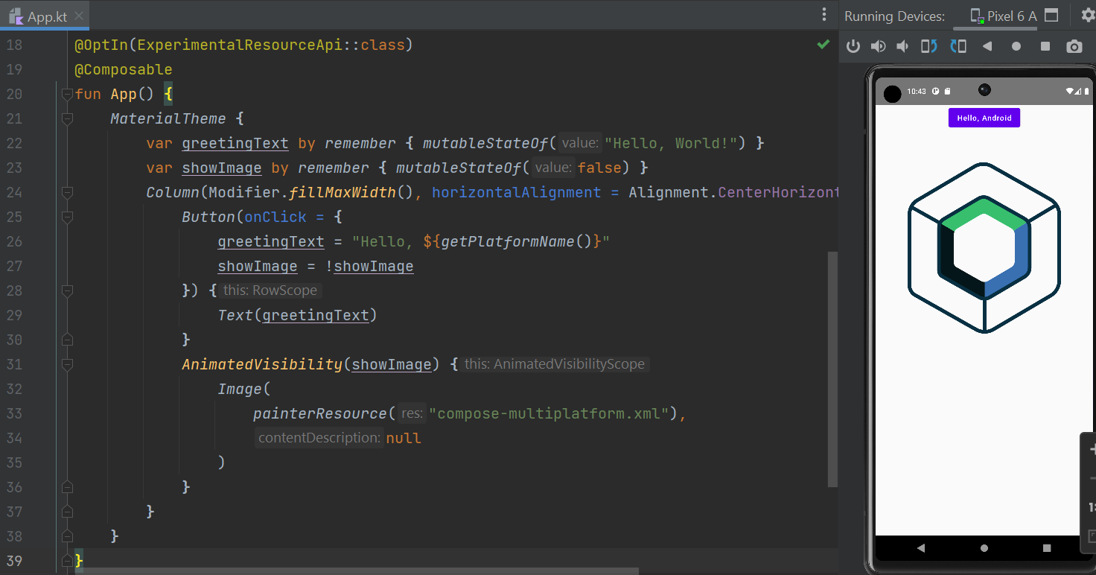

Slide 27
Similarity to React
Notice the rough similarity to React JSX
Nested UI components
@Composable indicates a UI component much like a JSK component
Named "properties" on components
Really are named parameters to functions in Kotlin
"Single Activity" design pattern
Similar in rough concept to single page app design of React
State management and re-render UI when state changes

Slide 28
That sure doesn't look like Java…
fun?
var?
Where are the semi-colons?
… ExperimentalResourceApi – yikes!
Welcome to alpha/beta…

Slide 29
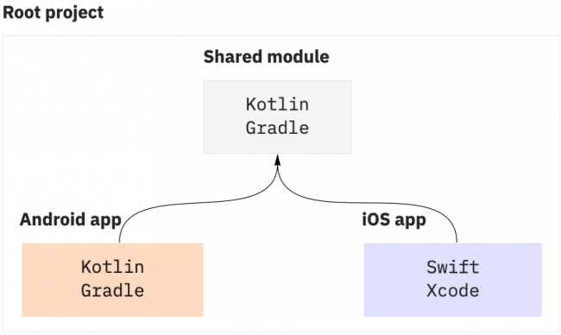
Notes:
Image from https://www.kodeco.com/19144111-kotlin-multiplatform-project-for-android-and-ios-getting-started

Slide 30
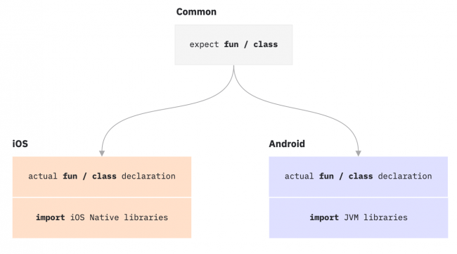

Slide 31
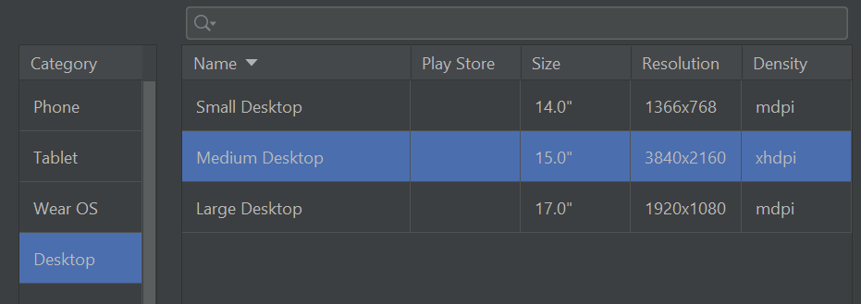
Let's also run it as a Desktop App!
Device Manager – Create Device
Pick a desktop and complete the steps.
It may take a while to download.
Then Change the run target and run.

Slide 32
Capture screenshot showing both the desktop and Android emulator running.
Save with a name like "Lab1_a"

Slide 33
Let's run it as an iOS App…
If you're running a PC, sign in to a Mac computer online using Splashtop
Use chat to say which computer you are using so no 2 people are on the same machine.
Teacher is on BH408-01.
Open a terminal and run kdoctor
It should give you all green checkmarks except perhaps the following:
✖ CocoaPods requires your terminal to be using UTF-8 encoding. Consider adding the following to ~/.bash_profile export LC_ALL=en_US.UTF-8
If so, then in your user folder (cd ~), create a .bash_profile with the contents: export LC_ALL=en_US.UTF-8
Open Android Studio and follow the earlier instructions to pull down the sample project. Run against an iPhone device.

Slide 34
Capture screenshot showing the iOS emulator
If you can, try to get all 3 emulators running on the same screen… cool.
Save with a name like "Lab1_b"
Upload Lab1_a & Lab1_b to Lea.

Slide 35
Kotlin
General-purpose, statically-typed, open-source language
Created by JetBrains – the company who built IntelliJ IDEA and Android Studio
v1.0 released 2016
It runs on a Java Virtual Machine (JVM) and can be used anywhere Java is used
Somewhat similar to Java, but has many simplifications in syntax and a variety of modern capabilities, such as null safety
Avoid boilerplate code
Avoid specifying types when unnecessary
Android mobile development has been "Kotlin-first" since 2019
Over 95% of the top thousand Android apps use Kotlin.
https://kotlinlang.org/docs/android-overview.html
Used by over 60% of professional Android developers
https://developer.android.com/kotlin
100% Java interoperable
Can call Java code from Kotlin and Kotlin code from Java
https://kotlinlang.org/docs/java-interop.html
https://kotlinlang.org/docs/java-to-kotlin-interop.html

Slide 36
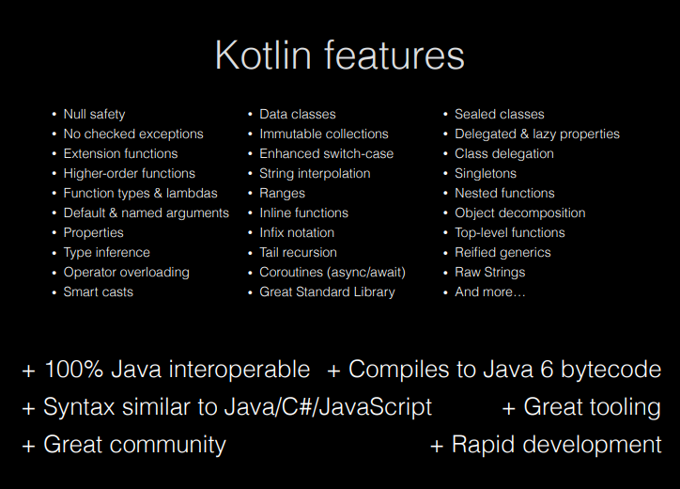
Concepts
Null safety
Composable UI design
Declarative UI

Slide 37
Intro to Kotlin
https://play.kotlinlang.org/byExample/overview
https://developer.android.com/teach#teach-a-class
https://www.w3schools.com/KOTLIN/index.php
https://kotlinlang.org/docs/home.html
https://eecs441.eecs.umich.edu/
https://www.slideshare.net/GoogleDevelopersLeba/android-development-with-kotlin-course
Codelabs:
https://developer.android.com/codelabs/basic-android-kotlin-compose-functions#0

Slide 38
Some basics that are the same as in Java
Comments // or /* */
Operators: + - * / % ++ -- = += -= *= /= %= == != > < >= <= && || !
if / if-else / if-else-if
while / do-while
break / continue / return
(Though Kotlin adds ability to use labels)
Index arrays/strings starting at 0
How to access an array element

Slide 39
Some basics that differ from Java
Semicolons are optional
Declaring functions, parameters, return types
Declaring variables / constants
Specifying types is optional
No primitive types - All types are objects (hence capitalized)
Using Strings varies in some ways – can use == (!!)
Easy string interpolation using $
How to create an array, list, etc.
Use arrayOf(), listOf(), arrayListOf(), etc

Slide 40
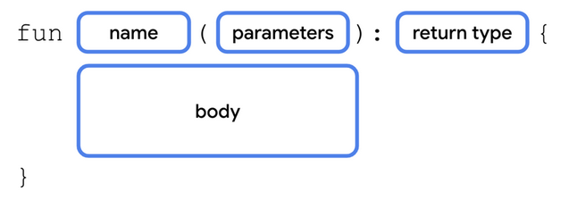
Functions
The fun keyword is used to declare a function
fun main() {
println("Hello World")
}
We don't need to add 'public' since public is the default visibility in Kotlin
Semicolons are optional!! But, this means that line breaks are significant.
When a function has parameters, you must specify the type.
The type is written after the parameter name and preceded by a colon
fun greeting(message: String) {
println(message)
}
If a function returns something, you must specify the return type
The return type is written after the parentheses containing the parameters and preceded by a colon (and is before the brace)
fun augmentMessage(message: String) : String {
return "This is the message: " + message;
}
If a function returns nothing, you can omit the type or use the special return type Unit
No 'void'

Slide 41
Try it as we go…
In App.kt, replace "Hello World" with a call to greeting() with an appropriate argument
In the App.kt file, define a function called greeting.
As we learn more about functions and variables, play around with the function definition and the function call to try variations out.
To see the results of a println in Android Studio, select View > Tool Windows > Logcat

Slide 42
Functions: Named arguments
fun greeting(name: String, age: Int) {
println ("Hello $name, you are now $age old")
}
Note: That's string interpolation – cool.
Kotlin functions can be called using named arguments
A named argument provides the name of the parameter in the calling line with an = sign and the value being passed in
greeting(name="Xing", age=15)
Order of named parameters doesn't matter
greeting(age=15, name="Xing") also works
Named and positional parameters cannot be mixed unless you retain order

Slide 43
Functions: Default arguments
A parameter in a function can be specified with a default value by using the assignment operator and provided the value
fun greeting(name: String = "Unknown", age: Int = 10) {
println ("Hello $name, you are now $age old")
}
Some, all or none may have default values.
When calling a function, a parameter with a default argument may be omitted. In that case, the default value will be used.
Typically, you will use named parameters when omitting a parameter
But, as long as the omitted parameters are last in the parameter list, you can use positional parameters as well. The following are all valid
greeting (age=5)
greeting(name="Joe")
greeting("Jane")
These are not valid
greeting(5)
greeting(age=5, "Juan")

Slide 44
Single Expression Functions (or "One-Line Functions")
If you have a function that has just a single expression, the curly braces are optional
fun convertToFahrenheit(degree : Float) : Float {
return (degree * 9 / 5) + 32
}
can be simplified to
fun convertToFahrenheit(degree : Float) = (degree * 9 / 5) + 32
Applies for almost every type of expression:
fun getResult(percentage : Int) = if (percentage > 40) "Pass" else "Fail"

Slide 45
Variables
The var keyword is used to declare a variable that may change in value
The val keyword is used to declare a constant
var name = "Joe"
val birthyear = 1985
Use of val is recommended where possible.
Cool feature → We don't have to specify a type – Kotlin will figure it out based on the first assignment.
Once a type is assigned, it can't be changed.
But, we can still specify a type if we wish. Unlike Java, the type is written after the variable name and preceded by a colon
var name: String = "Joe"
val birthyear: Int = 1985

Slide 46
Types
Main types are:
Int
Double
Char
Boolean
String
Also: Float, Long, Short
Note: All capitalized.
Conversion:
You can convert one type to another using a toXXX() method on the object
value1.toInt()
value2.toString()
Still have Double.MIN_VALUE, etc.

Slide 47
Note: Similarity to other languages
Notice how using optional named parameters with default values in Kotlin results in an effect similar to JSX specifying a component with only some props specified
Functions: Similarity to Swift
Note: There is a lot of similarity of syntax with Swift here
Use of "fun" is close to "func" in Swift
Specification of type using colon after the parameter name
Specification of return type after parameter list (but with colon instead of arrow)
Named parameters (but some rules are a bit different)
In Kotlin, don't have to use names of parameters when calling the function (in Swift, need to add underscore in order avoid using name, and then can't use name at all)
No argument labels
Variables: Similarity to Swift
Same use of colon notation with type after variable name
Same use of var
val instead of let for constants
Types: Similarity to Swift
Most type names are the same (Char instead of Character)
https://www.kodeco.com/6754-a-comparison-of-swift-and-kotlin-languages

