Slide 1

Related Technologies for Multiplatform Applications
420-731-AB
Instructor: Talib Hussain
Day 2: More Kotlin Basics
Notes:
Image from: https://img.freepik.com/premium-photo/phone-mobile-application-development-concept-mobile-internet-3d-illustration_76964-5164.jpg?size=626&ext=jpg

Slide 2
Objectives
Kotlin Basics, continued
Strings
Arrays
Lists
Kotlin Operations
Loops
Ranges
When
Functional Programming
Lambda functions
.map, .filter
Kotlin Object-Oriented Programming
Classes
Constructors
Inheritance
Null safety
data classes
Begin Group Formation

Slide 3
More differences
How to create an array, list, etc.
Use arrayOf(), listOf(), arrayListOf(), etc
No traditional for loop
Only a "for ( … in …)" loop
repeat loop
Ranges are new
when instead of switch
Behaves slightly differently
Main difference is no break needed.
Classes have a variety of differences with many shortcuts/new capabilities
No new keyword when creating objects
Default visibility is public and visibility modifiers vary slightly
Classes are not inheritable by default. Need to use keyword open.
Functions are not overridable by default. Need to be in open class, use open keyword and use override keyword.
Lambda
Map/Filter operations

Slide 4
Strings
Access string characters using array notation
name = "Jane"
println(name[0]) would print 'J'
Can use triple quotes to assigned any arbitrary text
val text = """
var age = 5
// This is a comment
"""
Note: whitespace and line breaks are included...
String templates
Starts with a $ and can be a simple value or an expression in { }
val name = "Ginger"
println("$name.length is ${name.length} ")
println("Computed number is ${name.length * 2 + 1}")
>Ginger.length is 6
>Computed number is 13
Comparison
Can use == to compare strings (yay!) This is like .equals() in Java
Also .equals(), .compareTo(), indexOf()
.upperCase(), .lowerCase() and many more
Can also use === (triple equals) to check if two variables are pointing to the same object (i.e., this is like == in Java).

Slide 5
Arrays
Implicit type declaration
val nums = arrayOf(1, 2, 3, 4) //implicit type declaration
Explicit type declaration
val nums = intArrayOf(1, 2, 3, 4)
val nums = arrayOf<Int>(1, 2, 3, 4)
Create an array with a set of default values
var nums = Array<Int>(4, { 0 })
var nums = IntArray(4, { 0 })
var nums = IntArray(4, { it }) – special keyword it
var nums = IntArray(4, { it + 1})
Created an array with mixed types
var nums = arrayOf(2, "s", 4.0,2F)
Get size of array using size property
nums.size

Slide 6
Lists, etc.
Several types of collections (List, Set, Map, etc.)
https://kotlinlang.org/api/latest/jvm/stdlib/kotlin.collections/
https://www.geeksforgeeks.org/kotlin-collections/
Create a list using listOf():
https://kotlinlang.org/api/latest/jvm/stdlib/kotlin.collections/list-of.html
ArrayList: arrayListOf()
https://kotlinlang.org/api/latest/jvm/stdlib/kotlin.collections/array-list-of.html

Slide 7
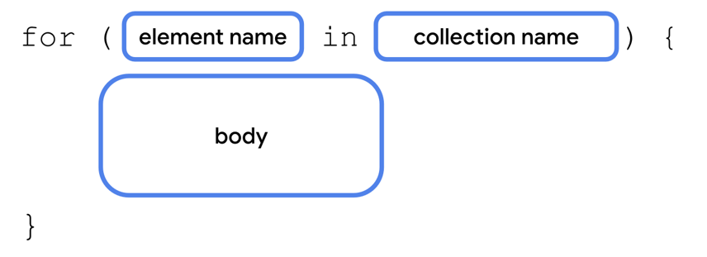
for – in loop
In Kotlin, there is no traditional "for" loop (e.g., no counting over index values…)
Instead, a for – in loop is used.
Kotlin just calls it a for loop. But for – in helps distinguish it from the "usual"
This is used to iterate over elements in a collection
Similar in functionality to for – in loop in Swift and for – each loop in Java.

Slide 8
Try It!
Spend 20 minutes creating and calling different functions that use parameters, variables, types, strings, arrays and lists in different ways.
Goal: Become familiar with the new syntax
Explore https://www.w3schools.com/KOTLIN/kotlin_examples.php
Up to "Kotlin For Loop" (skip When)
CodeLabs to Explore:
Functions: https://developer.android.com/codelabs/basic-android-kotlin-compose-functions#0
Collections: https://developer.android.com/codelabs/basic-android-kotlin-compose-collections#0
Up to end of Lists

Slide 9
when statement
Kotlin does not have a switch statement, but does provide a when statement that behaves similarly
val option = 3
val result = when (option) {
1 -> "Choice 1"
2,4 -> "Choice 2 or 4"
3 -> "Choice 3"
else -> "Invalid Choice"
}
https://www.w3schools.com/KOTLIN/kotlin_when.php
This replaces the use of multiple if .. else expressions
Unlike a switch in Java, you do not need a "break" between cases.
else is not needed if it is unreachable
when statement is very flexible and can be used in several interesting ways.
https://blog.mindorks.com/replace-switch-with-when-in-kotlin/

Slide 10
Ranges
Kotlin allows you to explicitly express a range of values using the .. notation
Most often used with for – in loop
for (x in 1..10) {
}
Can use a step function
for (x in 1..10 step 2) {
}
A range may be over characters
for (c in 'a'..'x') {
println(c)
}
Use downTo to specify a range that is decreasing
for (x in 10 downTo 1) {
}
You can also check whether a value is in a given range using an if statement
if (y in 1..100) {
}
https://www.baeldung.com/kotlin/ranges
https://www.w3schools.com/KOTLIN/kotlin_ranges.php

Slide 11
Lambda Expressions
Lambda expressions are functions that do not have a name which are defined without the fun keyword
Used immediately as an expression
Can help your code be more concise
They are essentially code inside of curly braces
{ body_of_function }
They may take variables as arguments
{ argument_list -> body_of_function}
Special keyword "it"
Implicit name of a single parameter
We'll see this later in .filter and .map
https://student.cs.uwaterloo.ca/~cs346/1231/learning-kotlin/functional/index.html
https://www.geeksforgeeks.org/kotlin-lambdas-expressions-and-anonymous-functions/
https://www.baeldung.com/kotlin/lambda-expressions

Slide 12
repeat loop
Since we can't easily use a for loop for counting, Kotlin provides a simple "repeat" function that loops a fixed number of times.
It is a function followed by a lambda
repeat(number) {
}
Repeats the loop the given number of times.
https://kotlinlang.org/api/latest/jvm/stdlib/kotlin/repeat.html
// greets with an index
repeat(3) { index ->
println("Hello with index $index")
}

Slide 13
Using functional programming techniques
Kotlin allows you to use a variety of functional programming operations on collections
Two common ones are .filter and .map
Many others exist
These exist in other languages such as JavaScript and Swift
The syntax in Kotlin is to call the function on an object and provide it with a lambda expression in curly braces.
These operations may be chained together
val list = listOf(1,2,3,4,5)
// Filter by given predicate and return the list of elements that match the predicate
val selecteditems = list.filter { it < 4 }
// Apply the same operation to each element of the list and return the new list
val transformedItems = list.map { it*it }
// Chain operations together
val selectedAndTransformedItems = list.filter { it < 4 }.map { it*it }

Slide 14
Store a function in a variable
Use the :: notation to store a function in a variable
fun main() {
val trickFunction = ::trick
}
fun trick() {
println("No treats!")
}
Or, use a lambda expression to define the function. Store that lambda in a variable.
fun main() {
val trickFunction = trick
trick()
trickFunction()
}
val trick = {
println("No treats!")
}
https://developer.android.com/codelabs/basic-android-kotlin-compose-function-types-and-lambda#2

Slide 15
Try It!
Spend 20 minutes exploring when, ranges, lambda functions, functional programming, etc. in detail
Goal: Become familiar with the new syntax
Explore https://www.w3schools.com/KOTLIN/kotlin_examples.php
When and Ranges
CodeLab to Explore:
Lambdas: https://developer.android.com/codelabs/basic-android-kotlin-compose-function-types-and-lambda#3

Slide 16
OOP in Kotlin
A basic class in Kotlin is similar to one in Java
class Car {
var brand = ""
var model = ""
var year = 0
fun updateModel(newmodel: String){...}
...
}
"Fields" (from Java) are generally called properties
"Methods" (from Java) are called class functions
But, visibility is public is default
private – only visible in that file
internal – visible within same module
protected - visible inside that class AND that it is also visible in subclasses
https://www.baeldung.com/kotlin/visibility-modifiers

Slide 17
Constructor
For a simple class, we can just define a constructor
We don't have to explicitly define all the fields, etc.
class Car(var brand: String, var model: String, var year: Int)
Constructor arguments can have default values
class Car(var brand: String, var model: String = "Unknown", var year:Int = 2022)
When calling a constructor in Kotlin, we don't use the 'new' keyword
val c1 = Car("Ford", "Mustang", 1969)
Multiple constructors are possible (self-study).

Slide 18
Sample class with constructor & functions
class Car(var brand: String, var model: String, var year: Int) {
// Class function
fun drive() {
println("Wrooom!")
}
// Class function with parameters
fun speed(maxSpeed: Int) {
println("Max speed is: " + maxSpeed)
}
}

Slide 19
Setting values
Unlike java, the getter and setter for a property of a class simply uses the name of the property
i.e., not getX(), setX().
val car = Car("Honda", "Camry", 2023)
println(car.brand) Access with .<property name>
car.model = "Civic" Set with .<property name>
println(civis.name)

Slide 20
No Static…
Kotlin does not have the static keyword.
If you want to create the equivalent to a static method in Kotlin, you can use "companion objects"
Companion objects are the singleton objects whose properties and functions are tied to a class but not to the instance of that class. Hence, we can access them just like a static method of the class.
Note that only one companion class is allowed per class. More than one companion object per class will lead to a runtime error in Kotlin.
class MyClass {
companion object{
fun myStaticMethod(): String{
return "This method can be called without object"
}
}
}
fun main(args: Array<String>) {
println(MyClass.myStaticMethod())
}
https://medium.com/@waqarul/kotlin-static-member-fields-and-singletons-b79fd65aaf9b

Slide 21
Inheritance
To allow a class to be subclassed, it must be defined with the keyword open.
A class extends another using the colon syntax below:
// Superclass
open class MyParentClass {
val x = 5
}
// Subclass
class MyChildClass: MyParentClass() {
fun myFunction() {
println(x) // x is now inherited from the superclass
}
}

Slide 22
Inheritance
To allow a class to be subclassed, it must be defined with the keyword open.
A class extends another using the colon syntax below:
// Superclass
open class MyParentClass {
val x = 5
}
// Subclass
class MyChildClass: MyParentClass() {
fun myFunction() {
println(x) // x is now inherited from the superclass
}
}
If the parent has constructor values, must also pass the appropriate constructor values when subclassing.
open class MyClass(var value:Int)
class SubClass(var value:Int, var otherValue:String): MyClass(value)

Slide 23
Overriding Functions
A function of a parent class cannot be overridden in a subclass unless the function in the parent is declared open.
The override keyword must also be used when defining the overridden function.
open class MyClass(var value:String) {
open fun myFunction() {
println(value)
}
}
class SubClass(var value:String, var otherValue:String): MyClass(value) {
override fun myFunction() {
println(otherValue);
}
}
Elsewhere:
val x = MyClass("Hi")
val y = SubClass("Hi", "Bye")
x.myFunction()
y.myFunction()
Should print out "Hi" then "Bye"

Slide 24
Try It!
Spend 20 minutes exploring Kotlin OOP in detail
Goal: Become familiar with the new syntax
Explore https://www.w3schools.com/KOTLIN/kotlin_examples.php
Classes section
Details at:
https://docs.google.com/presentation/d/1FSZwOeSwL-XNkMXnKDy-YPMEpCPKyb29RlpekSzzJDY/edit#slide=id.gb9961b3fa0_0_433
CodeLab to Explore:
https://developer.android.com/codelabs/basic-android-kotlin-compose-classes-and-objects#0

Slide 25
Null Safety
Kotlin is designed as a null safe language
By default, variables in Kotlin cannot be set to null.
There is a special nullable type which allows you to use nulls subject to certain rules.
https://medium.com/mobile-app-development-publication/swift-optional-and-kotlin-nullable-a-comparison-773227f277c3
Or, use cached version if can't access Medium
http://webcache.googleusercontent.com/search?q=cache:ej4eG6pKOeoJ:https://medium.com/mobile-app-development-publication/swift-optional-and-kotlin-nullable-a-comparison-773227f277c3&client=firefox-b-d&hl=en&gl=ca&strip=1&vwsrc=0

Slide 26
Null Safety: Cannot assign null to a normal variable
var str: String = "xyz"
str = null // Compile-time error
vs.
var str: String? = "xyz"
str =null // OK

Slide 27
Null Safety: Nullable parameter must be handled properly
fun getLength(str: String): Int? {
return str.length // OK
}
vs.
fun getLength(str: String?): Int? {
return str.length // Compile-time error
}
Since str could be null, checking it's length opens you up to the possibility of a null pointer error.

Slide 28
Several ways to handle
Can explicitly check for null ("old-school" way)
fun getLength(str: String?): Int? {
if (str != null) {
return str.length // OK
}
return 0
}
Or can use the safe call operator ?.
fun getLength(str: String?): Int? {
return str?.length // OK
}
This returns null if the given str string is null

Slide 29
Java vs. Kotlin Example
// Java
public ZipCode getZipCode(User user) {
if (user != null) {
if (user.getAddress() != null)
return user.getAddress().getZipCode();
}
}
return null;
}
vs
//Kotlin
fun getZipCode(user: User?): ZipCode? {
return user?.address?.zipCode;
}
Or, even more concisely
//Kotlin
fun getZipCode(user: User?): ZipCode? = user?.address?.zipCode

Slide 30
Java vs. Kotlin Example
// Java
public ZipCode getZipCode(User user) {
if (user != null) {
if (user.getAddress() != null)
return user.getAddress().getZipCode();
}
}
return null;
}
Vs

Slide 31
Data classes
Kotlin offers different types of classes, e.g.,
data classes
enum classes
sealed classes
Data classes are a very useful concise way to define a class whose purpose is to store data.
E.g., Similar to a "POJO" – plain old Java object or JavaBean
https://antonioleiva.com/data-classes-kotlin/

Slide 32
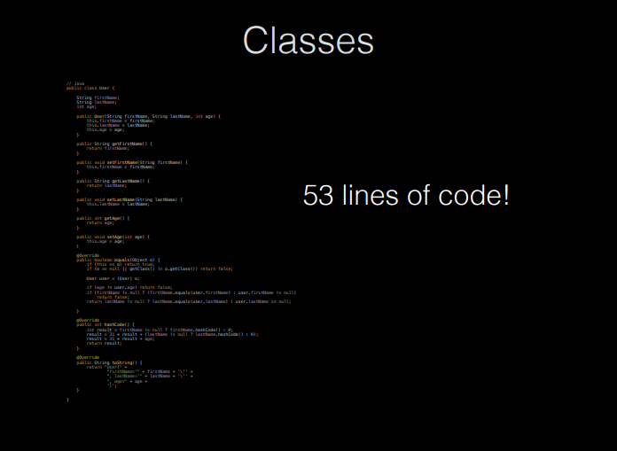

Slide 33
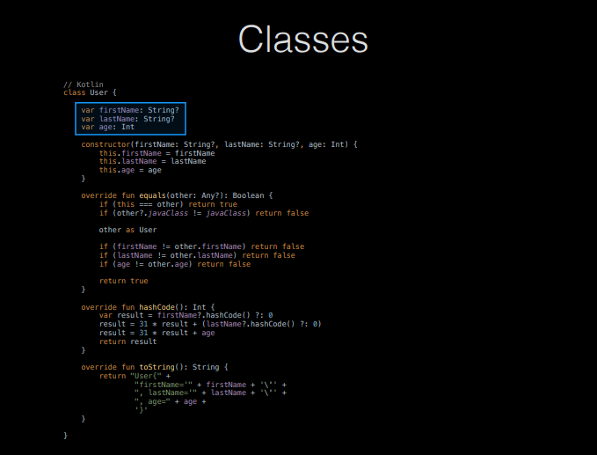

Slide 34
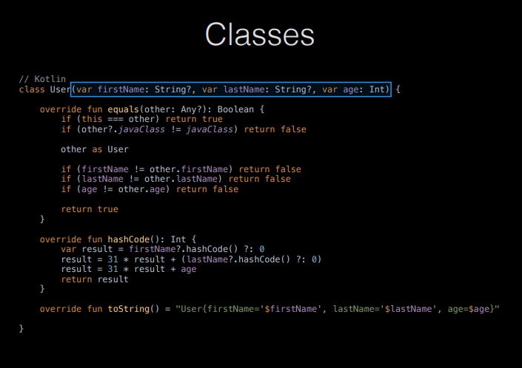

Slide 35
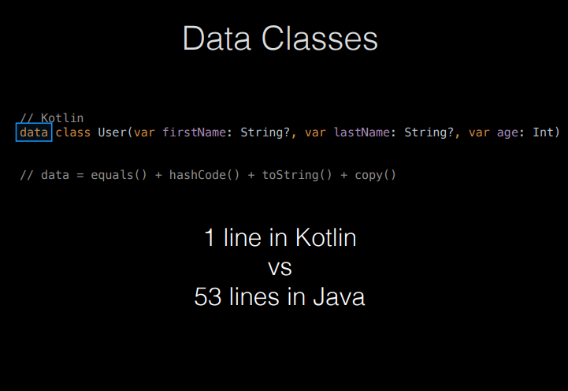

Slide 36
Exercise
Worth 1%
Do as many of the coding problems at the following site as you can until time indicated by teacher.
https://developer.android.com/codelabs/basic-android-kotlin-compose-kotlin-fundamentals-practice-problems#0
Note: The Internet profile and Special auction problems have nullable parameters. You can skip them if they are too complicated for you to understand.
Take a screenshot of your final code for each solution.
When time is up, submit zip of all your screenshots to Lea

Slide 37
Group Exercise
Share ideas for Apps in a shared google doc.
Try to find others with shared interests
Discuss group formation

