Slide 1

Related Technologies for Multiplatform Applications
420-731-AB
Instructor: Talib Hussain
Day 4: Dynamic/Interactive UI
Notes:
Image from: https://img.freepik.com/premium-photo/phone-mobile-application-development-concept-mobile-internet-3d-illustration_76964-5164.jpg?size=626&ext=jpg

Slide 2
Objectives
Using Material
Mutable State
Basic Event Handling
Basic I/O
Basic Form

Slide 3
Assignment #1: Single screen Kotlin Multiplatform / Compose Multiplatform App
Worth 5% of grade. Due Apr 11 by 4:00pm. This is an individual assignment.
For this assignment, you will create a single screen mobile app that runs on one platform (iOS or Android), and uses the multiplatform technologies taught in class.
The topic of the app is of your choice
Recommendation: Choose a screen/subject that aligns with your project. Try to focus on something different than your teammates.
The app must:
Be based on the Compose Multiplatform template and programmed in Kotlin
Use Material design
Contain multiple components and show good attention to layout
Show reasonable attention to styling/theming
Get user input (button and/or text input)
Update what is on the screen based on user input (using mutableState)
The code must be documentation internally and contain a Readme file
The internal documentation should be informative and meaningful (i.e., not vacuous)
The Readme should give a high level indication of what the product is and how to use it. If there are any known issues, they should be described/explained in the Readme. The Readme file should live at the root level of the project.
The code must compile and run.
If you submit something with compile errors or that shows no meaningful output, a high penalty will be assessed, as appropriate.
The app should be usable – with clear wording/instructions and understandable, easy-to-use interface

Slide 4
Assignment #1: Single screen Kotlin Multiplatform / Compose Multiplatform App
Marking Scheme:
40% Functionality
20% Styling/Layout
20% Documentation
20% Usability/Design
10% Bonus: Works on both iOS and Android!
Submission:
Submit zip file of entire project on Lea.
ALSO (i.e., in addition to not instead of a zip file)… please invite me to your GitHub or somehow provide me access to clone it.
Late Penalty:
Late submissions lose 10% per day to a maximum of 1 day (specifically: midnight the next day)
Nothing accepted after 1 day without prior arrangement and a grade of zero may be given.
Strong Recommendation: Submit incomplete version ON TIME with explanation of what is not done. Submit completed version the next day. This will likely result in a lower penalty than just submitting late.
Original work!
"Your submitted work must be clear, complete, and YOUR OWN. You must be prepared to explain any of your work to me in person. Failure to be able to defend your work, or do a similar question in front of me in person can/will void any grade you get on this assignment."
Any code snippets copied or highly inspired from a 3rd party source must be explicitly indicated in the code documentation or Readme. The total amount of such non-original code should be a small portion of your code.

Slide 5
Material
Material is a design system created by Google to help teams build high-quality digital experiences for Android, iOS, Flutter, and the web.
It provides a number of components and layouts available as composable functions in Compose
Note: These components are also available in React and other languages.
Read about it here:
https://m3.material.io/get-started
https://developer.android.com/jetpack/compose/layouts/material

Slide 6
MaterialTheme
Generally, we use the MaterialTheme component at the highest level. This provides theme value (colors, shapes, etc) that are used by the various Material components.
https://developer.android.com/reference/kotlin/androidx/compose/material3/package-summary#materialtheme
https://developer.android.com/codelabs/basic-android-kotlin-compose-material-theming#2
Often, we just stick with the defaults by using it without parameters
@Composable
fun MyApp() {
MaterialTheme {
// Material Components like Button, Card, Switch, etc.
}
}

Slide 7
Other Material UI Components
There are many Material components we can use.
https://developer.android.com/reference/kotlin/androidx/compose/material3/package-summary
Buttons
https://m3.material.io/components/all-buttons
https://developer.android.com/reference/kotlin/androidx/compose/material3/package-summary#Button(kotlin.Function0,androidx.compose.ui.Modifier,kotlin.Boolean,androidx.compose.ui.graphics.Shape,androidx.compose.material3.ButtonColors,androidx.compose.material3.ButtonElevation,androidx.compose.foundation.BorderStroke,androidx.compose.foundation.layout.PaddingValues,androidx.compose.foundation.interaction.MutableInteractionSource,kotlin.Function1)
Card – Several types of card variants
https://m3.material.io/components/cards/overview
https://developer.android.com/reference/kotlin/androidx/compose/material3/package-summary#card
Card(
onClick = { /* Do something */ },
modifier = Modifier.size(width = 180.dp, height = 100.dp)
) {
Box(Modifier.fillMaxSize()) {
Image(…)
Text("Clickable", Modifier.align(Alignment.Center))
}
}

Slide 8
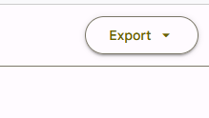
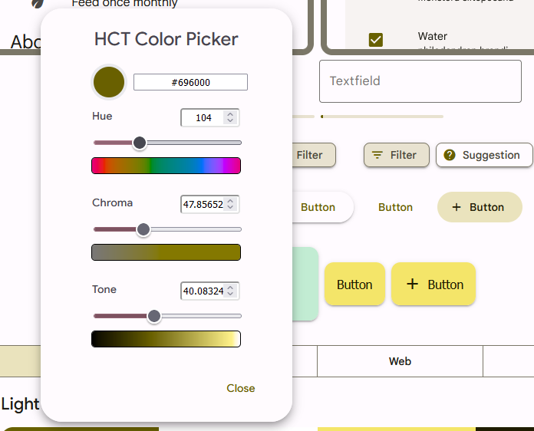
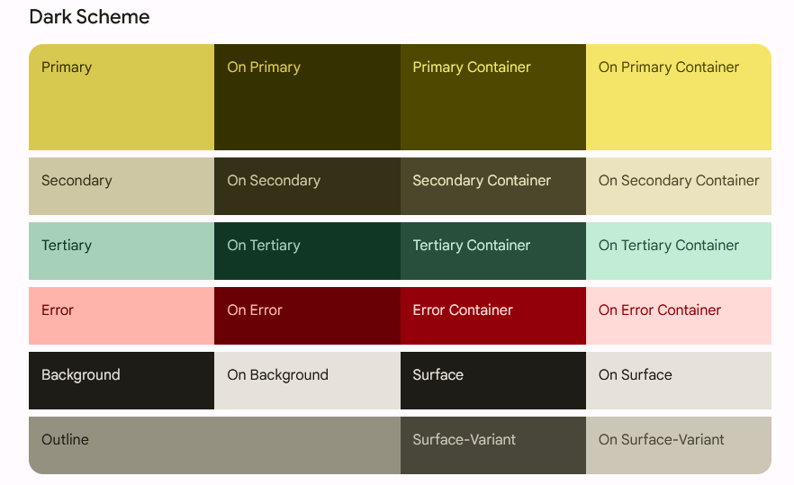
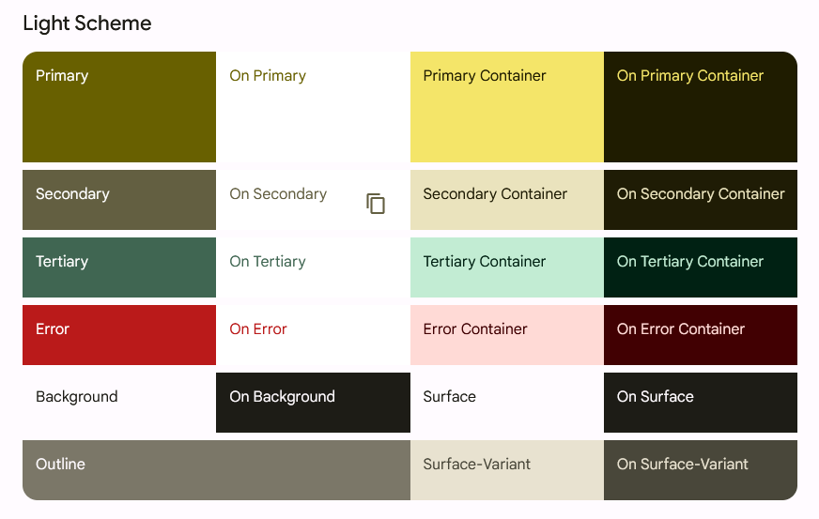
Custom Theme
https://m3.material.io/theme-builder#/custom
https://material.io/blog/material-theme-builder
https://proandroiddev.com/how-to-create-a-truly-custom-theme-in-jetpack-compose-55fb4cd6d655
Click on the Primary color circle to bring up the Color Picker.
Choose your desired colors with the sliders
Can export the theme for Jetpack Compose by selecting the export button near the top right of the web page

Slide 9
Few Tweaks
Copy Color.kt to your project in a commonMain.ui.theme folder
i.e., create the ui subfolder and then create the theme subfolder in that
Use the teacher-provided Theme.kt (in Teams or next slide) and copy that to the same location
Use the teacher-provided Shape.kt (in Teams or slide after next) and copy that to the same location
Make sure the package line at the top of all 3 files says "package ui.theme"
Put @file:OptIn(ExperimentalMaterialApi::class) at the top (line 1) of your App.kt file
Otherwise seems to complain about Card component
In App.kt, import ui.theme.AppTheme
In App.kt, wrap your components in AppTheme rather than MaterialTheme.
E.g.,
fun App() {
AppTheme {
Banner("Jane")
}
}
Now, your Material components should use your new custom color scheme.
You can also refer to colors in the theme explicitly to ensure the components you create are consistent with the theme

Slide 10
Theme.kt
package ui.theme
import androidx.compose.foundation.isSystemInDarkTheme
import androidx.compose.material.MaterialTheme
import androidx.compose.material.lightColors
import androidx.compose.material.darkColors
import androidx.compose.runtime.Composable
private val LightColors = lightColors(
primary = md_theme_light_primary,
onPrimary = md_theme_light_onPrimary,
primaryVariant = md_theme_light_primary,
secondary = md_theme_light_secondary,
onSecondary = md_theme_light_onSecondary,
secondaryVariant = md_theme_light_secondary,
error = md_theme_light_error,
onError = md_theme_light_onError,
background = md_theme_light_background,
onBackground = md_theme_light_onBackground,
surface = md_theme_light_surface,
onSurface = md_theme_light_onSurface
)
private val DarkColors = darkColors(
primary = md_theme_dark_primary,
onPrimary = md_theme_dark_onPrimary,
primaryVariant = md_theme_dark_primary,
secondary = md_theme_dark_secondary,
onSecondary = md_theme_dark_onSecondary,
secondaryVariant = md_theme_dark_secondary,
error = md_theme_dark_error,
onError = md_theme_dark_onError,
background = md_theme_dark_background,
onBackground = md_theme_dark_onBackground,
surface = md_theme_dark_surface,
onSurface = md_theme_dark_onSurface,
)
@Composable
fun AppTheme(
useDarkTheme: Boolean = isSystemInDarkTheme(),
content: @Composable() () -> Unit
) {
val colors = if (!useDarkTheme) {
LightColors
} else {
DarkColors
}
MaterialTheme(
colors = colors,
shapes = ThemeShapes,
content = content
)
}

Slide 11
Change Theme Shapes
If you haven't copied the teacher-provided Shape.kt, then create a file called Shape.kt in ui.theme
Copy the following to Shape.kt
package ui.theme
import androidx.compose.foundation.shape.RoundedCornerShape
import androidx.compose.material.Shapes
import androidx.compose.ui.unit.dp
val ThemeShapes = Shapes(
small = RoundedCornerShape(8.dp),
medium = RoundedCornerShape(4.dp),
large = RoundedCornerShape(0.dp)
)
Using this Shape theme, you can vary the shape of the corners used by some Material components (such as button) to make them more or less rounded at different sizes.
Possible shapes include RoundedCornerShape, CircleShape, CutCornerShape

Slide 12
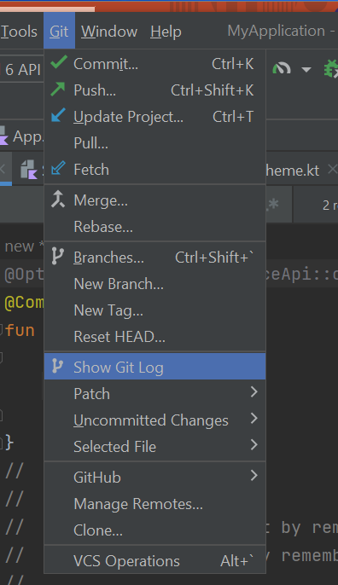
Digression on Git
In class, we talked about how to use Git (commit and push)
= Save points
= Easy collaboration
…
Main point:
Commit and push every time you've finished getting something working.
That way you can get back to a working state if you "get into trouble" later
E.g., can "Show Git Log" and then pick the earlier commit you want to compare your current code to.

Slide 13
Scaffold
A common screen pattern that comes with Material.
https://developer.android.com/jetpack/compose/layouts/material
A Scaffold has the following common elements
title
topBar - https://m3.material.io/components/top-app-bar/overview
Often use a TopAppBar component
https://semicolonspace.com/jetpack-compose-topappbar/
https://medium.com/google-developer-experts/exploring-jetpack-compose-topappbar-c8b79893be34
https://developer.android.com/reference/kotlin/androidx/compose/material3/package-summary#centeralignedtopappbar
bottomBar: https://m3.material.io/components/bottom-app-bar/overview
Often a BottomAppBar
https://developer.android.com/reference/kotlin/androidx/compose/material3/package-summary#bottomappbar
Or a NavigationBar
https://m3.material.io/components/navigation-bar/overview
https://developer.android.com/reference/kotlin/androidx/compose/material3/package-summary#navigationbar
https://itnext.io/navigation-bar-bottom-app-bar-in-jetpack-compose-with-material-3-c57ae317bd00
floatingActionButton
As well as the main content of the component

Slide 14
Scaffold
Very basic example:
Scaffold(
topBar = { TopAppBar(title = { Text("My App") }) },
bottomBar = { BottomAppBar { Text("Copyright (c) 2023 CoolEntertainment, Inc.") } },
floatingActionButton = { FloatingActionButton(onClick = {}) { Text("Click Me")} }
) {
Banner("Jorge")
}

Slide 15
Consistency using Material Formatting
Material offers a number of consistent text formatting options using MaterialTheme.typography
h1, h2, h3, body1, body2, etc.
E.g.,
Text(text="Welcome to My App", style=MaterialTheme.typography.h1)
You can directly use the colors in the theme for consistency across your app using MaterialTheme.colors
E.g., Using a theme-consistent background color:
Column(
modifier = Modifier.padding(24.dp)
.fillMaxSize()
.background(MaterialTheme.colors.background)
You can specify the shape of a component using MaterialTheme.shapes
E.g.,
modifier = Modifier.size(width = 180.dp, height = 180.dp).clip(MaterialTheme.shapes.small)

Slide 16
Misc Formatting/Layouting
Change opacity of an image
Image component has a parameter alpha that can be set of a float value between 0 and 1
E.g., alpha = 0.5F
For a column, verticalArrangement has more than just top Arrangement.Center, .Bottom, .Top. Also have .SpaceBetween, .SpaceAround, .SpaceEvenly.
For a row, horizontalArrangement has several similar options too.
For scaling, there are several options: Crop, Fit, FillBounds, FillHeight, FillWidth, Inside.
Some of these may stretch an image to fit, others may crop an image to fit, and some preserve the complete image.

Slide 17
Advanced
FlowRow, FlowColumn
https://developer.android.com/jetpack/compose/layouts/flow
fillMaxWidth(0.7f) -- Fractional sizing
Responsive design
https://proandroiddev.com/adaptive-ui-with-jetpack-compose-968e375795d4
Old-school: ConstraintLayout
https://developer.android.com/jetpack/compose/layouts/constraintlayout
https://dev.to/saketh/constraint-layout-in-jetpack-compose-create-complex-and-responsive-android-layouts-on-the-fly-47gd

Slide 18
Some sample code snippets
Making a small circular image using clip and crop
Image(
painter = painterResource("penguin.jpg"),
contentDescription = "This image shows penguins",
modifier = Modifier.size(40.dp).clip(RoundedCornerShape(50.dp)),
contentScale = ContentScale.Crop
)
Recall: Box lets you stack components on top of each other

Slide 19
Exercise
Worth 0.5%
Play around with different display variations
Colors
Color Scheme
Text Formatting
Scaling
Layout using Column, Row, Box
Scaffold Layout
Different types of buttons
Etc.
You don't have to do this codelab, but it has some good examples to consult:
https://developer.android.com/codelabs/basic-android-kotlin-compose-add-images#0
When you are done, take one or more screenshots showing what you built.
Zip together all the screenshots and upload to Lea

Slide 20
Examples from Class: BottomBar with Icons
From Ian
bottomBar = {
BottomAppBar {
IconButton(
onClick = {}
) {
Icon(Icons.Filled.Menu, contentDescription = "Description.")
}
IconButton(
onClick = {}
) {
Icon(Icons.Filled.AccountCircle, contentDescription = "Description.")
}
IconButton(
onClick = {}
) {
Icon(Icons.Filled.AccountBox, contentDescription = "Description.")
}
IconButton(
onClick = {}
) {
Icon(Icons.Filled.Call, contentDescription = "Description.")
}
IconButton(
onClick = {}
) {
Icon(Icons.Filled.Add, contentDescription = "Description.")
}
}
}

Slide 21
Examples from Class: Checkboxes
From Garett
items(ingredients.size) { index ->
val isChecked = checkedState[index]
//
Row {
Checkbox(
checked = isChecked,
onCheckedChange = { checked ->
checkedState[index] = checked
if (checked) {
selectedIngredients.add(ingredients[index])
} else {
selectedIngredients.remove(ingredients[index])
}
}
)
Text(
text = ingredients[index],
style = MaterialTheme.typography.body1,
modifier = Modifier.padding(start = 16.dp)
)
}
}
has context menu
Compose

Slide 22
State
Since components are immutable, we must explicitly change state of the component using a mutableState in order to cause the component to be recomposed.
This approach is similar in principle to useState in React.
We must use the keyword 'remember' in order to avoid resetting the state value each time the component is recomposed.
Or, better in some situations, rememberSaveable (see next slide)
The syntax for creating a state variable is:
e.g., val count = remember { mutableStateOf(0) }
The syntax for accessing or modifying the value of a state variable is to use <statevariable>.value
e.g., count.value
E.g.,
@Composable
fun CountWithButton() {
val count = remember { mutableStateOf(0) }
Column(modifier = Modifier.padding(16.dp)) {
Text("You've had ${count.value} glasses.")
Button(onClick = { count.value++ }, Modifier.padding(top = 8.dp)) {
Text("Add one")
}
}
}
https://developer.android.com/jetpack/compose/state
https://developer.android.com/codelabs/jetpack-compose-state

Slide 23
TextField
TextField is a Material composable for getting textual input from the user
To make a good, usable text field, you want to make sure that the field shows the current value typed in by the user and that the component remembers that value in state.
It is also good usability to provide a placeholder for the text field before the user enters any information
The TextField component issues an ValueChange event every time the user changes the information in the test field.
E.g.,
val text = rememberSaveable { mutableStateOf("") }
TextField(
value = text.value,
onValueChange = { text.value = it },
textStyle = TextStyle(textAlign = TextAlign.Center),
label = { Text(text = "Please enter your name")}
)
rememberSaveable behaves similarly to remember, but the stored value will survive the activity or process recreation using the saved instance state mechanism (for example it happens when the screen is rotated in the Android application)
Material also has an OutlinedTextField
https://github.com/JetBrains/compose-multiplatform/blob/master/tutorials/Context_Menu/README.md
https://m3.material.io/components/text-fields/overview
https://developer.android.com/reference/kotlin/androidx/compose/material3/package-summary#textfield

Slide 24
onClickable
You can turn most components into the equivalent of buttons using Modifier.
Modifier.clickable(onClick = {count.value-- },
onClickLabel = "Decrement count")
Note: The optional onClickLabel is for accessibility purposes. It does not actually display on the screen.

Slide 25
Conditional Content
You can change whether a particular component is displayed or not using a conditional statement
Combined with a state variable, this lets you toggle visibility when, say, a user clicks a clickable.
E.g.,
val showImage = remember { mutableStateOf(true) }
Column() {
…
if (showImage.value) {
Image( … )
}
…
… in another composable:
onClick = { showImage.value = !showImage.value }
}

Slide 26
Form
We can create a form in our app using several TextFields and a Button to complete/"submit" the form.
There are a variety of things we can do here:
Include logic to check the validity of the values entered in a text field
E.g., check that a given entry is long enough
Make the "submit" button appear only once something has been entered in all the text fields
Simply check the values of all the state variables associated with the text fields to make sure they are non-empty and "valid"
Once the submit button is clicked, several things can be done:
All state values should be appropriately handled.
At this early stage, we can just put all those values into an object and save it to state.
The form elements should go away (i.e., gated content) or limited so that the user cannot change the values
The submit button should be disabled to prevent multiple submissions.
Perhaps pop-up a message (e.g., using Snack Bar) thanking them for submitting their information

Slide 27
Sample Form
val nameValue = rememberSaveable { mutableStateOf("") }
val passwordValue = rememberSaveable { mutableStateOf("") }
val ageValue = rememberSaveable { mutableStateOf("") }
Column {
TextField(
value = nameValue.value,
onValueChange = { nameValue.value = it },
textStyle = TextStyle(textAlign = TextAlign.Center),
label = { Text(text = "Please enter your username") }
)
Spacer(modifier = Modifier.height(20.dp).width(20.dp))
TextField(
value = passwordValue.value,
onValueChange = { passwordValue.value = it },
textStyle = TextStyle(textAlign = TextAlign.Center),
label = { Text(text = "Please enter your password") }
)
Spacer(modifier = Modifier.height(20.dp).width(20.dp))
TextField(
value = ageValue.value,
onValueChange = { ageValue.value = it },
textStyle = TextStyle(textAlign = TextAlign.Center),
label = { Text(text = "Please enter your age") }
)
}
if (!nameValue.value.isEmpty() && !passwordValue.value.isEmpty()
&& passwordValue.value.length >= 8 && !ageValue.value.isEmpty()
&& ageValue.value.toInt() >= 18) {
Button(onClick={}) {
Text("Signup")
}
}

Slide 28
Digression on Documentation
Goal:
Let another programmer know how to use your code
Mention each parameter and what it is for
Let yourself remember why you did what you did
Clarify explicitly any assumption made
If the algorithm is complicated, then describe the algorithm
Expectation:
EVERY composable function you create contains documentation (meaningful).

Slide 29
Try It!
Create appropriate event handling for the onClick of your buttons and Card from earlier
Create appropriate state variables
Convert at least one component into a clickable and add event handling to it.
Make at least one component display only if a certain Boolean variable is true.
Toggle that variable in one of your buttons/clickables.
Capture user textual input using a text field and display that information elsewhere on the screen
Generally, play around with adding basic event handling to your screen and making it behave in a dynamic fashion based on the user's actions.
Create a dynamic form with at least two text fields.

Slide 30
Work on Assignment
Ok, you now know all you need to do the assignment…

Slide 31
Next week
Navigating Multiple Screens
https://github.com/JetBrains/compose-multiplatform/blob/master/tutorials/Navigation/README.md
Connecting to DB
Displaying Lists
MVVM
Work on Design document
And more…

