Slide 1

Related Technologies for Multiplatform Applications
420-731-AB
Instructor: Talib Hussain
Day 6: Navigation
Notes:
Image from: https://img.freepik.com/premium-photo/phone-mobile-application-development-concept-mobile-internet-3d-illustration_76964-5164.jpg?size=626&ext=jpg

Slide 2
Objectives
Navigating Multiple Screens
Sealed Classes
Navigation Bar

Slide 3
Navigation
We'd like to build an app that contains multiple screens
We need to be able to load a particular screen when we want to
E.g., on a button click, etc.
We need to be able to hook our screen changes into the system's back button to provide a normal app experience.
We need to be able to pass data to the screen when calling it
We'd like the screen to be easy to use in our Composable UI
We'd like to be able to share state across screens
E.g., darkmode, user information, etc.
We'd like to share layouts

Slide 4
Bit of a challenge in Multiplatform
Normal Jetpack Compose navigation does not work on iOS
So, be careful looking at online documentation since most of it won't work for Compose Multiplatform.
One 3rd party package, called Decompose, is recommended, but is hard to use and understand, and difficult to get working with iOS.
https://github.com/arkivanov/Decompose
So, we'll use another 3rd party package, called Voyager, that appears to be easy to use and full featured.
Of course, setting it up from scratch has issues (sigh…)
BUT, there is a nice starting template available that is integrated with KMM and Compose Multiplatform for iOS and Android (!)
Last updated 3 weeks ago
It works!
We get image loading on iOS too (!!)
Main site: https://voyager.adriel.cafe/
Blog: https://appkickstarter.com/blog/multiplatform-navigation-with-voyager/
Template: https://github.com/AppKickstarter/KMPStarterOS

Slide 5
Getting Started
Similar to what we did with the earlier template, go to the following GitHub site
https://github.com/AppKickstarter/KMPStarterOS
Click "Use this Template"
Select "Create a new repository"
Get the code clone link from your new repository in your GitHub account
Start a new project in Android Studio.

Slide 6
Now, transfer over your Assignment #1
We're going to get you setup for Assignment #2
1. Create a 'main' folder inside their package.
2. Copy over your assignment components
3. Add a package line to the top of each of those files
package com.lduboscq.appkickstarter.main
But, if the file says @file:OptIn…, then put the package line AFTER that.
4. Copy the theme folder from your old project to the ui folder in the new folder
Add a package line to the top of each file in the theme folder
package com.lduboscq.appkickstarter.ui.theme
5. For the main composable (not in App.kt, but the one that App.kt called before), convert it to a "Screen" using the following format:
internal class MainScreen : Screen {
@OptIn(ExperimentalResourceApi::class)
@Composable
override fun Content() {
Make sure to call it MainScreen for consistency with the class.
Make sure the composable inside is called Content

Slide 7
Finally, configure support for Images properly
6. Overwrite the Image.kt file in the folder ui with the following:
package com.lduboscq.appkickstarter.ui
import androidx.compose.foundation.Image
import androidx.compose.runtime.Composable
import androidx.compose.runtime.CompositionLocalProvider
import androidx.compose.ui.Alignment
import androidx.compose.ui.Modifier
import androidx.compose.ui.graphics.ColorFilter
import androidx.compose.ui.graphics.DefaultAlpha
import androidx.compose.ui.layout.ContentScale
import com.seiko.imageloader.LocalImageLoader
import com.seiko.imageloader.rememberAsyncImagePainter
@Composable
internal fun Image(url: String, modifier: Modifier = Modifier,
contentDescription: String? = null,
alignment: Alignment = Alignment.Center,
contentScale: ContentScale = ContentScale.Fit,
alpha: Float = DefaultAlpha,
colorFilter: ColorFilter? = null
) {
CompositionLocalProvider(
LocalImageLoader provides generateImageLoader(),
) {
Image(
painter = rememberAsyncImagePainter(url),
contentDescription = contentDescription,
modifier = modifier,
alignment = alignment,
contentScale = contentScale,
alpha = alpha,
colorFilter = colorFilter
)
}
}

Slide 8
Images continued
In each file where you used "Image", remove the relevant import line. Add the following import line instead:
import com.lduboscq.appkickstarter.ui.Image
For each call to Image, replace painter="…" with url="…"
Find a url of an image to put there.
The url should be an image format (e.g., .jpg) not a .html.

Slide 9
Finally, update MainApp
Update MainApp so its function looks like the following. Add the appropriate import lines.
public fun MainApp() {
AppTheme {
Navigator(MainScreen()) { navigator ->
SlideTransition(navigator)
}
}
}

Slide 10
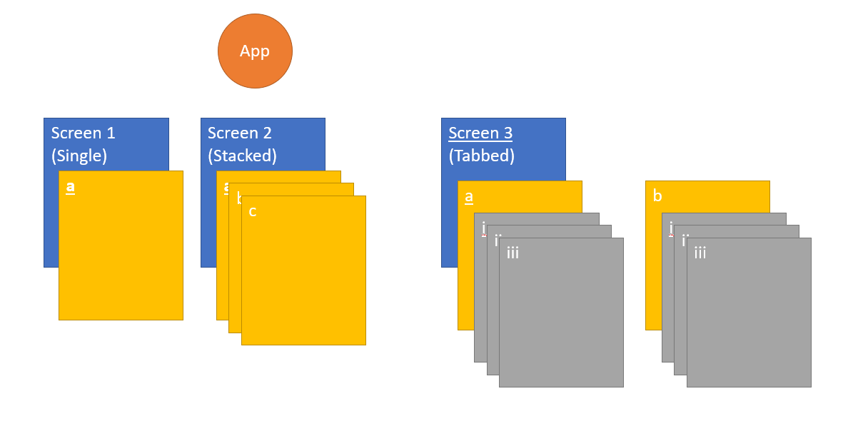
Navigate.push put a new Screen on the Stack (This lets the device's back-button work with the Screens)

Slide 11
Get setup on Macs in Lab
Clone a copy of the project there too.

Slide 12
Sealed Classes
Sealed classes are used for representing restricted class hierarchies, when a value can have one of the types from a limited set, but cannot have any other type.
Often we need to represent a limited set of possibilities; a web request either succeeds or fails, a User can only be a Pro-User or a standard user.
We could use an enum, but they are limited.
E.g., can only allow a single instance of each value
Can't encode more information on each type.
You could use an abstract class, but this loses the restricted set of types advantage of enums.
Kotlin provides sealed classes to allow the best of both worlds: The freedom of representation of abstract classes with the restricted set of types of enums.

Slide 13
Sealed Classes
To declare a sealed class or interface, put the sealed modifier before its name
No other subclasses may appear outside the module and package within which the sealed class is defined.
For example, third-party clients can't extend your sealed class in their code.
Like abstract classes, sealed classes allow you to represent hierarchies.
Sealed classes cannot have public constructors (private by default)
The child classes can be any type of class: a data class, an object, a regular class or even another sealed class. Unlike abstract classes, you have to define these hierarchies in the same file or as nested classes.
https://www.freecodecamp.org/news/how-to-handle-ui-events-in-jetpack-compose/
https://www.freecodecamp.org/news/how-to-handle-ui-events-in-jetpack-compose/
https://developer.android.com/jetpack/compose/navigation
https://medium.com/androiddevelopers/sealed-with-a-class-a906f28ab7b5
https://proandroiddev.com/understanding-kotlin-sealed-classes-65c0adad7015
https://cazimirroman.medium.com/sealed-classes-vs-data-classes-669446e8ed3b

Slide 14
Sealed class rules
Sealed classes are abstract and can have abstract members.
Sealed classes cannot be instantiated directly.
Sealed classes cannot have public constructors (The constructors are private by default).
Sealed classes can have subclasses, but they must either be in the same file or nested inside of the sealed class declaration.
Sealed classes subclass can have subclasses outside of the sealed class file.

Slide 15
Sealed Class Example
The below is an example of a sealed class (Result) with two possible subclasses (Success and Error), each of which behaves slightly differently
sealed class Result<out T : Any> {
data class Success<out T : Any>(val data: T) : Result<T>()
data class Error(val exception: Exception) : Result<Nothing>()
}
Trying to extend the sealed class outside the file it was defined in yields a compile error
When using a sealed class, we can check a result's type similarly to an enum:
when(result) {
is Result.Success -> { }
is Result.Error -> { }
}

Slide 16
Hierarchical
We can extend subclasses when defining our sealed class.
sealed class Result<out T : Any> {
data class Success<out T : Any>(val data: T) : Result<T>()
sealed class Error(val exception: Exception) : Result<Nothing>() {
class RecoverableError(exception: Exception) : Error(exception)
class NonRecoverableError(exception: Exception) :
Error(exception)
}
object InProgress : Result<Nothing>()
}
These can be used as follows, for example:
val action = when (result) {
is Result.Success -> { }
is Result.Error.Recoverable -> { }
is Result.Error.Nonrecoverable -> {}
Result.InProgress ->
}

Slide 17
Pro/Con Sealed Classes
Pros:
One of the main benefits of using sealed classes is that they can help to ensure that your code is correct and easy to understand. Because sealed classes only allow a fixed set of subclasses, you can be sure that any object of a sealed class will be one of the defined subclasses. This makes it easier to reason about your code and can help to reduce the risk of bugs.
Another advantage of sealed classes is that they can make it easier to write code that handles different states in a consistent way. For example, you can use a when expression to handle each of the different states, and the Kotlin compiler will ensure that you have covered all of the possible states. This can make it easier to write correct code and can save you time and effort.
Cons:
However, sealed classes also have some drawbacks. One of the main drawbacks is that they can be more verbose than other options, especially if you have a large number of states. Defining a sealed class and all of its subclasses can take more code than using other options, such as data classes or enums.

Slide 18
Comparing sealed vs data vs enum classes
Sealed classes are best for situations where you need to define a fixed set of possible states and want to ensure that your code is correct and easy to understand.
Data classes are better for situations where you just need to hold simple data and don’t need any complex logic.
// Using a sealed class
sealed class AppState {
object Loading : AppState()
data class Success(val data: Data) : AppState()
data class Error(val message: String, val stackTrace: String) : AppState()
}
// Using a data class
data class AppState(val state: String, val data: Data? = null, val message: String? = null)
// Using an enum
enum class AppState {
LOADING,
SUCCESS,
ERROR
}

Slide 19
Pro/Con Data Classes
Pros
One of the main advantages of data classes is that they are concise and easy to use. Data classes are especially useful when you just need to hold a simple data structure and don’t need any complex logic. They allow you to define the data you need in a single line of code and provide automatically generated methods for accessing and modifying that data.
Another advantage of data classes is that they can be more flexible than sealed classes. Because data classes don’t have any restrictions on where they can be subclassed, you can define them in one file and use them in another without any problems. This can be useful if you need to share data between different parts of your codebase.
Cons:
However, data classes also have some drawbacks. One of the main drawbacks is that they don’t provide the same level of type safety as sealed classes. Because data classes can be subclassed anywhere, it’s possible for other code to define additional subclasses that you aren’t aware of. This can make it harder to reason about your code and can increase the risk of bugs.

Slide 20
Navigation Bar
https://itnext.io/navigation-bar-bottom-app-bar-in-jetpack-compose-with-material-3-c57ae317bd00
Let's build a navigation bar, similar to the one in the article above, but using Voyager navigation.

Slide 21
Misc Info

Slide 22
MongoDb
https://www.mongodb.com/developer/products/realm/getting-started-kmm-flexiable-sync/#building-a-more-complex-app

Slide 23
List of items
Need to import the right thing
import androidx.compose.foundation.lazy.items
@Composable
fun ListContent(onItemClick: (String) -> Unit) {
val items = remember { List(100) { "Item $it" } }
LazyColumn {
items(items) { item ->
Text(
text = item,
modifier = Modifier
.clickable { onItemClick(item) }
.fillMaxWidth()
.padding(16.dp)
)
}
}
}

Slide 24
Mutable List
https://medium.com/geekculture/add-remove-in-lazycolumn-list-aka-recyclerview-jetpack-compose-7c4a2464fc9f
Caution: Using mutable objects such as ArrayList<T> or mutableListOf() as state in Compose causes your users to see incorrect or stale data in your app. Mutable objects that are not observable, such as ArrayList or a mutable data class, are not observable by Compose and don't trigger a recomposition when they change. Instead of using non-observable mutable objects, the recommendation is to use an observable data holder such as State<List<T>> and the immutable listOf().

Slide 25
Layout Inspector
https://developer.android.com/jetpack/compose/tooling/layout-inspector

Slide 26
Grids (LazyGrid)
https://developer.android.com/jetpack/compose/lists

Slide 27
protected
protected visibility is available as in Java for members of a class
protected means that the member is visible inside that class AND that it is also visible in subclasses.

Slide 28
More on Forms
https://www.section.io/engineering-education/jetpack-compose-forms/

Slide 29
Kotlin Koans
For small exercises focused on Kotlin language,
https://play.kotlinlang.org/koans/overview

Slide 30
Snackbar
Side-effects
https://developer.android.com/jetpack/compose/side-effects
https://medium.com/@jurajkunier/how-to-show-snackbar-in-jetpack-compose-3f2d81891f87
https://developer.android.com/reference/kotlin/androidx/compose/material3/SnackbarHostState
https://www.devbitsandbytes.com/configuring-snackbar-jetpack-compose-using-scaffold-with-bottom-navigation/
https://developer.android.com/jetpack/compose/layouts/material

Slide 31
More on Text Styling
https://semicolonspace.com/jetpack-compose-text/

Slide 32
Enum classes
https://blog.logrocket.com/kotlin-enum-classes-complete-guide/
https://kotlinlang.org/docs/enum-classes.html

Slide 33
Misc Kotlin
Returning multiple values from functions
https://www.baeldung.com/kotlin/returning-multiple-values
Destructuring declarations
https://www.tutorialspoint.com/kotlin/kotlin_destructuring_declarations.htm
Concurrency and coroutines
https://kotlinlang.org/docs/multiplatform-mobile-concurrency-and-coroutines.html#multithreaded-coroutines
Architecture
https://proandroiddev.com/building-modern-apps-using-the-android-architecture-guidelines-3238fff96f14
Misc
https://proandroiddev.com/zero-to-hero-in-kmm-with-compose-and-swiftui-d8951f7d80b7
Delegated Properties
https://kotlinlang.org/docs/delegated-properties.html#delegating-to-another-property

Slide 34
Misc Compose Multiplatform
Tutorials
https://github.com/JetBrains/compose-multiplatform/tree/master/tutorials/Image_And_Icons_Manipulations#loading-images-from-device-storage-or-network-asynchronously

Slide 35
Compose Multiplatform Examples
https://github.com/JetBrains/compose-multiplatform/blob/master/examples/README.md
Kotlin Multiplatform Example
https://github.com/android/kotlin-multiplatform-samples
Room with a View exercise
https://developer.android.com/codelabs/android-room-with-a-view-kotlin#0

Slide 36
Pokedex app in Compose Multiplatform
Interesting application that may have useful capabilities to draw inspiration from
https://www.reddit.com/r/Kotlin/comments/11pph1p/kotlin_multiplatform_app_with_shared_ui_for/
https://github.com/MohamedRejeb/Pokedex/blob/main/shared/src/commonMain/kotlin/com/mocoding/pokedex/ui/comingsoon/AsyncImage.kt#L18

Slide 37
Nice link on State
https://www.kodeco.com/30172122-managing-state-in-jetpack-compose

Slide 38
More on Hoisted State
https://developer.android.com/jetpack/compose/state
State that is hoisted this way has some important properties:
Single source of truth: By moving state instead of duplicating it, we're ensuring there's only one source of truth. This helps avoid bugs.
Encapsulated: Only stateful composables can modify their state. It's completely internal.
Shareable: Hoisted state can be shared with multiple composables. If you wanted to read name in a different composable, hoisting would allow you to do that.
Interceptable: callers to the stateless composables can decide to ignore or modify events before changing the state.
Decoupled: the state for the stateless ExpandingCard may be stored anywhere. For example, it's now possible to move name into a ViewModel.

