Slide 1

Related Technologies for Multiplatform Applications
420-731-AB
Instructor: Talib Hussain
Day 7: Database
Notes:
Image from: https://img.freepik.com/premium-photo/phone-mobile-application-development-concept-mobile-internet-3d-illustration_76964-5164.jpg?size=626&ext=jpg

Slide 2
Objectives
Connecting up to MongoDb
MVVM (Model-View-ViewModel)
Coroutines

Slide 3
Navigation Bar
https://itnext.io/navigation-bar-bottom-app-bar-in-jetpack-compose-with-material-3-c57ae317bd00
Let's build a navigation bar, similar to the one in the article above, but using Voyager navigation.

Slide 4
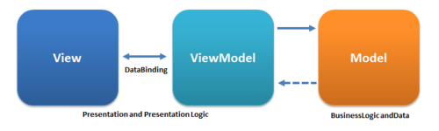
MVVM – Model-View-ViewModel
MVVM is an architectural pattern that seeks to separate the presentation of data in an application from the data itself.
A general approach used across many systems/languages
Also is a specific approach used in Android (with an actual ViewModel class)
A ViewModel plays a key role of getting data from the model and organizing it in the way that is needed by the View.
The View simply displays the data in the ViewModel
The Model contains any business logic regarding the data, as well as provides access to the stored data.

Slide 5
ScreenModel
ScreenModel is just like a ViewModel (from Android approach).
It is designed to store and manage UI-related data in a lifecycle conscious way.
It also allows data to survive configuration changes such as screen rotations.
ScreenModel is Android independent and doesn't require an Activity or Fragment to work.
By design, it's only possible to create a ScreenModel instance inside a Screen. Call rememberScreenModel and provide a factory lambda.
https://voyager.adriel.cafe/screenmodel

Slide 6
High-Level Idea
class HomeScreenModel : ScreenModel {
}
class HomeScreen : Screen {
@Composable
override fun Content() {
val screenModel = rememberScreenModel { HomeScreenModel() }
// ...
}
}

Slide 7
Walkthrough
Take a look at PersonsListScreenModel and PersonRepository in detail to get an idea of the distinction between "ViewModel" and "Model"

Slide 8
MongoDb Plugin Installation
In order to use MongoDb with our app, we need to install "Realm", MongoDb's plugin to support Kotlin Multiplatform
Installation instructions at this link. Relevant instructions for us are below. https://www.mongodb.com/docs/realm/sdk/kotlin/install/#installation
Add the following to the "plugins" section in build.gradle.kts in shared/commonMain
id("io.realm.kotlin") version "1.9.1"
If you scroll down further, you will see a section in the build.gradle.kts that starts with the following
sourceSets {
val commonMain by getting {
dependencies {
Add the following to that commonMain "dependencies" section (make sure not to put it in a different dependencies section)
implementation("io.realm.kotlin:library-sync:1.9.1")
From the File menu, choose option "Sync Project with Gradle Files"
This article has lots of information, but not everything is relevant directly since we are using the Voyager ScreenModel approach.
https://www.mongodb.com/developer/products/realm/getting-started-kmm-flexiable-sync/#building-a-more-complex-app

Slide 9
Realm
Realm Database is a reactive, object-oriented, cross-platform, mobile database:
Reactive: query the current state of data and subscribe to state changes like the result of a query, or even changes to a single object.
Object-oriented: organizes data as objects, rather than rows, documents, or columns.
Cross-platform: use the same database on iOS, Android, Linux, macOS, or Windows. Just define a schema for each SDK you use.
Mobile: designed for the low-power, battery-sensitive, real-time environment of a mobile device.
You can also synchronize data between Realm Database and MongoDB Atlas using Atlas Device Sync.
https://www.mongodb.com/docs/realm/sdk/kotlin/realm-database/

Slide 10
Schema
Every realm object has a schema.
The Schema maps Realm objects directly to native Kotlin objects.
Realm objects are regular Kotlin classes, and you can work with them as you would any other class instance.
The following schema defines a Car object type with make, model, and miles properties
class Car : RealmObject {
var _id: ObjectId = ObjectId()
var make: String = ""
var model: String = ""
var miles: Int = 0
}
There must be a primary key property named '_id' on a synchronized Realm
Synchronized means you are storing information in the cloud not on your device.
https://www.mongodb.com/docs/realm/sdk/kotlin/realm-database/schemas/define-realm-object-model/#std-label-kotlin-define-object-model

Slide 11
Realm Object
To define a Realm object type:
Create a uniquely named Kotlin class that implements the RealmObject or EmbeddedRealmObject interface.
Add fields to your class. You can add any supported data types as a field in your class.
Add any property annotations to give Realm additional information about a property, including whether Realm should ignore the property or should be indexed.
https://www.mongodb.com/docs/realm/sdk/kotlin/realm-database/schemas/property-annotations/#std-label-kotlin-property-annotations
https://www.mongodb.com/docs/realm/sdk/kotlin/realm-database/schemas/define-realm-object-model/#std-label-kotlin-define-object-model

Slide 12
@PrimaryKey
Realm Database treats fields marked with the @PrimaryKey annotation as primary keys for their corresponding object schema.
The primary key is a unique identifier for an object in a realm.
No other objects of the same type may share an object's primary key.
There must be a primary key property named '_id' on a synchronized Realm
You can create a primary key with any of the following types:
String, Byte, Char, Short, Int, Long, ObjectId, RealmUUID
Important aspects of primary keys:
You can define only one primary key per object schema.
You cannot change the primary key field for an object type after adding any object of that type to a realm.
Primary key values must be unique across all instances of an object in a realm. Attempting to insert a duplicate primary key value results in an error.
Primary key values are immutable. To change the primary key value of an object, you must delete the original object and insert a new object with a different primary key value.
Primary keys are nullable. null can only be the primary key of one object in a collection.
Realm automatically indexes primary keys, so you can efficiently read and modify objects based on their primary key.

Slide 13
e.g., Frog class
class Frog() : RealmObject {
@PrimaryKey
var _id: ObjectId = ObjectId()
var name: String = ""
var age: Int = 0
var species: String = ""
var owner: String = ""
}

Slide 14
Open a Realm
When you open the realm, you must provide a list of object schemas as an argument.
If a realm already contains data when you open it, Realm Database validates each object to ensure that an object schema was provided for its type and that it meets all of the constraints specified in the schema.
To open a realm that runs entirely in memory without being written to a file use .inMemory property
val config = RealmConfiguration.Builder(setOf(Frog::class))
.inMemory()
.build()
val realm = Realm.open(config)
println("Successfully opened an in memory realm")
To open a realm that writes to file, omit the inMemory property.
https://www.mongodb.com/docs/realm/sdk/kotlin/realm-database/realm-files/open-and-close-a-realm/#std-label-kotlin-open-a-realm

Slide 15
Writes
Because the create, update, and delete operations modify the state of the realm, we call them writes.
Realm handles writes in terms of transactions.
A transaction is a list of read and write operations that Realm treats as a single indivisible operation.
In other words, a transaction is all or nothing: either all of the operations in the transaction succeed or none of the operations in the transaction take effect.
A realm allows only one open write transaction at a time.
Realm blocks other writes on other threads until the open transaction is complete.
Consequently, there is no race condition when reading values from the realm within a transaction.
https://www.mongodb.com/docs/realm/sdk/kotlin/realm-database/write-transactions/

Slide 16
"Create"
Sample syntax
realm.write {
// create a frog object in the realm
val frog = this.copyToRealm(Frog().apply {
name = "Kermit"
age = 45
species = "Green"
owner = "Jim"
})

Slide 17
Find
find() is Synchronous
find() runs a synchronous query on the thread it is called from.
As a result, avoid using find() on the UI thread or in logic that could delay the UI thread.
Find Object by Primary Key
To find an object with a specific primary key value, open a realm and query the primary key field for the desired primary key value using realm.query(). Specify the object type as a type parameter passed to query():
// Search equality on the primary key field name
val frogs: Frog? = realm.query<Frog>(Frog::class, "_id == $0", PRIMARY_KEY_VALUE).first().find()
Query Language:
https://www.mongodb.com/docs/realm/realm-query-language/
https://www.mongodb.com/docs/realm/sdk/kotlin/realm-database/crud/read/#std-label-kotlin-read-objects

Slide 18
Kotlin Coroutine
Coroutines offer asynchronous programming support at the language level in Kotlin.
A coroutine is an instance of suspendable computation.
It is conceptually similar to a thread, in the sense that it takes a block of code to run that works concurrently with the rest of the code.
However, a coroutine is not bound to any particular thread. It may suspend its execution in one thread and resume in another one.
Coroutines can be thought of as light-weight threads.
Compose offers APIs that make using coroutines safe within the UI layer
The rememberCoroutineScope function returns a CoroutineScope with which you can create coroutines in event handlers and call Compose suspend APIs.
Try this:
fun main() = runBlocking { // this: CoroutineScope
launch { // launch a new coroutine and continue
delay(1000L) // non-blocking delay for 1 second (default time unit is ms)
println("World!") // print after delay
}
println("Hello") // main coroutine continues while a previous one is delayed
}

Slide 19
Voyager – Screen model and Coroutine Scope
The ScreenModel provides a coroutineScope property.
It's cancelled automatically when the ScreenModel is disposed.
https://voyager.adriel.cafe/screenmodel/coroutines-integration
class PostDetailsScreenModel(
private val repository: PostRepository
) : StateScreenModel<PostDetailsScreenModel.State>(State.Init) {
sealed class State {
object Init : State()
object Loading : State()
data class Result(val post: Post) : State()
}
fun getPost(id: String) {
coroutineScope.launch {
mutableState.value = State.Loading
mutableState.value = State.Result(post = repository.getPost(id))
}
}
}

Slide 20
Update
Find followed by change to object, all in a write block
realm.write {
// fetch a frog from the realm by primary key
val frog: Frog? =
this.query<Frog>("_id == $0", PRIMARY_KEY_VALUE).first().find()
// modify the frog's age in the write transaction to persist the new age to the realm
frog?.age = 42
}
https://www.mongodb.com/docs/realm/sdk/kotlin/realm-database/crud/update/

Slide 21
Delete
Inside a write block, find the object, then call delete(object)
https://www.mongodb.com/docs/realm/sdk/kotlin/realm-database/crud/delete/
realm.write {
// fetch the frog by primary key value, passed in as argument number 0
val frog: Frog =
this.query<Frog>("_id == $0", PRIMARY_KEY_VALUE).find().first()
// call delete on the results of a query to delete the object permanently
delete(frog)
}

Slide 22
Later
Sync https://www.mongodb.com/docs/realm/sdk/kotlin/sync/
Authentication: https://www.mongodb.com/docs/realm/sdk/kotlin/users/authenticate-users/
Notifications / Change listeners / Flows: https://www.mongodb.com/docs/realm/sdk/kotlin/realm-database/react-to-changes/
Handle Errors: https://www.mongodb.com/docs/realm/sdk/kotlin/realm-database/errors/
User Authentication
https://www.mongodb.com/docs/realm/sdk/kotlin/users/authenticate-users/

Slide 23
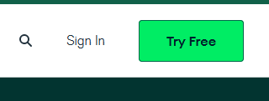
Sign in to MongoDb
If you don't have one already, create an account on MongoDb
Go to www.mongodb.com and sign up (click on "Try Free")

Slide 24
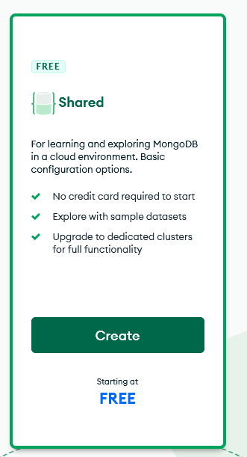
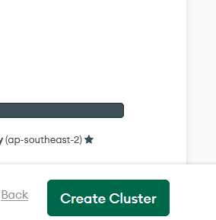
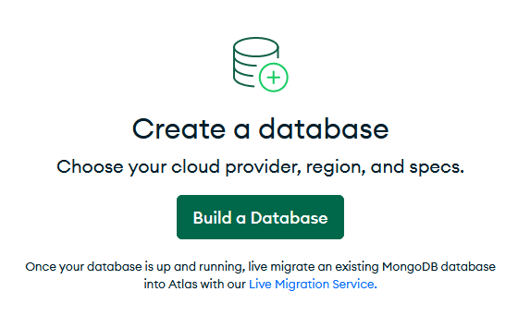
Setup MongoDb
First, let's get started with MongoDB
Go to www.mongodb.com and sign up (click on "Try Free")
Once signed up and signed in, create a free tier cluster in 3 steps
Click "Build a Database", then select the free tier and click "Create", and finally select "Create Cluster"

Slide 25
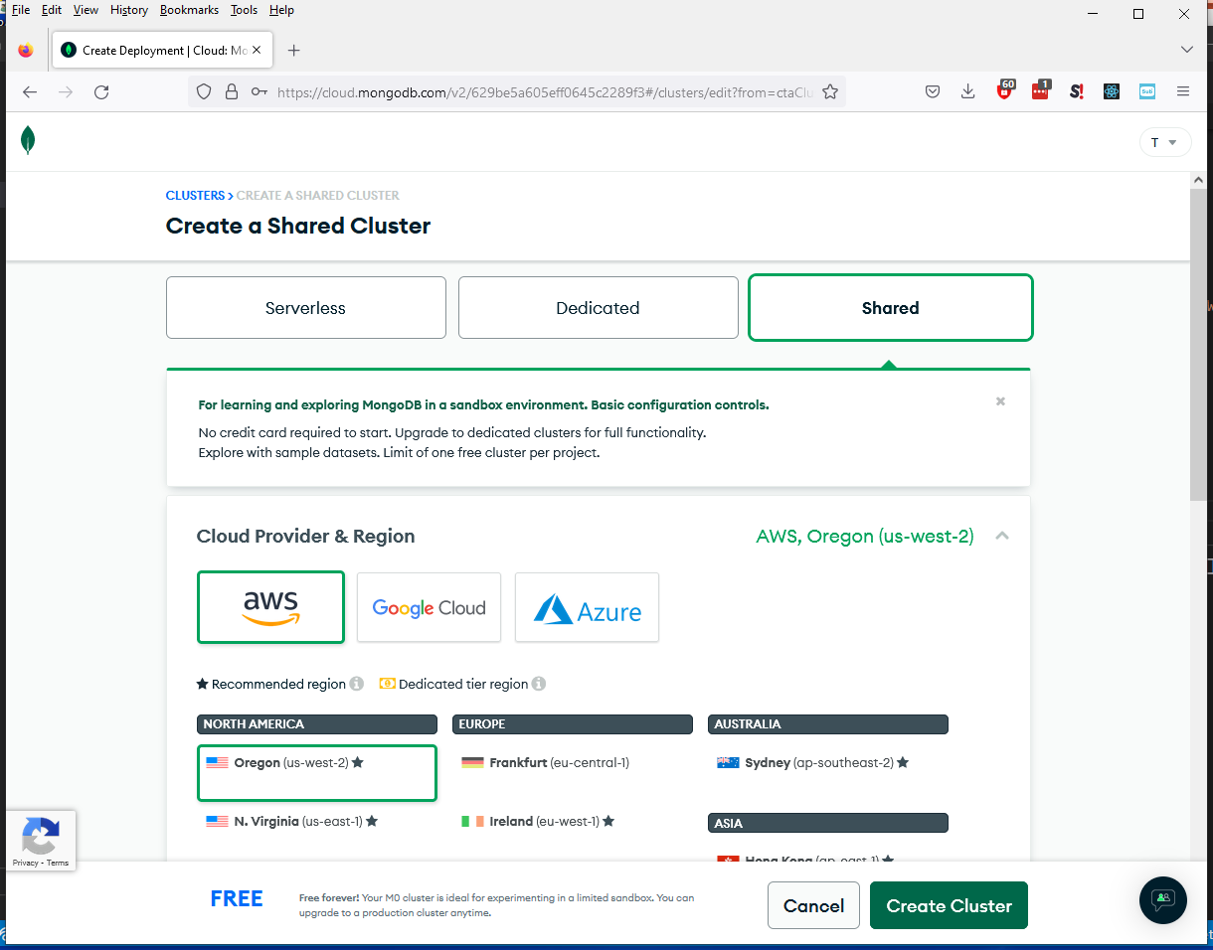

Slide 26
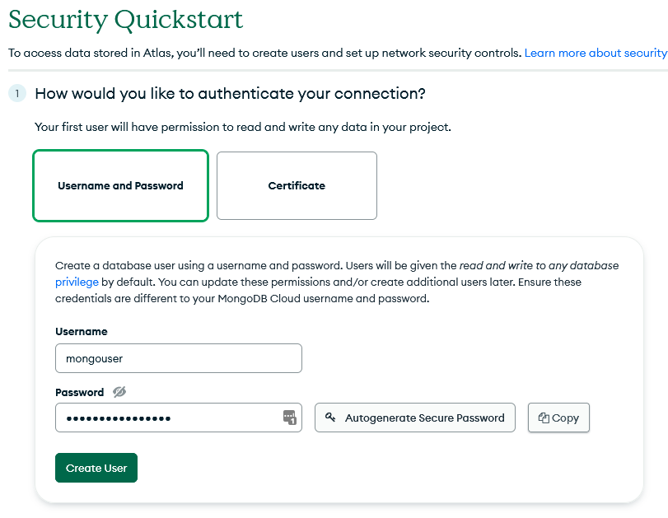
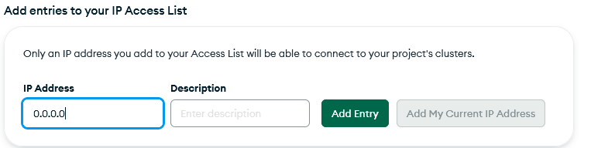

Create a User
Enter username (e.g., mongouser)
This should not be the same as your MongoDb username. This is for accessing the new database remotely.
Enter or generate a secure password
Do not use @ % or :
Make sure to hit the copy button
Then, go to VS code and store the password as follows in your .env file and save the file
MONGODB_PWD="<pasted-password>"
Click "Create User"
Enter 0.0.0.0 in the IP address section and click "Add Entry"
Click "Finish and Close"

Slide 27
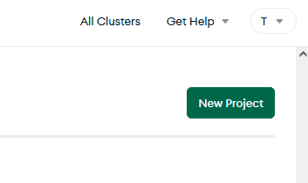
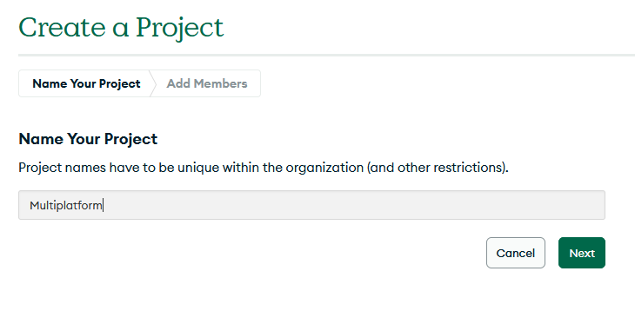
Mongo Atlas: Create Project

Slide 28
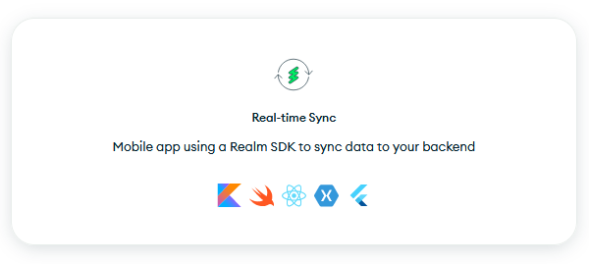
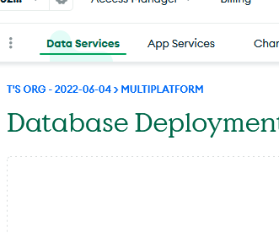
Click on App services tab and select "Real-time Sync" template

Slide 29
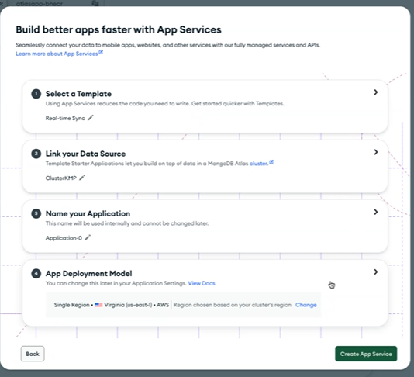
If you want, in step 3, change the default name of the application

Slide 30
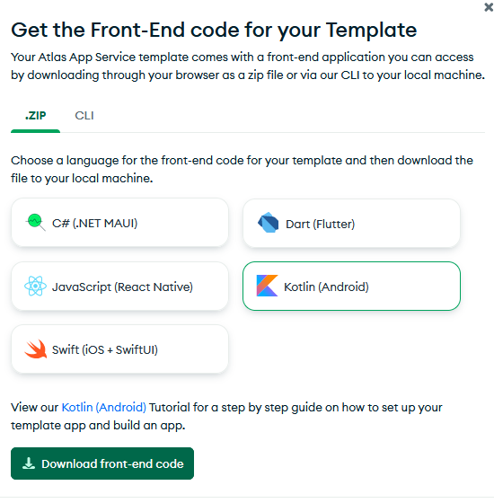
When prompted, choose "Kotlin (Android)" front-end code and download
Note: You don't need this (and the code is complicated), but you can use it to explore.

Slide 31
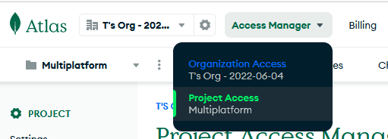
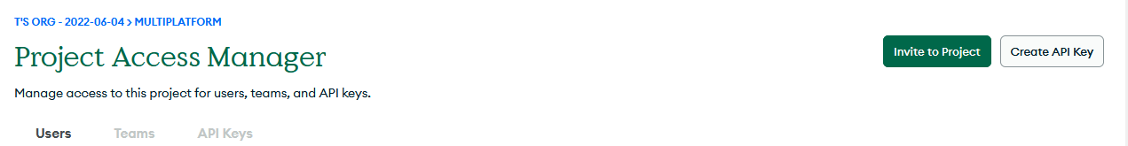
Create an API key

Slide 32
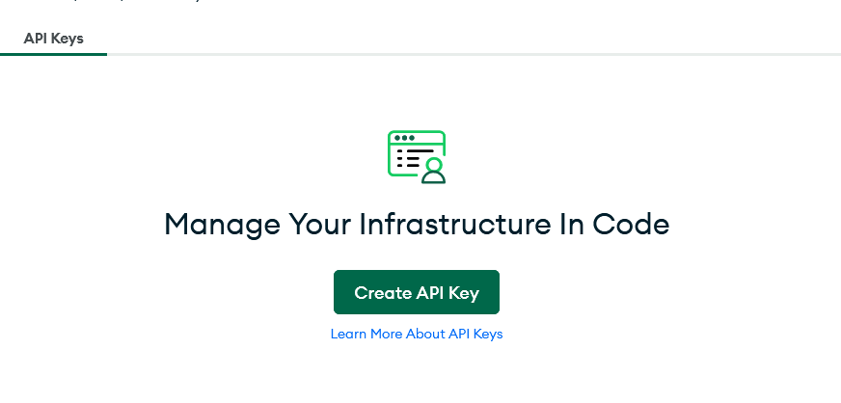
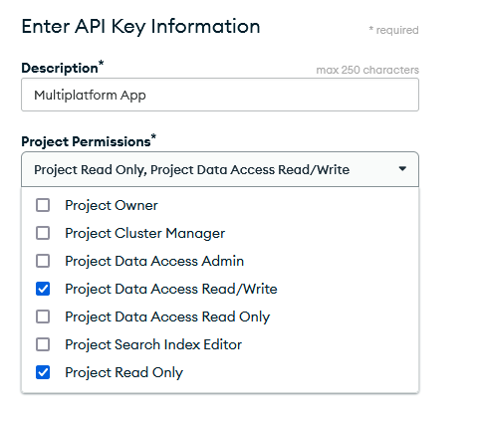
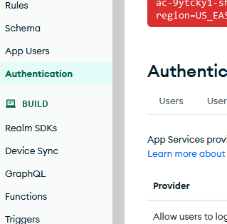
Create API Key
Or, you might see this green icon, depending where you go in the web site
Store the private key somewhere for the future (we won't really use it yet)
XXXXXXXX-XXXX-XXXX-XXXX-XXXXXXXXX
Store the public key for the future
XXXXXXXX

Slide 33
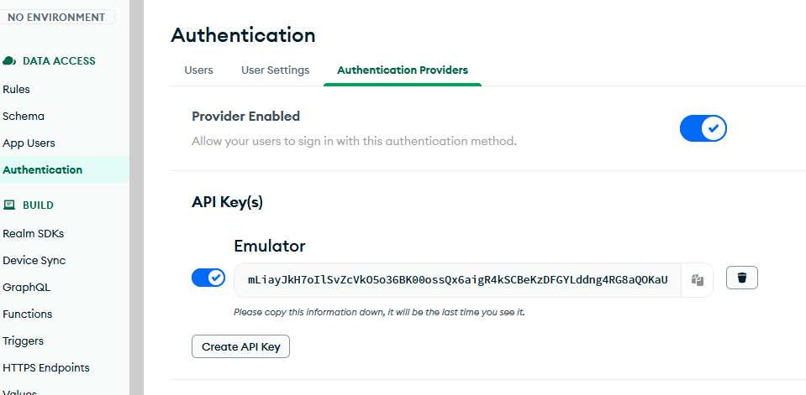
Turn on API key authentication
Go back to app services, and click on the authentication menu item on the left
Copy and store this API key – We will actually use this one in our code

Slide 34
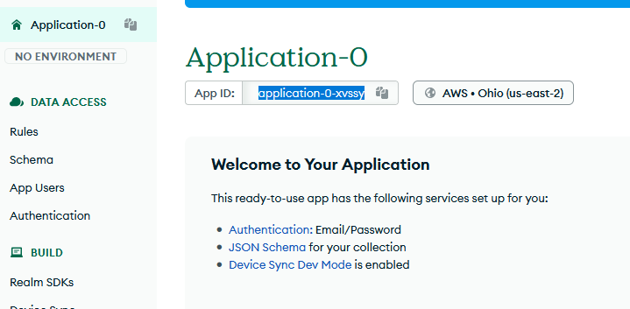
App ID
Copy and store your Application ID (e.g., application-0-xvssy)
We will actually use this one in our code

Slide 35
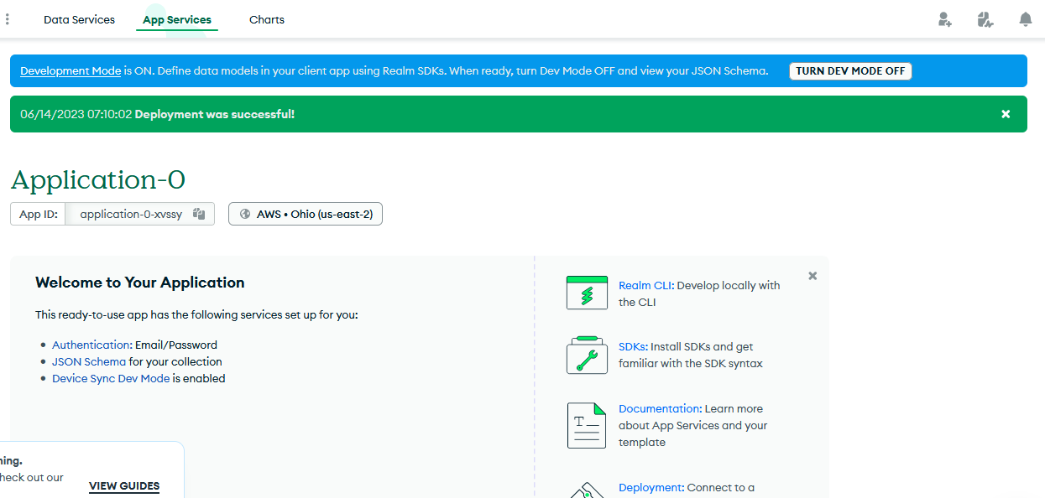

Slide 36
Afternoon Exercise
Look through the Frog / FrogRepository* / FrogScreenModel and FrogScreen files posted to Teams.
These show an end-to-end MVVM for storing and retrieving Frogs.
To "hook these up" for now and run them, just replace the Screen that is used in your MainApp.kt to use be FrogScreen instead.
Caveat: There are some errors connecting to MongoDb in the sync version. The Local version should work.
Based on this, write a set of appropriate MVVM files for your own project.
These will form the basis for your next assignment.
To be continued tomorrow…

