Slide 1

Related Technologies for Multiplatform Applications
420-731-AB
Instructor: Talib Hussain
Days 8 and 9: CR²UD, Coroutines and Flows
Notes:
Image from: https://img.freepik.com/premium-photo/phone-mobile-application-development-concept-mobile-internet-3d-illustration_76964-5164.jpg?size=626&ext=jpg

Slide 2
Objectives
More MongoDB Realm for Kotlin
Frozen Architecture
Walkthrough full sample CR²UD MVVM implementation
Hands-on coding of CR²UD operations using Model-View-ViewModel approach (see Class Materials for Frog-MVVM)
Note: Actually using specific terms: Repository – Screen – ScreenModel, but is still an MVVM approach.
More Kotlin Coroutines
Kotlin Flows
Additional Work/Discussion
Handout Assignment #2 (see Class Materials)
Handout Milestone #1 (see Class Materials)
Individual work on Assignment #2
Groupwork on Milestone 1
Flutter discussion

Slide 3
Frozen Architecture
Kotlin Realm works exclusively with frozen objects that can be passed between threads safely
This is different than using Realm in other languages
So, the objects that we received from the Realm database are not "Live"
This means that we can't see the changes made to the data
This means that we can't directly access that data.
This makes it a bit complicated when doing a read operation
To access a Live version of the frozen object, we must be inside of a write or writeBlocking closure.
Objects returned from a write closure become frozen objects when the write transaction completes.
https://www.mongodb.com/docs/realm/sdk/kotlin/realm-database/frozen-arch/

Slide 4
Separation of Concerns
A key job of the ViewModel (in our case "ScreenModel") is to isolate the View from the details of the Model.
A key job of the Model is to isolate theViewModel from details of the implementation of the database
So, let's avoid returning MongoDb-specific data structures from our model to our ViewModel.
We'll convert the results of a query/write to the database into a data structure that holds the latest data from the realm object.
This is a bit of a hassle, but would let us, for example, to later on change the database implementation (e.g., to SQL or Firebase, etc) without changing the ViewModels or Views.

Slide 5
Lazy Loading
Realm objects are lazy-loaded by default.
This allows you to query large collections of objects without reading large amounts of data from disk.
This also means that the first access to a field of an object will always return the most recent data.

Slide 6
Realm Query Language
https://www.mongodb.com/docs/realm/realm-query-language/#std-label-flexible-sync-rql-limitations

Slide 7
What is that $0 in the query???
val frog: Frog? = this.query<Frog>("_id == $0", PRIMARY_KEY_VALUE).first().find()
From ChatGPT ☺ (saved me typing)
In the given code snippet, $0 is used as a placeholder to represent a parameter in a query. It is a convention commonly used in query languages to refer to the first parameter in a list of values.
In this specific code, the query is using the string interpolation to substitute $0 with the value of PRIMARY_KEY_VALUE. The PRIMARY_KEY_VALUE is likely a constant or a variable that holds the value of the primary key to search for in the database.
So, the line val frog: Frog? = this.query<Frog>("_id == $0", PRIMARY_KEY_VALUE).first().find() translates to a query that searches for a Frog object in the Realm database where the _id field is equal to the value stored in PRIMARY_KEY_VALUE. The $0 is replaced with the value of PRIMARY_KEY_VALUE during the query execution.

Slide 8
Kotlin Flows
A suspending function asynchronously returns a single value, but how can we return multiple asynchronously computed values? This is where Kotlin Flows come in.
Using the List<Int> result type, means we can only return all the values at once.
To represent the stream of values that are being computed asynchronously, we can use a Flow<Int> type just like we would use a Sequence<Int> type for synchronously computed values:
Let's review this page together:
https://kotlinlang.org/docs/flow.html
Flows are cold streams similar to sequences — the code inside a flow builder does not run until the flow is collected.
Terminal operators on flows are suspending functions that start a collection of the flow. The collect operator is the most basic one, but there are others such as toList(), toSet(), first(), reduce()
Calling toList() on a Flow collects all of the objects emitted by the Flow and returns them to you in a List.
https://bladecoder.medium.com/kotlins-flow-in-viewmodels-it-s-complicated-556b472e281a
https://developer.android.com/kotlin/flow
https://developer.android.com/kotlin/flow/stateflow-and-sharedflow
https://blog.canopas.com/7-useful-ways-to-create-flow-in-kotlin-577992b73315

Slide 9
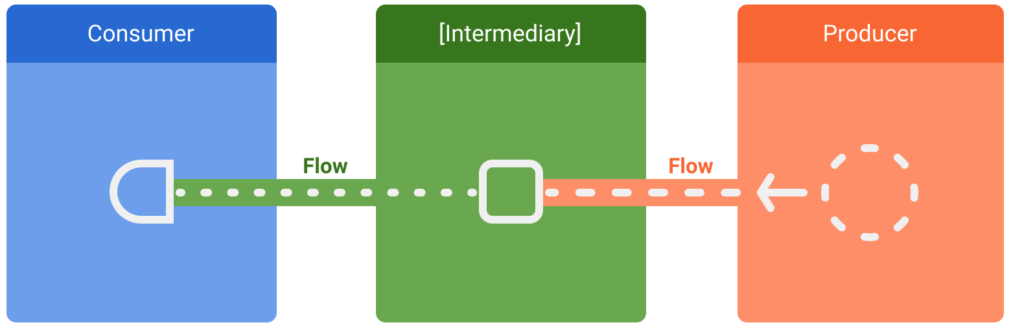
Flow

Slide 10
Misc Flows
collectAsState is an extension on StateFlow.
Collects values from this StateFlow and represents its latest value via State.
You need to handle the collection as per appropriate Lifecyle.
You may see documentation online regarding LiveData. Kotlin does something different with its Flows
https://medium.com/androiddevelopers/migrating-from-livedata-to-kotlins-flow-379292f419fb

Slide 11
Flow: List vs non-List
From ChatGPT (even more typing saved!)
The difference between Flow<List<Frog>> and Flow<Frog> lies in the nature of the emitted values and the structure of the resulting flow.
Flow<List<Frog>>:
This represents a flow that emits lists of Frog objects.
Each emission of the flow contains a list of Frog objects.
It is useful when you expect multiple Frog objects to be emitted together as a batch or collection.
For example, if you want to fetch a list of all frogs from a database and receive the entire list at once.
Flow<Frog>:
This represents a flow that emits individual Frog objects.
Each emission of the flow contains a single Frog object.
It is useful when you want to process Frog objects one at a time or react to individual Frog objects as they are emitted.
For example, if you want to observe a stream of real-time updates for individual frogs in a dynamic manner.
In summary, Flow<List<Frog>> emits lists of Frog objects, while Flow<Frog> emits individual Frog objects. The choice between the two depends on the specific use case and whether you need to work with batches of frogs or process them individually.

Slide 12
Recall: Kotlin Coroutine
Coroutines offer asynchronous programming support at the language level in Kotlin.
A coroutine is an instance of suspendable computation.
It is conceptually similar to a thread, in the sense that it takes a block of code to run that works concurrently with the rest of the code.
However, a coroutine is not bound to any particular thread. It may suspend its execution in one thread and resume in another one.
Coroutines can be thought of as light-weight threads.
Compose offers APIs that make using coroutines safe within the UI layer
The rememberCoroutineScope function returns a CoroutineScope with which you can create coroutines in event handlers and call Compose suspend APIs.
Try this:
fun main() = runBlocking { // this: CoroutineScope
launch { // launch a new coroutine and continue
delay(1000L) // non-blocking delay for 1 second (default time unit is ms)
println("World!") // print after delay
}
println("Hello") // main coroutine continues while a previous one is delayed
}

Slide 13
Recall: Voyager – Screen model and Coroutine Scope
The ScreenModel provides a coroutineScope property.
It's cancelled automatically when the ScreenModel is disposed.
https://voyager.adriel.cafe/screenmodel/coroutines-integration
class PostDetailsScreenModel(
private val repository: PostRepository
) : StateScreenModel<PostDetailsScreenModel.State>(State.Init) {
sealed class State {
object Init : State()
object Loading : State()
data class Result(val post: Post) : State()
}
fun getPost(id: String) {
coroutineScope.launch {
mutableState.value = State.Loading
mutableState.value = State.Result(post = repository.getPost(id))
}
}
}

Slide 14
Exercise: Coroutines and Flow
Worth 2%
Visit the following two web pages. Read the pages in detail and try out each code example in an IDE. Play around with it a bit to get a sense of how coroutines and flows work.
https://kotlinlang.org/docs/coroutines-basics.html
https://kotlinlang.org/docs/flow.html#flows-are-cold
Then, complete as much of these two codelabs as possible during remaining classtime.
https://developer.android.com/codelabs/basic-android-kotlin-compose-coroutines-android-studio
Don't do step 7 (unit tests)
https://developer.android.com/codelabs/jetpack-compose-advanced-state-side-effects
Please note: This has Android-specific approaches in it that are not fully aligned with Multiplatform.
Capture screenshots of your work as you go, and submit a zip of them to Lea
Other available labs:
https://developer.android.com/codelabs/advanced-kotlin-coroutines
https://developer.android.com/codelabs/kotlin-coroutines
https://play.kotlinlang.org/hands-on/Introduction%20to%20Coroutines%20and%20Channels/01_Introduction

Slide 15
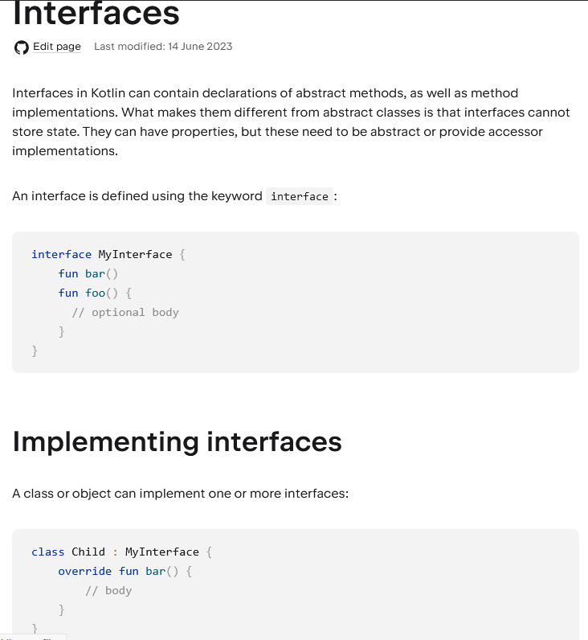
Interfaces
As discussed in class, the colon : is used to indicate "implements an interface"
i.e., not just for "extends"
https://kotlinlang.org/docs/interfaces.html#implementing-interfaces

Slide 16
Misc Info
For you information (same as in earlier slides).

Slide 17
List of items
Need to import the right thing
import androidx.compose.foundation.lazy.items
@Composable
fun ListContent(onItemClick: (String) -> Unit) {
val items = remember { List(100) { "Item $it" } }
LazyColumn {
items(items) { item ->
Text(
text = item,
modifier = Modifier
.clickable { onItemClick(item) }
.fillMaxWidth()
.padding(16.dp)
)
}
}
}

Slide 18
Mutable List
https://medium.com/geekculture/add-remove-in-lazycolumn-list-aka-recyclerview-jetpack-compose-7c4a2464fc9f
Caution: Using mutable objects such as ArrayList<T> or mutableListOf() as state in Compose causes your users to see incorrect or stale data in your app. Mutable objects that are not observable, such as ArrayList or a mutable data class, are not observable by Compose and don't trigger a recomposition when they change. Instead of using non-observable mutable objects, the recommendation is to use an observable data holder such as State<List<T>> and the immutable listOf().

Slide 19
Layout Inspector
https://developer.android.com/jetpack/compose/tooling/layout-inspector

Slide 20
Grids (LazyGrid)
https://developer.android.com/jetpack/compose/lists

Slide 21
protected
protected visibility is available as in Java for members of a class
protected means that the member is visible inside that class AND that it is also visible in subclasses.

Slide 22
More on Forms
https://www.section.io/engineering-education/jetpack-compose-forms/

Slide 23
Kotlin Koans
For small exercises focused on Kotlin language,
https://play.kotlinlang.org/koans/overview

Slide 24
Snackbar
Side-effects
https://developer.android.com/jetpack/compose/side-effects
https://medium.com/@jurajkunier/how-to-show-snackbar-in-jetpack-compose-3f2d81891f87
https://developer.android.com/reference/kotlin/androidx/compose/material3/SnackbarHostState
https://www.devbitsandbytes.com/configuring-snackbar-jetpack-compose-using-scaffold-with-bottom-navigation/
https://developer.android.com/jetpack/compose/layouts/material

Slide 25
More on Text Styling
https://semicolonspace.com/jetpack-compose-text/

Slide 26
Enum classes
https://blog.logrocket.com/kotlin-enum-classes-complete-guide/
https://kotlinlang.org/docs/enum-classes.html

Slide 27
Misc Kotlin
Returning multiple values from functions
https://www.baeldung.com/kotlin/returning-multiple-values
Destructuring declarations
https://www.tutorialspoint.com/kotlin/kotlin_destructuring_declarations.htm
Concurrency and coroutines
https://kotlinlang.org/docs/multiplatform-mobile-concurrency-and-coroutines.html#multithreaded-coroutines
Architecture
https://proandroiddev.com/building-modern-apps-using-the-android-architecture-guidelines-3238fff96f14
Misc
https://proandroiddev.com/zero-to-hero-in-kmm-with-compose-and-swiftui-d8951f7d80b7
Delegated Properties
https://kotlinlang.org/docs/delegated-properties.html#delegating-to-another-property

Slide 28
Misc Compose Multiplatform
Tutorials
https://github.com/JetBrains/compose-multiplatform/tree/master/tutorials/Image_And_Icons_Manipulations#loading-images-from-device-storage-or-network-asynchronously

Slide 29
Compose Multiplatform Examples
https://github.com/JetBrains/compose-multiplatform/blob/master/examples/README.md
Kotlin Multiplatform Example
https://github.com/android/kotlin-multiplatform-samples
Room with a View exercise
https://developer.android.com/codelabs/android-room-with-a-view-kotlin#0

Slide 30
Pokedex app in Compose Multiplatform
Interesting application that may have useful capabilities to draw inspiration from
https://www.reddit.com/r/Kotlin/comments/11pph1p/kotlin_multiplatform_app_with_shared_ui_for/
https://github.com/MohamedRejeb/Pokedex/blob/main/shared/src/commonMain/kotlin/com/mocoding/pokedex/ui/comingsoon/AsyncImage.kt#L18

Slide 31
Nice link on State
https://www.kodeco.com/30172122-managing-state-in-jetpack-compose

Slide 32
More on Hoisted State
https://developer.android.com/jetpack/compose/state
State that is hoisted this way has some important properties:
Single source of truth: By moving state instead of duplicating it, we're ensuring there's only one source of truth. This helps avoid bugs.
Encapsulated: Only stateful composables can modify their state. It's completely internal.
Shareable: Hoisted state can be shared with multiple composables. If you wanted to read name in a different composable, hoisting would allow you to do that.
Interceptable: callers to the stateless composables can decide to ignore or modify events before changing the state.
Decoupled: the state for the stateless ExpandingCard may be stored anywhere. For example, it's now possible to move name into a ViewModel.

