Slide 1

Related Technologies for Multiplatform Applications
420-731-AB
Instructor: Talib Hussain
Day 14: Authentication
Notes:
Image from: https://img.freepik.com/premium-photo/phone-mobile-application-development-concept-mobile-internet-3d-illustration_76964-5164.jpg?size=626&ext=jpg

Slide 2
Objectives
Design Milestone Presentations
Exercise 11: User authentication
More Error Handling
Misc.
Handout test

Slide 3
Authentication
We have a serverless mobile app. Thus, we do not have a back-end server that we control that can perform user authentication.
Doing user authentication solely on the front-end is not secure since we can't ensure secure access to the database (e.g., malicious client)
But, we can use the Firebase authentication service to validate our users securely
We will be following the approach in this link:
https://dev.to/raajeevchandran/firebase-authentication-and-keeping-users-logged-in-with-provider-in-flutter-9j5
Official documentation is available here:
https://firebase.google.com/docs/auth/flutter/start

Slide 4
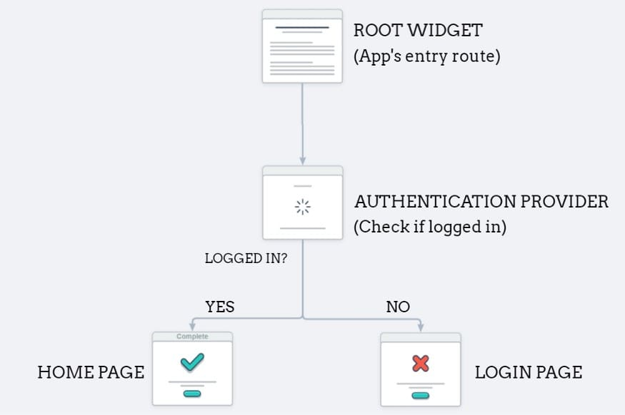
Provider-based approach…

Slide 5
Exercise 11: Setting Up
Before starting: Make sure you have committed & pushed!
We need to add the firebase_auth plugin
flutter pub add firebase_auth
If you haven't already from the earlier exercise, also:
flutter pub add firebase_core
flutter pub add provider
At the top of the files that access the auth capabilities, you will need to import the package
import 'package:firebase_auth/firebase_auth.dart';
We won't be using emulators per se, but be aware that they are available, which will let you develop offline if needed.

Slide 6
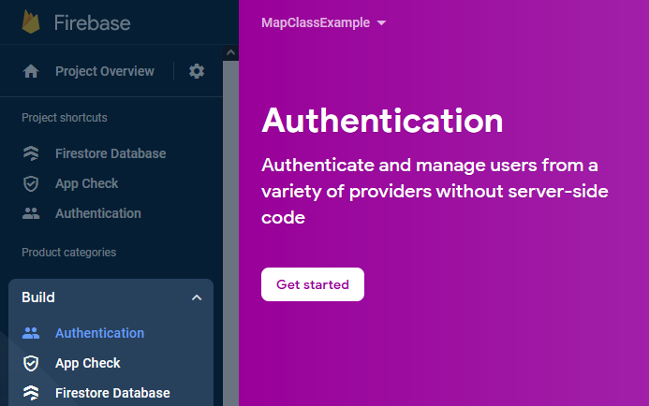
Setup on Firebase online
Go to your console.firebase.google.com and go to the authentication page in the build menu on the left
Click Get Started

Slide 7
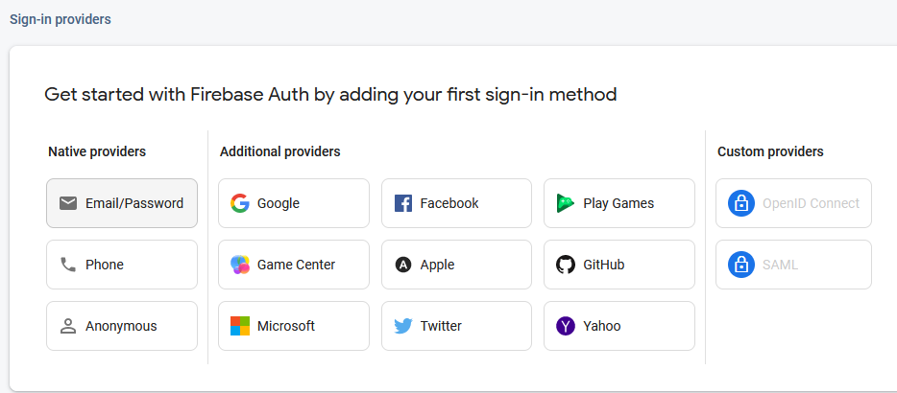
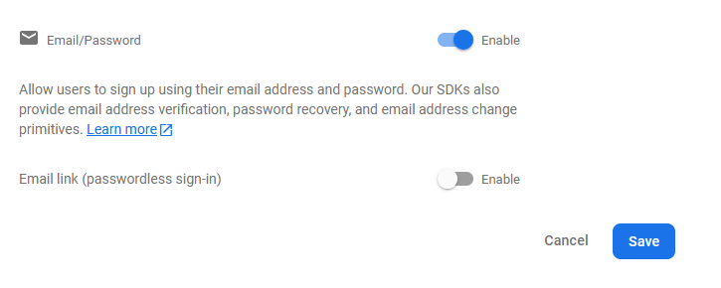
Choose the email/password provider and enable it.

Slide 8
Walkthrough of Link and Teacher Code
Mostly the same as the link
https://dev.to/raajeevchandran/firebase-authentication-and-keeping-users-logged-in-with-provider-in-flutter-9j5
Teacher code in class materials: teaching_example_flutter_June23_withAuth
New way of accessing provider: context.watch / context.read
Can also still use Provider.of
We'll rename the former "User" and "UserRepository" to be "Profile" and "ProfileRepository" to avoid confusion with an auth package provided "User" object
We'll create an "AuthRepository" that will perform our sign-in/sign-up operations using firebase auth.
We'll perform a joint operation when registering a user
The "Profile" repository will have a handle on the "Auth" repository
When adding a new user, the Profile repository will call the auth repository first and then create the profile if successful.
i.e., perform both asynchronous operations in a single method to avoid inconsistencies and simplify what we need to do in the UI widget.
Finally, once everything is setup, we can use the information about the currently authorized user to retrieve that user's profile information from the profile repository.

Slide 9
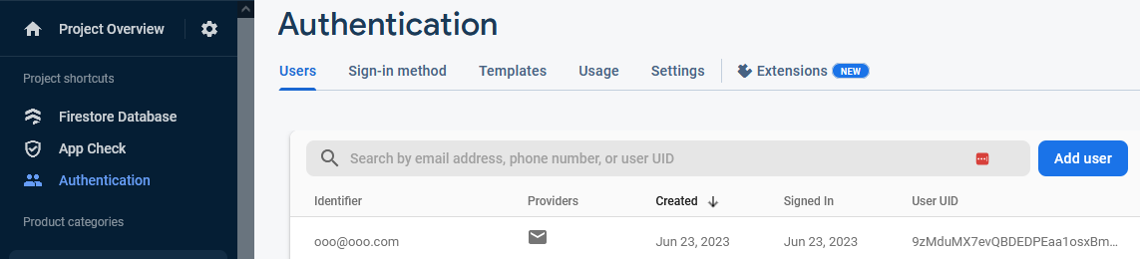
After addUser is updated and ProfileRepository is properly connected to the AuthRepository, clicking on your register link should resuly in a new user being created in Firebase.
In your console.firebase.google.com, click on Authentication on the menu on the left and look at the Users tab. You should see your new user.

Slide 10
Exercise 11 Wrap-Up
Capture screenshot of your online authentication database showing created users
Capture screenshots of your app showing logged in and logged out status.
If you have other gated content (e.g., UserGrid), capture screenshots showing those before and after log in
Zip up your screenshots and upload to Lea.

Slide 11
Alternative links for user authentication
There are several approaches to user authentication.
Social authentication: Using a "Google Sign-In" / "Facebook Sign-in" / "Apple Sign-in" etc.
https://firebase.google.com/docs/auth/flutter/federated-auth
Below are some links showing or discussing approaches that differ in some ways from the one taught in class. There are many other links online.
Recommend: Keep it simple for this class!
https://firebase.google.com/codelabs/firebase-auth-in-flutter-apps
https://stackoverflow.com/questions/63669262/check-authentication-state-of-user-using-firebaseauth-in-flutter
https://stackoverflow.com/questions/46253226/detect-firebase-auth-provider-for-loged-in-user
https://stackoverflow.com/questions/37873608/how-do-i-detect-if-a-user-is-already-logged-in-firebase

Slide 12
More Error Handling
Make error handling requirements clear as part of the function documentation and even better as the function signature
Throw explicit user-defined exceptions (so rest of code is not dependent on 3rd party exceptions)
Result/sealed class approach: https://codewithandrea.com/articles/flutter-exception-handling-try-catch-result-type/
"Either" approach: https://medium.com/flutter-community/a-pragmatic-approach-to-error-handling-468c4ac1a645
Asynchronous error handling. Recommend using await and try..catch, but can use .catch() and .then() on the Future. https://dart.dev/guides/libraries/futures-error-handling
Note: This approach can be hard to debug in the IDE with breakpoints, etc.

Slide 13
Self-Study - Fetch
This link does a very good job of describing how to use fetch. Please consult it to learn how to use fetch.
https://docs.flutter.dev/cookbook/networking/fetch-data
A fetch call is necessarily asynchronous
Roughly dealing with a fetch is similar to dealing with the asynchronous database calls we made for our CRUD.
i.e., use Futures/FutureBuilder

Slide 14
Group Config
Share database: https://support.google.com/firebase/answer/7000272?hl=en
Git branch / merge
Next week…

Slide 15
Misc
Using Emulators
https://firebase.google.com/docs/emulator-suite/connect_auth
https://firebase.google.com/docs/emulator-suite/connect_firestore
StreamBuilder
https://stackoverflow.com/questions/50844519/flutter-streambuilder-vs-futurebuilder
https://webcache.googleusercontent.com/search?q=cache:Emz3_jfLBmoJ:https://medium.com/quick-code/reading-lists-from-firestore-using-streambuilder-in-flutter-eda590f461ed&cd=9&hl=en&ct=clnk&gl=ca
Shimmer
Shimmer is a loading effect that is used to add beautiful animation when the data is loading from the server. In simple words, it is a loader like the Circular Progress Indicator available in the Flutter framework.
https://levelup.gitconnected.com/shimmer-loading-with-provider-28173f4267b0
import 'package:shimmer/shimmer.dart';
Widget loadingShimmer() => Shimmer.fromColors(
baseColor: Colors.grey,
highlightColor: Colors.grey[400]!,
period:const Duration(seconds: 1),
child:
Using a logger
https://blog.logrocket.com/flutter-logging-best-practices/
Snackbar
https://docs.flutter.dev/cookbook/design/snackbars
Documentation
https://dart.dev/effective-dart/documentation

