Slide 1
Web Application Security Testing the OWASP style
John Vargas – Michael Hidalgo
7th WCSQ Lima, Perú 2017

Slide 2
About us
Michael Hidalgo
John Vargas

Slide 3
Agenda
Overview of the HTTP Protocol and Web Technologies
Web Application (In)Security
Mapping the Application
Client-Side Validations Bypass
Common Web Application Vulnerabilities.

Slide 4
Overview of HTTP Protocol and web technologies

Slide 5
The HTTP Protocol
Hypertext Transfer Protocol is the core communication protocol used to access the WWW.
Uses a message-based model where a client sends a request and the server returns a response message.
HTTP is an application layer protocol: It relies on TCP protocol for transport.
HTTP is a stateless protocol. Web Application Security Testing the OWASP style

Slide 6
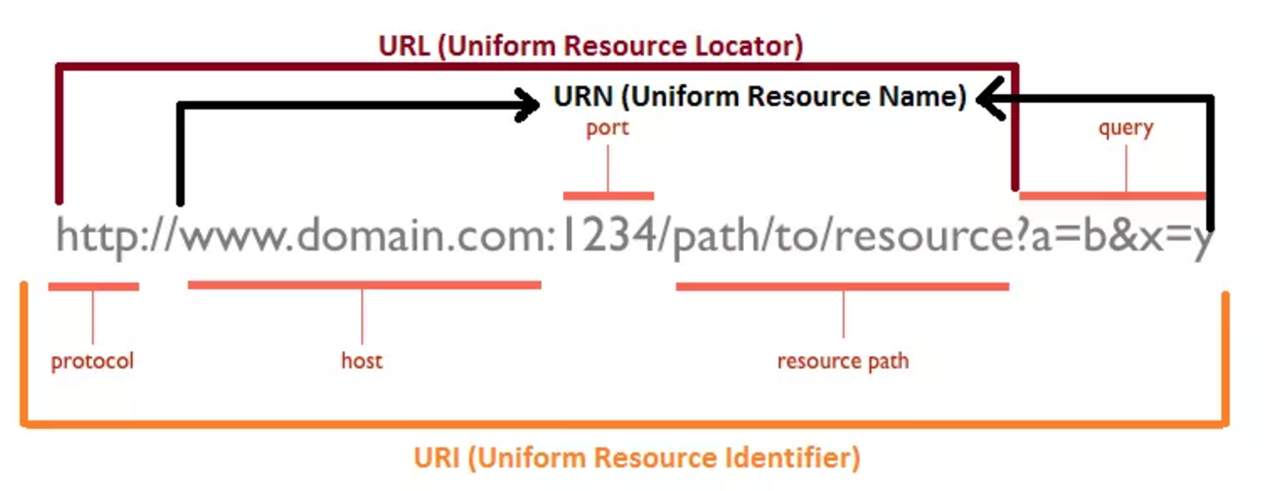
URL, URN, URI: Oh My!
Image taken from: http://webtechsharing.com/http-web-developer-must-know/

Slide 7
HTTP Request
HTTP request consist of three items separated by spaces:
HTTP Verb : Indicates the HTTP Method.
Requested URL : URL is the name of the resource being requested.
HTTP version being used.
HTTP Headers:
Referer
User-Agent
Host
Cookies.

Slide 8
HTTP RESPONSE
HTTP request consist of the following elements:
HTTP version being used.
Status Code : A numeric value indicating the result of the request.
Server header.
Set-Cookie
Content Lengh.

Slide 9
HTTP Methods

Slide 10
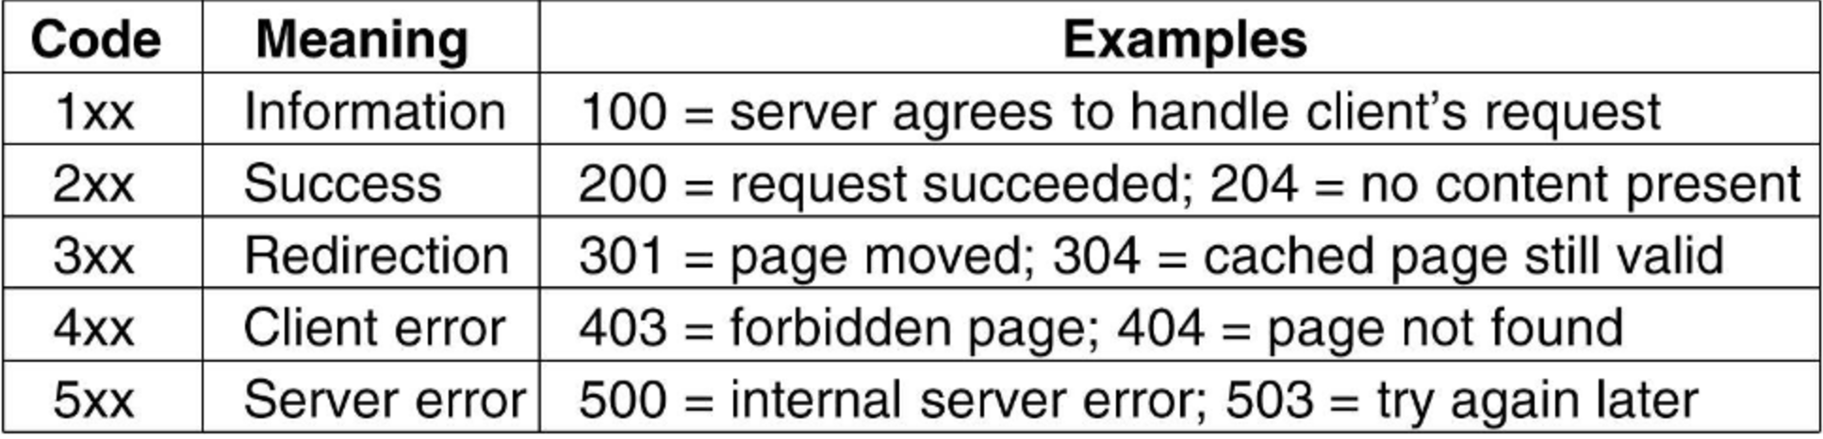
HTTP Status Codes

Slide 11
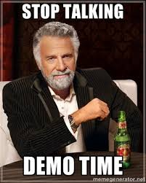

Slide 12
State Management with Cookies

Slide 13
Web aPPLICATION (IN)Security

Slide 14
Core Problem : Input Data Validation

