Slide 1


search research without having to re-search once
Rohit Saily
Donisius Wigie
Michael Ilao
L01-G08

Slide 2

Project Objective
Performance
Variety
To create a product that allowed users to search for research papers with ease and accuracy
Growth
search
re-search
UI
Quality
And Relevance
Flexibility

Slide 3

Scope and Motivation
The target audience for our application is any academics that publish research and would like it available for others to use and cite in their research.
The other side of our audience is students searching for relevant research papers to what they require.
Creating an innovative and useful application that could be widely used by all members of academia.

Slide 4

Dataset
AMINER.ORG - DBLP-CitationnetworkV10
Contains 3,079,007 papers and 25,166,994 citation relationships.
The papers are tuples Paper ID, the title, the authors, the publishing venue, the year it was published, the citation number, the references and the abstract.
The papers were related by citations.

Slide 5
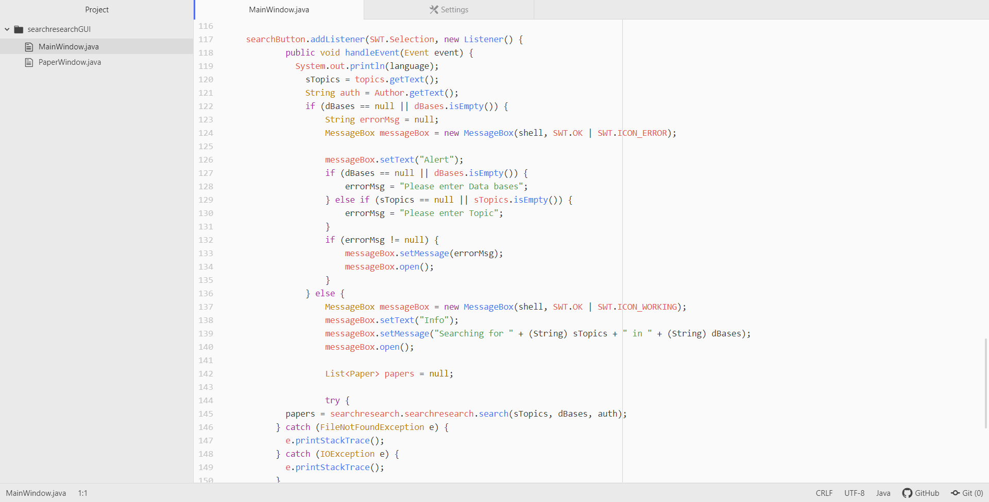
Requirements
Non-Functional
Reliability
Performance
Growth
Quality
Functional
Search for relevant papers based on key words
Search by authors
User Interface
Presenting the results in worst case linear time

Slide 6
Algorithm Challenges
Searching Algorithm
Sorting Algorithm
Graphing Algorithm
Input and Output
-search topics
-search authors
-Sort databases
-sort papers and rank them
-graphed papers by references, digraph if a refers to b. b points to a. helps with ranking
Input is taken from the AMINER data set and converted to an XLS file with title, abstract, authors, Id, references.
Input from the user is the data set to be searched and the topic or author to be searched.
Output is all the relevant papers that matched the user input.

Slide 7


Verification and Validation
Test Cases - Back-End
Validity: program is returning relevant information
Performance: program returns information in linear time
Boundary Cases: testing empty string as input
Exceptions: test all exceptions are working functional
Test Cases – Front-End
Performance: ease-of-use is of high priority
Quality: User Inputs should be filtered for trivial strings. ex: “empty string”
Validity: UI returns the same output as the Back-End console

Slide 8
Demonstration

