Slide 1
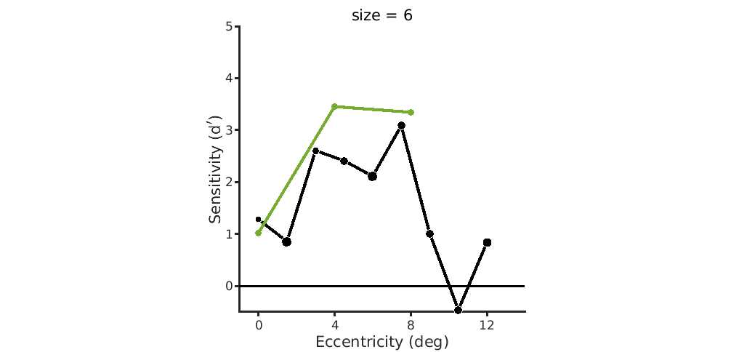
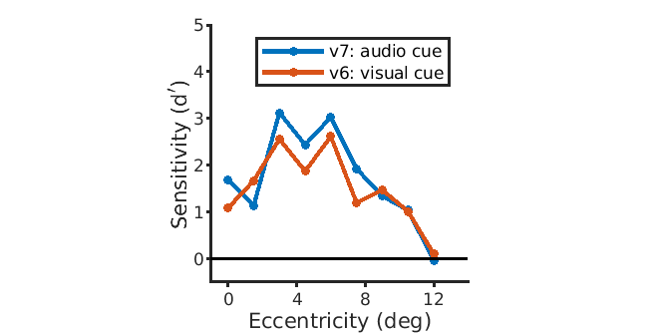
Neutral performance doesn’t change a lot between versions
Daniel
Nina
v7
v3

Slide 2
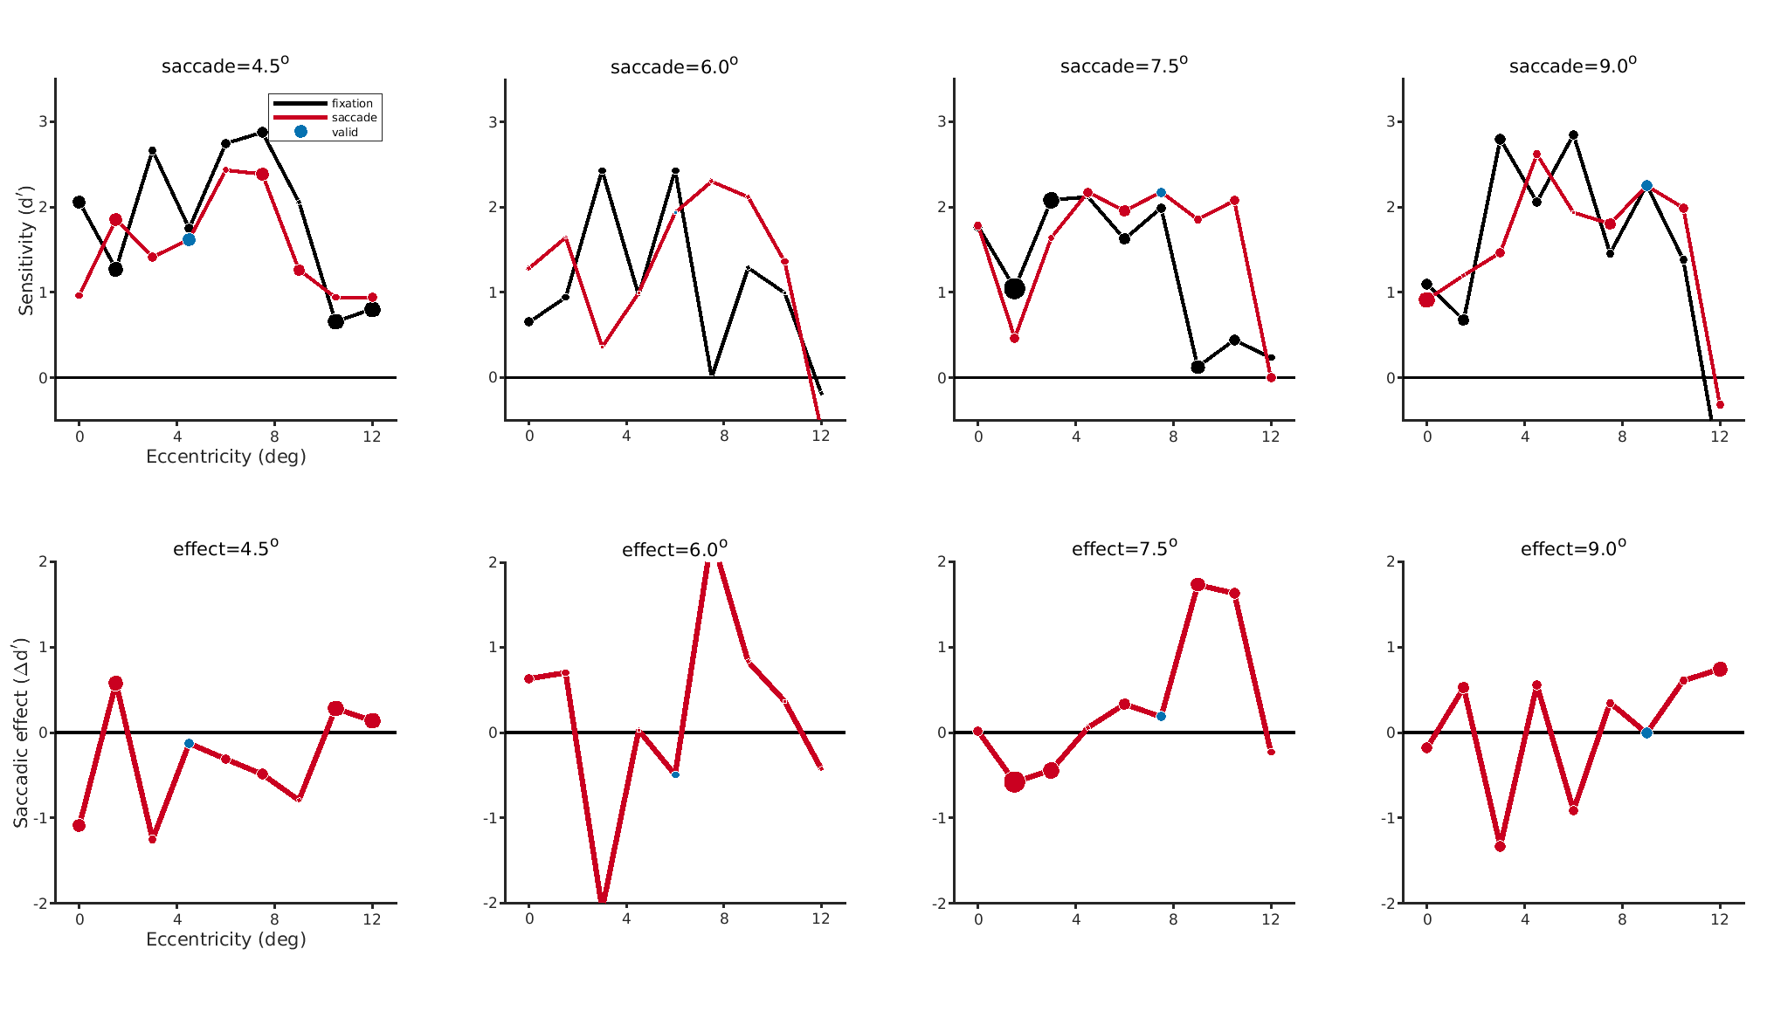
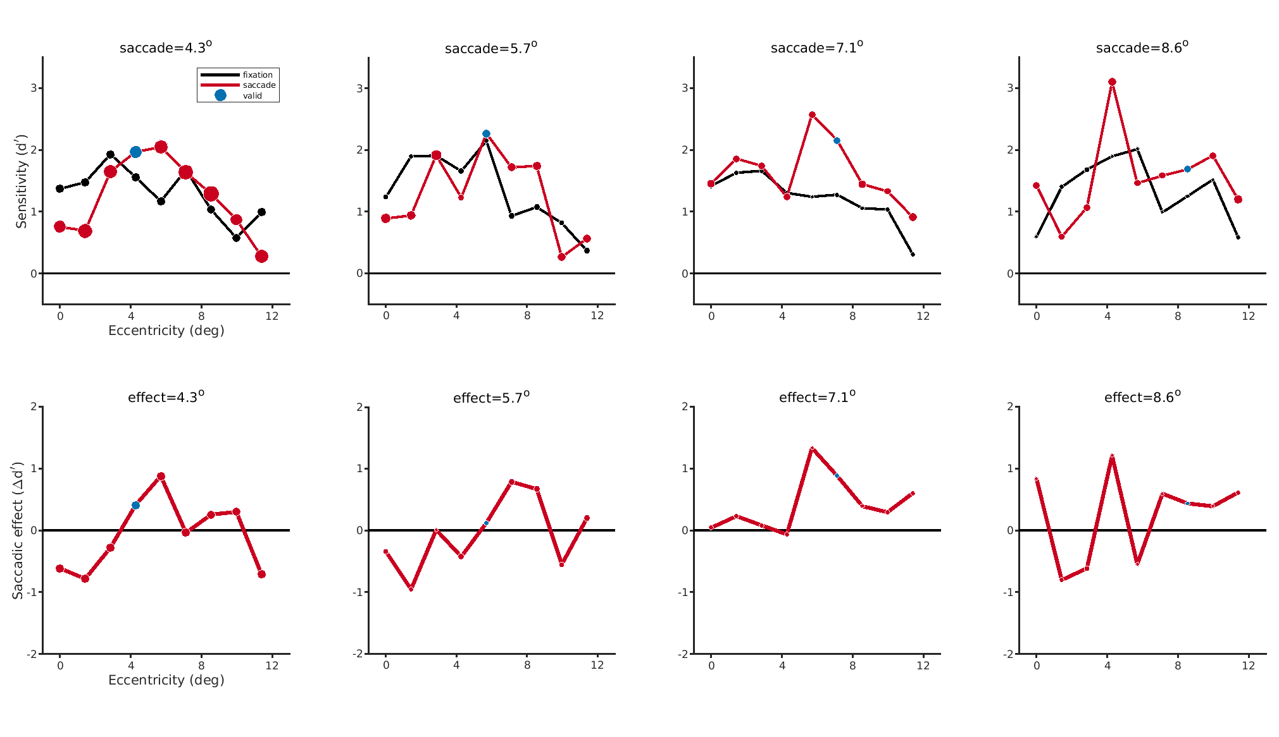
No clear ‘release’ from suppression at fovea with audio cue
Audio cue
Visual cue

