Slide 1
noPizzaCPD update
03/10/22

Slide 2
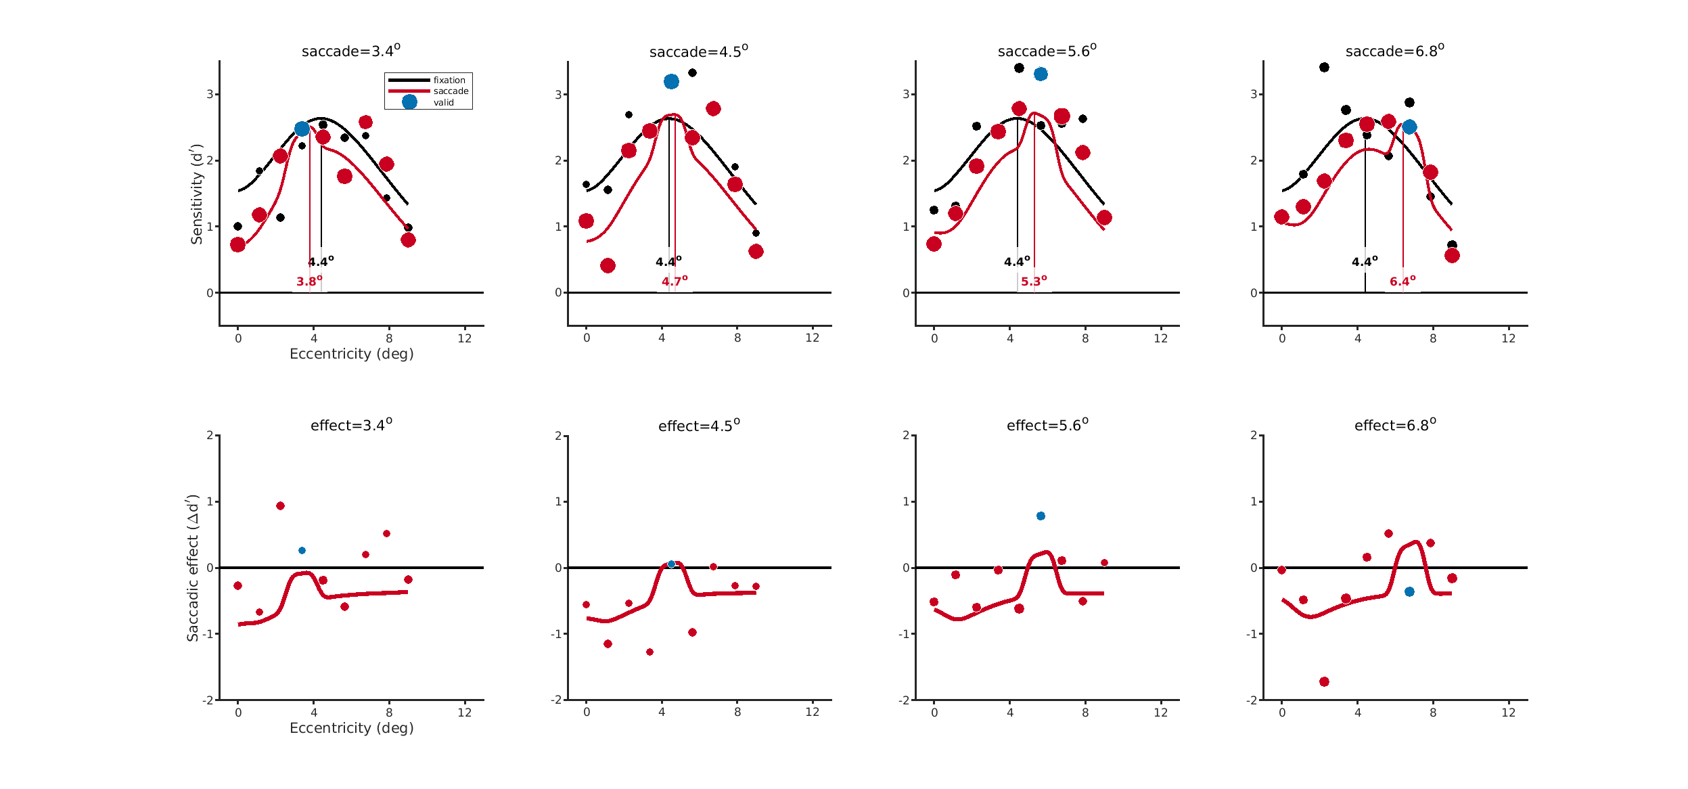
DT – response gain (ΔBIC = 0)

Slide 3
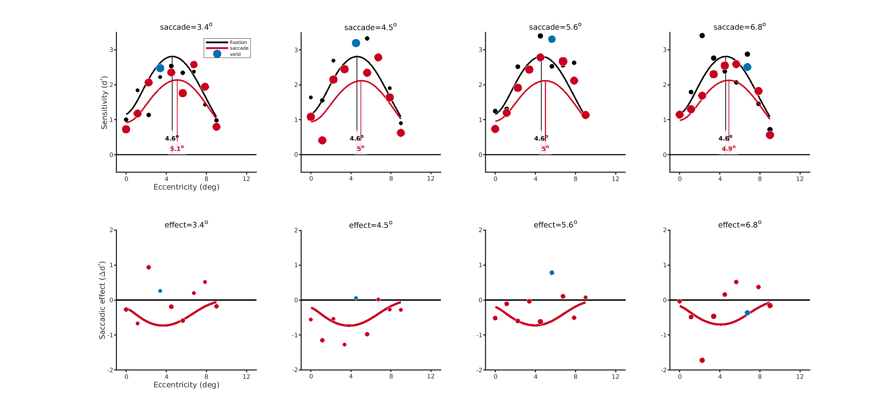
DT – NMA (ΔBIC = 5.5)

Slide 4
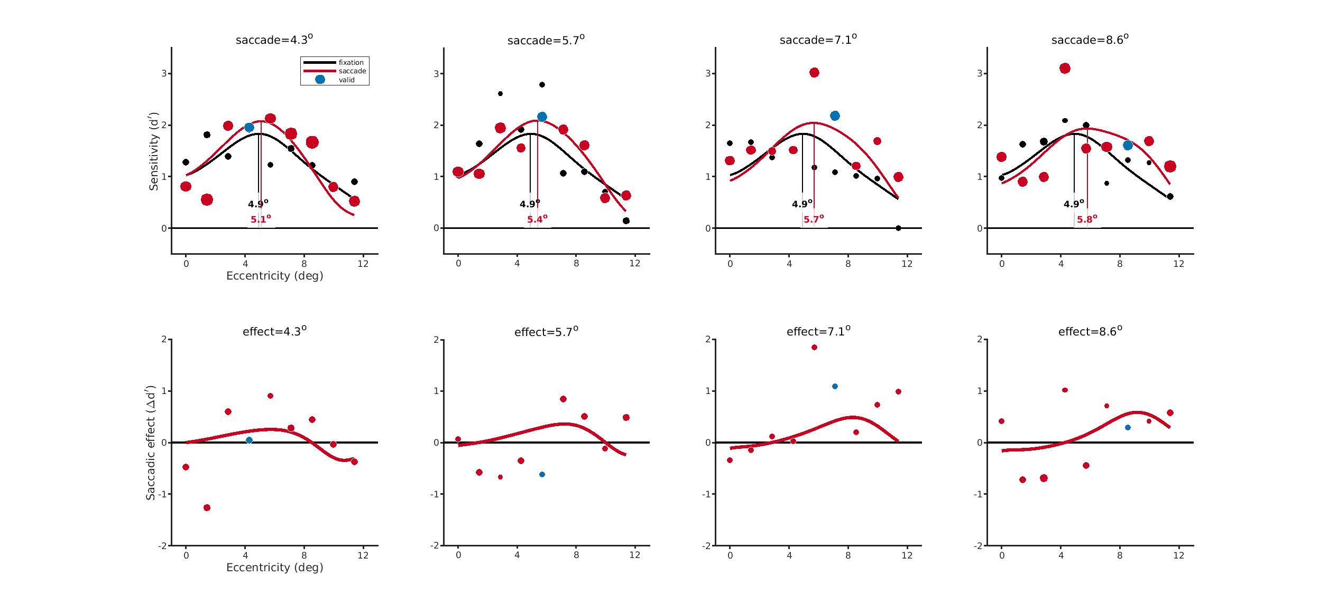
NH – response gain (ΔBIC = 0)

Slide 5
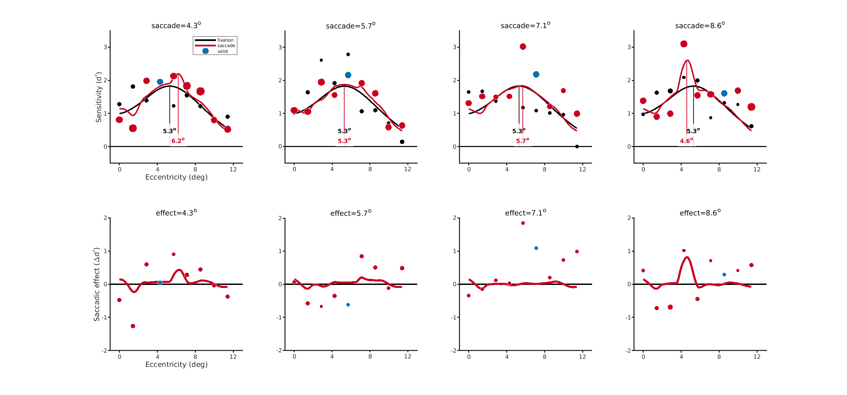
NH – main model (ΔBIC = 15.5)

Slide 6
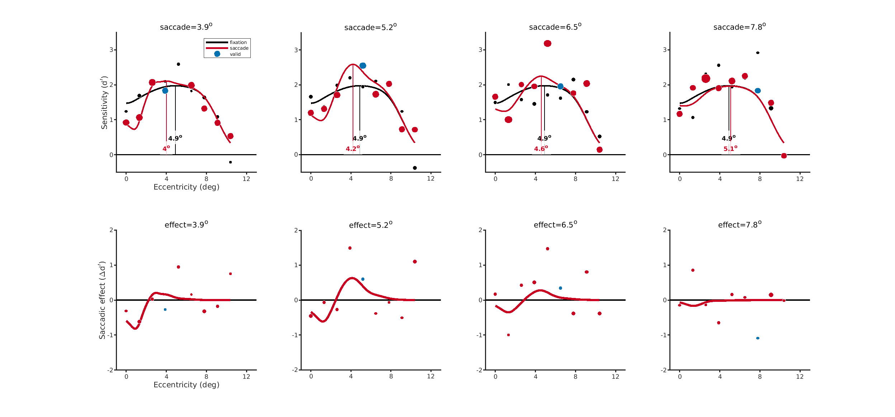
MJ – response gain (ΔBIC = 0)

Slide 7
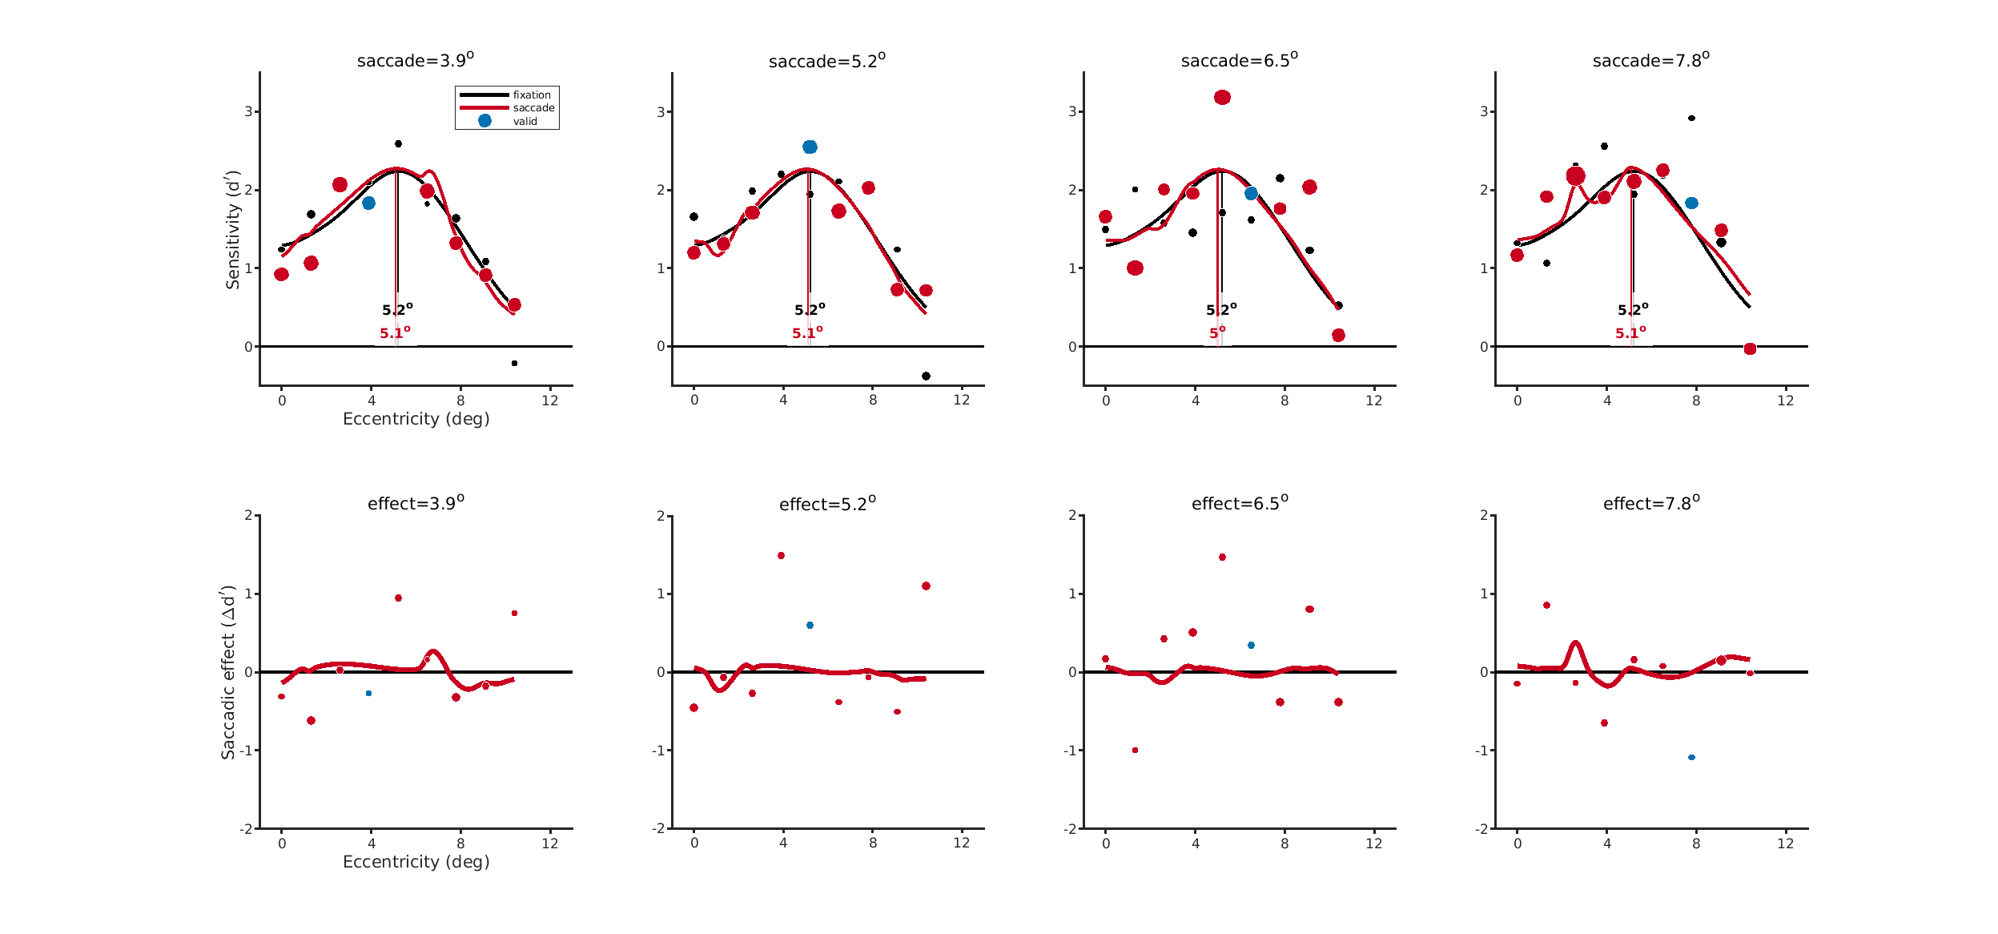
MJ – NMA (ΔBIC = 4.5)

Slide 8
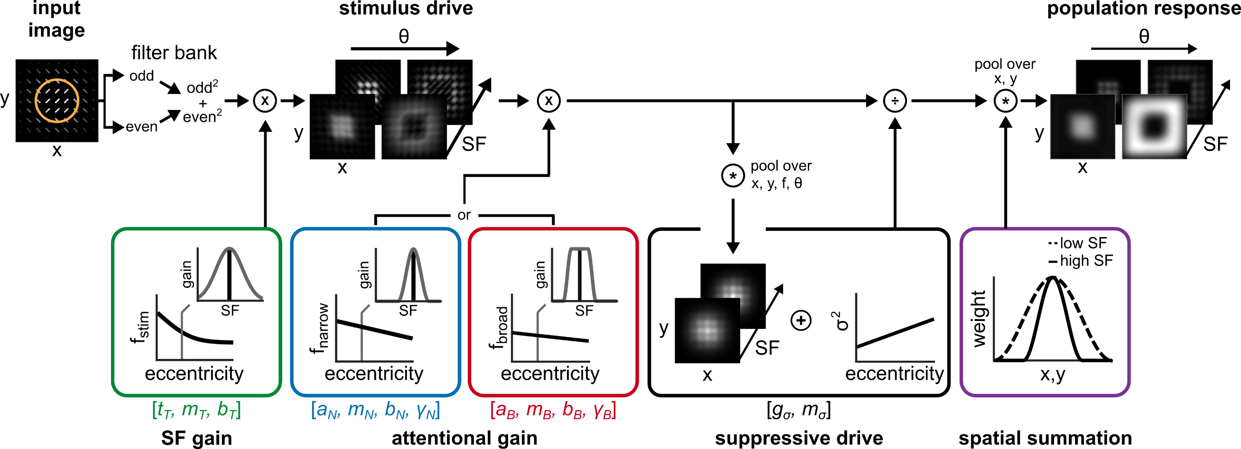
Model ingredients - NMA

Slide 9
Model ingredients – response gain
Attention happens after normalization

