Slide 1
MVC
Organizing Code for a Web App

Slide 2
MVC - Model View Controller
It can be overwhelming knowing how to even begin starting a web app. MVC is a way to organize/structure an application so that it is easy to understand, build, and maintain.
MVC is broken up into 3 parts - the Model, View, and Controller; and how they are expected to interact.

Slide 3
Model - data storage and data logic
The Model is where the data is stored. You interact with the Model to read, change, add, or delete data.
In a web application, this could be the database and tools that interact/translate that data.

Slide 4
View - user interface
The View is what the user sees and interacts with (the UI - User Interface). It’s the window/door between the user and the entire application. We only allow the user to see and interact with very specific things.

Slide 5
Controller - application logic and flow
The Controller processes and passes data/instructions between the View and Model.

Slide 6
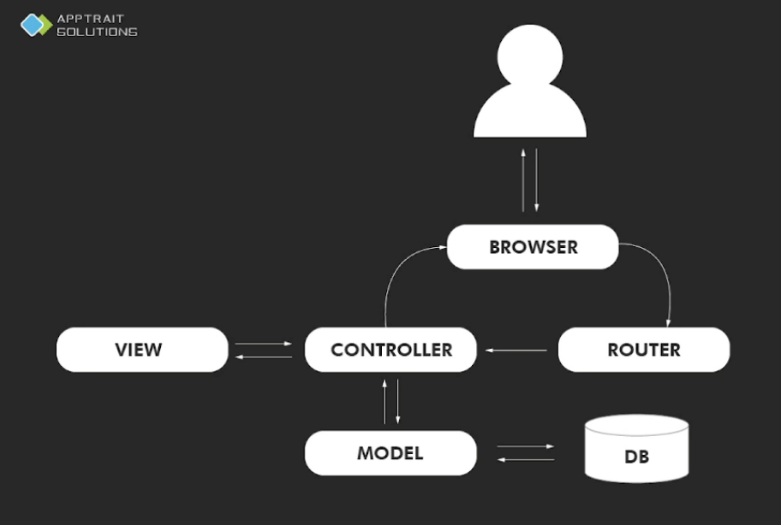
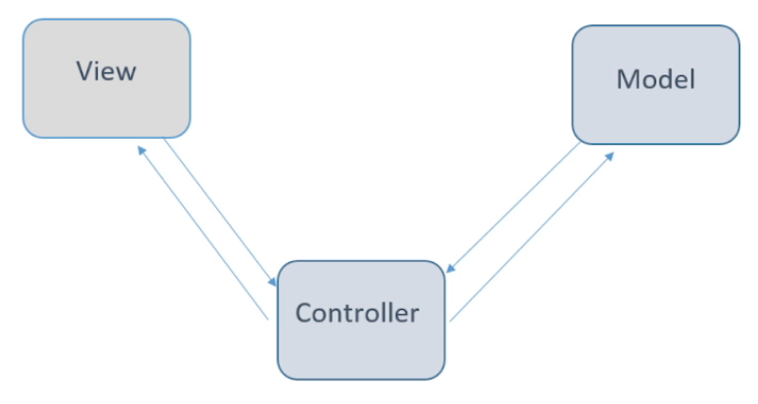
General MVC Flow Examples
Examples of how workflow may work with MVC.

Slide 7
How do you implement MVC in a JS Web App?
Model - data storage using dbs such as MySQL, Oracle, MongoDB. Can include db interfaces such as Mongoose.
Views - allow user interaction with data using a “templating language” such as EJS, Handlebars, Pug, Nunjucks
Controllers - handles application behaviour and data movement between Model and View, often through multiple javascript files

Slide 8
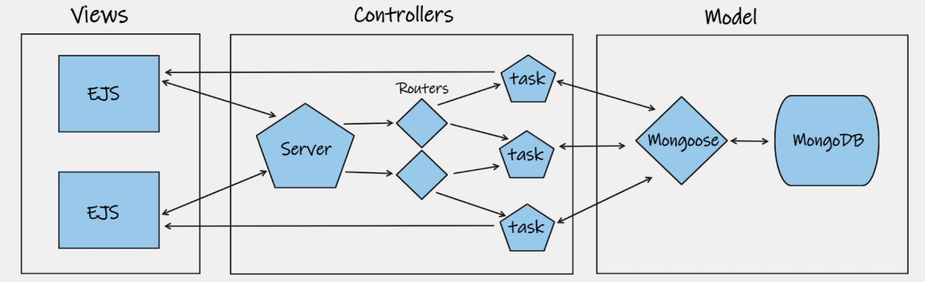
MVC JS Example
basic app with 2 views, server, and multiple controllers
data storage = mongoDB ; storage interface = mongoose
controller - command sent to appropriate controller through URL paths handled by Routes
Routers - route map URLs to specific controller functions
paths may be routed multiple times to reach a function in a file
source - MayanWolfe: https://www.twitch.tv/mayanwolfe

Slide 9
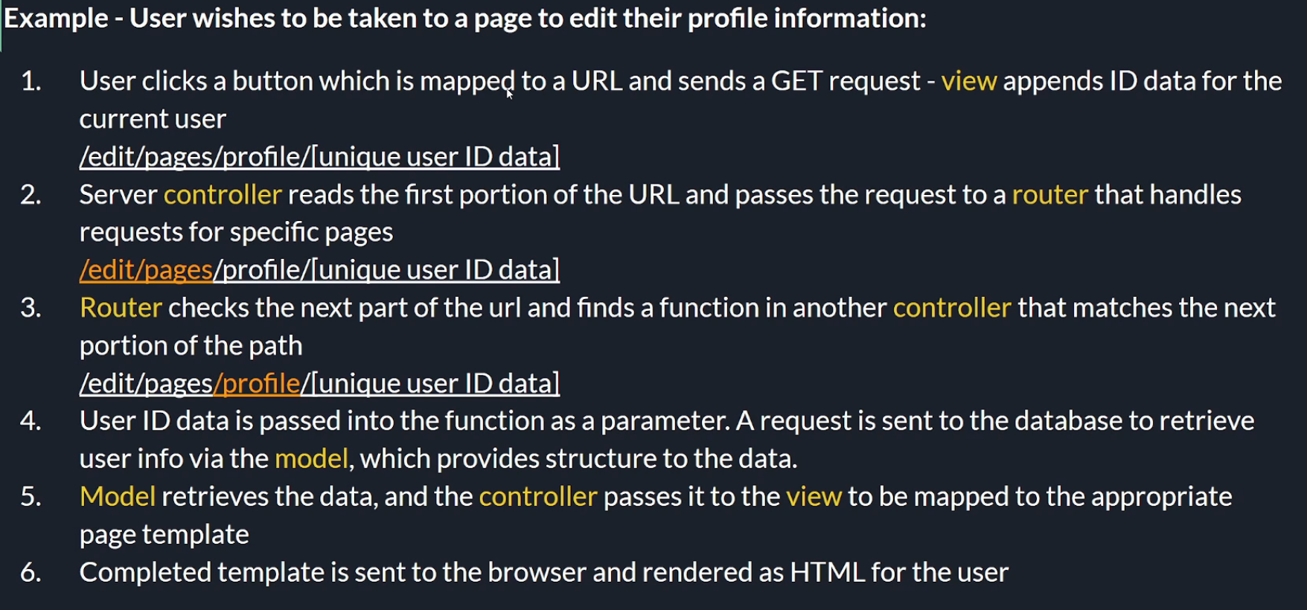
MVC JS Example - Routing
source - MayanWolfe https://www.twitch.tv/mayanwolfe

