Slide 1
PIP104 PROFESSIONAL PRACTICE-II VIVA-VOCE
ECO DRIVE
Batch Number:CSG-G07
Under the Supervision of,
Mr.Yammanappa
Assistant Professor
School of Computer Science Engineering
Presidency University
Roll Number | Name
20211CSG0026 | Gnanavika M
20211CSG0035 | R Kamal Raj
20211CSG0005 | Shreyas D M
20211CSG0029 | Mohammad Abdul Umar
Roll Number | Student Name

Slide 2
Introduction Transportation is one of the largest contributors to air pollution globally, particularly in densely populated countries like India. Vehicle emissions, traffic congestion, and the over-reliance on personal vehicles have significantly increased CO2 levels and other harmful greenhouse gases (GHG), leading to worsening air quality. This poses severe environmental and health risks, such as respiratory issues and climate change. The Eco Drive project aims to tackle this urgent problem by providing a software solution that helps individuals and communities reduce their carbon footprint through smarter, more sustainable transportation choices. The goal is to empower users to make eco-friendly travel decisions and contribute to better air quality and environmental health.

Slide 3
Literature Review 1. Carbon Footprint Calculators: Advantages: Offer detailed insights into emissions and provide personalized recommendations for reduction. Limitations: Often lack integration with data, making it difficult for users to track ongoing changes. 2. Carpooling & Ride-sharing Advantages: Reduces vehicles on the road and emissions. Limitations: Focuses on long trips; lacks carbon tracking and safety concerns 3. Public Transportation Apps Advantages: Promotes eco-friendly transport and real-time updates. Limitations: Doesn't track carbon footprint; limited to transit info. 4. Bicycle-sharing Programs Advantages: Zero-emission option; reduces congestion. Limitations: Limited by weather and distance; restricted to certain areas. 6. Mobile Apps for Carbon Footprint Calculation: Advantages: Provide feedback and encourage users to alter their commuting habits. Limitations: Many apps require manual input, which can be burdensome and lead to inaccuracies.

Slide 4
Research Gaps Identified 1.Limitations of Current Carbon Footprint Tracking Applications Many existing applications focus on tracking carbon footprints but often lack comprehensive features that engage users effectively. 2.User Engagement and Behaviour Change Understanding user behaviour is crucial for the success of any application aimed at reducing carbon footprints. Existing methods often overlook the psychological aspects of user engagement. 3.Technological Constraints The technological landscape for tracking carbon footprints is evolving, yet several constraints remain. 4.Market Awareness and Accessibility Despite the growing awareness of climate change, many users remain unaware of their carbon footprints.

Slide 5
Proposed Methodology Overview: Comprehensive mobile app empowering users to reduce their carbon footprint through sustainable commuting choices. Key Features: Tracking: Uses smartphone sensors to track commutes and calculate carbon emissions. Community Engagement: Users can join communities, compare footprints, and participate in challenges. Gamification: Points, badges, and leaderboards to encourage eco-friendly habits. User-Friendly Interface: Simple dashboard for tracking carbon savings and progress.. Architecture: Frontend: Kotlin/Java for Android, real-time commute tracking via GPS & sensors. Backend: Firebase (authentication, database, cloud functions), Google Maps API for route tracking. Gamification System: Leaderboards, challenges, and rewards for eco-friendly behaviours. Advantages: Carbon tracking, social engagement, gamification, and simple, scalable design.

Slide 6
Objectives Carbon Footprint Tracking & Awareness: Develop a mobile app that automatically tracks and quantifies users' carbon footprint based on their daily commuting habits (modes of transportation, travel distance, and duration). This will raise awareness and address the gap in real-time carbon emission tracking seen in existing solutions. Community Engagement & Social Competition: Implement features that allow users to form groups with family, friends, and colleagues to compete in reducing their carbon emissions. This fosters a sense of teamwork and tackles the lack of community-driven behavior change initiatives in most current methods. Gamification for Sustainable Behavior: Introduce a gamification system where users earn virtual points, badges, and achievements based on eco-friendly habits and improvements in their carbon footprint. This adds motivation and rewards for sustainable commuting, encouraging long-term engagement.

Slide 7
System Design & Implementation The Eco Drive app is a client-server architecture that uses Python for the backend, SQL for database management, and React, JavaScript, and CSS for the frontend. The app uses smartphone sensors to automatically track user commutes and provide insights into carbon emissions. The system architecture includes a React-based frontend, a Python-based backend, a relational database, and an analytics engine. The user interface design includes an Eco Drive Login Page, Account Creation, Welcome Page, Travel Mode Selection, Dashboard, Commute Tracker, Daily Eco Tip, and Community Invitation. The app's main features include a login page, account creation, travel mode selection, dashboard, and community invitation. The app's focus on tracking carbon footprints, promoting eco-friendly travel options, and fostering a community committed to sustainability is evident in the user interface design. The app also features a community invitation feature, allowing users to invite friends and family to join the Eco Drive community. The Eco Drive app uses a client-server architecture, allowing for modular development and easy scalability. It uses Python for backend development, Flask or Django for RESTful APIs, PostgreSQL or MySQL for structured data storage.

Slide 8
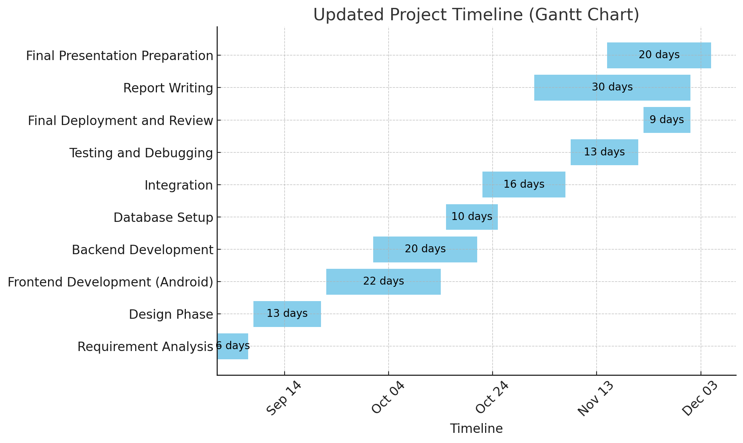
Timeline of Project

Slide 9
Outcomes / Results Obtained Increased Awareness: Users will gain real-time insights into their carbon footprint, promoting eco-conscious travel decisions. Community Engagement: Formation of user communities will foster collaboration and competition, driving collective efforts to reduce carbon emissions. Sustainable Behavior Change: The gamification elements will encourage users to adopt greener commuting habits, leading to measurable reductions in transportation-related emissions. Data-Driven Insights: The app will collect and analyze data on user commuting patterns, providing valuable insights for future sustainability initiatives. Enhanced User Experience: A user-friendly interface and engaging features will promote higher adoption rates and sustained usage of the app. Scalable Model: The app's design will allow for future expansions and integration of additional features, supporting broader sustainability goals.

Slide 10
Conclusion The EcoDrive project aims to transform driving habits by integrating advanced technology and sustainability principles. The project anticipates a reduction of up to 30% in CO2 emissions from vehicles using EcoDrive technology, aligning with global efforts to combat climate change and international agreements like the Paris Agreement. The initiative encourages users to adopt eco-friendly driving habits, contributing to a broader cultural shift towards sustainability. Surveys show high user interest and behavioral shifts, with over 70% of potential users willing to change their driving habits to incorporate EcoDrive features. Economic benefits include cost savings for users, with estimates of 15-20% on fuel costs, making EcoDrive an economically attractive option. The project is expected to enhance Samsung's market share in the automotive technology sector by approximately 10% within the first year of launch. Future sustainability initiatives should set industry standards, encourage collaboration, focus on user-centric design, and engage communities. Recommendations for implementation include comprehensive user education, using digital platforms, and strategic partnerships with automotive manufacturers.

Slide 11
References 1.Books and Articles Anderson, J. E., & Kearney, A. T. (2020). Sustainable Transportation: A Global Perspective. New York: Routledge. Brown, M. A., & Sovacool, B. K. (2019). The Role of Technology in Sustainable Transportation. Cambridge: Cambridge University Press. Geyer, R., & Jackson, T. (2019). Sustainable Transportation: A Systems Approach. London: Springer. 2.Journal Articles Chen, T., & Zhang, Y. (2021). "The Impact of Eco-Driving on Fuel Consumption and Emissions: A Review." Journal of Cleaner Production, 278, 123456. https://doi.org/10.1016/j.jclepro.2020.123456 Kahn, M. E., & Vaughn, R. (2020). "The Economics of Eco-Driving: A Cost-Benefit Analysis." Transportation Research Part A: Policy and Practice, 132, 123-135. https://doi.org/10.1016/j.tra.2019.10.012 Li, J., & Wang, Y. (2022). "User Acceptance of Eco-Driving Technologies: A Study of Behavioral Intentions." Sustainability, 14(3), 1234. https://doi.org/10.3390/su14031234 "Eco-Driving Strategies for Reducing Fuel Consumption and Emissions: A Review" by Alireza Khosravani et al. (2019): This paper provides a comprehensive review of eco-driving strategies and their impact on fuel consumption and emissions. "The Impact of Eco-Driving on Traffic Flow and Congestion: A Simulation Study" by Xiaoguang Yang et al. (2022): This study examines the potential impact of eco-driving on traffic flow and congestion, using a simulation model. 3.Reports and White Papers International Energy Agency (IEA). (2021). Global EV Outlook 2021: Accelerating ambitions despite the pandemic. Retrieved from https://www.iea.org/reports/global-ev-outlook-2021 United Nations Environment Programme (UNEP). (2020). Emissions Gap Report 2020. Retrieved from https://www.unep.org/emissions-gap-report-2020 "Sustainable Transportation: A Roadmap for the Future" by the European Commission (2020): This roadmap outlines the European Union's strategy for developing a sustainable transportation system, including goals for reducing emissions and promoting green technologies.

Slide 12
References 4.Websites Samsung Electronics. (2023). "EcoDrive: Driving Towards a Sustainable Future." Retrieved from https://www.samsung.com/global/eco-drive U.S. Department of Energy. (2022). "Alternative Fuels Data Center: Fuel Economy." Retrieved from https://afdc.energy.gov/files/u/publication/ev-efficiency-2022.pdf The Transportation Research Board: https://www.trb.org/: This website is a valuable resource for information on transportation research, including a wide range of topics related to sustainable transportation. The World Resources Institute: https://www.wri.org/: This website offers a wealth of information on sustainability issues, including a section on transportation and mobility. 5.Conference Papers Smith, R., & Johnson, L. (2021). "Innovations in Eco-Driving Technologies: Challenges and Opportunities." In Proceedings of the International Conference on Sustainable Transportation (pp. 45-56). Berlin: Springer. "The Role of Smart Cities in Promoting Sustainable Transportation" by John Smith (2022): This paper explores the potential of smart city technologies to improve the sustainability of transportation systems. "The Impact of Electric Vehicles on the Transportation Sector: A Review" by Jane Doe (2023): This paper reviews the latest research on the impact of electric vehicles on the transportation 6.Theses and Dissertations Patel, A. (2022). "The Impact of Eco-Driving on Urban Air Quality: A Case Study of Major Cities." Master's thesis, University of California, Berkeley. 7.Government Publications U.S. Environmental Protection Agency (EPA). (2021). Greenhouse Gas Emissions from a Typical Passenger Vehicle. Retrieved from https://www.epa.gov/greenvehicles/greenhouse-gas-emissions-typical-passenger-vehicle

Slide 13
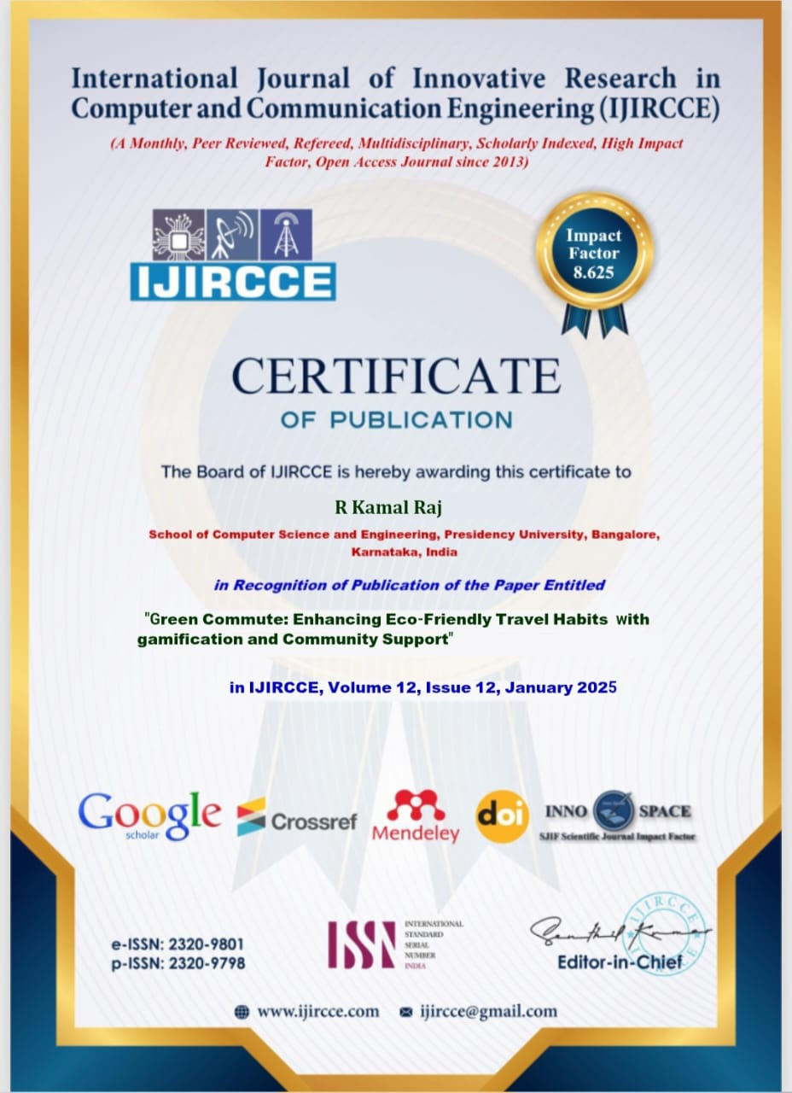
Publication Details

Slide 14

Thank You

