Slide 1
PROJECT TITLE - ECO DRIVE
PIP104 University Project-II
Review-1
Batch Number: CSG-G08
Roll Number | Student Name
R Kamal Raj | 20211CSG0035
Shreyas D M | 20211CS0005
Mohammed Umar | 20211CSG0029
Gnanavika M | 20221LCG0026
Under the Supervision of,
Prof.Yamanappa
Assistant Professor
School of Computer Science & Engineering
Presidency University

Slide 2
Problem Statement Number:
Organization: Samsung R&D
Category (Hardware / Software / Both) : Software
Problem Description: Eco Drive Goal: Reduce carbon footprint of the travel Proposal: Build a smartphone app that helps you to car/bike pool,
compare and compete with your friends on the carbon footprint of the travel. Air pollution in India is a serious issue with major
contributors being vehicle emissions and traffic congestions. Individuals and communities can play a more effective role in
reducing the air pollution if they are aware of their contributions to the same.
Carbon footprint is one way of quantifying the direct and indirect emissions. We propose smartphone application (app) that can
automatically track the carbon footprint of the users by analyzing the details of the commute, such as mode of travel, distance,
and duration. Basic guidelines of the app: 1. Community centered – the app lets you invite family and friends to join a community that strives to
reduce the carbon footprint 2. Gamification – Virtual points/badges awarded to the members who top the eco-friendliness of
commute, or make significant improvements to their carbon footprint 3. Simple to use – the app may request the user to setup
their regular mode of travel (private vehicle or public transport) during the onboarding time. The app infers other details of the
commute automatically through smartphone sensors (GPS etc.) and related
framework, for e.g., Android’s DetectedActivity class
Difficulty Level: Complex

Slide 3
Introduction
Transportation is one of the largest contributors to air pollution globally, particularly in densely populated countries like India. Vehicle emissions, traffic congestion, and the over-reliance on personal vehicles have significantly increased CO2 levels and other harmful greenhouse gases (GHG), leading to worsening air quality. This poses severe environmental and health risks, such as respiratory issues and climate change.
The Eco Drive project aims to tackle this urgent problem by providing a software solution that helps individuals and communities reduce their carbon footprint through smarter, more sustainable transportation choices. The goal is to empower users to make eco-friendly travel decisions and contribute to better air quality and environmental health.

Slide 4
Literature Review
1. Carbon Footprint Calculators:
Advantages: Offer detailed insights into emissions and provide personalized recommendations for reduction.
Limitations: Often lack integration with data, making it difficult for users to track ongoing changes.
2. Carpooling & Ride-sharing
Advantages: Reduces vehicles on the road and emissions.
Limitations: Focuses on long trips; lacks carbon tracking and safety concerns
3. Public Transportation Apps
Advantages: Promotes eco-friendly transport and real-time updates.
Limitations: Doesn't track carbon footprint; limited to transit info.
4. Bicycle-sharing Programs
Advantages: Zero-emission option; reduces congestion.
Limitations: Limited by weather and distance; restricted to certain areas.

Slide 5
Literature Review
6. Mobile Apps for Carbon Footprint Calculation:
Advantages: Provide feedback and encourage users to alter their commuting habits.
Limitations: Many apps require manual input, which can be burdensome and lead to inaccuracies.
7. Community-Based Initiatives:
Advantages: Foster collective action towards reducing emissions by encouraging shared responsibility.
Limitations: Success often hinges on community participation, which can be inconsistent.

Slide 6
Proposed Method
Overview:
Comprehensive mobile app empowering users to reduce their carbon footprint through sustainable commuting choices.
Key Features:
Tracking: Uses smartphone sensors to track commutes and calculate carbon emissions.
Community Engagement: Users can join communities, compare footprints, and participate in challenges.
Gamification: Points, badges, and leaderboards to encourage eco-friendly habits.
User-Friendly Interface: Simple dashboard for tracking carbon savings and progress..
Architecture:
Frontend: Kotlin/Java for Android, real-time commute tracking via GPS & sensors.
Backend: Firebase (authentication, database, cloud functions), Google Maps API for route tracking.
Gamification System: Leaderboards, challenges, and rewards for eco-friendly behaviours.
Advantages:
Carbon tracking, social engagement, gamification, and simple, scalable design.

Slide 7
Objectives
Carbon Footprint Tracking & Awareness: Develop a mobile app that automatically tracks and quantifies users' carbon footprint based on their daily commuting habits (modes of transportation, travel distance, and duration). This will raise awareness and address the gap in real-time carbon emission tracking seen in existing solutions.
Community Engagement & Social Competition: Implement features that allow users to form groups with family, friends, and colleagues to compete in reducing their carbon emissions. This fosters a sense of teamwork and tackles the lack of community-driven behavior change initiatives in most current methods.
Gamification for Sustainable Behavior: Introduce a gamification system where users earn virtual points, badges, and achievements based on eco-friendly habits and improvements in their carbon footprint. This adds motivation and rewards for sustainable commuting, encouraging long-term engagement.

Slide 8
Methodology
Hardware & Software Used in Eco Drive Project
Hardware:
Development System: Laptop/PC with 8GB+ RAM (16GB recommended) and modern processor (Intel i5/AMD).
Mobile Devices: Android Smartphone (API Level 21+), integrated GPS for location tracking.
Internet Connection: Reliable connection for server-side deployment, API access, and real-time data sync.
Software:
Mobile App Development: Android Studio (IDE), Kotlin/Java for coding.
Backend Development: Firebase Firestore (NoSQL database), Firebase Authentication, Node.js or Python for backend services.
APIs & Services: Google Maps API for route tracking, Firebase Cloud Messaging (FCM) for notifications.
Version Control & Collaboration: Git (GitHub/GitLab) for version control and team collaboration.
Testing Tools: Android Emulator for device testing, Postman for API testing.
Deployment & Cloud Hosting: Heroku/Railway for backend hosting, Firebase Hosting for static content.

Slide 9
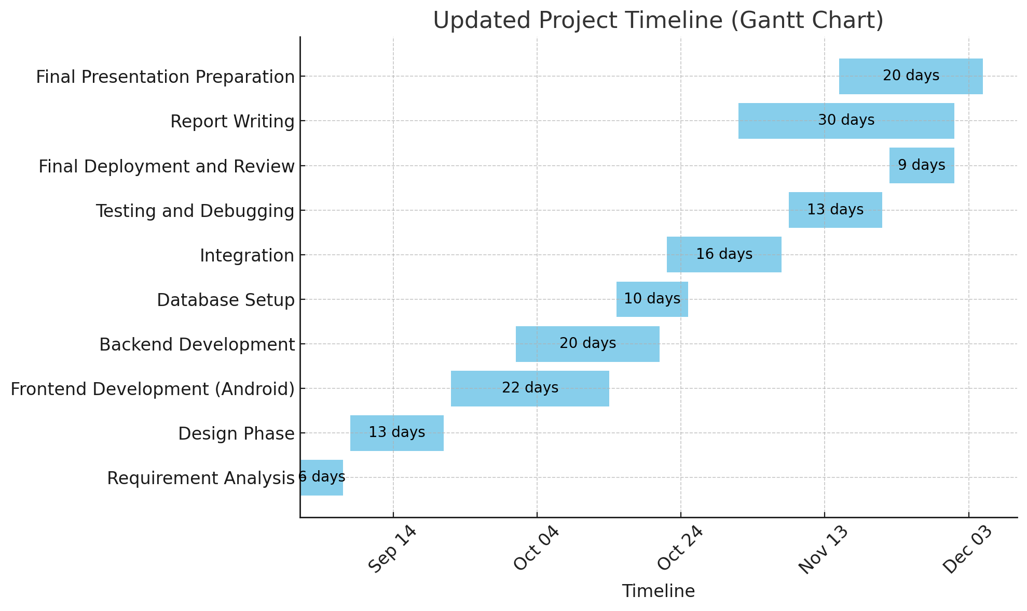
Timeline of Project

Slide 10
Expected Outcomes
Increased Awareness: Users will gain real-time insights into their carbon footprint, promoting eco-conscious travel decisions.
Community Engagement: Formation of user communities will foster collaboration and competition, driving collective efforts to reduce carbon emissions.
Sustainable Behavior Change: The gamification elements will encourage users to adopt greener commuting habits, leading to measurable reductions in transportation-related emissions.
Data-Driven Insights: The app will collect and analyze data on user commuting patterns, providing valuable insights for future sustainability initiatives.
Enhanced User Experience: A user-friendly interface and engaging features will promote higher adoption rates and sustained usage of the app.
Scalable Model: The app's design will allow for future expansions and integration of additional features, supporting broader sustainability goals.

Slide 11
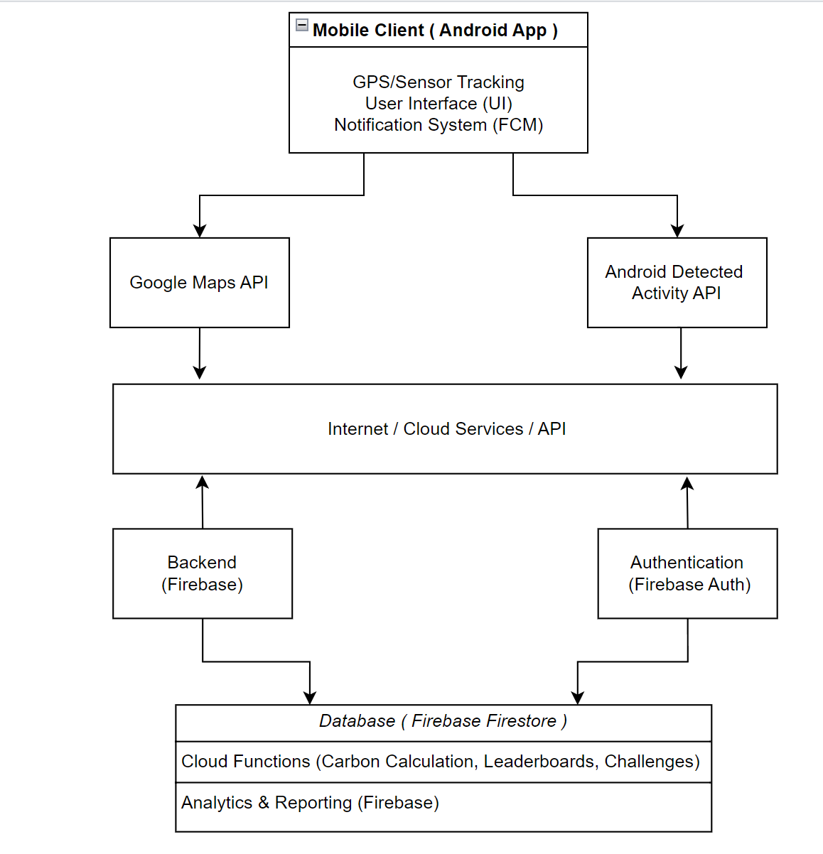
Architecture:

Slide 12
Conclusion
The Eco Drive project aims to address the critical challenge of reducing the carbon footprint of transportation through innovative technology. By providing a mobile application that tracks users' carbon emissions in real-time, fosters community engagement, and incorporates gamification, the project seeks to motivate individuals to adopt sustainable commuting practices.
Through collaboration and competition, users will become more aware of their environmental impact and be empowered to make eco-friendly choices. Ultimately, Eco Drive not only aims to contribute to improved air quality and reduced greenhouse gas emissions but also strives to create a scalable and replicable model for future sustainability initiatives in urban environments.

Slide 13
References
1. "Developing a Web-Based Carpooling Application":
https://ieeexplore.ieee.org/abstract/document/10303442
This paper discusses the design and implementation of a web-based platform to promote sustainable transportation and reduce traffic congestion. It provides insights into modern tools like ReactJS, NodeJS, and MongoDB.
2. "Platforms To Calculate Carbon Footprints: A Step Towards Sustainable
https://ieeexplore.ieee.org/document/10141821
Development": This framework enables users to calculate carbon footprints at both individual and industrial levels, incorporating an AI-based recommendation system for customized solutions.
3. "Smart Contract Based Carpooling Application for Secure and Efficient Ride Sharing":
https://ieeexplore.ieee.org/document/10363507
This study presents a decentralized carpooling system leveraging smart contracts to ensure data security and user privacy.
4. "Identification of Eco-Friendly Transportation Mode by Multi-Criteria Decision-Making Method":
https://ieeexplore.ieee.org/document/10443412
This research addresses the selection of environmentally friendly transportation modes by evaluating factors like environmental impact and cost efficiency.

Slide 14
Thank You

