Slide 1
AI System Pilot Results:
Power Series Module Review Example
Notes:
We're piloting an AI system that reviews educational content using the same standards as human reviewers
This demonstration shows results from a real Power Series module - typical raw content from authors with rough edges and todo placeholders

Slide 2
Module's authoring pipeline
Iterate
We are here
Product vision
Authoring guidelines
Style guide
Academic research
...
1 Kit: LOs
1 Module: KSAs
1 Module: Outline
1 Module: Flesh

Slide 3
Author submits module
System Architecture Overview
Designed to emulate existing workflow
Two-Pass Reviewer Phase
First, 30 AI agents run a comprehensive analysis focusing on pedagogy and style.
Authors revise based on these results
A second AI pass verifies fixes and detects new issues
Results are sent to the author and reviewer.
Two-Pass Copy Editor Phase
This is analogous to the process for the Reviewer Phase, but focusing only on style, and reporting out to the autor and the copy editor
Full 4-Pass Workflow
This layered approach moves from raw content to polished final material—progressively refining through pedagogical and stylistic lenses.
1st Review Pass
Results to Author
2nd Review Pass
Results to Author
& Reviewer
1st Review Pass
Results to Author
2nd Review Pass
Results to Author
& Copy Editor
Notes:
Review: Two-phase approach: First review pass focuses on pedagogy and style, second pass verifies fixes
Copy Edit: same process
Four total passes mirror human workflow but execute in seconds instead of days

Slide 4
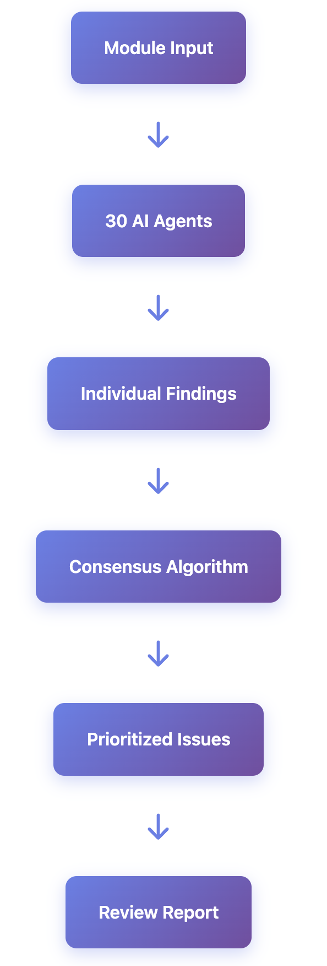
1st Pass - Initial Review
Combines pedagogical and Style Analysis
30 specialized agents review the content from different perspectives (30 API calls)
  Multi-Agent Analysis: 30 specialized agents review the content from different perspectives
  Layered Prompting: Each agent receives layered instructions including exemplars, domain rules, and specific rubrics
Authoring
  9 agents trained on individual rubrics created from the Authoring Guide
  6 generalists
Style
  9 agents trained on individual rubrics created from the Authoring Guide
  6 generalists
Independent Review
  Agents work independently to avoid groupthink
Consensus Building
  Issues are aggregated and ranked by agreement level
Priority Scoring
  Combined severity and consensus determine priority (1-5 scale)
Notes:
30 specialized AI agents review independently to avoid groupthink - like having 30 experts simultaneously
Consensus building identifies real issues when 4+ agents flag the same problem

Slide 5

01
Teaches radius & interval of convergence
02
3 learning activities with worked examples
Module Overview: The Test Subject
03
Includes multiple-choice and short answers
04
Trainee author-submitted with draft level of quality
05
Selected for mixed math & pedagogy validation out of a limited pool of raw author inputs
Notes:
Real trainee-authored content on radius and interval of convergence - deliberately unpolished
Perfect validation case because it represents actual draft quality we receive

Slide 6

Processing Efficiency: Human vs AI
Traditional Review Cycle
A human reviewer typically spends a significant amount of time to perform a first review, and authors can wait several days for feedback.
AI Performance Snapshot
Our AI system completed the full review in just 8 seconds, identifying 18 consensus issues—especially strong on mechanical and structural problems.
Outcome: Time Saved
The system enables instant feedback to the author, and on the second pass, a head start to the author and reviewer/copy editor.
Notes:
Traditional human review takes hours with multi-day turnaround; AI completes in 8 seconds
System excels at catching mechanical issues that reviewers might miss while focusing on pedagogy

Slide 7

Consensus Mechanism: High Confidence Signals
Key Issues with Agent Consensus
The system reached consensus (4+ agents) on 18 major issues like 'Todo' placeholders, vague references, missing IDs, and passive voice usage—clear signs of genuine flaws.
How Consensus Works
Multiple agents reviewing the same content independently spot the same issues.
When four or more agree, the finding is marked as highly reliable.
Why This Matters
High-confidence flags are trusted by authors, cutting through false positives and streamlining content fixes.
Prioritization
Each issue receives a priority score from 1 to 5 based on issue severity and level of agent consensus.
The system is fully explained at the bottom of the consensus issues tab of the output html.
Notes:
When 4+ agents independently flag the same issue, we have high confidence it's real
Priority scoring (1-5) combines severity and consensus level to help authors focus on what matters most

Slide 8

Review Model Results
Explore the full interactive analysis
For the HTML report including issue categories,
consensus breakdowns, agent views, and original
content, visit:
https://michaeljoyce217.github.io/LEARNVIA/
Notes:
Live demonstration of the HTML report showing all findings, consensus analysis, and prioritization
Authors can explore issues by category, see original content, and understand exactly what needs fixing

Slide 9

01
Run partial model in tandem with human reviewers
02
Compare AI and human results for alignment
Paths to Production
03
Engineer and finalize model architecture with API calls
04
Advance to other Learnvia AI projects concurrently
Notes:
Live demonstration of the HTML report showing all findings, consensus analysis, and prioritization
Authors can explore issues by category, see original content, and understand exactly what needs fixing

