Slide 1
GDES-3081-501 - Intro to Design Management
March 23rd, 2026
tokentrust
The AI Data
Governance Society
Term Project Phase I - The Richly Augmented Future Enterprise
Michael Joongmin Park
Industrial Design
#3187413
Jaehong Hwang
Graphic Design
#3191183
Elsie Jang
Graphic Design
#3197476
Group 14

Slide 2
GDES-3081-501 - Intro to Design Management
March 23rd, 2026
Introduction & Background
03-09
Data invisibility and the birth of TokenTrust
Crisis & Opportunity: The AI Data Shift
10-16
Model noise and the new token economy
Strategic Value & Perspectives
17-21
User agency and enterprise liability protection
Stakeholder & Engagement Matrix
22-24
Governance ecosystem for data-token exchange
25-32
Core Service Infrastructure
DQI assessment and reward distribution logic
33-38
Market Positioning & Business Model
Competitive edge in the DaaS and compliance market
39-40
Strategic Roadmap & Future Vision
Works Cited
41
Table of Contents
02

Slide 3
GDES-3081-501 - Intro to Design Management
March 23rd, 2026
Where does the data we provide to AI actually go?
“We use AI every day without a second thought. But we have no visibility into how AI enterprises handle our data, or whose hands it ends up in.”
Introduction
03

Slide 4
GDES-3081-501 - Intro to Design Management
March 23rd, 2026
How is the data we provide being processed?
"Is our data being processed? Stored? Or fed into the next AI model? We simply do not know. Just like the black box of AI thinking, what happens to our data remains invisible to us."
Introduction
04

Slide 5
GDES-3081-501 - Intro to Design Management
March 23rd, 2026
Are AI companies properly rewarding us for the value of our data?
"AI enterprises walk away with our intellectual property and the value of our data. And still, we are the ones writing the check. Where exactly did our data rights go?"
Introduction
05

Slide 6

GDES-3081-501 - Intro to Design Management
March 23rd, 2026
Project Overview
tokentrust
TokenTrust is an ethical data governance platform that converts user-contributed data into measurable, compensable value through the DQI(Data Qaulity Index) framework, Reward token, and Data Credit.
Background
06

Slide 7
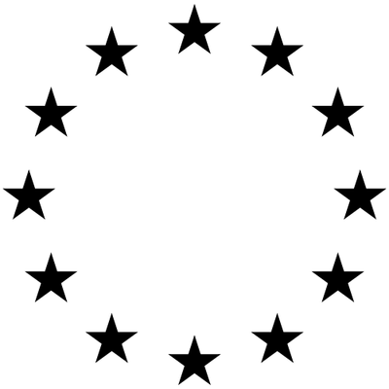
GDES-3081-501 - Intro to Design Management
March 23rd, 2026
General Data
Protection Regulation
“GDPR is a data protection law in the EU that requires companies to obtain user consent and ensure transparency when collecting and using personal data.”
Background
07

Slide 8
GDES-3081-501 - Intro to Design Management
March 23rd, 2026
“Data protection should be integrated into technology design from the beginning.”
GDPR, Art. 25 & Recital 78
GDPR, GDPR, Art. 7
“The data subject shall have the right to withdraw his or her consent at any time.”
“Controller means the natural or legal person, public authority, agency or other body
which, alone or jointly with others, determines the purposes and means of the processing of personal data”
GDPR, GDPR, Art. 4(7)
Privacy
Consent
Control
Protects personal data and ensures secure handling
Requires clear user permission before data collection and use
Gives users the right to access, modify, and delete their data
Background
08

Slide 9
GDES-3081-501 - Intro to Design Management
March 23rd, 2026
24
84
75
%
%
%
CAGR - The Global Sovereign Cloud Market was valued at approximately $129 billion in 2025 and is projected to reach $572.3 billion by 2032.
of business leaders say data sovereignty and repatriation regulations have grown more important over the past year.
of consumers say they won't purchase from an organization they don't trust with their data.
Data
Sovereignty
Source: MarkNtel Advisors via PR Newswire, March 16, 2026 of business leaders say data sovereignty and repatriation regulations have grown more important over the past year.
Source: Kyndryl via PR Newswire, March 10, 2026 Source: MarkNtel Advisors via PR Newswire, March 16, 2026 of business leaders say data sovereignty and repatriation regulations have grown more important over the past year.
(Ownership)
Source: Cisco 2024 Consumer Privacy Survey Source: https://investor.cisco.com/news/news-details/2024/New-Cisco-Survey-Shows-Strong-Relationship-Between-Privacy-Awareness-and-Trust-in-AI/default.aspx
Trend
09

Slide 10
GDES-3081-501 - Intro to Design Management
March 23rd, 2026
As AI-generated content saturates the information environment,
firms face growing risks from degraded high-value data.
Because trustworthy AI requires trustworthy data, stronger standards for
accuracy, relevance, and reliability in training datasets have become essential.
AI-generated
Noise
Source: NIST AI Risk Management Framework, January 26, 2023. NIST frames AI as a risk-management issue for individuals, organizations, and society https://nvlpubs.nist.gov/nistpubs/ai/NIST.AI.100-1.pdf
(Model Collapse)
Source: "AI, Data Governance and Privacy: Synergies and Areas of International Co-operation" (OECD Artificial Intelligence Papers, No. 22) https://www.oecd.org/en/publications/ai-data-governance-and-privacy_2476b1a4-en.html
Signal I - Strong Signal
10

Slide 11
GDES-3081-501 - Intro to Design Management
March 23rd, 2026
Misuse
Harm
Misinformation
enables manipulation, deception, and harmful automated exploitation. The EU AI Act explicitly prohibits harmful AI-based manipulation and deception.
extends beyond users to organizations and society as a whole. NIST frames AI risk as harm that can affect individuals, organizations, and society.
threatens the reliability of AI-generated outputs at scale. Generative AI can produce false or misleading information at scale, including misinformation and disinformation.
Surge in AI Copyright Lawsuits
Source: NIST AI RMF 1.0, January 2023 — AI risk to individuals, organizations, and https://www.nist.gov/itl/ai-risk-management-framework
Source: "AI, Data Governance and Privacy: Synergies and Areas of International Co-operation" (OECD Artificial Intelligence Papers, No. 22) https://www.oecd.org/en/publications/ai-data-governance-and-privacy_2476b1a4-en.html
Source: European Parliament and Council of the EU, Regulation (EU) 2024/1689 (AI Act), July 12, 2024 (prohibitions applicable from February 2, 2025) https://eur-lex.europa.eu/legal-content/EN/TXT/?uri=CELEX:32024R1689
Signal II - Strong Signal
11

Slide 12
GDES-3081-501 - Intro to Design Management
March 23rd, 2026
Reward can do more than restrict the flow of information.
It can function as an institutional tool that improves accountability, data quality, and user consent across the AI ecosystem. Rather than simply blocking information, it helps define the conditions under which data can be shared, valued, and governed more responsibly.
Regulatory Pressure for Data Compensation
Signal III - Weak Signal
12

Slide 13
GDES-3081-501 - Intro to Design Management
March 23rd, 2026
What If AI Tokens Became a Tradeable Currency?
An integrated AI token infrastructure that consolidates fragmented platform ecosystems into a single tradeable network, supported by regulatory governance and built for seamless end-user accessibility.
Interplatform
AI Token economy
Signal IV - Weak Signal
13

Slide 14
GDES-3081-501 - Intro to Design Management
March 23rd, 2026
“Token can become not only what AI consumes, but also what users earn.”
AI Token can be redefined as more than a technical unit of input and output. It can become an economic mechanism through which users are compensated for the value created through their data and interactions.
At present, most AI enterprises treat tokens as internal measures of usage rather than visible units of value. As a result, users have limited awareness of how their data is translated into economic worth, and little autonomy over how that value is distributed.
Opportunity:
AI Token as economy model
Opportunity
14

Slide 15
GDES-3081-501 - Intro to Design Management
March 23rd, 2026
How might we create a unified AI token ecosystem that incentivizes both platforms and users to participate across boundaries?
Reward
AI Token
Interplatform
AI token rewards, as consent-based incentives for data contribution, transform data into a transactional asset that circulates within a self-sustaining loop, enabling systematic audit and traceability throughout.
As the AI token moves beyond its role as a unit of computing and reasoning into a receipt-generating exchangeable asset, it effectively functions as a currency tied to quantifiable indicators for data exchange.
Monetizing and consolidating siloed AI token units across platforms into a unified framework enables demand-driven pricing, greater service utility for users, and automation across a broader range of services.
Opportunity - HMW Question
15

Slide 16

GDES-3081-501 - Intro to Design Management
March 23rd, 2026
tokentrust
At this point, AI Token becomes closely connected to the issue of information sovereignty. Information sovereignty refers to the user’s ability to understand, choose, and control how their data is collected, evaluated, and used.
However, visibility alone is not enough. For AI Token to support information sovereignty, data valuation must be transparent, compensation must be understandable, and the token itself must function as a meaningful economic instrument.
“AI Token should not only measure usage, but also enable user agency.”
Opportunity
16

Slide 17
GDES-3081-501 - Intro to Design Management
March 23rd, 2026
As-is
To-be
No visibility into how data is used
Data extracted with zero compensation
Vague anxiety and uncertainty
Direct control over data sharing scope
AI token rewards based on DQI
Visible, actionable data ownership
The primary barrier to data compensation has not been technical, but definitional. Without a consistent framework for measuring data value, fair exchange has been structurally impossible. DQI establishes that measurement layer, effectively serving as the exchange rate system of the data economy.
User Perspective
Value Shift
17

Slide 18
GDES-3081-501 - Intro to Design Management
March 23rd, 2026
As-is
To-be
Unauthorized collection → litigation & regulatory risk
Inconsistent data quality
Limited scope of data collection
Consent-based collection → liability protection
High-quality data selection powered by DQI
Expanded reach through trusted framework
Unauthorized data collection, built on inaccessible consent, is not a scalable foundation. Litigation risk, inconsistent quality, and eroding user trust are not separate problems. They are structural consequences of a model that was never designed to last. When data is contributed willingly, liability converts to protection, quality becomes a selectable standard powered by DQI, and collection expands on the basis of trust rather than resistance.
AI Enterprise Perspective
Value Shift
18

Slide 19

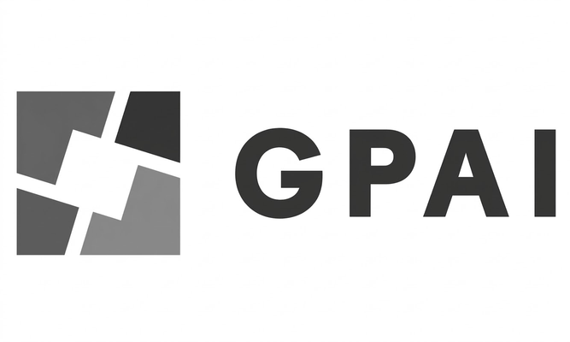

GDES-3081-501 - Intro to Design Management
March 23rd, 2026
Infrastructure Partnership
Safe Superintelligence Inc.
AI Identity and Access Management
Global Partnership on Artificial Intelligence
For commercialization at scale, the strategic foundation includes Safe Superintelligence (SSI) as technical advisor, Okta as the authentication and identity management infrastructure, and a partnership with GPAI to support global market entry.
Value Proposition - Potential Partnerships
19

Slide 20


GDES-3081-501 - Intro to Design Management
March 23rd, 2026
Government Partnership
Government of Canada
Office of the privacy Commissioner of Canada
Government bodies are informed of program outcomes and consulted for input, retaining the authority to exert regulatory influence over direct and indirect compliance boundaries, information exchange, and AI token transactions. At the same time, they impose an obligation of transparent disclosure regarding how data is processed and the volume of tokens exchanged.
Value Proposition - B2G Proposal
20

Slide 21



GDES-3081-501 - Intro to Design Management
March 23rd, 2026
Subjects of Regulation
Gemini
Claude
ChatGPT
AI enterprises gain the ability to convert and manage tokens across multiple streams within a unified platform, while unlocking the potential for structured information exchange. Simultaneously, they can access high-quality data and claim corresponding token compensation.
Value Proposition - B2B Proposal
21

Slide 22
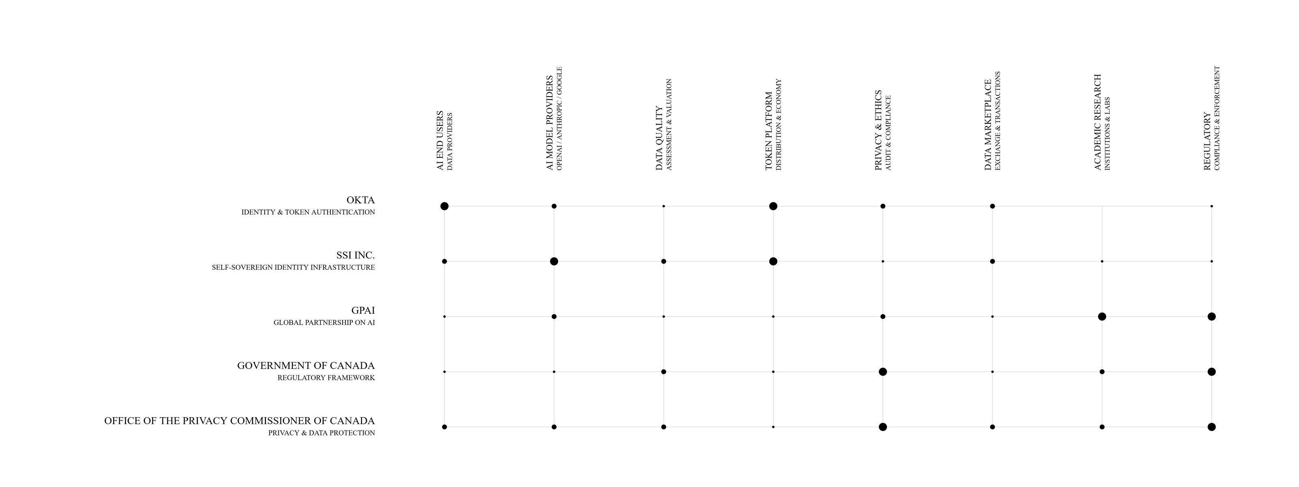
GDES-3081-501 - Intro to Design Management
March 23rd, 2026
*Dot size is proportional to the strength of the partnership between the stakeholder and partner
Partnerships fall into two layers: regulatory alignment and platform development. Okta and SSI are the Responsible parties as core builders, while government bodies are Consulted and Informed throughout.
Stakeholder Engagement Matrix
Value Proposition
22

Slide 23
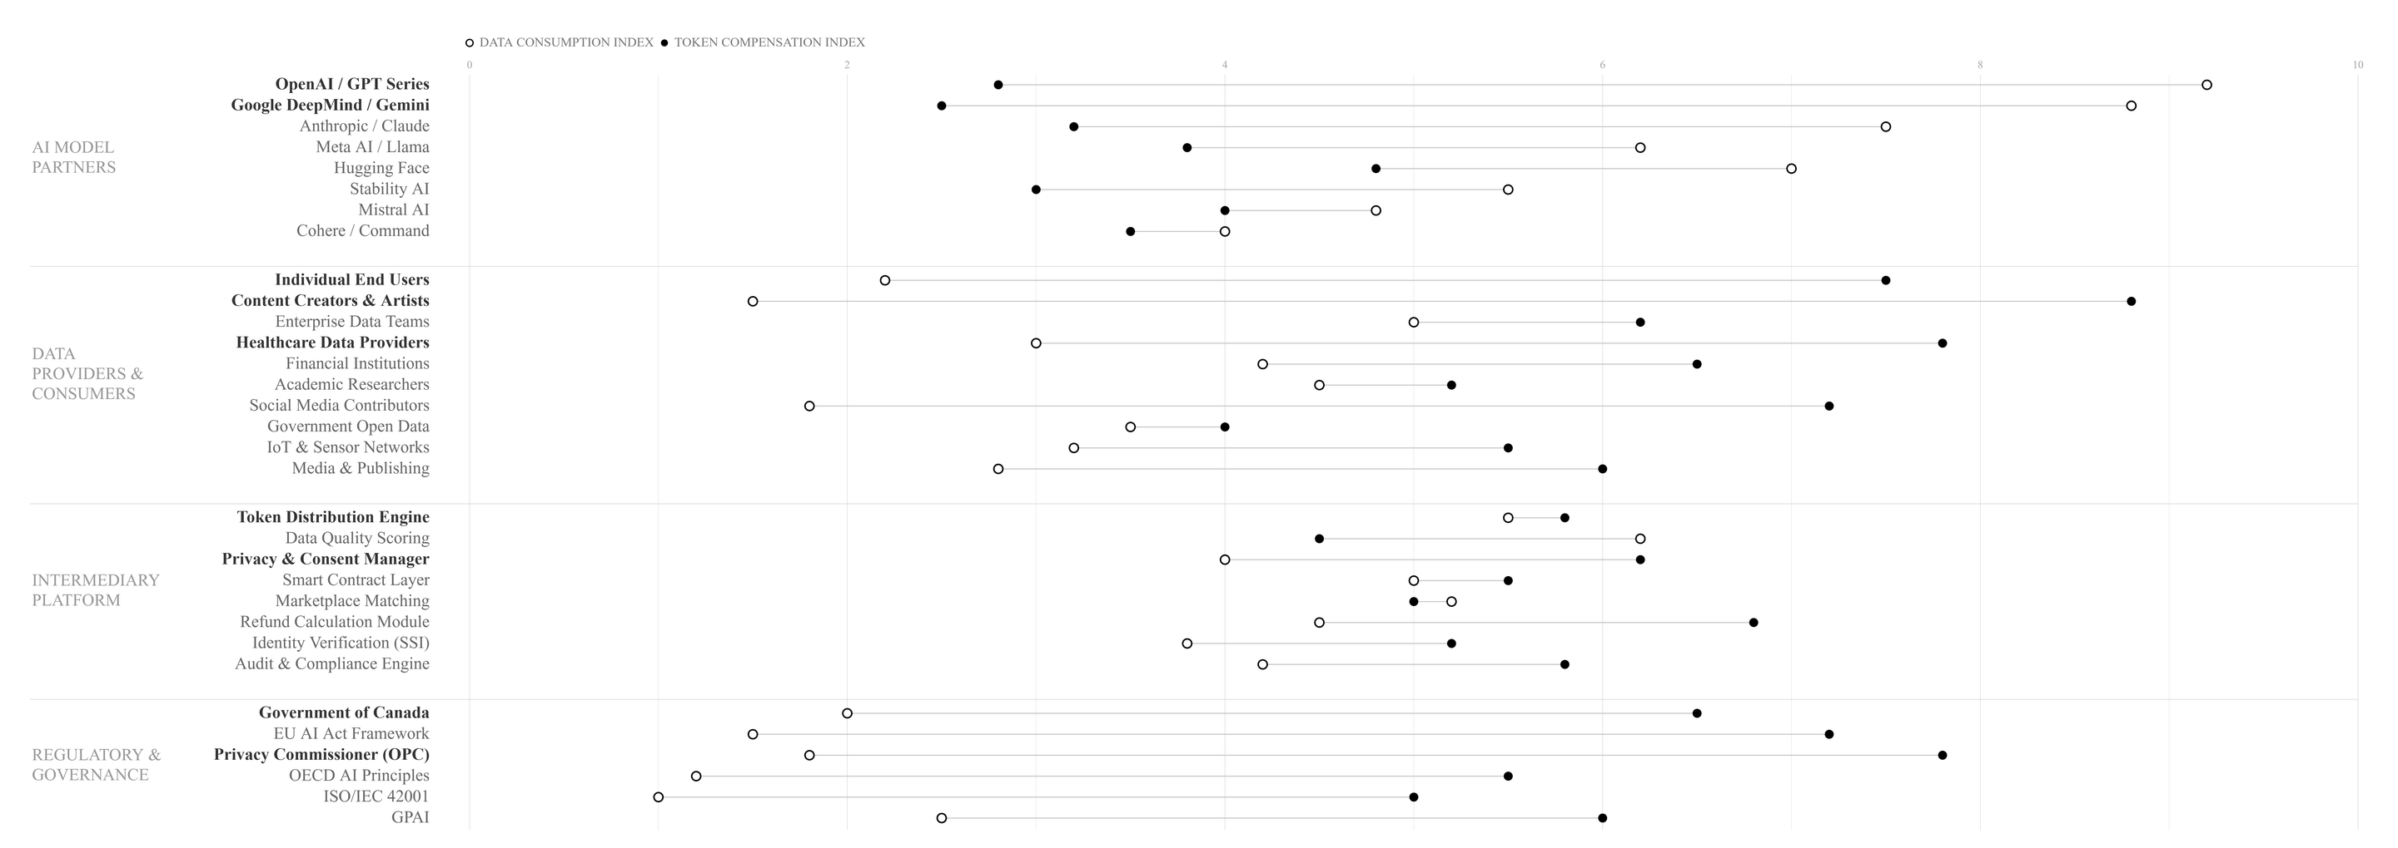
GDES-3081-501 - Intro to Design Management
March 23rd, 2026
Each ecosystem participant is positioned across two indices: data consumption and token compensation. The distribution exposes structural imbalances in how value is currently allocated, and where DQI-driven rebalancing impact.
Stakeholder Index Mapping
Value Proposition
23

Slide 24
GDES-3081-501 - Intro to Design Management
March 23rd, 2026
Government of Canada
Privacy Commissioner (OPC)
Treasury Board
EU AI Act
OECD AI Principles
ISO/IEC 42001
GPAINIST AI Framework
Communications Security Establishment (CSE)
Canadian Centre for Cyber Security
Safe Super Intelligence (SSI)
Public Safety Canada
Standards Council of Canada (SCC)
Digital Governance Council (Canada)
Canadian Institute for Advanced Research (CIFAR) – AI & Society Program
Stakeholder Mapping
Government/Enforce
Layer I - Governing Bodies
Layer II - Regulated Entities
Layer III - Affected Parties
OpenAI / GPT Series
Google DeepMind / Gemini
Anthropic / ClaudexAI
Grok
Amazon / Nova
Meta AI / Llama
Mistral AI
Hugging Face
Content Creators & Artists
Social Media Contributors
Freelance Annotators
Open Source Contributors
Podcast Creators
Enterprise Data Teams
Healthcare Providers
Financial Institutions
Academic Researchers
Legal & Law Firms
Insurance Companies
Pharmaceutical R&D
Government Open Data
Weather & Climate Services
Public Libraries & Archive
End Users
AI Enterprises
User/Data Agencies
Token Distribution
Refund Calculation
Marketplace Matching
Royalty Splitter
Usage Analytics Engine
Micro-Payment Gateway
Data Quality Scoring
Audit & Compliance
Privacy & Consent
Bias Detection Module
Watermark & Provenance
Dispute Resolution
Smart Contract Layer
Identity Verification (OKTA)
Decentralized Storage (IPFS)
API Gateway & Rate Limiting
tokentrust
AI Token Service
Value Proposition
24

Slide 25

GDES-3081-501 - Intro to Design Management
March 23rd, 2026
tokentrust
data quality index
reward token
data credit
DQI measures data worthiness, Reward Tokens translate that into direct compensation, and Data Credit converts accumulated value into purchasing power across the platform.
Service Components
25

Slide 26
GDES-3081-501 - Intro to Design Management
March 23rd, 2026
tokentrust
data quality index
“The worthiness of data”
Service Component I
26

Slide 27
GDES-3081-501 - Intro to Design Management
March 23rd, 2026
.I
.II
.III
.IV
Accuracy
Completeness
Consistency
Freshness
Data must accurately reflect the real world at all times. Any errors or inaccuracies will directly trigger regulatory penalties with serious consequences.
All required fields and records must be fully completed. Any gaps in audit trails constitute direct compliance violations.
The same data point holds the same value across all systems. Discrepancies between sources are inadmissible under regulatory review.
How current and up-to-date the data is, and whether the latest elements and updates have been properly applied and reflected.
Privacy Sensitivity
Operates as an independent gate, outside the weighted scoring model. If triggered, the DQI output is fully blocked until encryption, anonymization, and mandatory user notification protocols are resolved.
Service Component I
27

Slide 28
GDES-3081-501 - Intro to Design Management
March 23rd, 2026
tokentrust
reward token
“Value returned to users”
Service Component II
28

Slide 29
GDES-3081-501 - Intro to Design Management
March 23rd, 2026
AI Enterprise
Token
User
Data
Validating the quality of information and enabling high-quality data to be trained into future models.
Through the token refund process, it can be utilized for service use and applied as a new form of value.
AI Token Ecosystem
Constitutes a data circulation structure that benefits both the company and its users, a structure fundamentally grounded in consent and exchange, forming a new economic system built on mutual benefit.
Service Component II
29

Slide 30
GDES-3081-501 - Intro to Design Management
March 23rd, 2026
tokentrust
data credit
“Compliance trust rating”
Service Component III
30

Slide 31
GDES-3081-501 - Intro to Design Management
March 23rd, 2026
.I
.II
.III
.IV
Consent Compliance Rate
DQI
Accuracy
Reward Fulfillment Rate
Audit Transparency
The extent to which user consent boundaries were respected was verified through both internal and external audit-based validation procedures.
Whether the data value was assessed fairly, with objective metrics in place to ensure that all factors involved in the data valuation process were applied equitably.
Whether the promised tokens for data collection were actually distributed, and how effectively those distributed tokens can be utilized within the service.
Whether the company transparently disclosed how user data was utilized, and whether users were properly informed of how their data is processed and retained when in use.
Corporate credibility
This metric can function as a tool for measuring corporate data utilization credibility, much like a technical benchmark, and directly ties into data sovereignty.
Service Component III
31

Slide 32
GDES-3081-501 - Intro to Design Management
March 23rd, 2026
Data Agencies
(Third Parties)
AI Enterprises
[Data]
tokentrust
[Data]
Data-AI Token
Exchange Process
[Data]
tokentrust
[AI Token]
Ensure copyrights
Data Quality Assessment
[AI Token]
(Interplatform - Unified Exchange)
[AI Token]
Reward Engine
Data Protection
Intuitive UI
[Enforce]
[Report]
Regulatory Body
User
Enforce the Program
Data Usage Audit
Provides data
Rewarded token
The three service components bridge AI enterprises and users or data agencies, with regulatory oversight and audit mechanisms embedded directly within the enterprise infrastructure rather than imposed externally.
Ecosystem Mapping
Service Overview
32

Slide 33

GDES-3081-501 - Intro to Design Management
March 23rd, 2026
Operational Structure
Prior to market entry, the strategic priority is establishing foundational market trust and a stable infrastructure capable of sustaining long-term operations.
tokentrust
Strategic Foresight
33

Slide 34
GDES-3081-501 - Intro to Design Management
March 23rd, 2026
Key Partnerships
Key Activities
Value Propositions
Customer Relationships
Customer Segments
AI model providers
Identity verification partners
Privacy and compliance bodies
Independent auditors / governance groups
Data Quality Index (DQI) scoring
Consent logging and verification
Interplatform Token Economy
Higher-quality, consent-based data sourcing
Lower privacy, copyright, and compliance risk
Auditable records of data use
Visible and compensable user participation
Enterprise onboarding support
Long-term compliance partnership
Audit and reporting assistance
Enterprise onboarding support
Long-term compliance partnership
Audit and reporting assistance
Dedicated account management
Key Resources
Channels
DQI scoring engine
Consent and audit infrastructure
Enterprise integration system
Direct B2B sales
API integration
Institutional partnerships
Cost Structure
Revenue Streams
Data scoring infrastructure
Legal and compliance review
Reward pool management
Security and system integration
Sales and partnership operations
B2B SaaS licensing
API usage fees
Token transaction fees
Enterprise integration fees
Audit and certification subscriptions
Strategic Foresight - Business Model Canvas
34

Slide 35
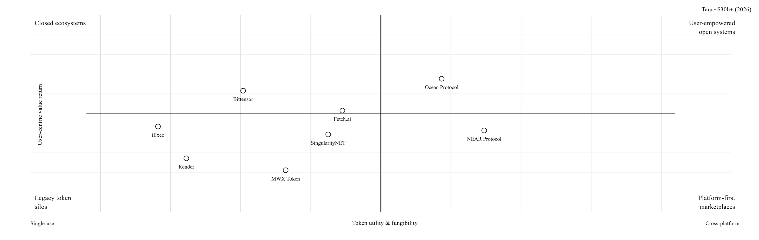
GDES-3081-501 - Intro to Design Management
March 23rd, 2026
Ai Token Market
Total Addressable Market | ~$30B+ (2026)
tokentrust
Positioning
Advantage
Market Gap
Existing AI tokens focus solely on utility within their own ecosystems. Inter-platform token refund and conversion remains a complete blue ocean.
Occupies the highest position on both token fungibility (x) and user value return (y). The only platform with a "refund" mechanism.
Competitors operate on a "use → deplete" model, whereas this platform enables a "use → refund → recirculate" loop.
Market Matrix - I
35

Slide 36
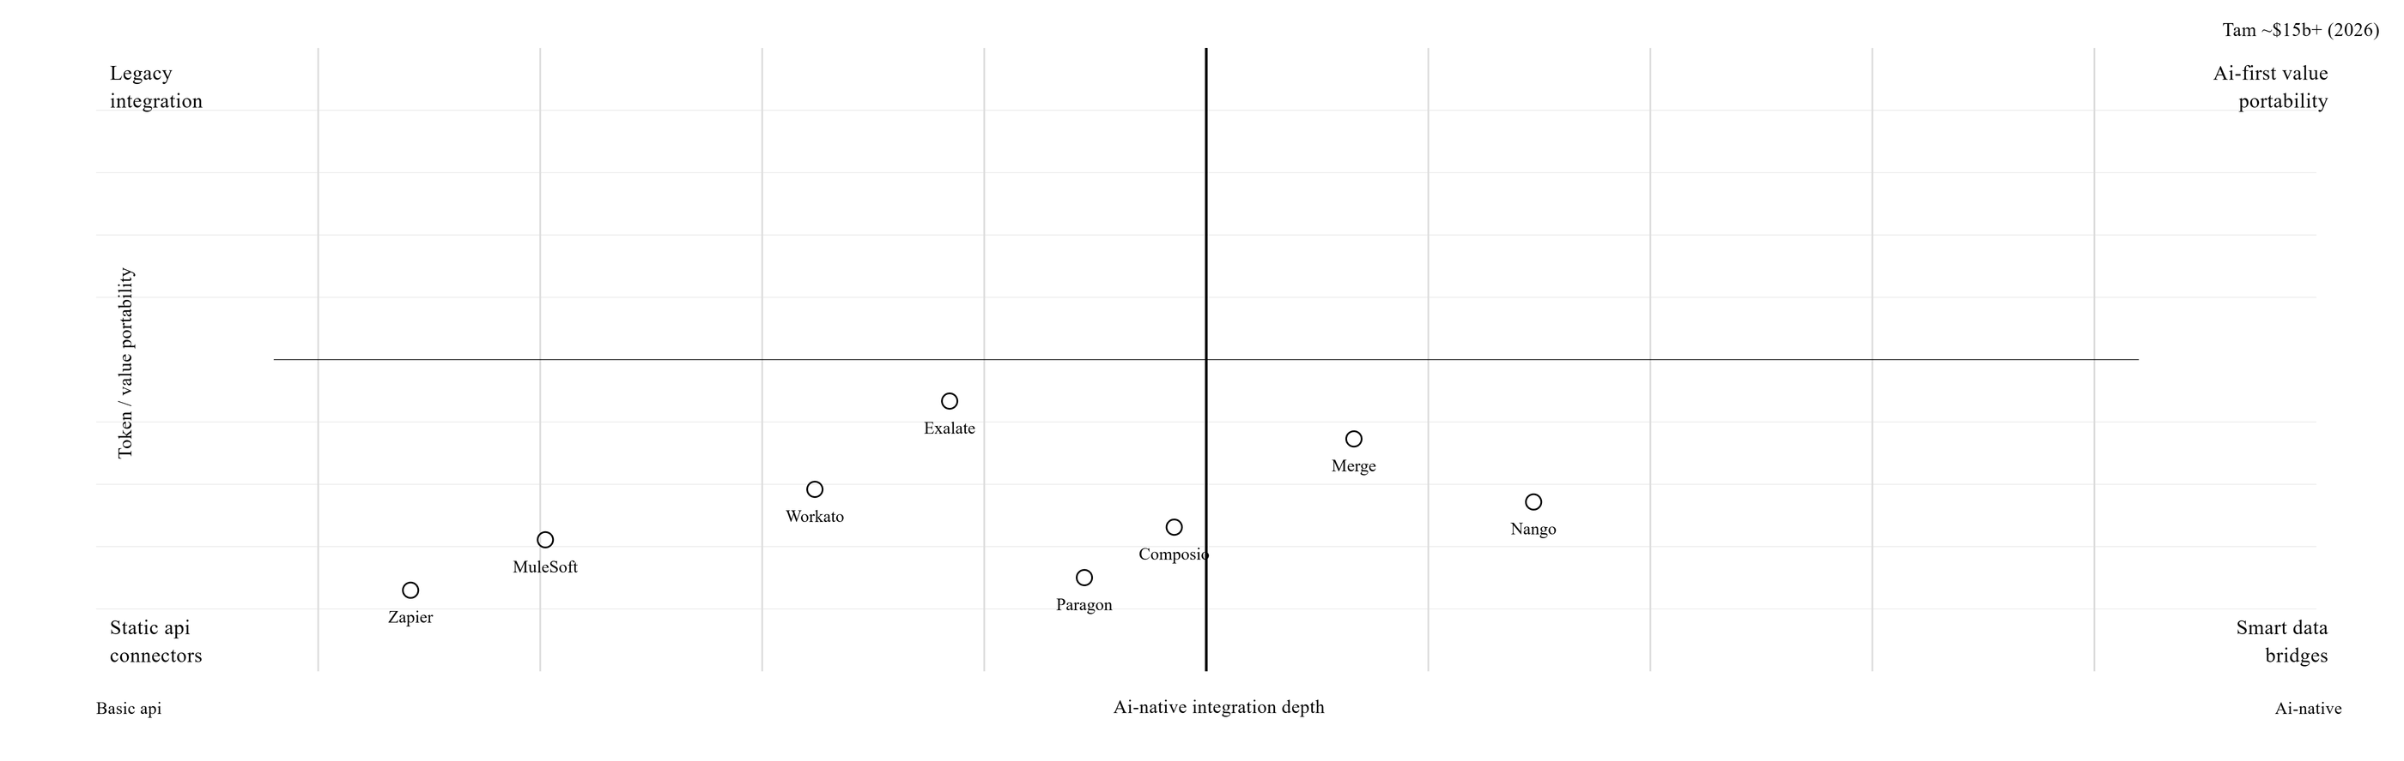
GDES-3081-501 - Intro to Design Management
March 23rd, 2026
Cross-platform interoperability market
Total Addressable Market | ~$15B+ (2026)
tokentrust
Positioning
Advantage
Market Gap
Existing integration platforms focus exclusively on "data movement." The space for "value (token) movement" remains entirely unoccupied.
Dominant advantage on token/value portability (y). The only player combining AI-native integration with token conversion.
Precisely positioned at the inflection point where iPaaS evolves from "data pipes" to "value pipes."
Market Matrix - II
36

Slide 37
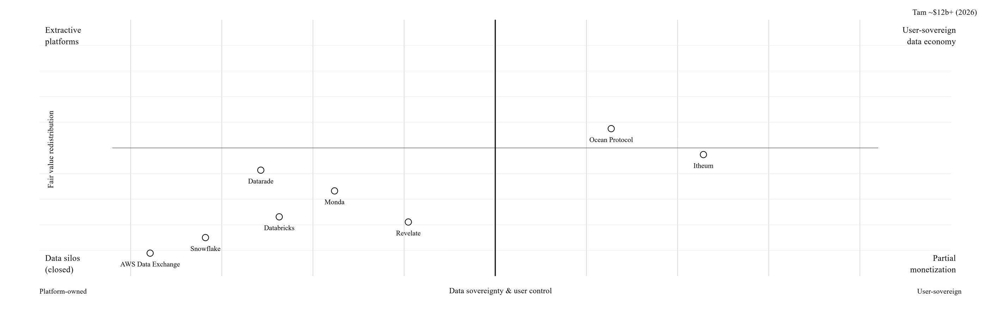
GDES-3081-501 - Intro to Design Management
March 23rd, 2026
Data-as-a-service market
Total Addressable Market | ~$12B+ (2026)
tokentrust
Positioning
Advantage
Market Gap
Existing DaaS platforms operate on a "companies buy and sell data" model. A user value return model is entirely absent.
Highest position on both data sovereignty (x) and value redistribution (y). Consent-based compensation is the core differentiator.
Aligned with the surge in user data sovereignty demands driven by EU AI Act and GDPR enforcement.
Market Matrix - III
37

Slide 38
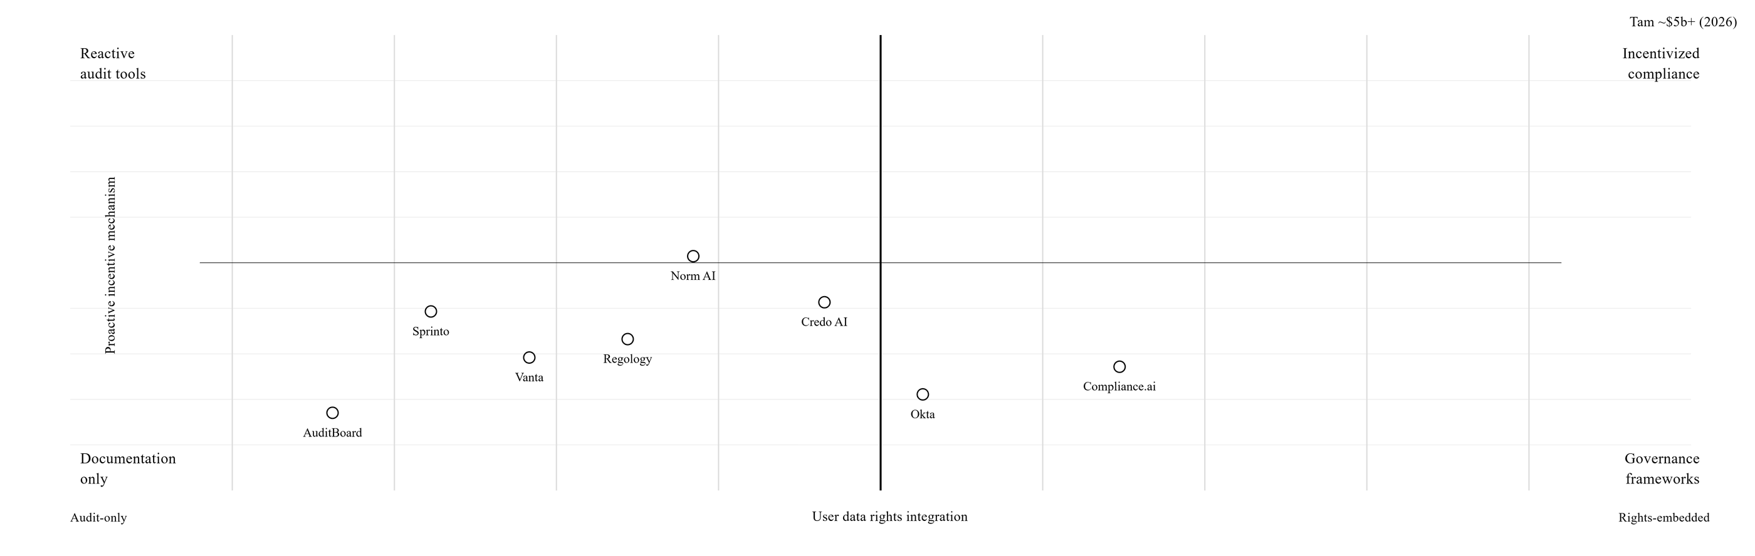
GDES-3081-501 - Intro to Design Management
March 23rd, 2026
Ai regulatory compliance market
Total Addressable Market | ~$5B+ (2026)
tokentrust
Positioning
Advantage
Market Gap
Every competitor approaches compliance from a "penalty avoidance" perspective. The "compliance = user reward" framing is a unique position.
Proprietary benchmarks such as consent compliance rate, reward fulfillment rate, and valuation fairness serve directly as regulatory evidence.
Resolves data sovereignty and regulatory compliance simultaneously through a corporate credibility index.
Market Matrix - IV
38

Slide 39
GDES-3081-501 - Intro to Design Management
March 23rd, 2026
Immediate Milestones
Growth Targets
Long-term Vision
H - I
H - II
H - III
Market Entry [Y0-Y1]
Market Entry [Y1-Y3]
Market Entry [Y3+]
Building the core governance infrastructure of the system.
Data Quality Index (DQI), establishing a consent logging mechanism
Audit-ready record of data Collection
Rewards - limited to internal credits
Controlled pilot incentives rather than open token circulation.
Pilot partnerships with selected AI Enterprises
Adapting the DQI model to sector-specific needs, validating consent, and reporting workflows.
Internal audit whether user reward structures can operate measurably and reliably.
Evaluation of the model can be run in real business settings
Scaling the system through standardization and institutional adoption.
Expanding audit partnerships, introducing certification and reporting structures, and building a broader governance framework
A trusted infrastructure for data quality, accountability, and compensation.
Strategic Foresight - Market Strategy
39

Slide 40
GDES-3081-501 - Intro to Design Management
March 23rd, 2026
AI Data Governance Society
"Beyond simple redemption or transactional utility, Tokentrust carries an inter-platform character that guarantees user autonomy and expands service accessibility for AI enterprises.”
This positions AI token commerce not merely as an exchange mechanism, but as the infrastructure that enables fluid movement of value across platforms and participants.
Conclusion
40

Slide 41
GDES-3081-501 - Intro to Design Management
March 23rd, 2026
tokentrust
Reference
Cisco. (2024). New Cisco survey shows strong relationship between privacy awareness and trust in AI. Cisco Investor Relations. https://investor.cisco.com/news/news-details/2024/New-Cisco-Survey-Shows-Strong-Relationship-Between-Privacy-Awareness-and-Trust-in-AI/default.aspx
European Parliament & Council of the European Union. (2024). Regulation (EU) 2024/1689 of the European Parliament and of the Council of 13 June 2024 laying down harmonised rules on artificial intelligence (Artificial Intelligence Act). Official Journal of the European Union, L 2024/1689. https://eur-lex.europa.eu/legal-content/EN/TXT/?uri=CELEX:32024R1689
European Parliament & Council of the European Union. (2016). Regulation (EU) 2016/679 of the European Parliament and of the Council of 27 April 2016 on the protection of natural persons with regard to the processing of personal data and on the free movement of such data (General Data Protection Regulation). Official Journal of the European Union, L 119, 1– 88. https://eur-lex.europa.eu/eli/reg/2016/679/oj
Kyndryl. (2026, March 10). [Press release]. PR Newswire. https://www.prnewswire.com
MarkNtel Advisors. (2026, March 16). [Press release]. PR Newswire. https://www.prnewswire.com
National Institute of Standards and Technology. (2023, January 26). Artificial intelligence risk management framework (AI RMF 1.0) (NIST AI 100-1). U.S. Department of Commerce. https://nvlpubs.nist.gov/nistpubs/ai/NIST.AI.100-1.pdf
Organisation for Economic Co-operation and Development. (n.d.). AI, data governance and privacy: Synergies and areas of international co-operation. OECD Artificial Intelligence Papers, No. 22. https://www.oecd.org/en/publications/ai-data-governance-and-privacy_2476b1a4-en.html
Works Cited
41

