Slide 1
ENGI 301 Programmable Music Box Proposal
10/3/2020
Michael Tang

Slide 2
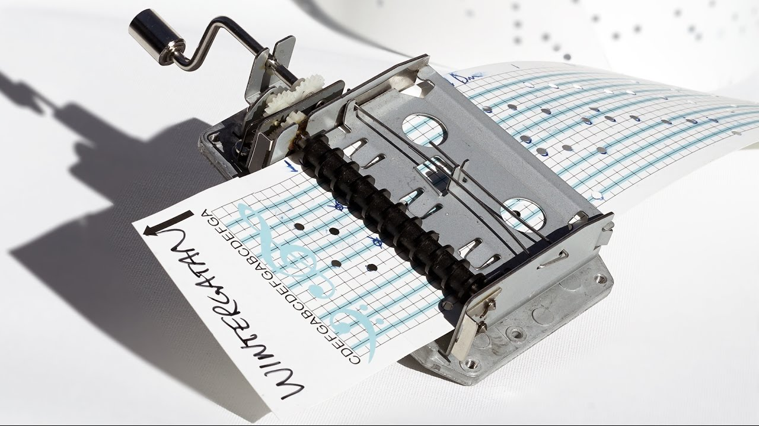
Background Information
Idea: Making an electronic version of the “punchcard music box”
Punchcard music box: https://youtu.be/qdj8kpP4fGY?t=19
Basically, you can program this music box by hole punching the tune you want into a piece of paper, and then feeding the paper into the music box through a crank – music is made when strings inside the box get caught on the holes and get plucked
I want to do the same thing, but instead of strings getting plucked, a buzzer will play different pitches
I will keep the same hole-punch structure of selecting notes. However, instead of plucking strings, I will have wires placed on top of a grounded copper plate. Then, the piece of paper will be fed on top of the copper plate but under the wires. If there is no hole, then the paper will block the wire and copper plate, and the wire will not be grounded. If there is a hole, then the wire will get grounded, and that is the cue to play a certain note.
In addition to a buzzer, I want to have a volume control, and an LCD screen that shows the current tempo at which the user is cranking the paper through the device
Existing resources online for this project:
https://www.hackster.io/nickericlester/ir-breakbeam-candy-dispenser-with-zelda-music-c76e65
Project has code mapping what frequencies are needed to get each note
https://www.reddit.com/r/DIY/comments/2xsrgd/how_to_build_a_programmable_music_box/
Someone else had exact same idea here – was not actually implemented, but comments offer a few alternative suggestions on implementation (ie. Using capacitive sensing to sense each pencil mark instead of treating it as a switch, or detecting presence of pencil mark using a photodiode instead)
Will use your library for the 4-digit LCD display

Slide 3
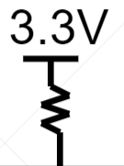
System Block Diagram
Create a System Block Diagram
Label interfaces / pins
Components (part numbers if possible)
Create a System Block Diagram
Label interfaces / pins
Components (part numbers if possible)
PocketBeagle
Floating Header Pin
AIN 1.8V (P1_19)
PWM0-A (P1_36)
Speaker 1
Floating Header Pin
AIN 1.8V (P1_21)
PWM1-A (P2_01)
Speaker 2
Floating Header Pin
AIN 1.8V (P1_23)
PWM2-B (P2_03)
Speaker 3
PWM0-B (P1_33)
Continuous Rotation Servo
Floating Header Pin
AIN 1.8V (P1_25)
AIN 1.8V (P1_27)
GPIO_IN (P2_02)
Button
Floating Header Pin
Floating Header Pin
AIN 1.8V (P1_36)
I2C1: SCL (P2_09)
4-Digit 7-Segment Display
(HT16K33)
I2C1: SDA (P2_11)

Slide 4
Power Block Diagram
Create a Power Block Diagram
Label voltages / currents of components
PocketBeagle
Floating Header Pin
No applied voltage
AIN 1.8V
3.3V, 140 mA
PWM0-A
Speaker 1
Floating Header Pin
No applied voltage
AIN 1.8V
3.3V, 140 mA
PWM1-A
Speaker 2
Floating Header Pin
No applied voltage
AIN 1.8V
3.3V, 140 mA
PWM2-B
Speaker 3
PWM0-B
3.3V, 140 mA
Continuous Rotation Servo
Floating Header Pin
No applied voltage
AIN 1.8V
AIN 1.8V
SYS 3.3V
3.3V, current unknown
Button
Floating Header Pin
No applied voltage
Floating Header Pin
No applied voltage
AIN 1.8V
4-Digit 7-Segment Display
(HT16K33)
SYS 3.3V
3.3V, 20 mA

Slide 5
Components / Budget
Component | Need to Buy | Cost
Speaker - https://www.adafruit.com/product/1898 | 3 | 1.85 * 3 = $5.55
Continuous Rotation Servo - https://www.sparkfun.com/products/10189 | 1 | $11.95

