Slide 1
ENGI 301 Pencil-Programmable Music Box Proposal
10/3/2020
Michael Tang

Slide 2
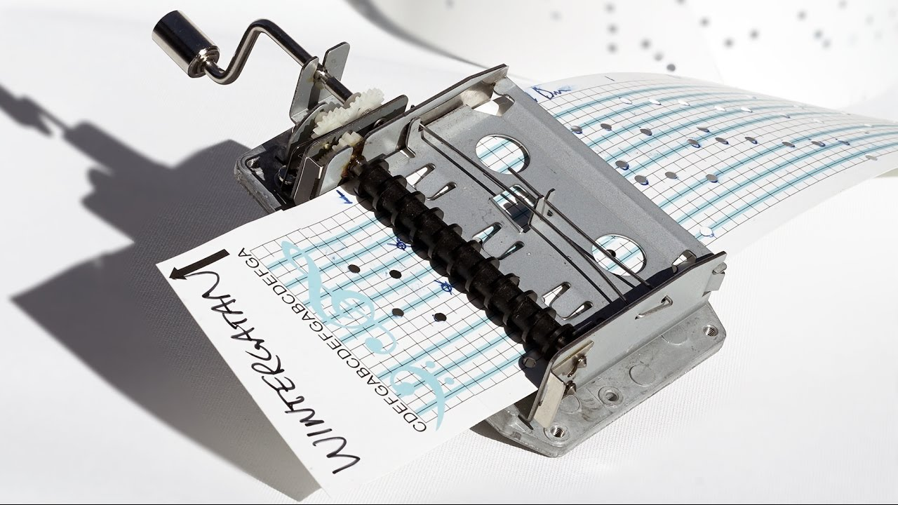
Background Information
Idea: Making an electronic version of the “punchcard music box”
Punchcard music box: https://youtu.be/qdj8kpP4fGY?t=19
Basically, you can program this music box by hole punching the tune you want into a piece of paper, and then feeding the paper into the music box through a crank – music is made when strings inside the box get caught on the holes and get plucked
I want to do the same thing, but instead of strings getting plucked, a buzzer will play different pitches, and instead of punching holes, the user can fill in what notes they want with a pencil
Since graphite conducts, I want it to work so that when the paper is fed through, the “notes” drawn in with a pencil act like a switch and close the circuit and trigger a certain sound to be played through a buzzer
In addition to a buzzer, I want to have a volume control, and an LCD screen that shows the current tempo at which the user is cranking the paper through the device
Existing resources online for this project:
https://www.hackster.io/nickericlester/ir-breakbeam-candy-dispenser-with-zelda-music-c76e65
Project has code mapping what frequencies are needed to get each note
https://www.reddit.com/r/DIY/comments/2xsrgd/how_to_build_a_programmable_music_box/
Someone else had exact same idea here – was not actually implemented, but comments offer a few alternative suggestions on implementation (ie. Using capacitive sensing to sense each pencil mark instead of treating it as a switch, or detecting presence of pencil mark using a photodiode instead)
Will use your library for the 4-digit LCD display

Slide 3
System Block Diagram
Create a System Block Diagram
Label interfaces / pins
Components (part numbers if possible)
Create a System Block Diagram
Label interfaces / pins
Components (part numbers if possible)
PocketBeagle
12x “Graphite Switches”
12x GPIO_IN
PWM1
Speaker 1
PWM2
Speaker 2
PWM3
Speaker 3
4-Digit 7-Segment Display
I2C1
AIN 3.3V
Potentiometer

Slide 4
Power Block Diagram
Create a Power Block Diagram
Label voltages / currents of components
PocketBeagle
PWM
3.3V, 140 mA
Speaker 1
12x “Graphite Switches”
5V, current unknown
SYS VOUT
PWM
3.3V, 140 mA
Speaker 2
PWM
3.3V, 140 mA
Speaker 3
4-Digit 7-Segment Display
3.3V, 20 mA
SYS 3.3V
SYS 3.3V
3.3V, current varies
Potentiometer

Slide 5
Components / Budget
Component | Need to Buy | Cost
Speaker - https://www.adafruit.com/product/1898 | 3 | 1.85 * 3 = $5.55
Continuous Rotation Servo - https://www.sparkfun.com/products/10189 | 1 | $11.95

