Slide 1

CSCE 312 LAB 4

Slide 2

LAB4
Report Deadline: 11 October midnight
Demonstrations: 12 October Labs
To be done in groups of 4
You need to submit a common lab report as a group along with all the files you create
You also need to submit an additional 1-page report individually to explain what your individual role and contribution was and critique the group design process.

Slide 3
PROBLEM 1
Start building a processor
For this lab, you design and simulate the peripheral components (IO interface circuitry, address/data/control bus, encoders, decoders, counters, registers)
First, let us understand how a processor works

Slide 4
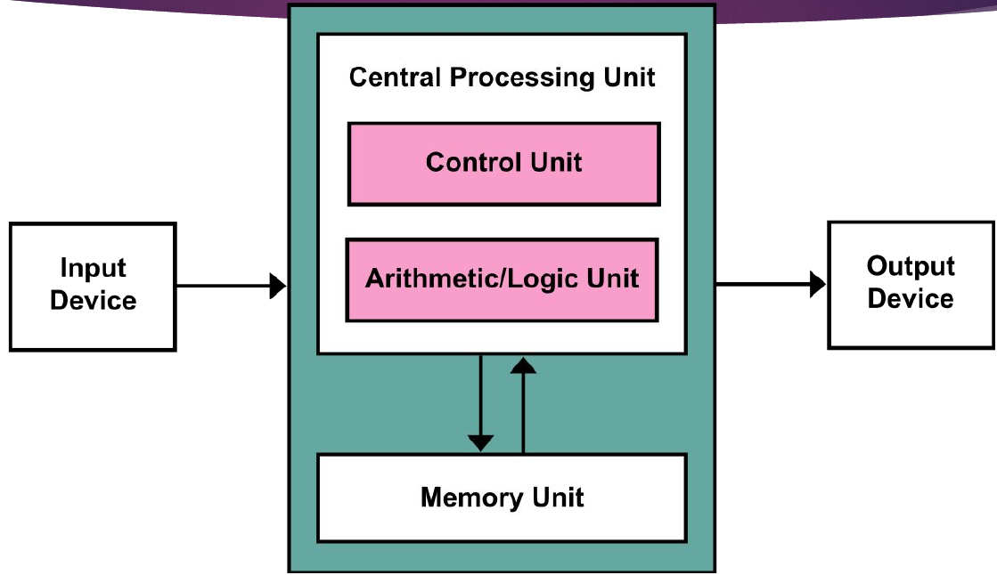
Von Neumann Architecture

Slide 5
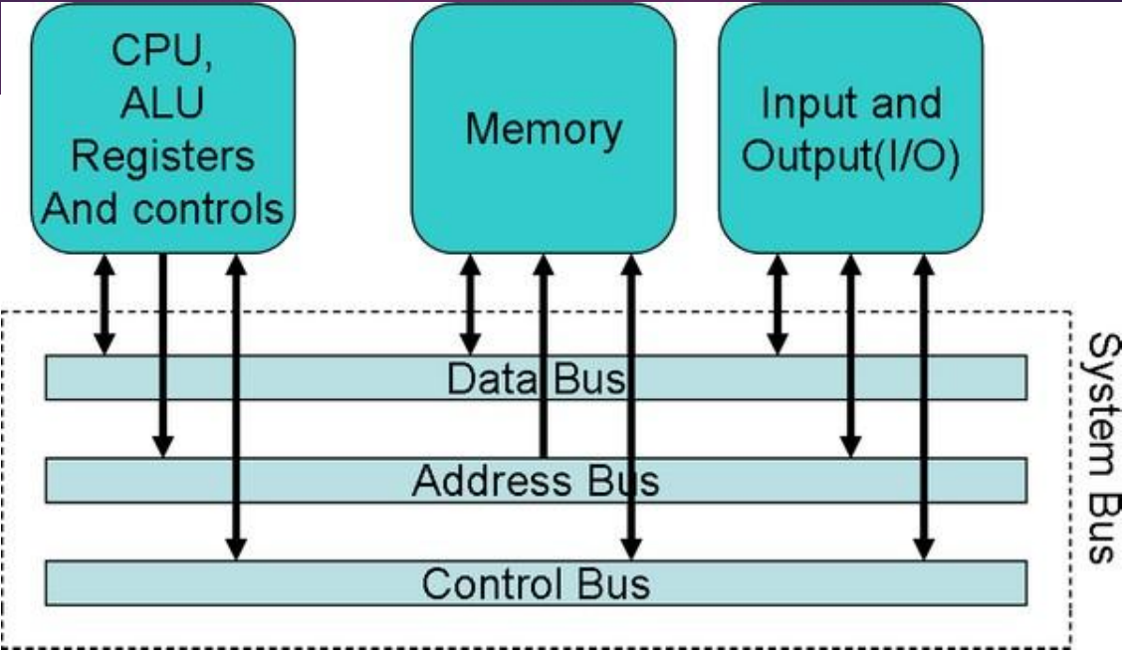

Slide 6
COMPONENTS
INPUT: Mouse, Keyboard, etc
OUTPUT: Speaker, Monitor, Printer, etc
MEMORY: DRAM, SRAM, etc
CPU: Central Processing Unit
  ALU: Arithmetic Logical Unit (Adders, Subtractors, Comparators, etc)
  Control Unit: Send Signals (Get data, Send data, Read Data, Write Data)
  Registers: Temporary storage (data just retrieved from memory, data that is being calculated)
  Memory?

Slide 7
BUSES
CONTROL BUS: The common signals that are transferred to the control bus from CPU to devices and vice versa are memory read, memory writes, I/O read, I/O write. (what to do?)
ADDRESS BUS: The address bus is used by the CPU to send the address of the memory location or the input/output port that is to be accessed at the instant. (where to get data from/make changes?)
DATA BUS: A data bus is used to carry the data and instructions from the CPU to memory and peripheral devices and vice versa. (what to send/get?)

Slide 8
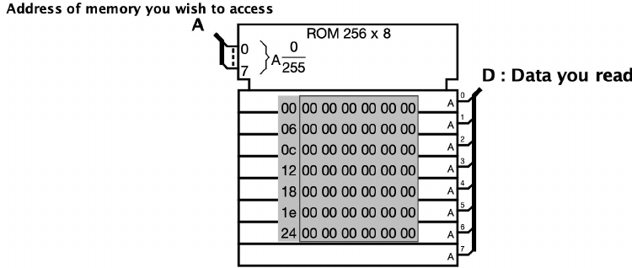
ROM in Logisim
Read Only Memory, means can only access the data not change it.
A: Address of the memory you try to access.
D: Data you retrieve present at A
A takes 8 bits
  Means you can address 2⁸ = 256 things
D gives 8 bits
  Means each address corresponds to 1 byte of data
Therefore, you have 256 x 1 B = 256B of data inside the ROM

Slide 9
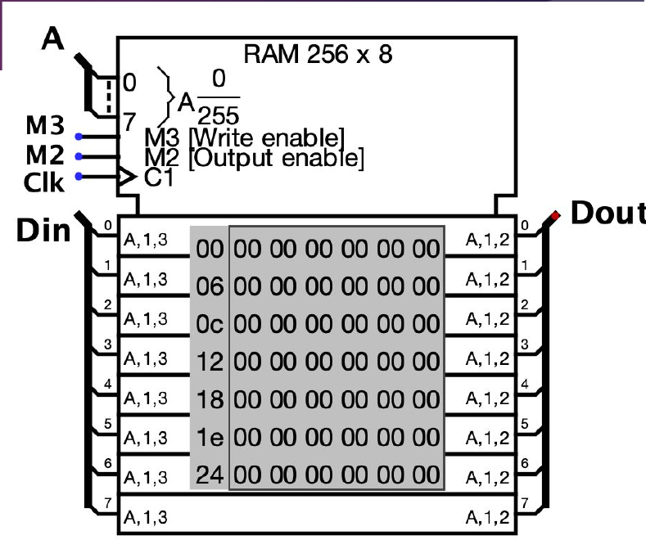
RAM in Logisim
Random Access Memory
Volatile Memory (lose it on turning power off)
can be read and changed in any order, typically used to store working data and machine code.
A: Address to write to/read from
M3: writing (store)
M2: reading (load)
Clk: Clock
Din: Data you write
Dout: Data you read
A: 8 bits meaning 256 things
D: 8 bits meaning each ‘thing’ is 1 B
So, total we have 256x1B = 256B data in the RAM

Slide 10
What you need to do:
read from ROM
  Control Bus: read from ROM
  Address Bus: where to read
  ROM: read the data
  Data Bus: put the read data in the data bus
read from RAM
write to RAM
read from I/O device
write to I/O device

Slide 11
How to implement
Assume that you have the Control, Address and Data signals from CPU.
Use these to create the three buses. Data Bus needs to be bidirectional.
Build a Memory Unit (consisting of RAM and ROM)
Build an I/O Unit
Use the control signals to figure out which of the 5 operations you need to do. (Build Decoder)
Depending on the output of decoder, send read/write enable, address and data(if required) to the Memory Unit or I/O Unit and get data from the unit back to the data bus (if required)
Whenever you try to write data or read data, you need to store that data in a Register (called the Data Buffer) so that you can use this stored data again if you need it in the next operation.

Slide 12
1. CPU
Add a Control Input
Add an Address Input
Add a Data Input

Slide 13
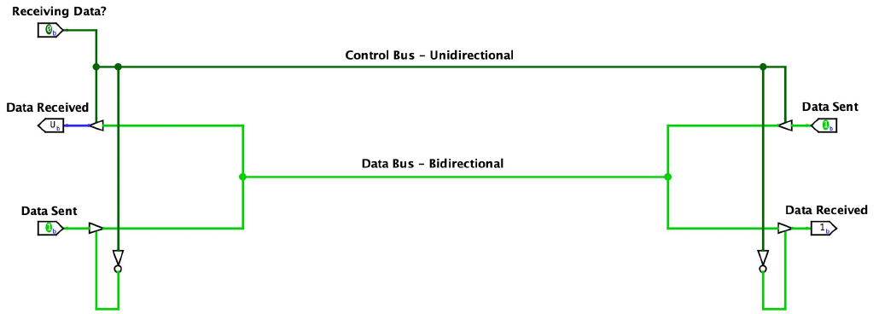
2. Create Buses
For unidirectional bus just directly use the input you have
For bidirectional bus, implement using controlled buffer
  You want to use the same bus to send data when writing and retrieve data when reading
  How to make such a bus?

Slide 14
3. Build a Memory Unit
Include a RAM and a ROM in the Unit
Using the control signals, figure out which one you need for the current operation. Then, depending on if it is a read (address only) or a write (address and data) do the operation (write it inside the RAM or get the read data from RAM/ROM back to the data bus)

Slide 15
4. Build an I/O Unit
The I/O Unit has 4 input devices and 4 output devices.
You take 8 bit input data using the input devices and you give back 8 bit data output using the output devices.
How to address the I/O devices is up to you.
How to implement?
  You take four 8 bit inputs from the input devices and send it to the CPU
  You have four 8 bit output devices (Lab 3 Problem 3) which take data from your CPU
  If your operation is to read from IO then you choose the correct Input device using the address and read data from that input and send it to the data buffer.
  If your operation is to write to the IO then you find the correct Output Device using the address and write to it the data you obtain from the CPU.

Slide 16
5. Decoder
You will input the control signals to figure out which of the required 5 operations are to be done and hence whether RAM, ROM, I/O is to be used and if we need to read/write.

Slide 17
6. Connections from Buses to Units
If it is a read, send address of location to the appropriate unit and get back read data from that unit.
If it is a write, send address and data to the appropriate unit.
Make sure every time you try to read a data, you store it in the data buffer and every time you try to write some data, that data is stored in the buffer as well.

Slide 18
7. Data Buffer
Implement using Register in Logisim.
If current operation requires you to write, then first input the data to this buffer and then use the output of this buffer to send data through data bus to the units.
If current operation requires you to read, then finish the read operation from unit and then input the data you just acquired into the data buffer.

Slide 19
REPORT:
Mention how the control signals for the 5 operations are implemented.
Mention how the addressing for the I/O devices is done
Explain how tri state buffers using controlled buffer ensures that your bus is bidirectional and how the buffer is handled differently in case of different operations.
Mention some examples for your 5 operations that work on your design and what are the inputs and outputs for each of those examples.
Screenshots of whole design and all the subparts (Memory and I/O Units)

Slide 20
PROBLEM 2
For 8-bit inputs:
Design an adder (2 input)
Design a subtracter – Using 2’s complement (2 input)
Magnitude Comparator (2 input)
Left and Right Barrel Shifter (2 inputs: The number and shift amount). [Extra Credit]
Refer to Lecture Slides to understand how to implement each of these.

Slide 21
PROBLEM 3 (Extra Credit)
A single row of 20 LEDs
One input
If input is 0: The LEDS blink from Right to Left in sequence.
If input is 1: The LEDS blink from Left to Right in sequence.
Each LED should be ON for 0.25 seconds before it turns OFF and next LED turns ON.
How to implement?
  Finite State Machine with 20 states.
  Rather than writing a very large truth table for each state transition and finding the complex Boolean logic, you can use a counter to increment state values one by one. You increment in case of input 0 and decrement in case of 1.
  After implementing, change the decoder to ROM and implement the same thing

Slide 22
Files to be submitted
Group Report
Individual Report
All Logisim Files with proper names (Problem1,2,3)

