Slide 1
LOO PROJECT · PRODUCTION MONTE CARLO
What survives a full
DGP × procedure comparison?
A visual summary of 500 simulated labor markets
25,000 workers · 5,000 firms · 60 periods · 100 replications per DGP
Current project procedure: BIC-selected low-rank plug-in; full LOO bias correction not yet evaluated.
LOO simulation · visual summary
1
Notes:
[Sources]
- C:\Users\A8327\OneDrive\Documents\OI\work\loo_simulation\DGP_ESTIMATOR_RESULTS.tex
- C:\Users\A8327\OneDrive\Documents\OI\work\loo_simulation\results\dgp_estimator_matrix_cluster_v2\merged\config.json
- C:\Users\A8327\OneDrive\Documents\OI\work\loo_simulation\results\dgp_estimator_matrix_cluster_v2\merged\metadata.json
[/Sources]

Slide 2
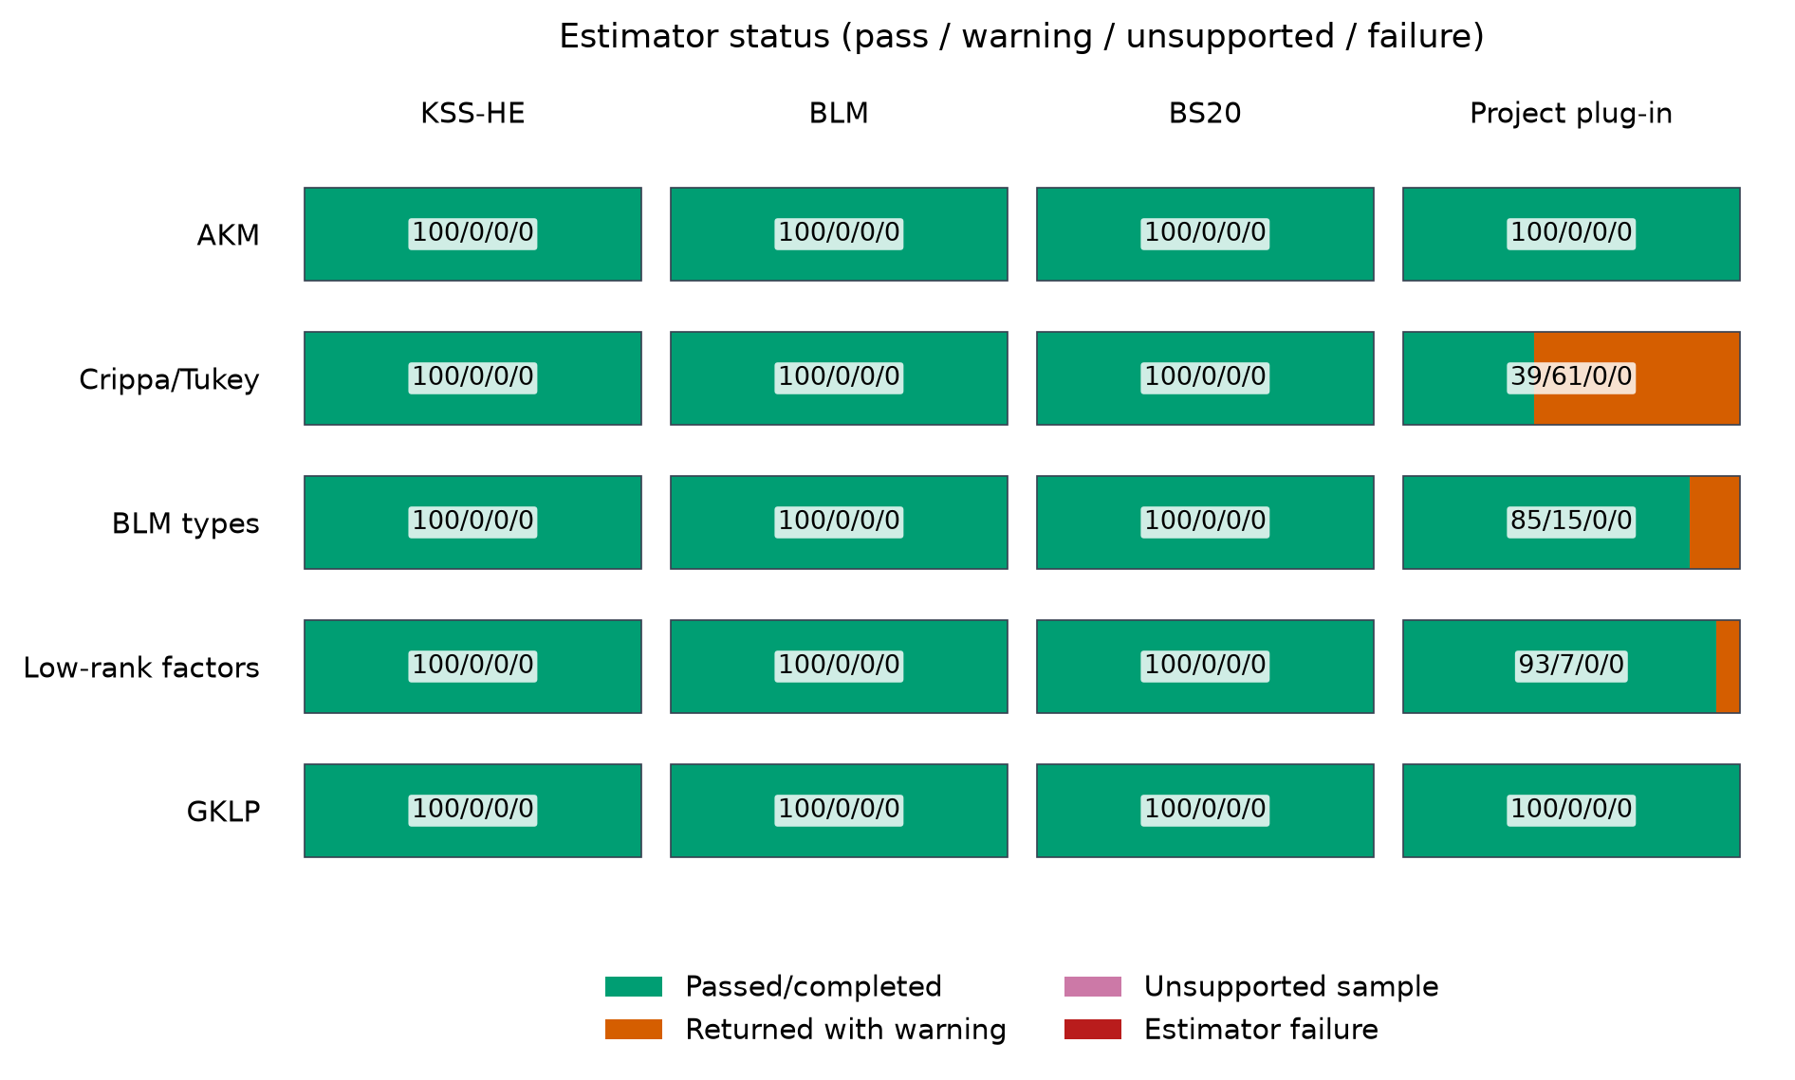
Every procedure was run under every DGP
Yᵢⱼ = Xᵢⱼ′δ + αᵢ + ψⱼ + uᵢ′Λvⱼ + εᵢⱼ, rank(Λ) = r
Simulation sets Xᵢⱼ′δ = 0
LOO simulation · visual summary
2
Notes:
[Sources]
- C:\Users\A8327\OneDrive\Documents\OI\work\loo_simulation\DGP_ESTIMATOR_RESULTS.tex
- C:\Users\A8327\OneDrive\Documents\OI\work\loo_simulation\reports\dgp_estimator_matrix_cluster_v2\figures\status-matrix.png
- C:\Users\A8327\OneDrive\Documents\OI\work\loo_simulation\results\dgp_estimator_matrix_cluster_v2\merged\attempt_summary.csv
[/Sources]

Slide 3
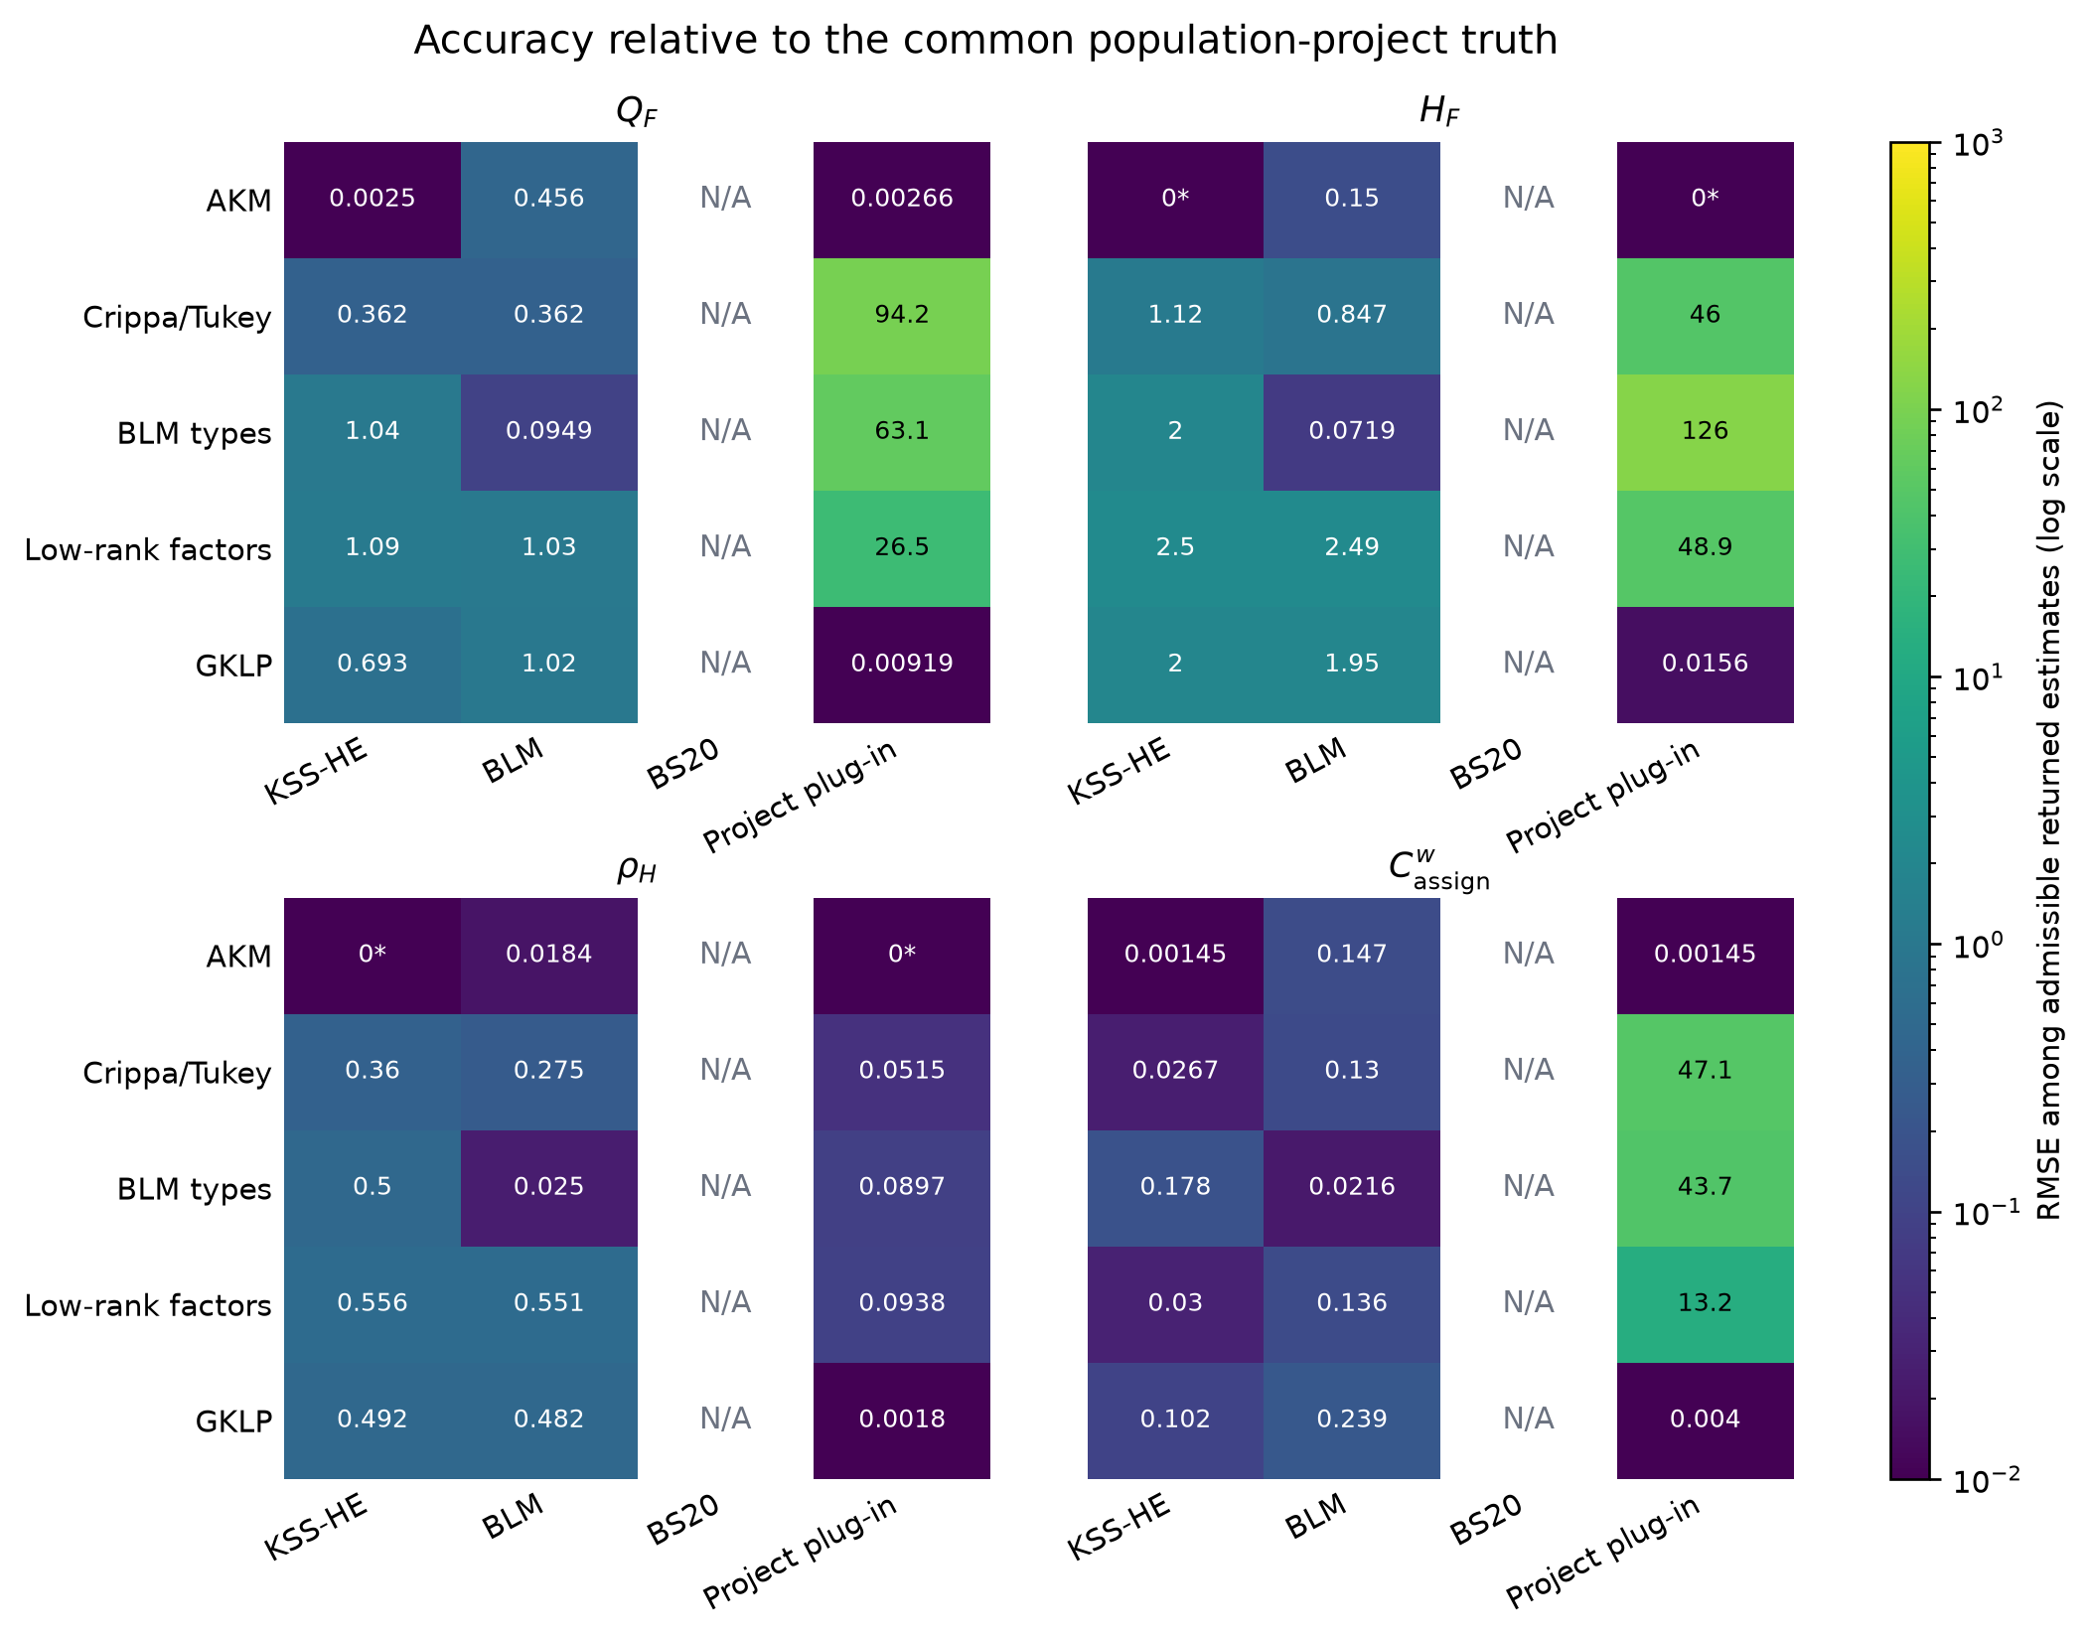
Correctly specified benchmarks behave as designed
KSS under AKM
0.0025
RMSE(Q_F); H_F = ρ_H = 0 by construction
BLM under BLM DGP
0.0949
RMSE(Q_F); RMSE(H_F) = 0.0719
Why BS20 is N/A
BS20 estimates ρ_BS and C_BS—not the four project estimands.
LOO simulation · visual summary
3
Notes:
[Sources]
- C:\Users\A8327\OneDrive\Documents\OI\work\loo_simulation\reports\dgp_estimator_matrix_cluster_v2\figures\common-target-rmse.png
- C:\Users\A8327\OneDrive\Documents\OI\work\loo_simulation\reports\dgp_estimator_matrix_cluster_v2\tables\benchmark_accuracy.tex
- C:\Users\A8327\OneDrive\Documents\OI\work\loo_simulation\DGP_ESTIMATOR_RESULTS.tex
[/Sources]

Slide 4
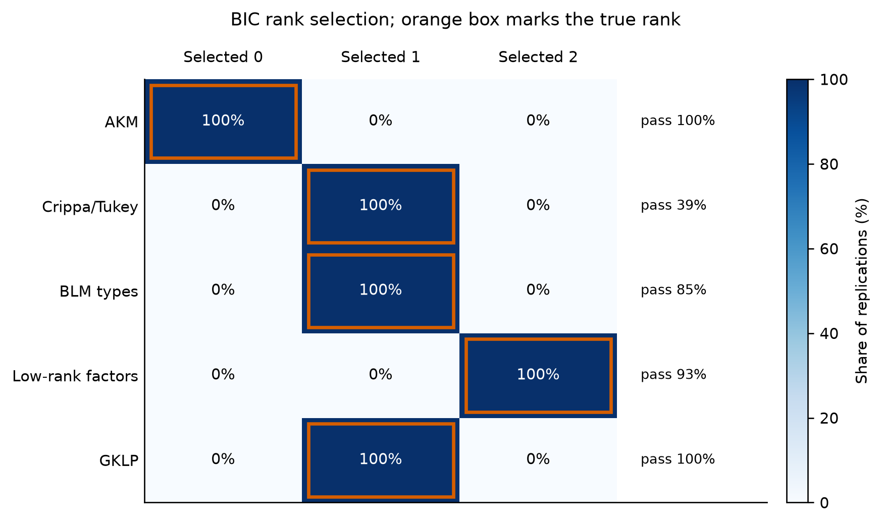
Correct rank selection does not guarantee reproducible completion
500 / 500
populations at the correct BIC rank
What is a project warning?
A finite estimate was returned, but its positive-rank fit failed at least one reproducibility condition:
1. Best ALS fit did not converge.
2. Fewer than two near-best starts.
3. Near-best starts disagree on Q_F, H_F, or C^w_assign beyond tolerance.
Near-best objective: within 10^-4 max(1,O*).
Functional spread limit: 10^-3 max(1,|theta*|).
Warnings: 61 Crippa/Tukey | 15 BLM | 7 low-rank
Rank asks which model size wins. A warning asks whether nearly equal-fitting solutions imply the same economic objects.
LOO simulation · visual summary
4
Notes:
[Sources]
- C:\Users\A8327\OneDrive\Documents\OI\work\loo_simulation\reports\dgp_estimator_matrix_cluster_v2\figures\rank-selection.png
- C:\Users\A8327\OneDrive\Documents\OI\work\loo_simulation\reports\dgp_estimator_matrix_cluster_v2\tables\rank_selection.csv
- C:\Users\A8327\OneDrive\Documents\OI\work\loo_simulation\src\loo_sim\low_rank.py
- C:\Users\A8327\OneDrive\Documents\OI\work\loo_simulation\DGP_ESTIMATOR_RESULTS.tex
[/Sources]

Slide 5
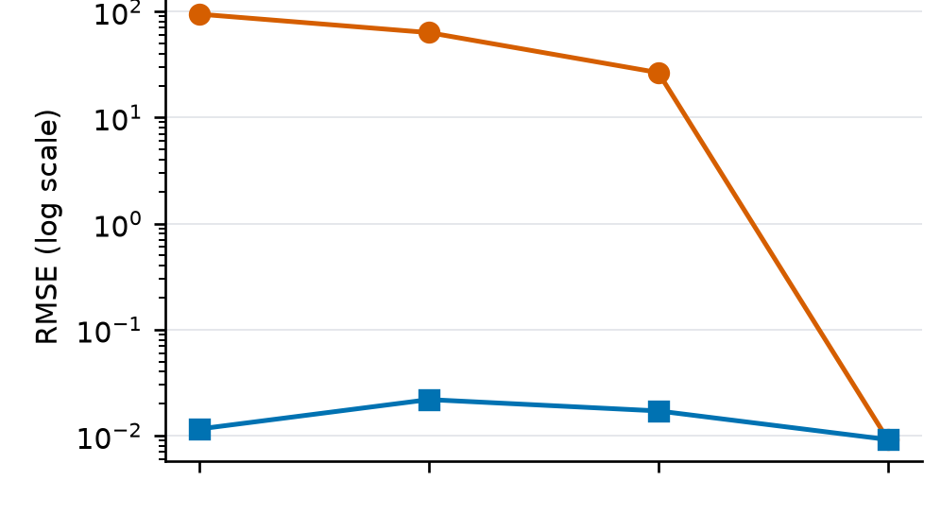
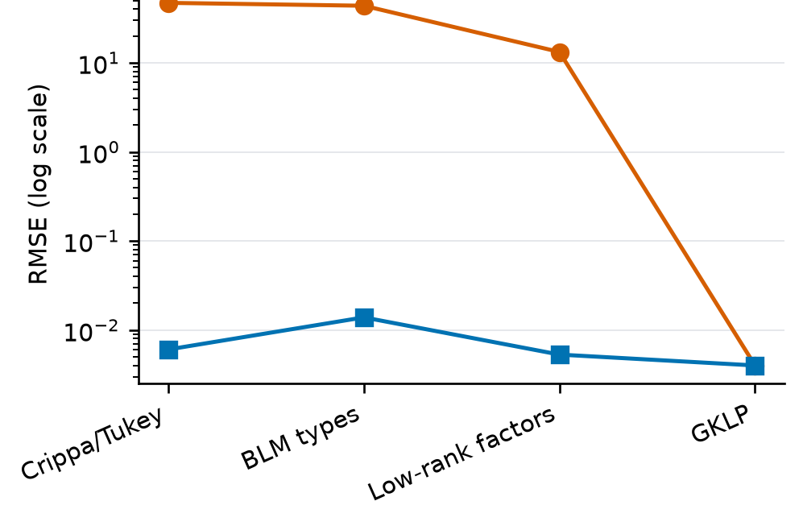
Warning fits create the large RMSE tail
Nonadditive DGPs shown: Crippa/Tukey | BLM types | Low-rank factors | GKLP
all returned
diagnostic pass only
Q_F
C^w_assign
All returned
Diagnostic pass only
How to read the gap
Every finite project estimate, warnings included. This is the unconditional performance of the procedure actually run.
The same estimator after removing warning fits. It is a sensitivity calculation, not a competing estimator or a valid replacement for unconditional RMSE.
RMSE squares errors. Five replications generate 91-100% of Q_F squared error in Crippa, BLM, and low-rank. The warnings locate this tail concentration.
LOO simulation · visual summary
5
Notes:
[Sources]
- C:\Users\A8327\OneDrive\Documents\OI\work\loo_simulation\reports\dgp_estimator_matrix_cluster_v2\figures\project-returned-vs-stable-rmse.png
- C:\Users\A8327\OneDrive\Documents\OI\work\loo_simulation\DGP_ESTIMATOR_RESULTS.tex
- C:\Users\A8327\OneDrive\Documents\OI\work\loo_simulation\reports\dgp_estimator_matrix_cluster_v2\tables\common_target_performance.csv
[/Sources]

Slide 6
Why some completed schedules become numerically unstable
Instability here means that starts with almost the same fit to observed match means imply materially different completed schedules - and therefore different Q_F, H_F, or C^w_assign.
1 Local factor update
2 Poor conditioning
3 Extreme completion
ALS estimates a worker's intercept and factor coordinates from the factor vectors of firms that worker visited; firm updates are analogous.
If those visited-firm vectors are nearly redundant, the local Gram matrix is almost singular. Its condition number measures noise amplification: larger means less independent information.
Small match-mean noise can then create huge u_i or v_j estimates. Those factors extrapolate to unobserved worker-firm pairs and can explode the plug-in functionals.
Low-rank DGP evidence: medians across replications
Diagnostic pass (93): worst local condition number 42; maximum factor norm 4.32.
Warning (7): worst local condition number 84,006; maximum factor norm 184.9.
42 versus 84,006 compares two groups of replications. It is not a before/after path, and the condition number itself is not the warning rule.
Takeaway: cross-start disagreement is the warning; poor conditioning is the mechanism that can produce that disagreement and the extreme RMSE tail.
LOO simulation · visual summary
6
Notes:
[Sources]
- C:\Users\A8327\OneDrive\Documents\OI\work\loo_simulation\reports\dgp_estimator_matrix_cluster_v2\tables\project_numerical_diagnostics.csv
- C:\Users\A8327\OneDrive\Documents\OI\work\loo_simulation\src\loo_sim\low_rank.py
- C:\Users\A8327\OneDrive\Documents\OI\work\loo_simulation\DGP_ESTIMATOR_RESULTS.tex
[/Sources]

Slide 7
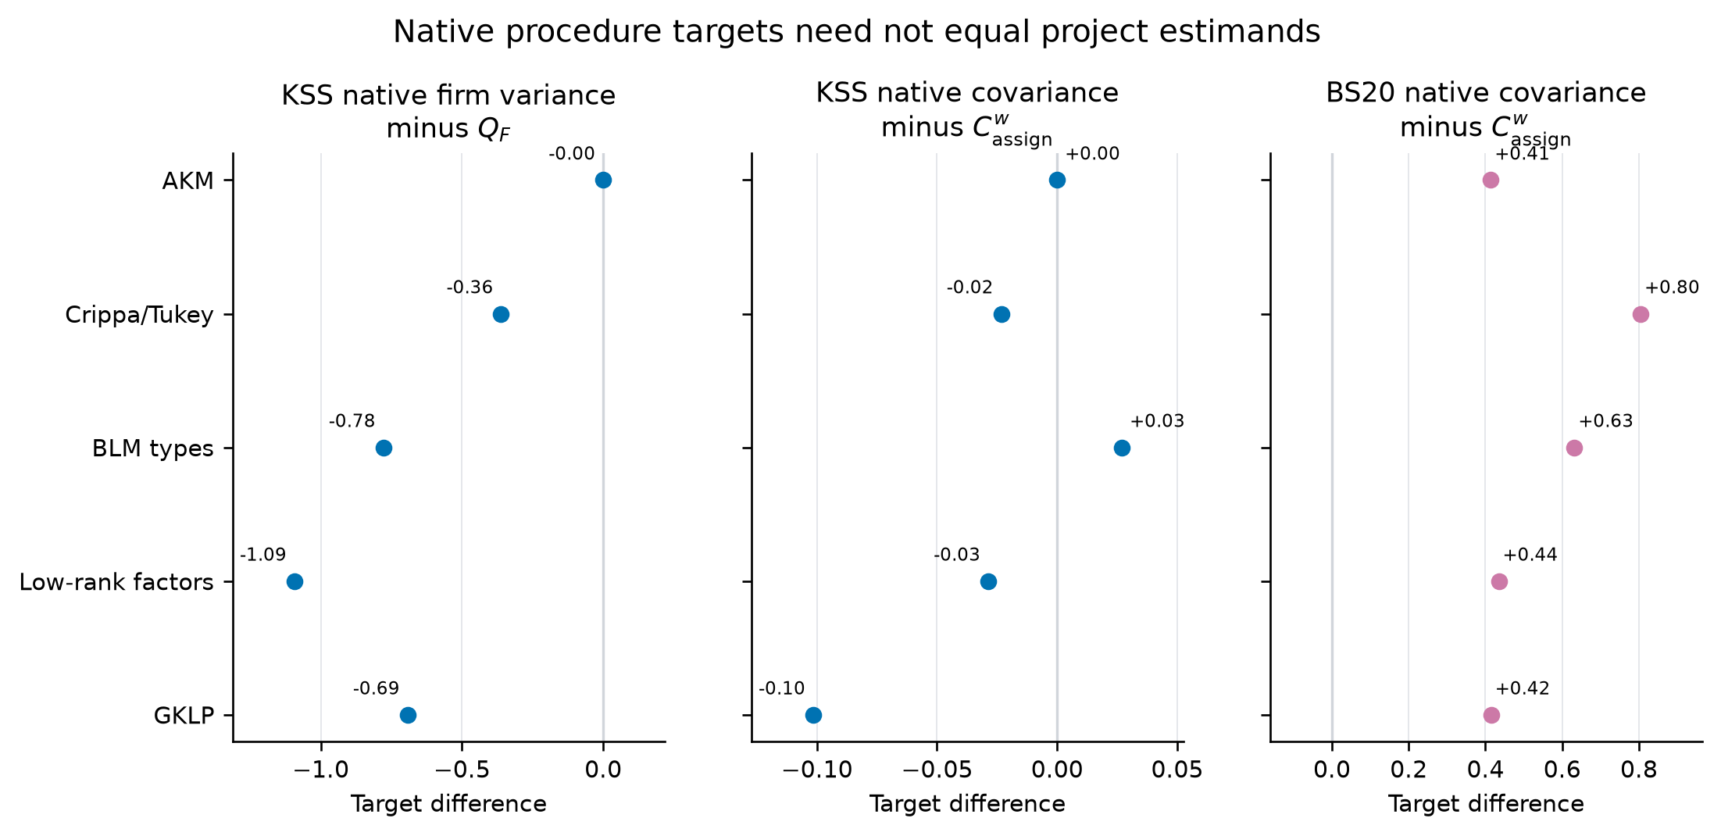
Why this target-gap figure uses KSS and BS20
Why these procedures?
KSS and BS20 return native objects whose names resemble project objects, creating a real risk of silently treating unlike estimands as the same.
Why only three gaps?
They are the defensible like-units comparisons: firm variance V_psi^AKM - Q_F, additive covariance C_psialpha^AKM - C^w_assign, and BS20 covariance C_BS - C^w_assign.
What is omitted on purpose?
KSS versus H_F or rho_H is model misspecification, already shown in RMSE. rho_BS and rho_H have different constructions. BLM grouped-minus-full is approximation error, not a change of estimand.
Takeaway: a benchmark can estimate its native object accurately and still answer a different economic question from the project estimand.
LOO simulation · visual summary
7
Notes:
[Sources]
- C:\Users\A8327\OneDrive\Documents\OI\work\loo_simulation\reports\dgp_estimator_matrix_cluster_v2\figures\native-project-target-gaps.png
- C:\Users\A8327\OneDrive\Documents\OI\work\loo_simulation\reports\dgp_estimator_matrix_cluster_v2\tables\native_project_target_contrasts.csv
- C:\Users\A8327\OneDrive\Documents\OI\work\loo_simulation\reports\dgp_estimator_matrix_cluster_v2\tables\bs20_native_accuracy.csv
- C:\Users\A8327\OneDrive\Documents\OI\work\loo_simulation\DGP_ESTIMATOR_RESULTS.tex
[/Sources]

Slide 8
What we tried - and what remains an actual experiment
Already embedded in the production baseline
Proposed, but not yet tested
1. Recenter and SVD-normalize after every ALS iteration.
2. Require r+2 distinct partners on a common support core.
3. Use six exploratory and three confirmation starts.
4. Use 60 periods with redraw probability 0.40.
1. Ridge/Tikhonov local factor regressions.
2. A pre-declared penalty or pooling rule triggered by weak local information.
3. Direct estimation of Q_F, H_F, and C^w_assign without completing every pair.
4. The proposal's full leave-worker-out correction.
These choices turned failed preflights into a viable baseline and made nonreproducible basins visible. They were not separate estimator arms, and production still produced 61/15/7 warnings.
'Make conditioning part of the estimator' means: inspect the local Gram spectrum before each update and apply a declared ridge or pooling rule when it is weak. That changes every returned estimate by design; it is not post-hoc removal of warnings.
The next controlled experiment
Hold the DGP draws and seeds fixed; compare the current baseline with declared regularized variants on unconditional RMSE, bias, and warning rate. Until that is run, there is no evidence that the proposed variants improve efficacy.
LOO simulation · visual summary
8
Notes:
[Sources]
- C:\Users\A8327\OneDrive\Documents\OI\work\loo_simulation\README.md
- C:\Users\A8327\OneDrive\Documents\OI\work\loo_simulation\DGP_ESTIMATOR_RESULTS.tex
- C:\Users\A8327\OneDrive\Documents\OI\work\loo_simulation\src\loo_sim\low_rank.py
- C:\Users\A8327\OneDrive\Documents\OI\work\loo_simulation\configs\dgp_estimator_matrix_cluster.json
[/Sources]

