Slide 1
Analysis of UAP Sightings for Report Classification
Michael Kennedy | Complex Data Analytics | March 12, 2025

Slide 2
Project Overview
- Data scraped from NUFORC (2023-2025) (Using Chrome Driver)
National UFO Reporting Center
- Analyzed reports using text mining & sentiment analysis
Bert SA, TF-IDF, Lemma
- Classified reports into UFO, Drone, or Not an Aircraft (y)
Use summary reports and text-mining to predict a reports classification report
Importance: increase in UAP activity and deregulated FAA reports puts air traffic control data in jeopardy
- Built a predictive model using logistic regression based on location, sentiment stars, sentiment confidence score, location, and time.

Slide 3
Questions
What is the overall sentiment from these reports?
Where do UFO’s most commonly appear?
When do UFO’s most commonly Appear?
Can reports from the public help us identify what aerial phenomenon is occurring?

Slide 4
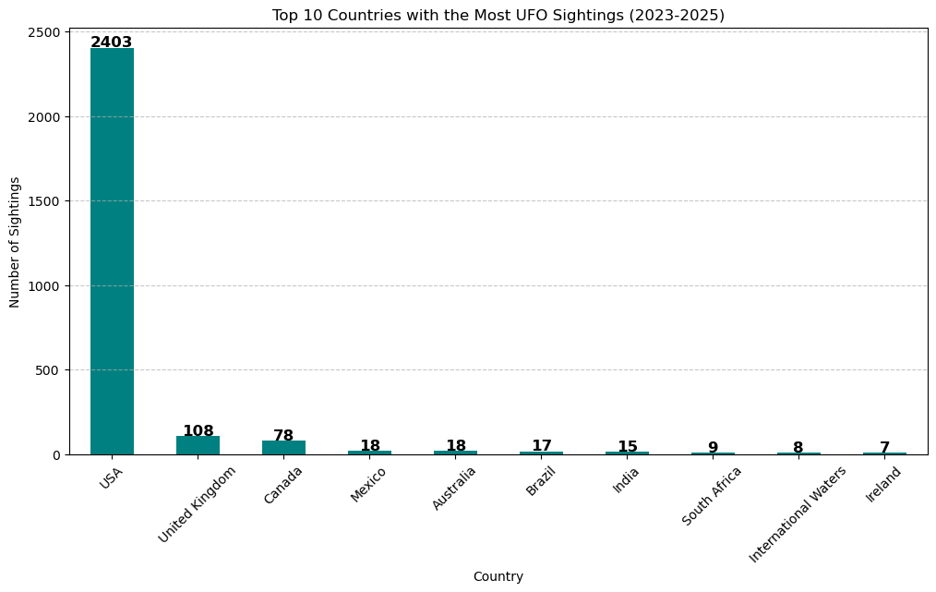
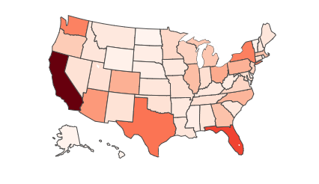
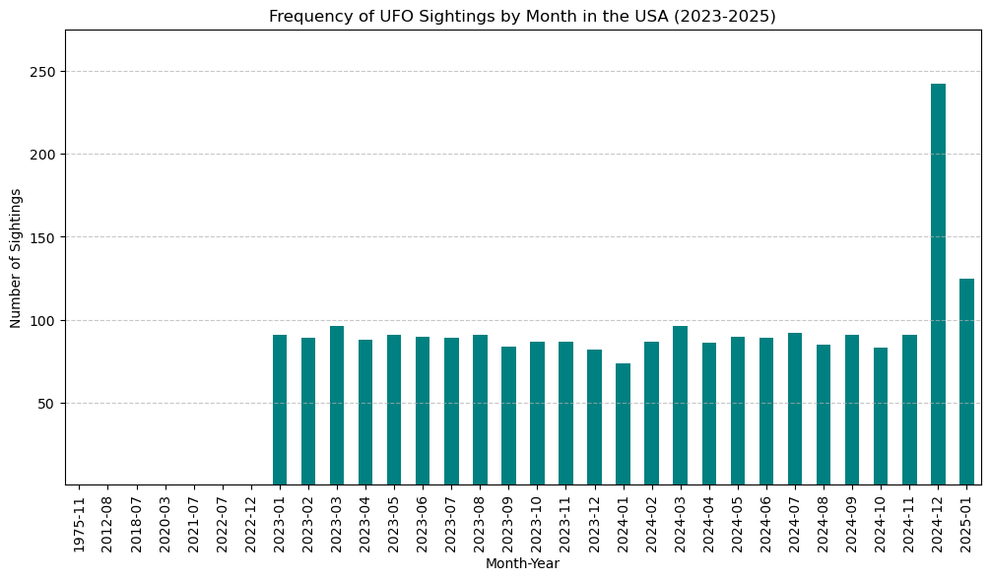
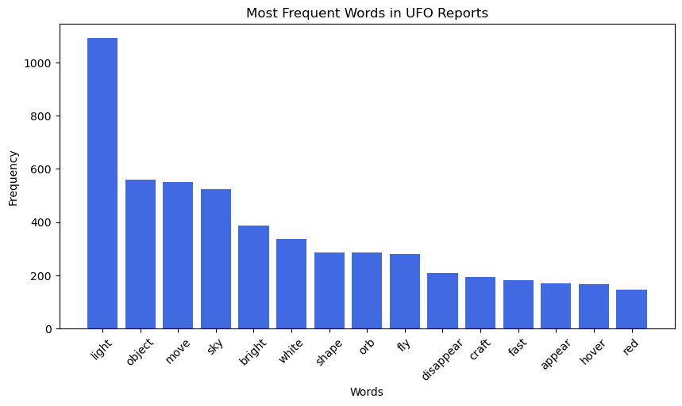
For The Beginning Data Analysis we Created Visuals to determine popular places, times, and shapes people have reported

Slide 5
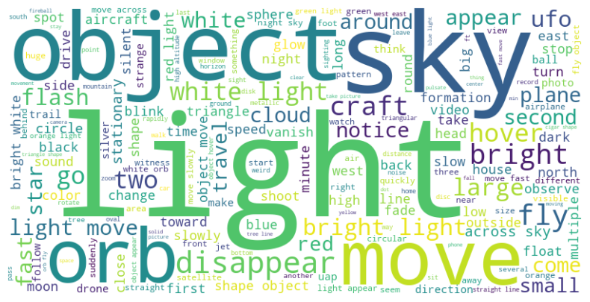
Most Common Words

Slide 6
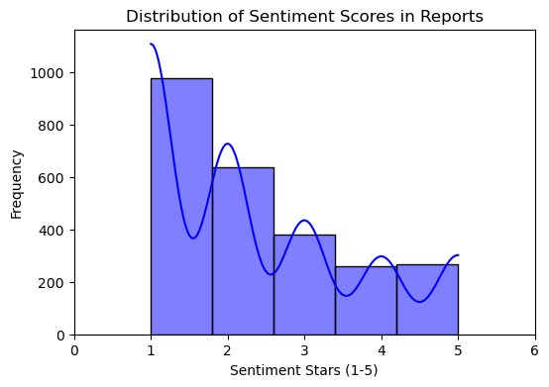
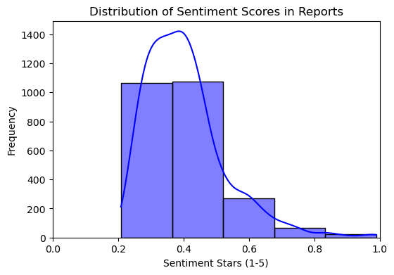
Sentiment Analysis Findings
- Used BERT-based sentiment analysis
- Sentiment scores ranged from 1-5 stars (As well as confidence in those scores

Slide 7
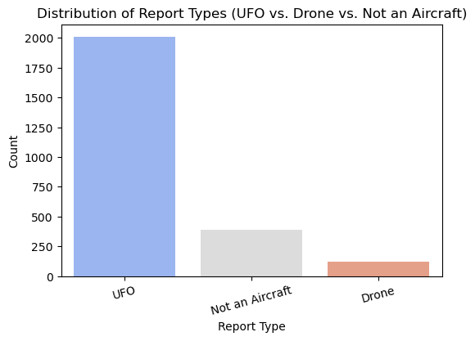
Predictive Model Performance
- Model: Logistic Regression
- Accuracy: 79.4%
- Features: Summary (TF-IDF), Location, Time of Day, Sentiment
- Strong classification of drones, but some misclassification of Not an Aircraft
Overall Distribution of Each Report Type:

Slide 8
Key Takeaways
- Text mining and sentiment analysis have an ability to classify these reports but need significant improvement
- Most reports were classified as UFOs, classification of Drones was trickier
- Sentiment trends: Higher skepticism linked to Not an Aircraft vs UAP
people reporting under Not an Aircraft or uap related are already skeptical
- Future work: Incorporate weather, media analysis, flight tracking, a wider dataset

Slide 9
Conclusion & Next Steps
Location, Time, Sentiment, TF-IDF Summary are significant predictors for report type but need improvement on the text mining portion

