Slide 1
Revilations

Slide 2
LELAND CURTIS
SMITHGROUP JJR
HANSHEN SUN
OFFICE
MICHEL KERO
CORE STUIDO
FATHY GAD
DAR GROUP
HIRAM RODRIGUEZ
CORE STUDIO
REVILATIONS || AECHACKATHON 2017

Slide 3
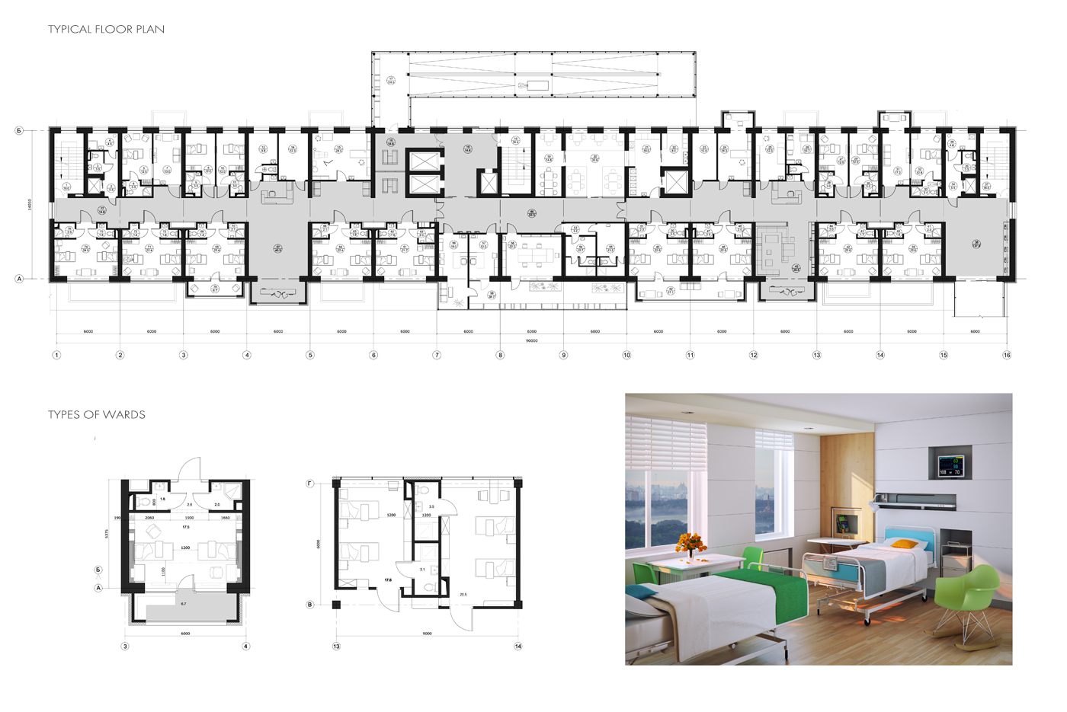
The Problem: Repetitive tasks
REVILATIONS || AEC HACKATHON 2017

Slide 4
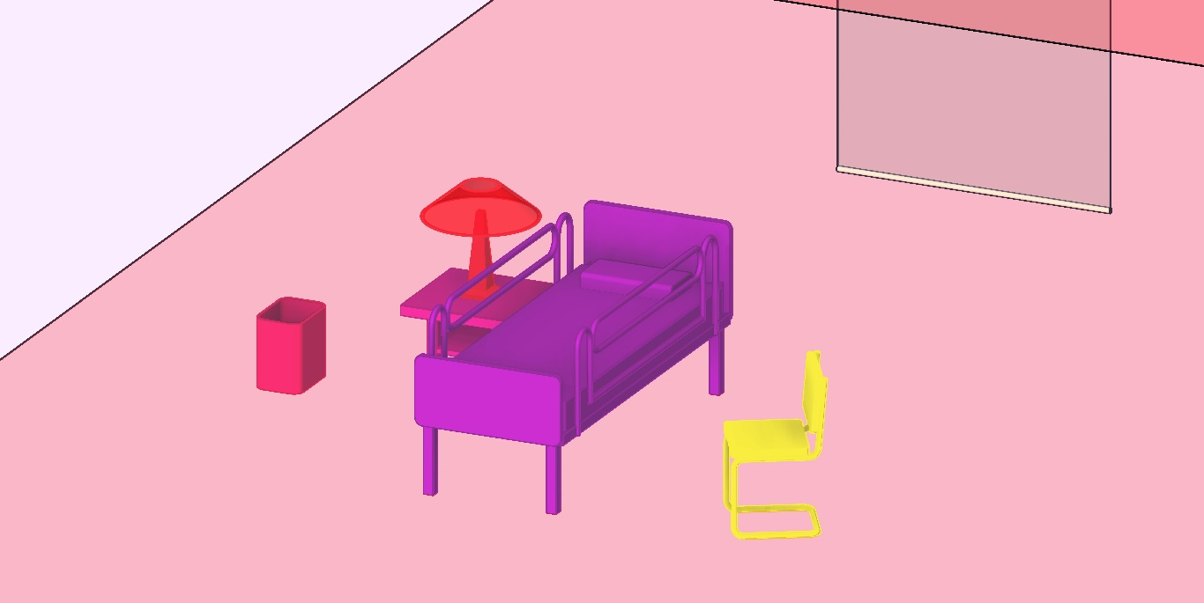
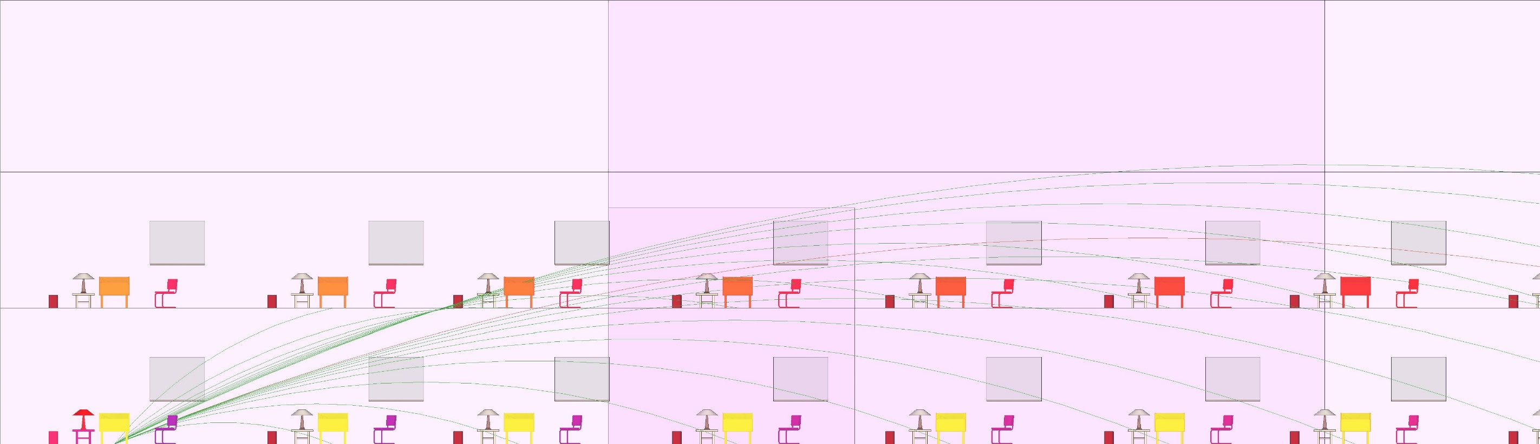
Set child-parent relationships
Automate placement + updating
REVILATIONS || AEC HACKATHON 2017

Slide 5
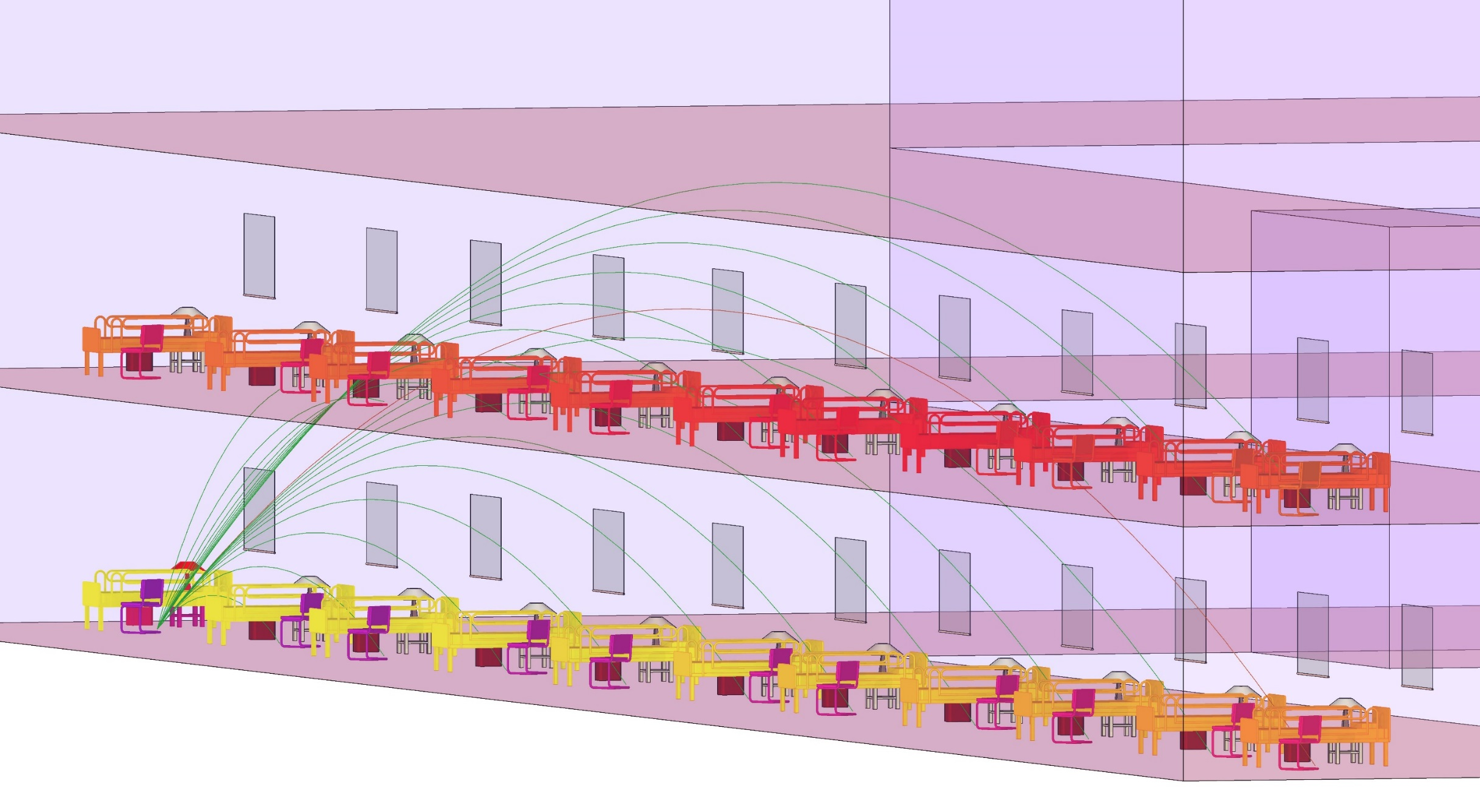
REVILATIONS || AEC HACKATHON 2017

Slide 6
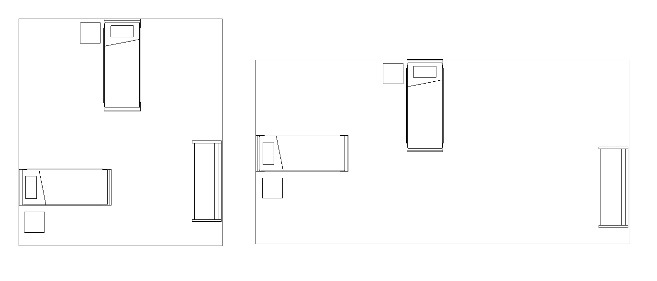
Enables smart guide plates
GUIDE PLATES
REVILATIONS || AEC HACKATHON 2017

Slide 7
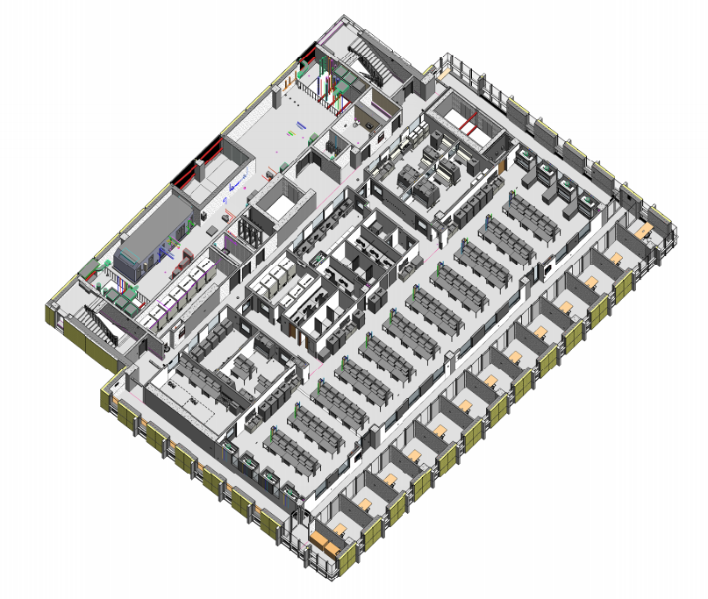
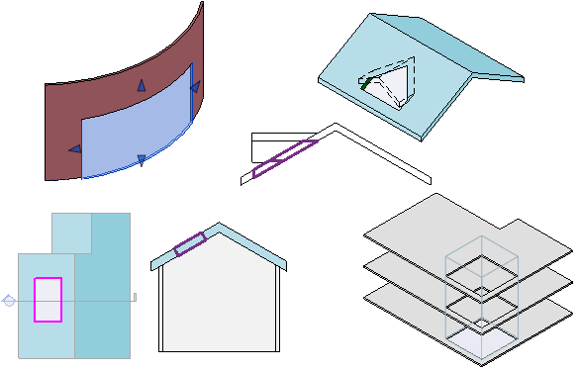
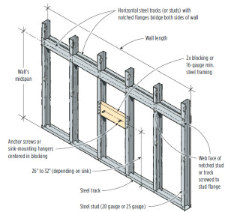
Use Cases: Any large hospital, lab or office
REVILATIONS || AEC HACKATHON 2017

Slide 8
REVILATIONS || AEC HACKATHON 2017

