Slide 1
Revilations

Slide 2
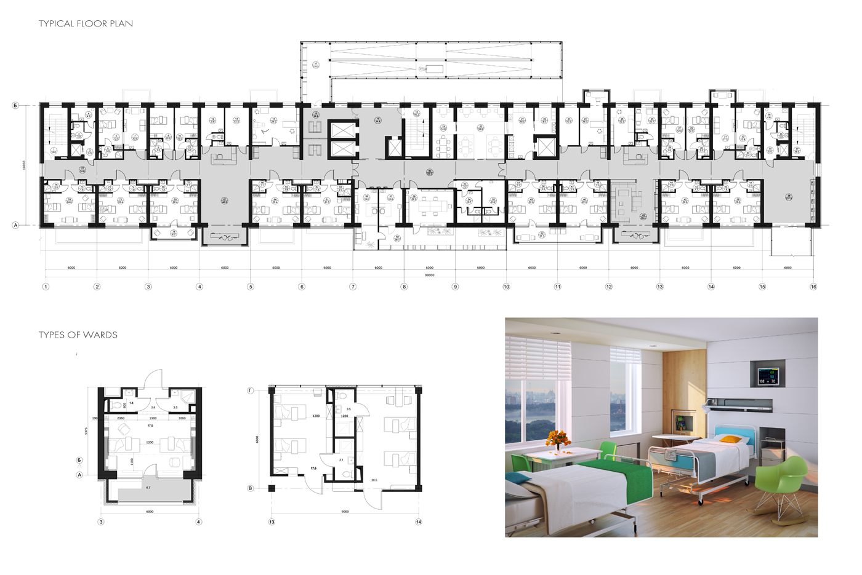
Automation tool for the 99%.
Easily define parent-child relationships between objects within Revit.
Model groups do not support parent-child relationships

Slide 3
Solution:
Gather relationships between objects in “guideplates” and auto-populate/update all rooms. Allow the user to manually adjust guideplate in Revit UI.

