Slide 1
Revilations

Slide 2
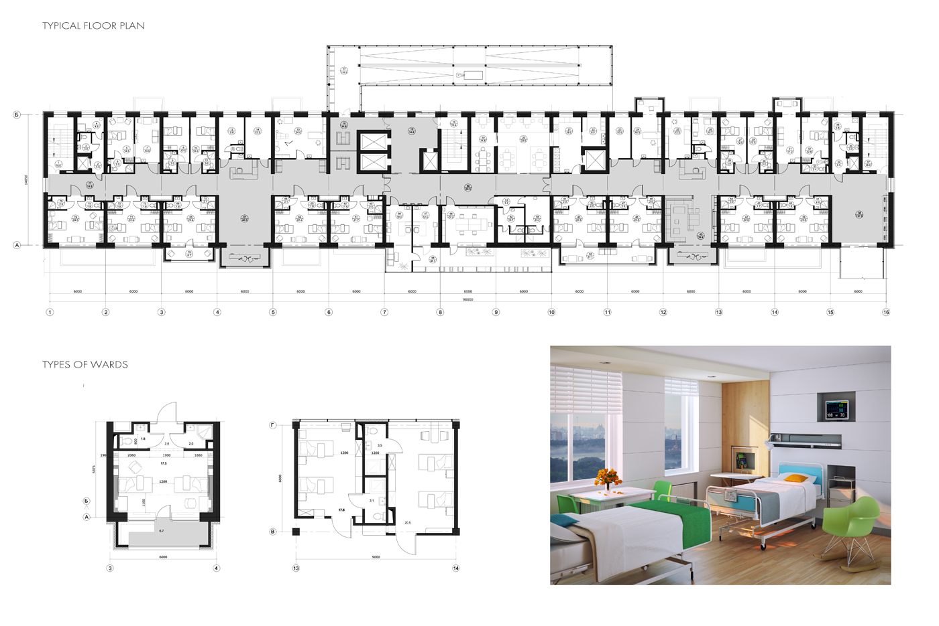
The Problem: Repetitive tasks

Slide 3
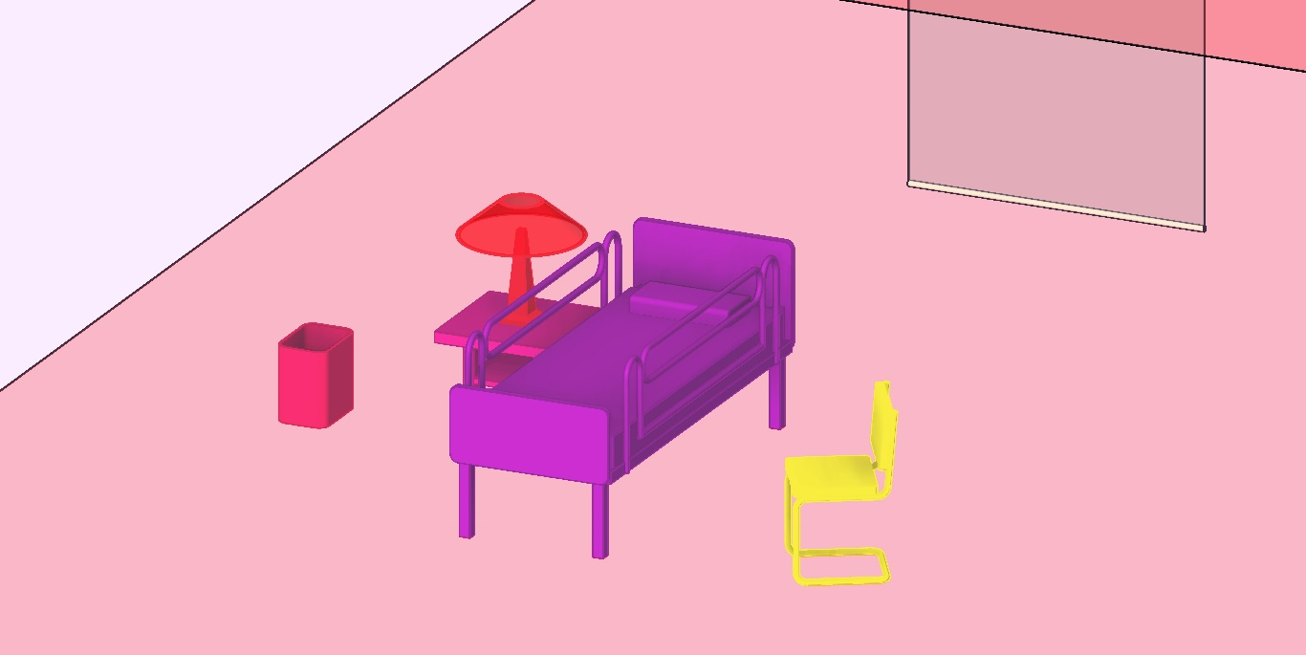
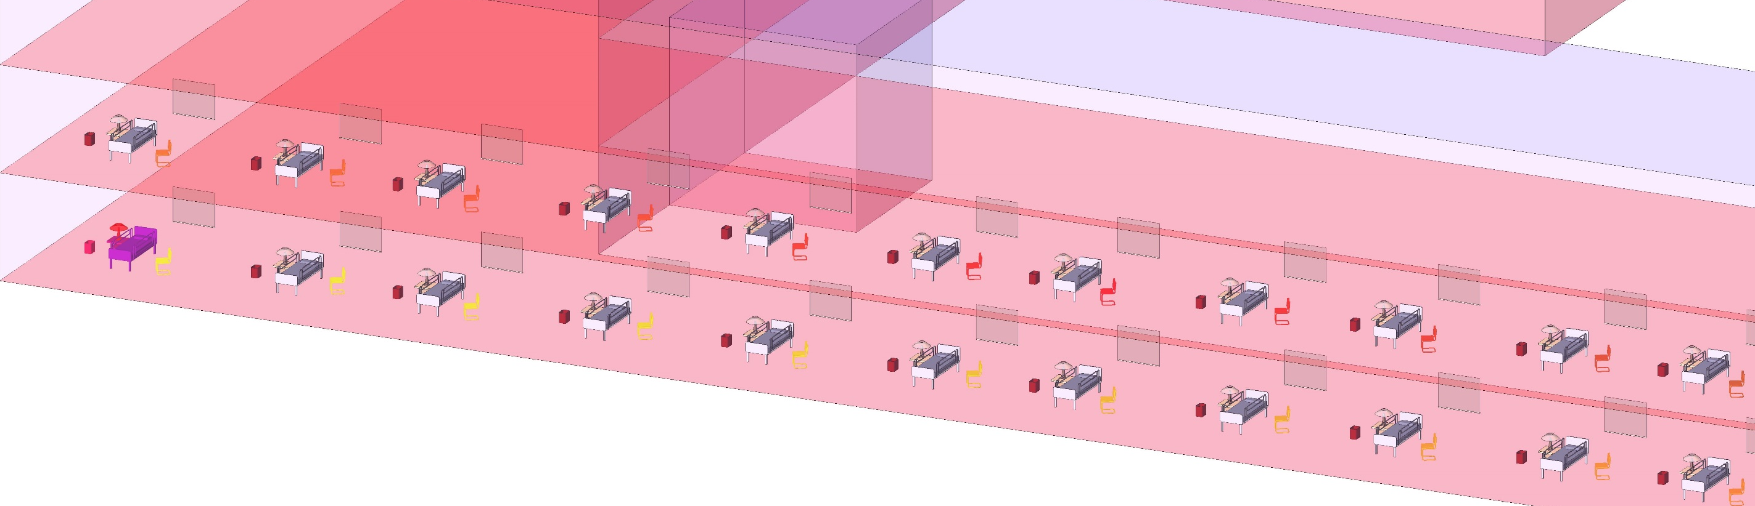

Set child-parent relationships
Automate placement + updating

Slide 4
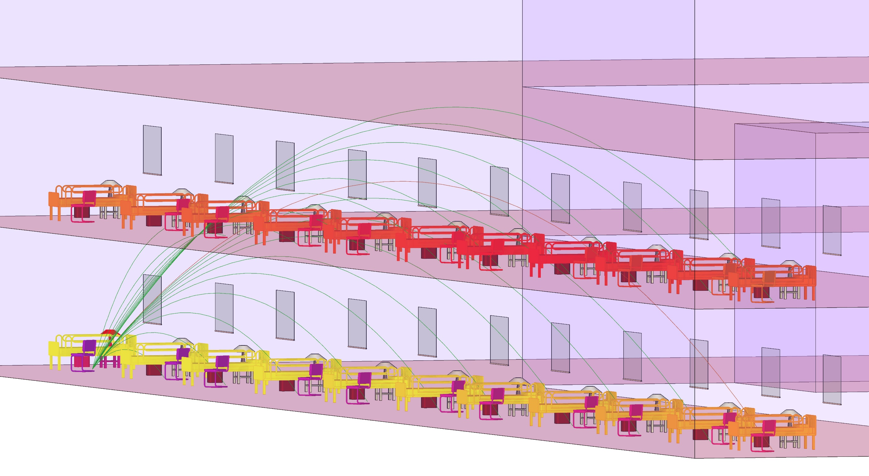

Slide 5
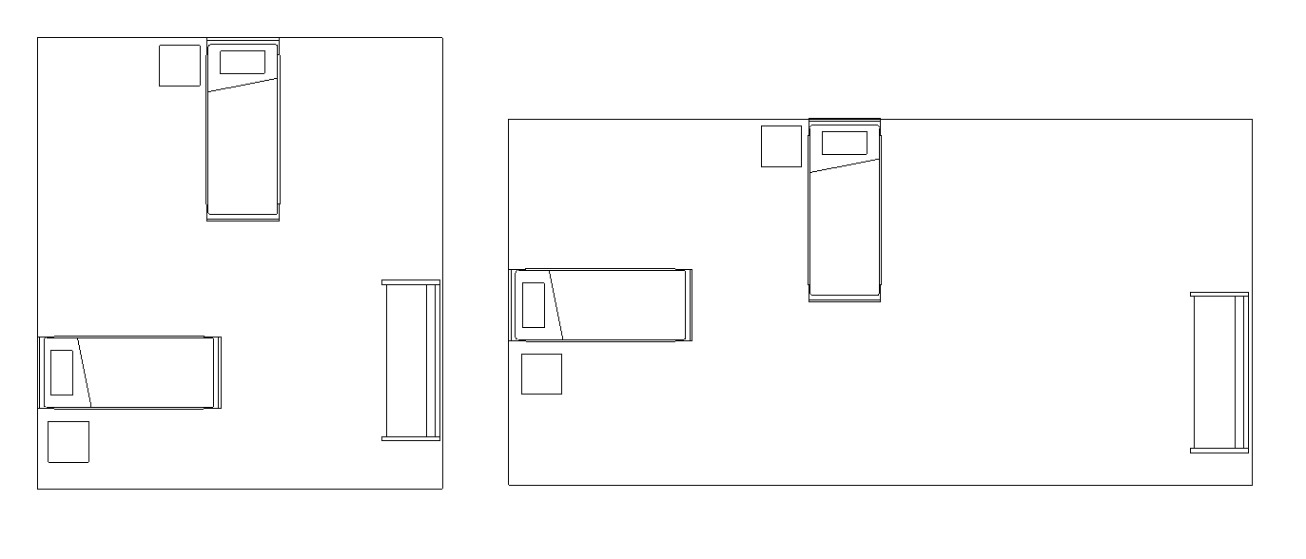
Enables smart guide plates

Slide 6
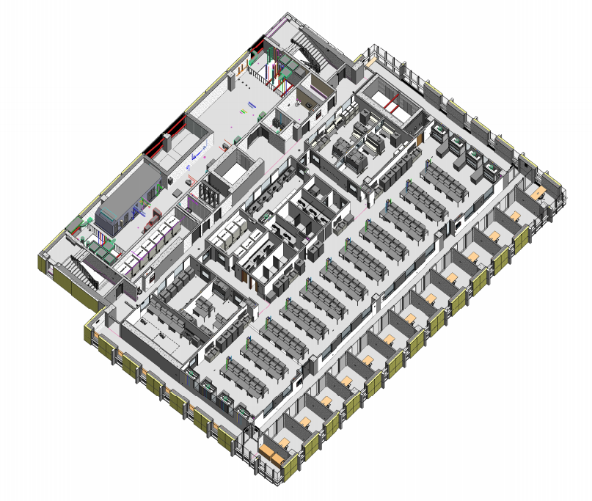
Use Cases: Any large hospital, lab or office

Slide 7
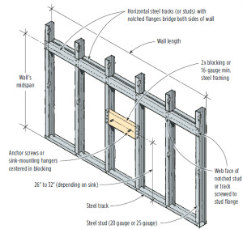
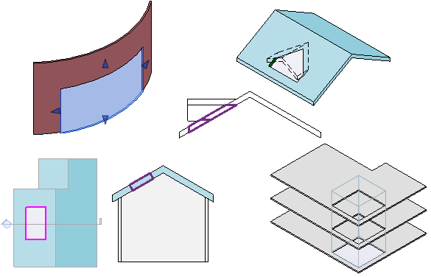
Use Cases: Any large hospital, lab or office

