Slide 1
Java/Spring Web Services
Instructor: Michael Gaffney
Max Technical Training
This deck and all other materials I produce are hosted at:
https://github.com/michaelkgaffney/MAXTrain-java-spring.git

Slide 2
Who am I?
Michael Gaffney
LinkedIn: MichaelKGaffney
Approaching 20 years of education and training experience
Century College
The Software Guild
Cognizant
Galvanize
Recently laid off
Which worked out OK, as Max Technical Training recently needed someone to step into this training
Last 6 months were spent training on Java/Microservices

Slide 3
Who are you?
Seriously. I have almost no idea. That got missed in the handoff somehow.
Pretty sure I’ll have built a class list from the names you have in Zoom by this point.
There should be 13 of you.
I’ve been told you’re experienced COBOL devs.
I hope that’s correct, as I’ll be really uncomfortable with the time frame if I have to explain how loops work.
Who do y’all work for? If you say “Cognizant”, I’m going to shoot myself with a phaser.

Slide 4
Course Overview
Part 1: August 30 – September 2, 9:00am – 4:30pm EDT
ALL THE JAVA
Ok, MOST of the Java
Well… some of the Java
The really critical stuff
Part 2: September 13 – September 16, 9:00am – 4:30pm EDT
RESTful Web Services
Spring Core
Framework we’ll use for dependency injection
Spring Web
Framework for handling Web requests
Spring JPA (Jakarta Persistence API)
An Object-Relational Mapping API

Slide 5
Course Overview II: Endgame
An HTTP-accessible CRUD application including
Callable Microservice API
Automated unit and API tests
Controller-Model-Service-Persistence architecture
A simple 1-M, two-entity data model

Slide 6
Cutting Room Floor
Significant topics that won’t be covered in these 8 days
Security
I’ll be having you connect to MySQL as root using “root” as your password. We’re definitely not covering endpoint authentication or the like.
Deployment
No AWS or Docker
Development Practices/Methodologies
E.g. Agile, Pair Programming, Test-Driven Development
Documentation
No Swagger or RESTDocs

Slide 7
Not the Course Format
Explain-Show-Try
Explain
The instructor describes the concept/activity in question, generally using a slide deck like this one, but fancier.
Show
The instructor walks through an example of the concept/activity, doing what the class will be asked to do
Try
The class works individually on a similar problem, raising questions and getting assistance as needed

Slide 8
The Course Format
Team Learn, Try, Discuss
Team Learn
You’ll be broken up into 4 groups of 3-4 people.
You’ll receive a topic to study and an exercise to complete
Try
As part of your break-out time, you’ll individually work on the exercise
(Unless it’s a conceptual topic, in which case I’ll have you do something as a group supporting it.)
Discuss
We’ll come back together as a class and discuss what you’ve worked on.
I’ll go over material, via discussion or code, as needed to support you.

Slide 9
Breakouts
Generally 60-75 minutes
Smaller, to make free conversation easier
How you use the time to learn the material and complete the exercise is entirely up to you.
Suggested resources at the end of this deck
Help each other with the exercises, but be sure that you each do them as well
I’m completely available the entire time, although I may be in a different room and delayed.

Slide 10
Discussion
Whenever you’re done, come back to the main room.
We’ll want to move as quickly as maintainable, while still taking as much time as needed.
Think of three questions
What went well?
What could have gone better?
What could be done differently next time?
This is a safe zone.
I want to hear mistakes and points of confusion, whether corrected or not.

Slide 11
Larger Exercises
At various points we’ll break into groups just to work on a larger exercise making use of the material to that point.
How often will depend on available time.
Toward the end of each week, we’ll break out to write a simple CRUD application using that week’s material.
These will be the same application
You’ll have a group around you but each person is writing the application
You might not have enough time to finish the first week’s in class.
In which case, you don’t need to worry about finishing it. The second week’s won’t be an extension of it.

Slide 12
Deviations
While I won’t be doing Explain-Show-Try, I will present some material.
Code-alongs
Sometimes the simplest and fastest way to introduce something is to have you code it with me.
We’ll do this right off with the creation of the required “Hello World!” program.
Goal presentation
This will likely kick-off our second week, as I give you a quick look through an application similar to what your own final applications will be so you know where everything is going.
Code-As-Tutorial
I’ll most likely present the Junit testing framework this way. A lot of its functionality can be put into a couple small examples.

Slide 13
Resources
Murach’s Text
We’ll be roughly following this text
There’s a LOT of material, as it is a textbook and is aimed at beginners.
The facing page format is very strong, but needs the app
There are two versions of the app:
Windows 10
Looks more modern
Doesn’t prompt you to upgrade all the time
Hides controls in the AA menu
Windows 7/8
Easier to read text, to my eye
Easier to find controls
Supports multi-level headings under chapters. Newer version just expands them all out and loses the organization
Has a bit of lag for me

Slide 14
Online Resources
https://www.w3schools.com/java/
Really bare-bones “Here’s the syntax, give it a try” tutorial.
https://www.tutorialspoint.com/java/index.htm
A nice balance between brevity and actually explaining things

Slide 15
This is Your Class
I’ll check in with you for feedback regularly, but give it whenever.
While I’m on contract to Max, I consider you my clients. I want your experience to be as good as it would be if I were working in house with you.
Unlike in-house, you have me for the 8 scheduled days. Outside of that, I’m focused on my next full-time role. So make use of those days.

Slide 16
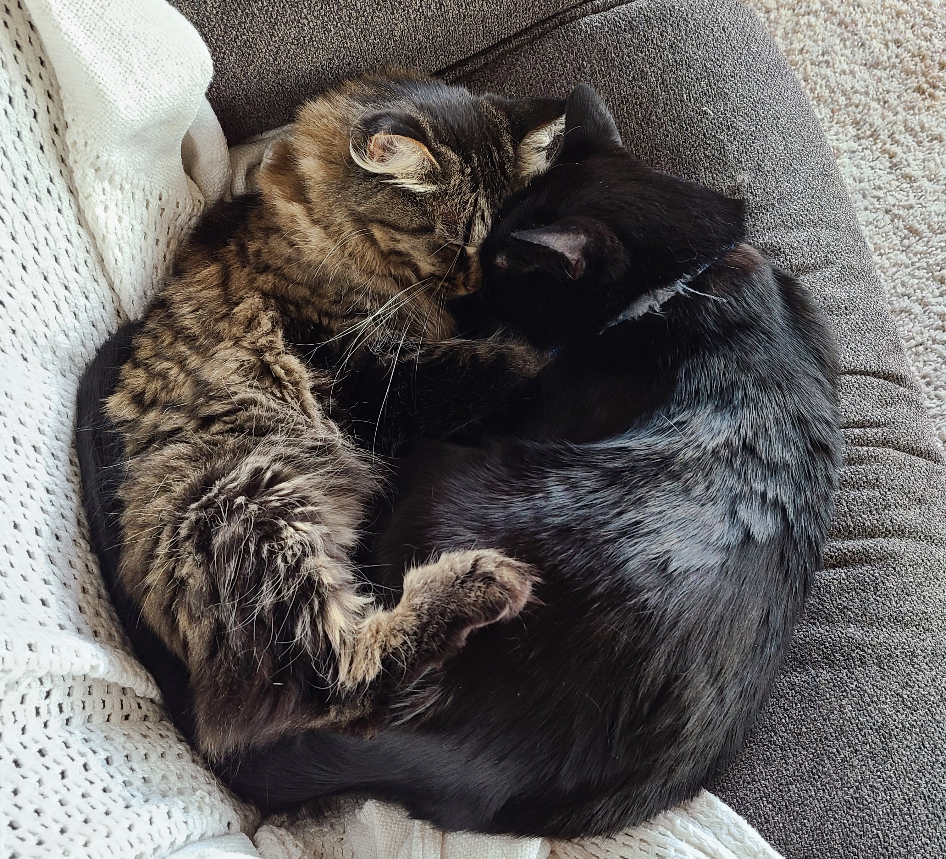
These are My Cats

