Slide 1
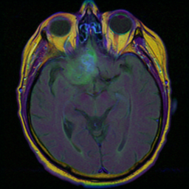
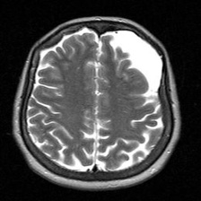
Digital Image Processing
Brain MRI Robustness Project
By Michael Khadarkevich 328259825 מיכאל חדרקביץ
3
2
4
tasks
datasets
distortion families
Clean → distorted → restored → fine-tuned

Slide 2
OVERVIEW
Brain MRI robustness
Distortions reduce reliability, so the project measures degradation and recovery.
The same experiment logic is repeated across super-resolution, CNN classification, and YOLO segmentation.
Super-resolution
CNN
YOLO
PSNR after x2 downsampling
total true percent on tumor/no-tumor
mask mAP50 on tumor segmentation
Experiment path: clean baseline → distorted input → restored input → fine-tuned model when relevant.
Note: I chose the super-resolution task because it is one of the few low-level tasks that can be adapted to MRI data. Although it is not the most suitable for the task in the context of noise performance.
03

Slide 3
EXPERIMENT DESIGN
Brain MRI robustness
Every task uses the same robustness question.
How much does distortion hurt, and which improvement helps recover performance?
Data 1: Kaggle tumor/no-tumor classification images.
Data 2: MRI tumor segmentation masks converted to YOLO format.
Distortions: gaussian noise, salt-and-pepper, gaussian blur, and YOLO brightness/contrast.
Improvement: restoration pre-processing and fine-tuning for learning-based models.
Clean
baseline
Distorted
degradation
Restored
pre-processing recovery
Fine-tuned
model adaptation
04

Slide 4
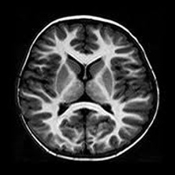
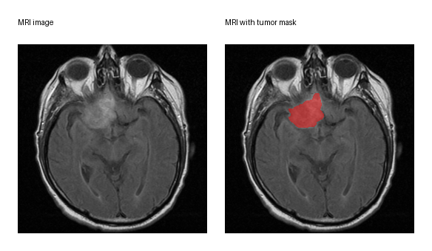
DATA PREPARATION
Brain MRI robustness
Two datasets support two different outputs: class labels and masks.
Data 1 labels are folder names; Data 2 labels are segmentation polygons for YOLO.
Data 1: no tumor
Data 1: tumor
Data 2: mask
05

Slide 5

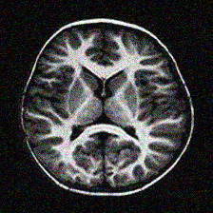
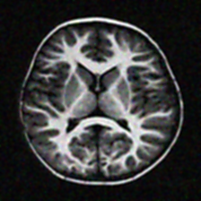
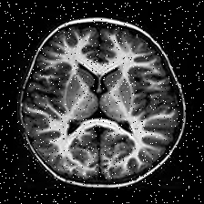
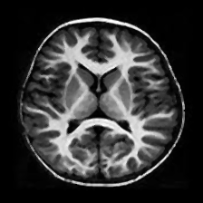
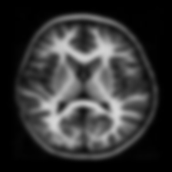

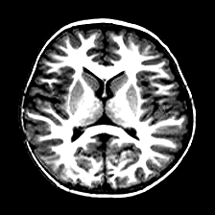
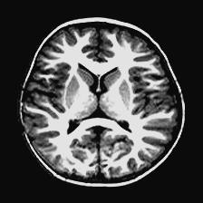
SHARED DISTORTION AND RESTORATION
Brain MRI robustness
Original, distorted, and restored images are compared together.
Each used distortion is shown with its restored result so the before/after effect is visible.
Gaussian noise
Salt-and-pepper
distorted
restored
distorted
restored
Gaussian blur
Brightness / contrast
Original
clean baseline
used before all distortions
distorted
restored
distorted
restored
06

Slide 6
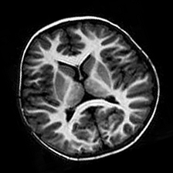
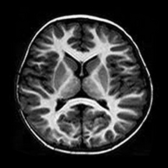
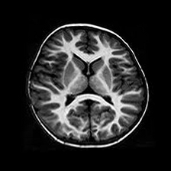

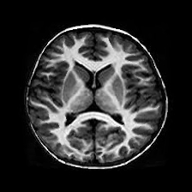
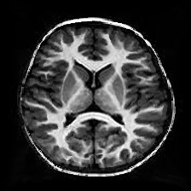
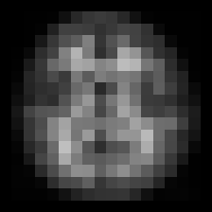

ADDITIONAL DISTORTIONS
Brain MRI robustness
Original, distorted, and restored images for the other distortions.
These methods were also implemented in the distortion/restoration pipeline and are shown with the same before/after structure as slide 6.
Rotation
Perspective warp
distorted
restored
distorted
restored
Barrel distortion
Pixelation
Original
clean baseline
used before all distortions
distorted
restored
distorted
restored
07

Slide 7
RESTORATION METHODS
Brain MRI robustness
How the restorations work after distortion.
Each restoration is a simple image-processing step that tries to recover useful MRI structure before measuring the task.
Gaussian noise
Salt-and-pepper
Light Gaussian smoothing reduces random pixel noise, then unsharp masking brings edges back.
A median filter replaces isolated black/white pixels using nearby values while preserving edges.
smooth
sharpen
median
remove specks
Gaussian blur
Brightness / contrast
Unsharp masking boosts local contrast so softened edges become clearer again.
Autocontrast spreads useful intensities, then contrast normalization brings the image back to a stable range.
edge boost
sharpen
normalize
rebalance
07

Slide 8
Task 1
Super-resolution
Downsample x2, reconstruct, and measure image fidelity with PSNR.

Slide 9
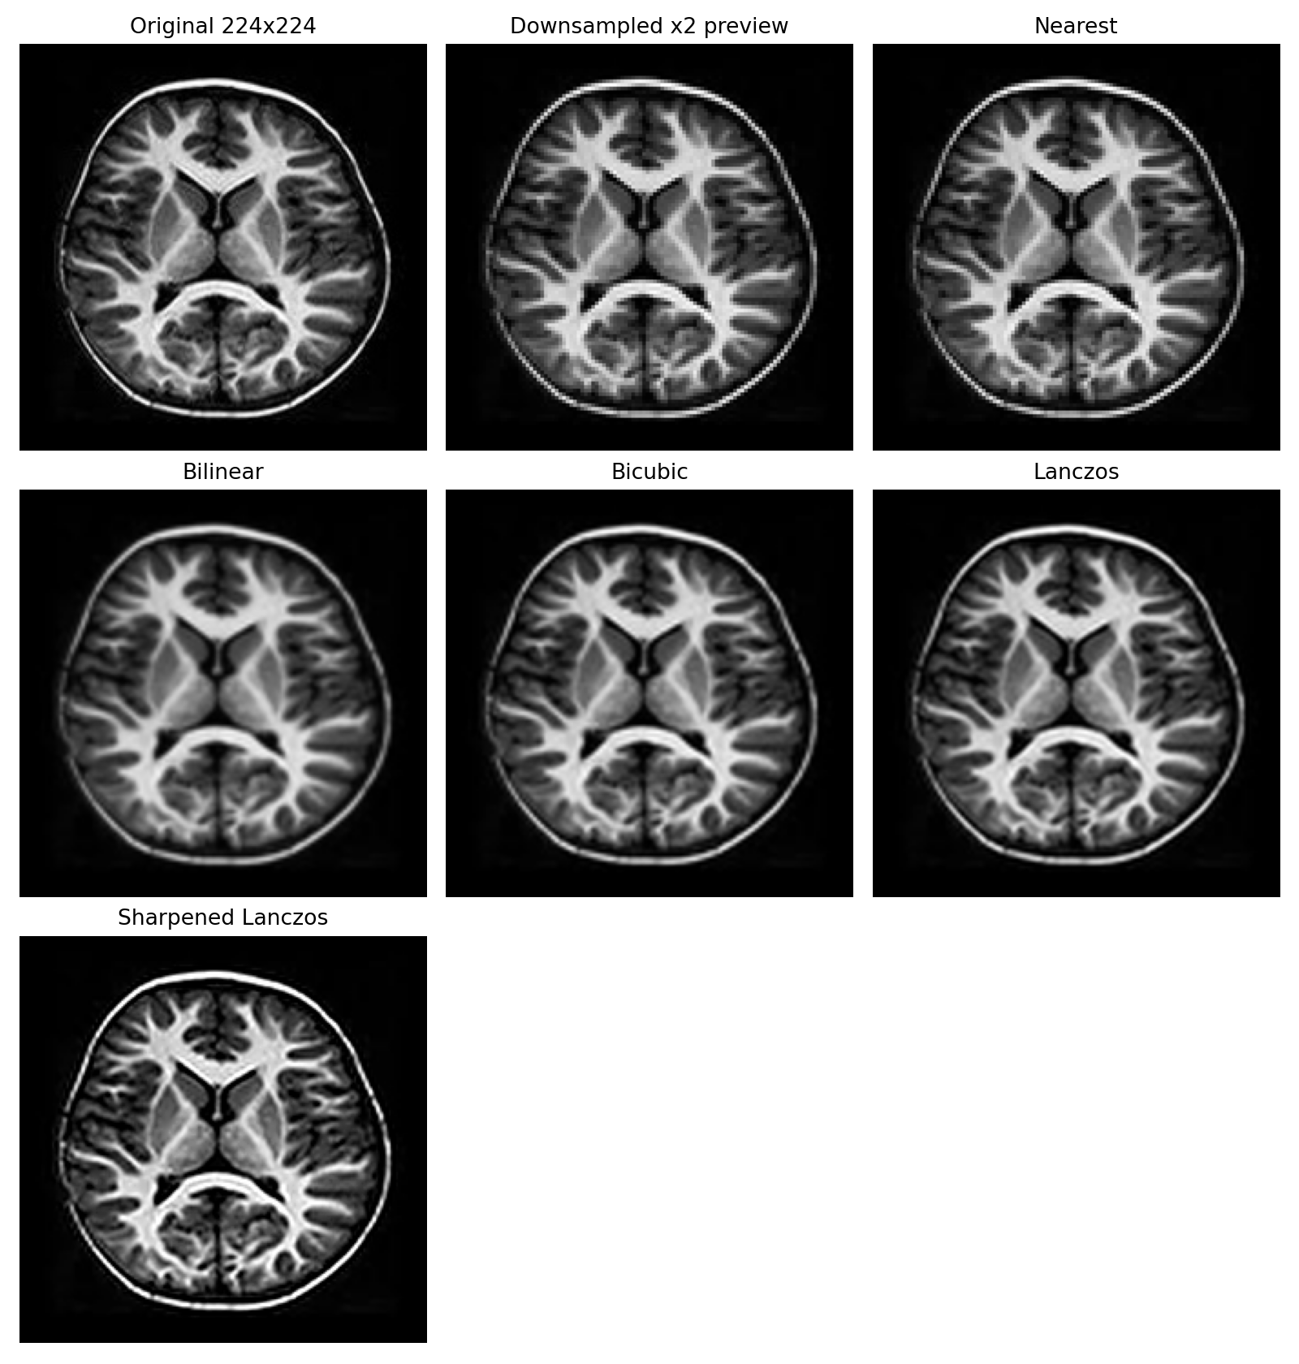
TASK 1 | CLEAN SUPER-RESOLUTION
Brain MRI robustness
Lanczos gives the strongest clean PSNR on the selected MRI image.
Sharpened_lanczos is used in the SNR/level experiments to compare distorted and restored images.
29.62
Best clean PSNR: Lanczos
26.87
Sharpened_lanczos PSNR
98.38
Best reconstruction score
08

Slide 10
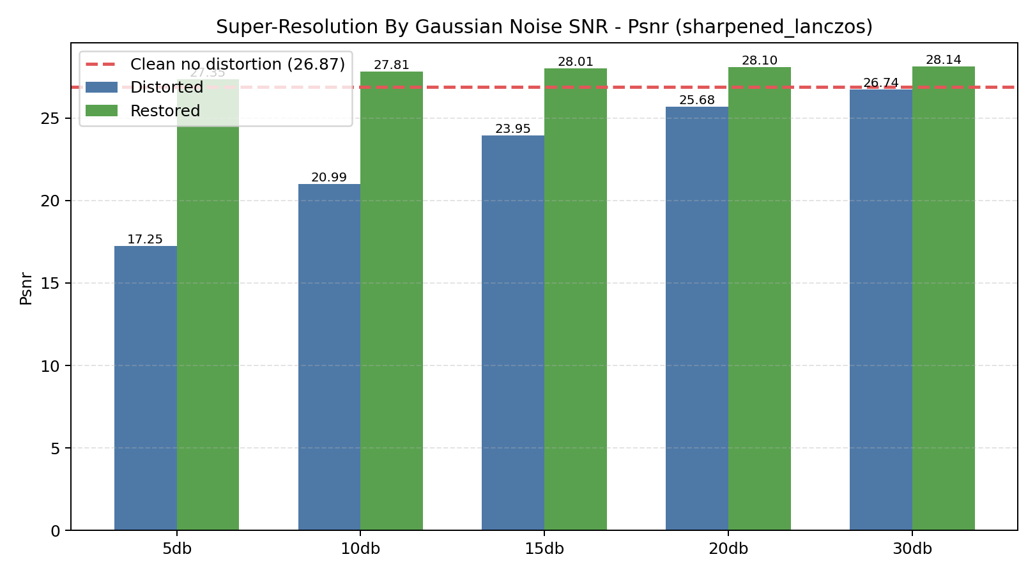
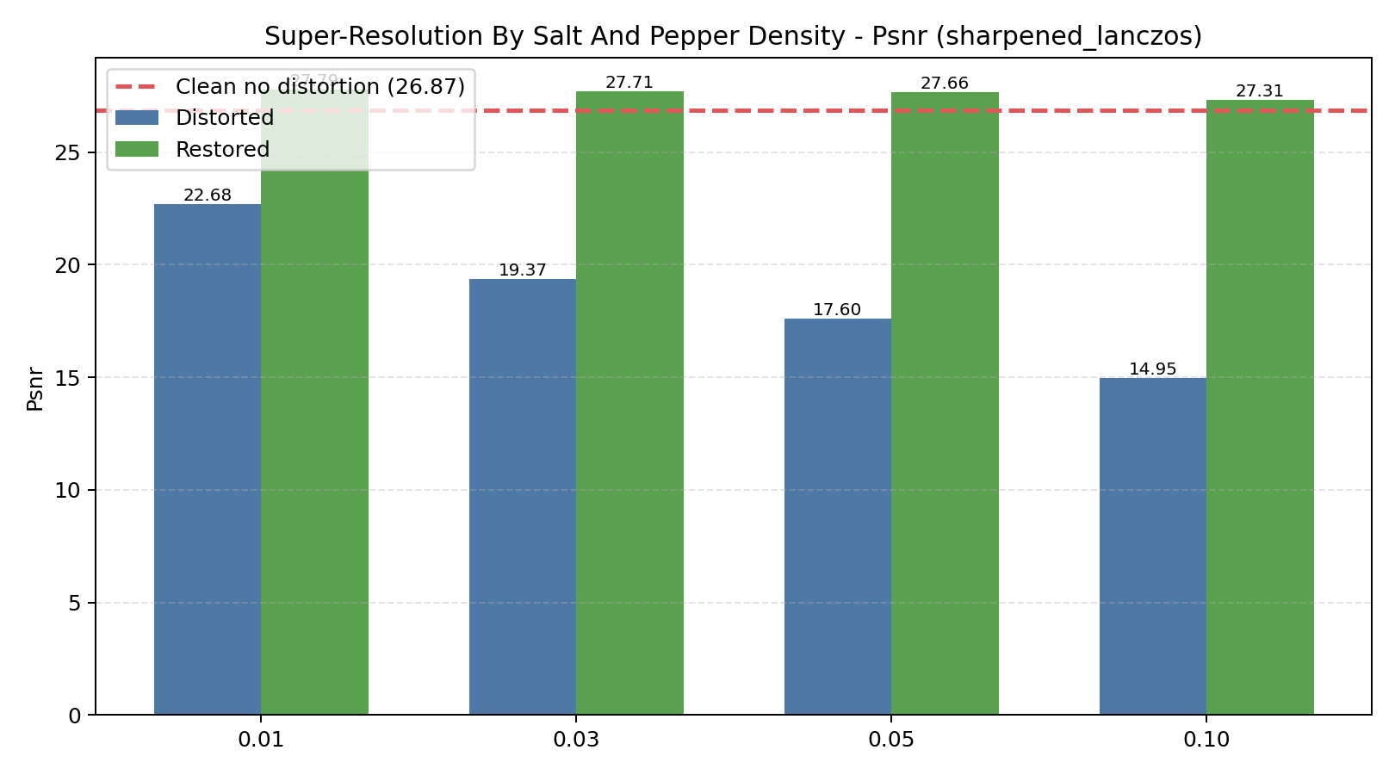
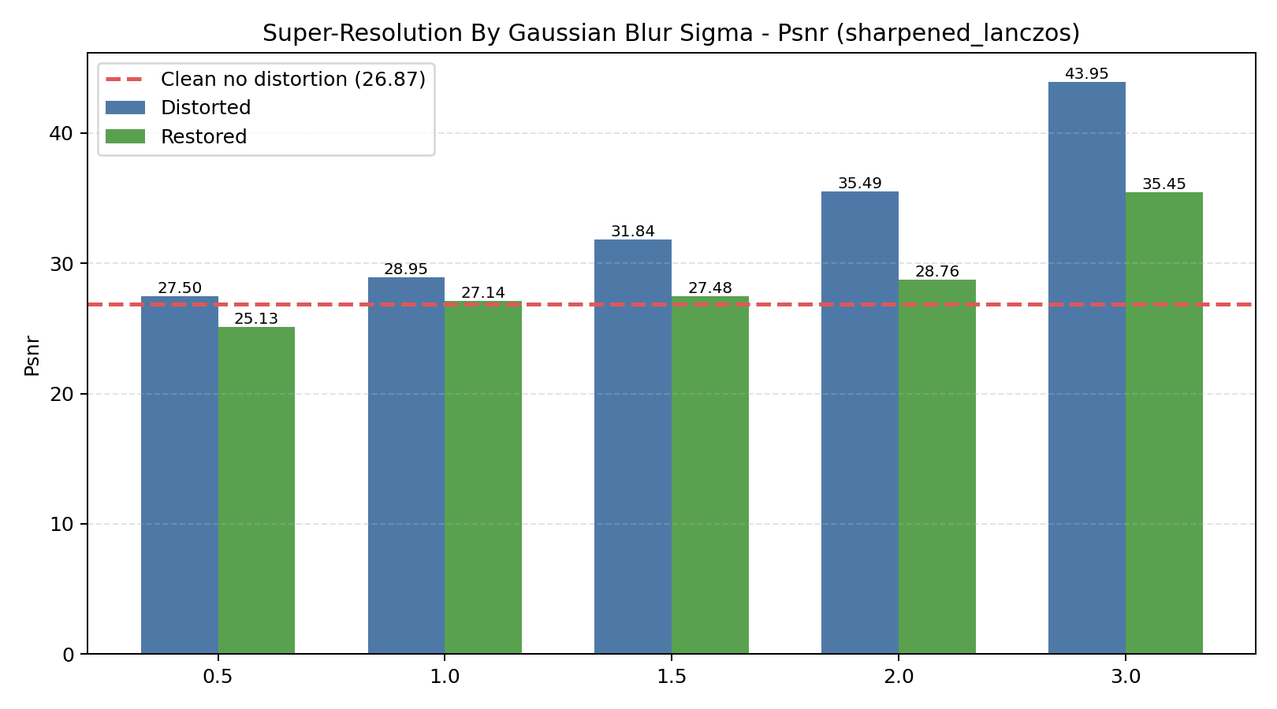
TASK 1 | DISTORTED SUPER-RESOLUTION
Brain MRI robustness
Restored inputs usually recover PSNR before sharpened_lanczos reconstruction.
Each graph includes a dashed clean baseline.
Main metric: PSNR. Restoration helps most when noise can be reduced without destroying structure. Severe salt-and-pepper is the hardest setting.
Disclaimer: Due to the nature of the super resolution task, it makes no sense to compare the final product to the original image because the noise affects each image differently, so in each experiment the final product is compared to the image with the noise/with the restoration.
Following these changes, an interesting phenomenon occurs that due to a certain amount of noise, reducing it by 2 loses less information.
I will give you an example: If I take an image and take extreme noise that turns it white – and then after I divide it by 2 and return it to the original image, I will get a white image, so we got the same image and did not lose information.
I know that this was not the goal of the work, but unfortunately super resolution is the only task that fits the data.
09

Slide 11
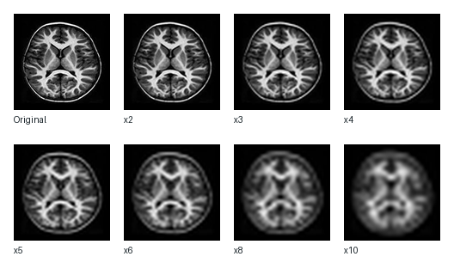
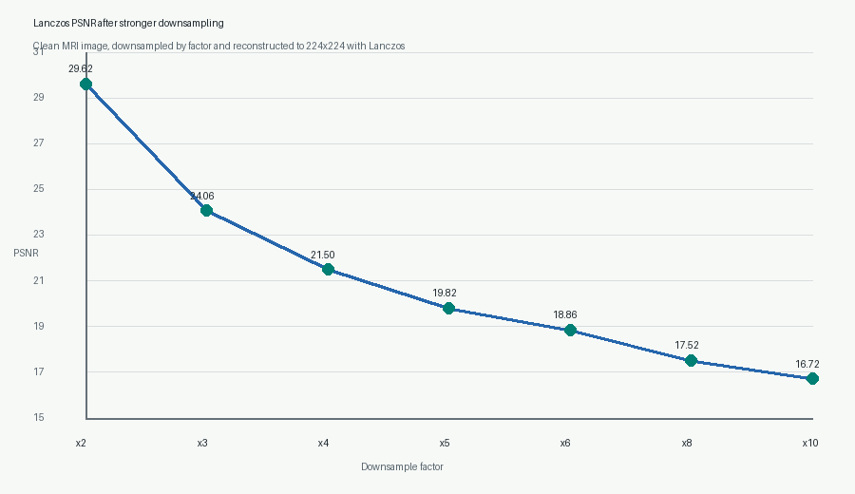
TASK 1 EXTRA
I decided to do some extra work.
Brain MRI robustness
Dividing the clean image by more than x2 quickly lowers Lanczos quality.
The clean MRI image was downsampled by stronger factors and reconstructed back to 224x224 using Lanczos.
What the graph shows
PSNR drops from 29.62 at x2 to 16.72 at x10. Stronger downsampling removes detail that Lanczos cannot fully reconstruct.
Main metric: PSNR, higher is better.
12

Slide 12
Task 2
CNN tumor classification
Classify Data 1 images as tumor or no_tumor, then test robustness.

Slide 13
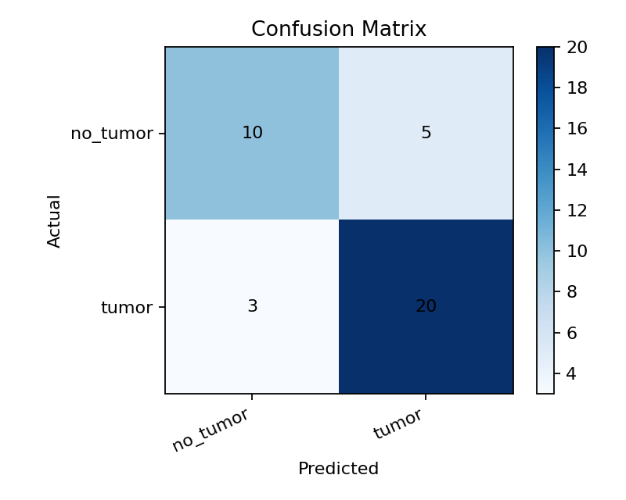
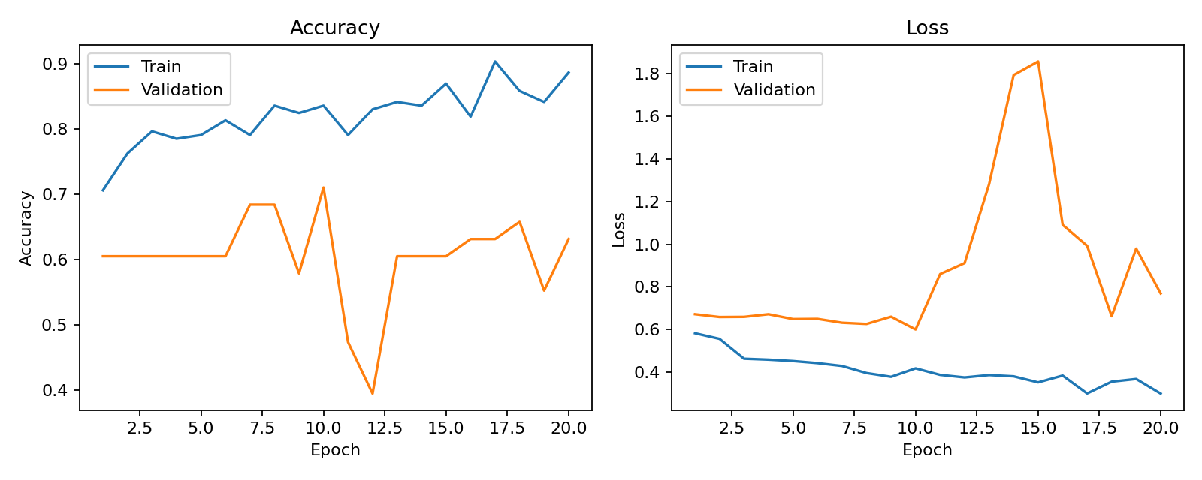
TASK 2 | BASIC CNN
Brain MRI robustness
The basic CNN reaches 78.95% accuracy on clean Data 1 test images.
The confusion matrix shows actual labels as rows and predicted labels as columns.
78.95%
38
Basic CNN test accuracy
test images
11

Slide 14
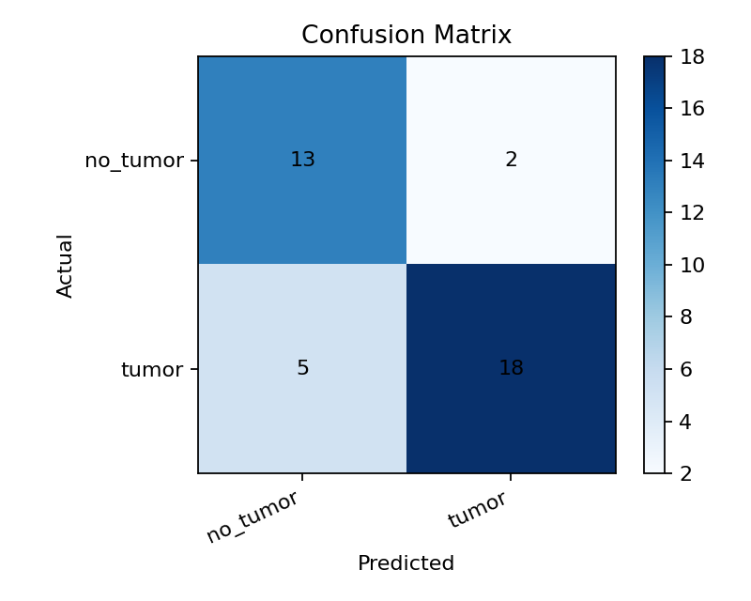
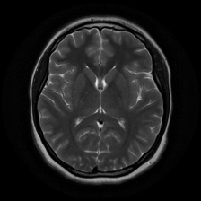
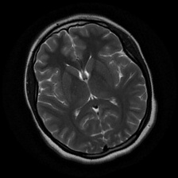
TASK 2 | AUGMENTATION
I decided to do some extra work.
Brain MRI robustness
Extra: Rotation augmentation improved the CNN, but only by a small amount.
Because the dataset is small, augmentation adds examples; changing head position did not create a large gain.
81.58%
Augmented CNN accuracy
+2.63 pp
gain over basic CNN
Original
Augmented
I wanted to improve the results, because the data was small, I thought about using Augmentation, unfortunately it didn't help much with the results.
12

Slide 15
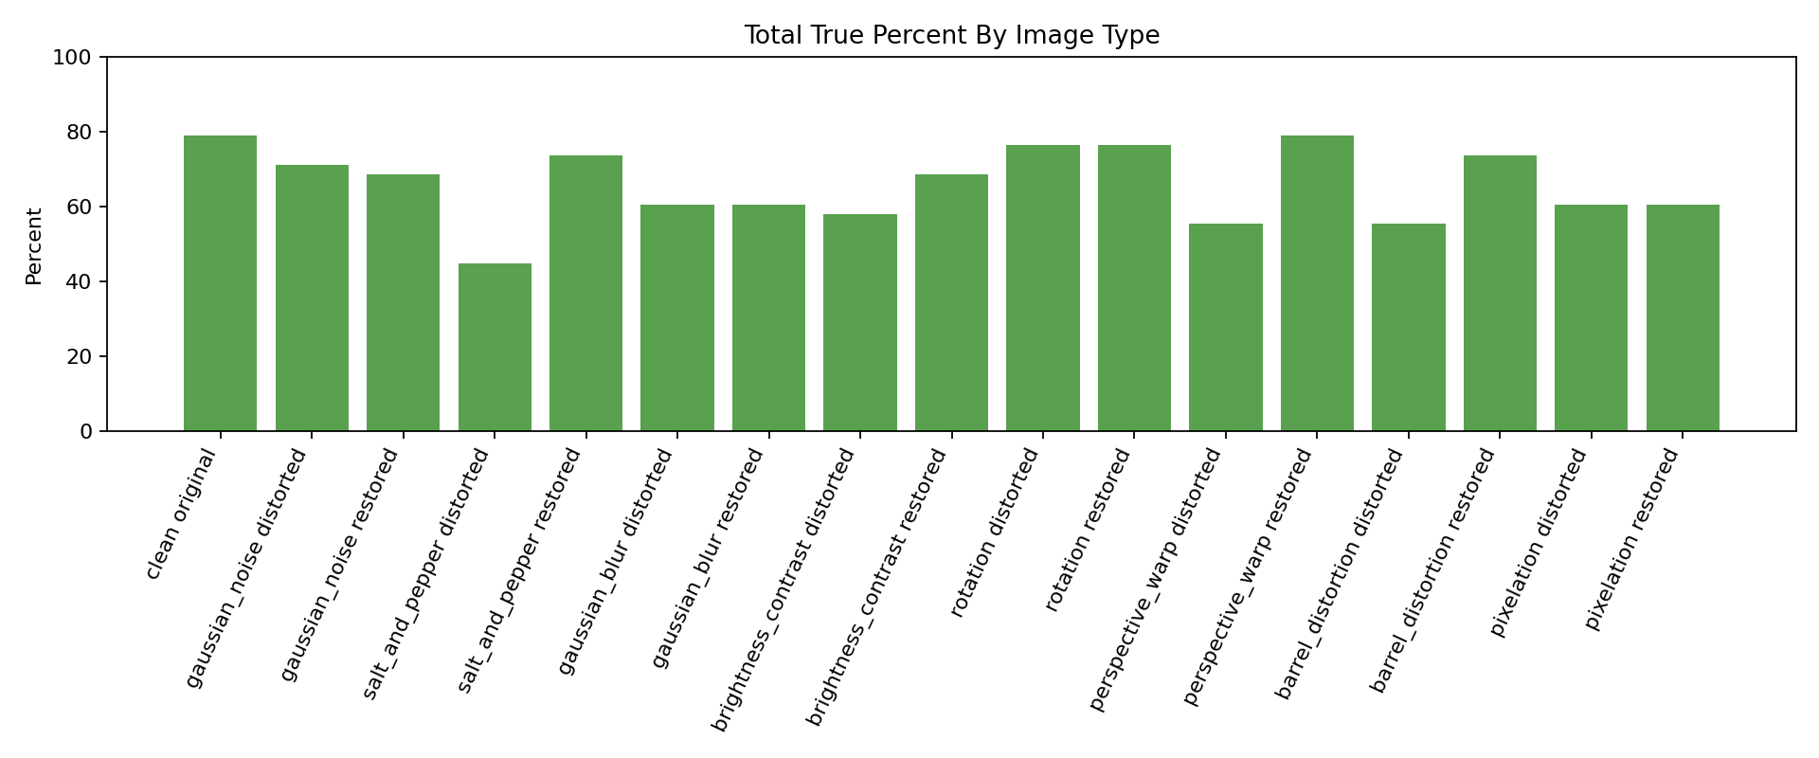
Cnn on different distortions with restor ,without fine tuning

Slide 16
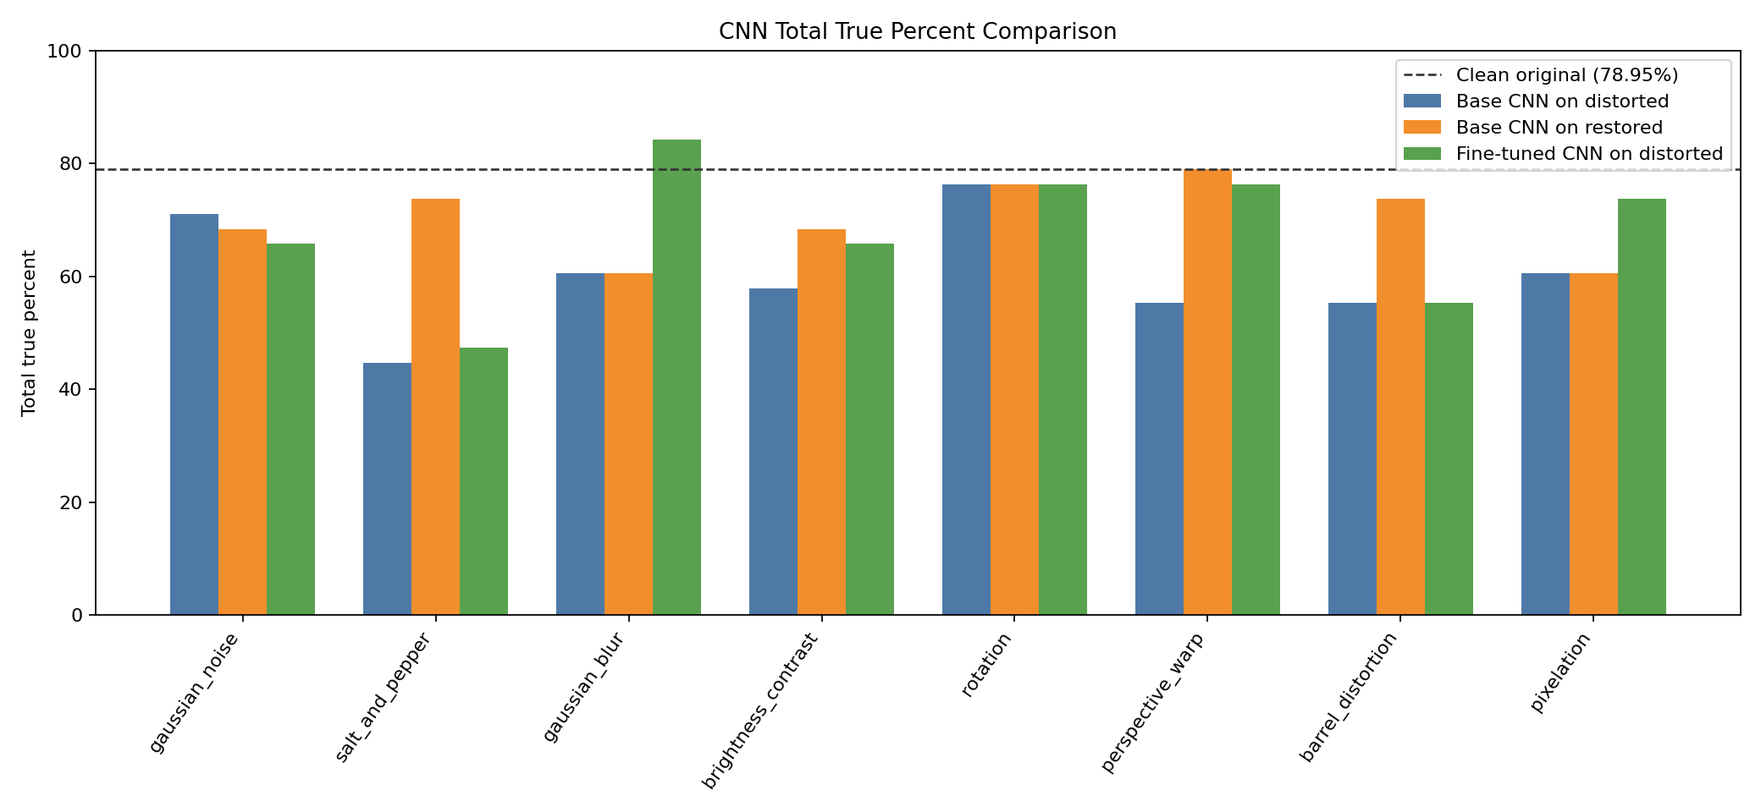
TASK 2 | RESTORATION AND FINE-TUNING
Brain MRI robustness
Fine-tuning and restoration are compared against the same clean CNN baseline.
Total true percent summarizes how many tumor/no-tumor predictions are correct.
Salt-and-pepper noise is the clearest CNN failure mode. Restoration recovers some cases; fine-tuning is the stronger model-level improvement.
13

Slide 17
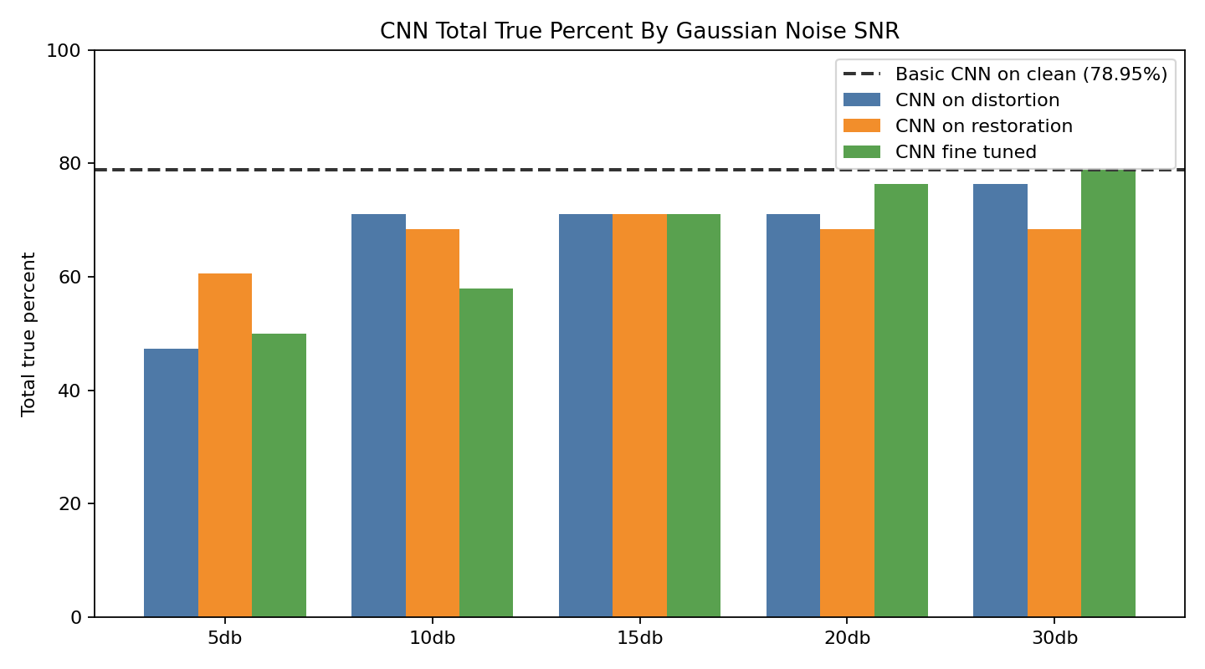
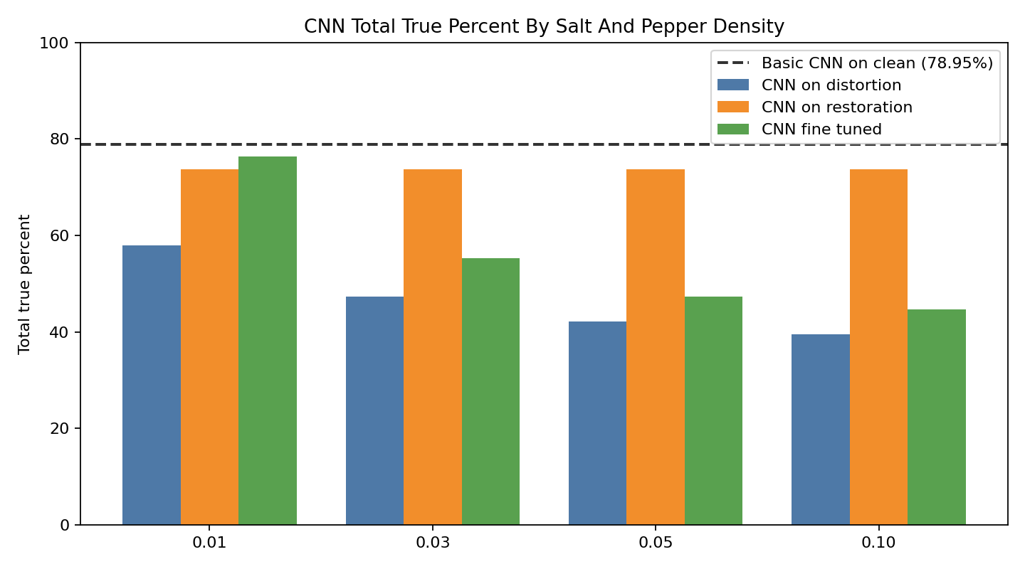
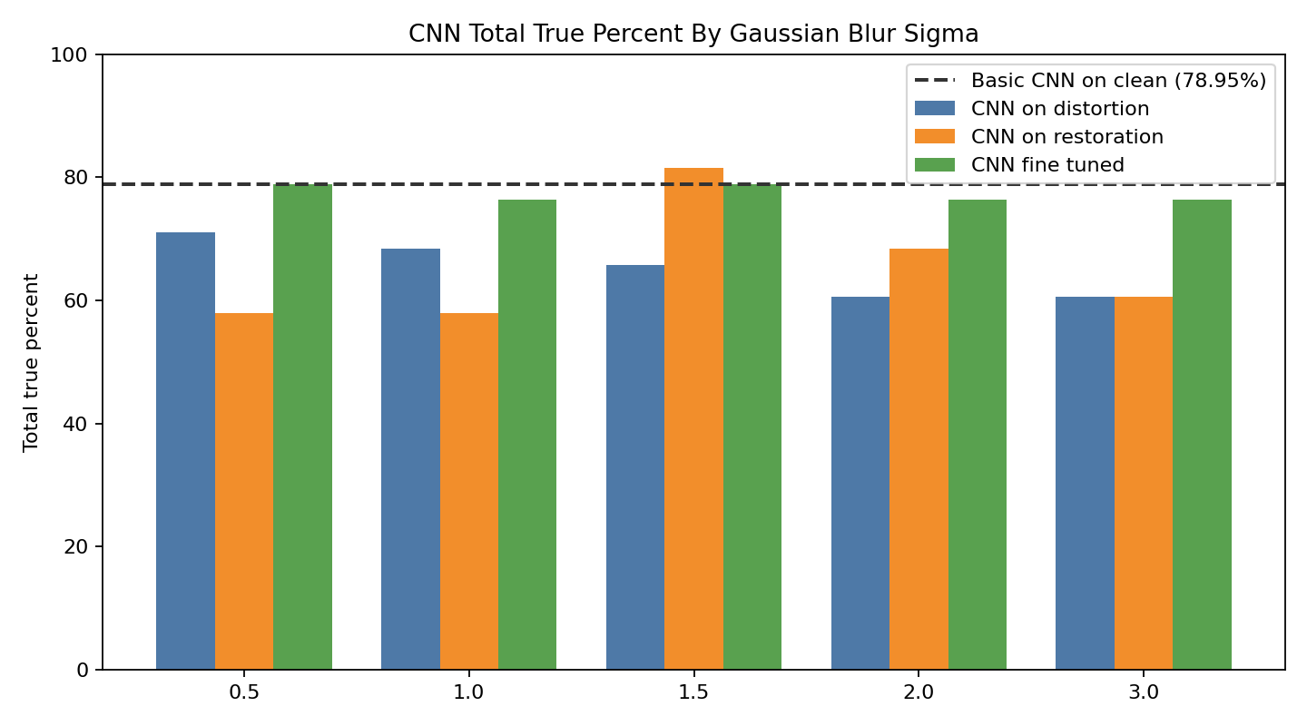
TASK 2 | CNN SNR AND LEVEL ANALYSIS
Brain MRI robustness
Separate distortion-level graphs show where classification begins to break.
The dashed line is the basic CNN on clean, non-distorted images.
Reading the graphs together separates distortion strength from model strategy: basic, restored, and fine-tuned.
Each fine tuning was performed on a different SNR
14

Slide 18
Task 3
YOLO tumor segmentation
Use Data 2 masks so the model can mark tumor regions, not only classify the image.

Slide 19
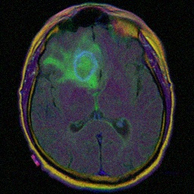
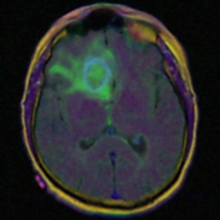
TASK 3 | SEGMENTATION EXAMPLES
Brain MRI robustness
YOLO output is evaluated as a mask prediction problem.
Clean, mask, distorted, and restored images show the full experiment path.
Clean
Mask
Distorted
Restored
16

Slide 20
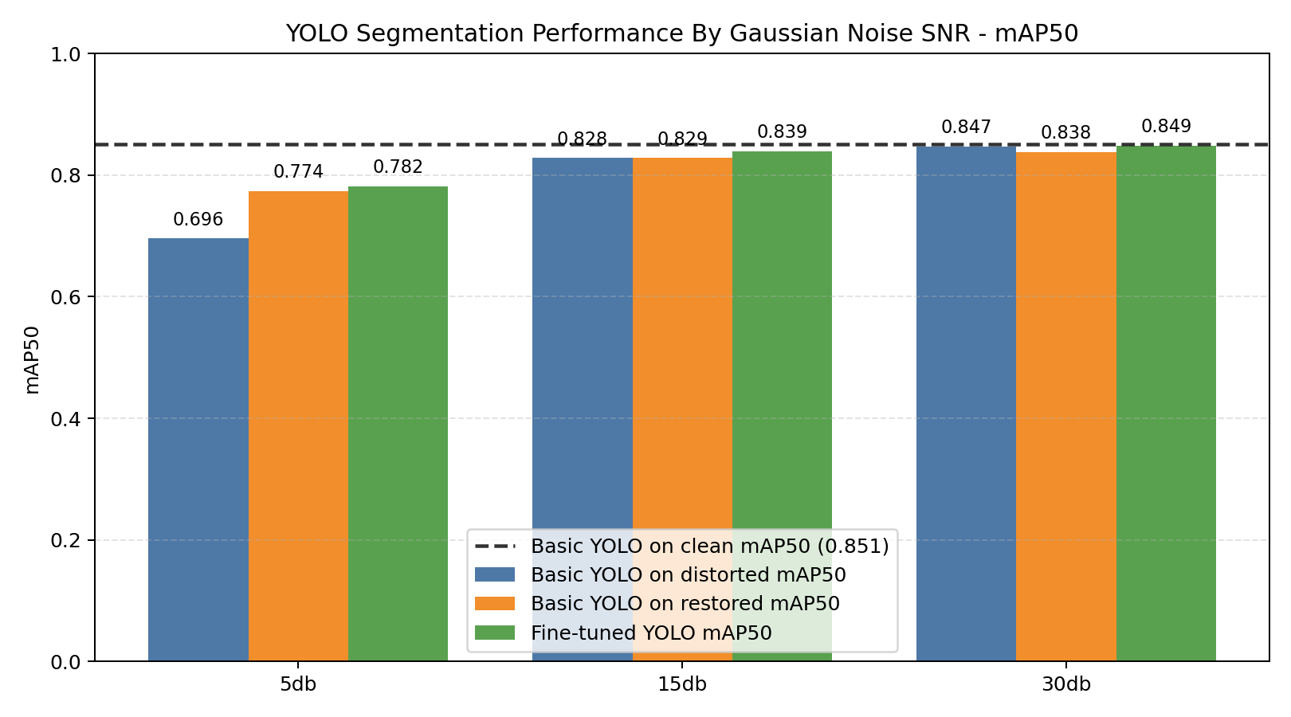
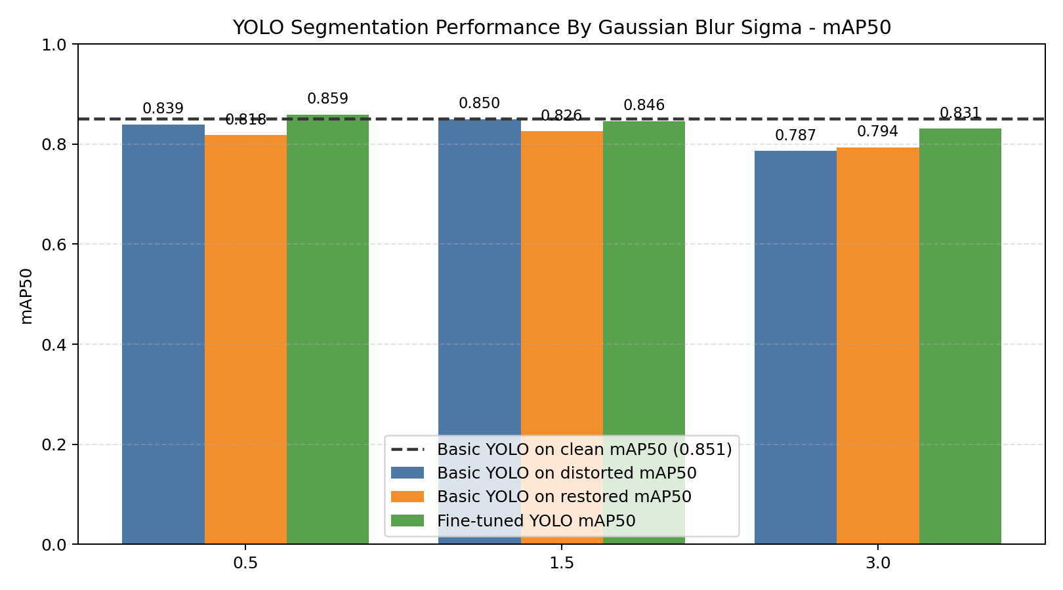
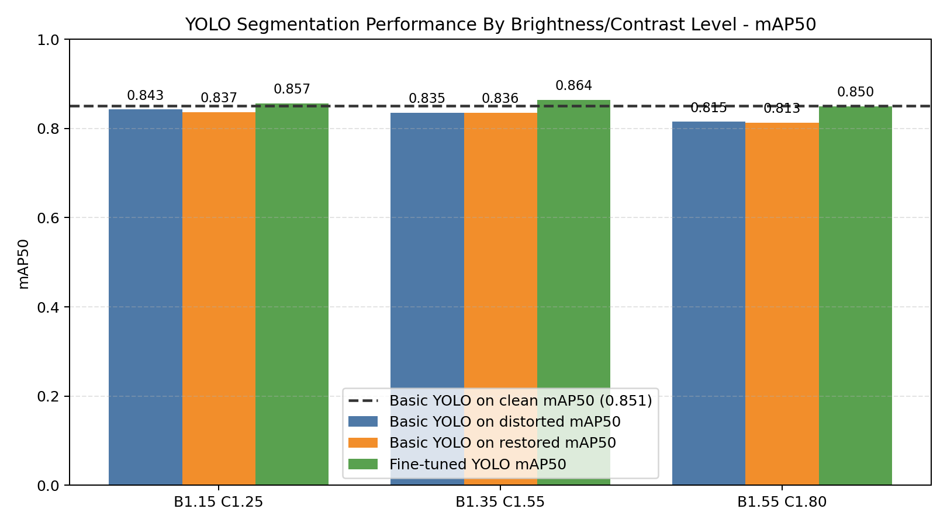
TASK 3 | YOLO MAP50
Brain MRI robustness
Clean YOLO is the reference line; distortion and fine-tuning reveal robustness.
mAP50 is shown separately for gaussian noise, blur, and brightness/contrast levels.
Main metric: mask mAP50. Fine-tuned YOLO models are trained on matching distorted data; restored images test pre-processing recovery.
17

Slide 21
Conclusion
Robustness should be measured across clean, distorted, restored, and fine-tuned settings.
Task 1 | Super-resolution
Best when image structure remains; restoration often raises PSNR before sharpened_lanczos.
Task 2 | CNN
Augmentation improved clean accuracy slightly; salt-and-pepper remains the hardest distortion.
Task 3 | YOLO
Mask training enables tumor marking; fine-tuning improves robustness on distorted data.
Main takeaway: restoration is useful, but for deep-learning tasks, distortion-aware fine-tuning is usually the stronger improvement.

