Slide 1
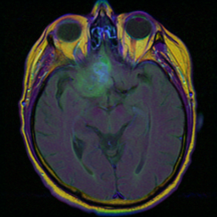
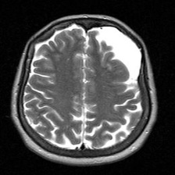
Digital Image Processing
Brain MRI Robustness Project
By Michael Khadarkevich and Ranana Khava
3
2
4
tasks
datasets
distortion families
Clean → distorted → restored → fine-tuned

Slide 2
PROJECT NOTE
Brain MRI robustness
Why this project uses brain MRI images
The selected data supports medical image-processing tasks better than some generic vision tasks.
הערה
בחרנו לעסוק בסרטן מוח משום שהדאטה מתאים למשימות של עיבוד תמונה וראייה ממוחשבת.
בפרויקט נבדק איך עיוותים פוגעים בתמונה ובמודלים, ואיך שחזור או אימון נוסף יכולים לשפר את התוצאות.
המטרה היא לא אבחון רפואי, אלא בדיקת עמידות של אלגוריתמים על תמונות MRI.
02

Slide 3
OVERVIEW
Brain MRI robustness
Distortions reduce reliability, so the project measures degradation and recovery.
The same experiment logic is repeated across super-resolution, CNN classification, and YOLO segmentation.
Super-resolution
CNN
YOLO
PSNR after x2 downsampling
total true percent on tumor/no-tumor
mask mAP50 on tumor segmentation
Experiment path: clean baseline → distorted input → restored input → fine-tuned model when relevant.
03

Slide 4
EXPERIMENT DESIGN
Brain MRI robustness
Every task uses the same robustness question.
How much does distortion hurt, and which improvement helps recover performance?
Data 1: Kaggle tumor/no-tumor classification images.
Data 2: MRI tumor segmentation masks converted to YOLO format.
Distortions: gaussian noise, salt-and-pepper, gaussian blur, and YOLO brightness/contrast.
Improvement: restoration pre-processing and fine-tuning for learning-based models.
Clean
baseline
Distorted
degradation
Restored
pre-processing recovery
Fine-tuned
model adaptation
04

Slide 5
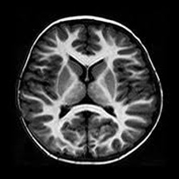
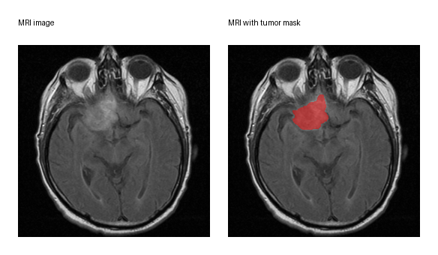
DATA PREPARATION
Brain MRI robustness
Two datasets support two different outputs: class labels and masks.
Data 1 labels are folder names; Data 2 labels are segmentation polygons for YOLO.
Data 1: no tumor
Data 1: tumor
Data 2: mask
05

Slide 6
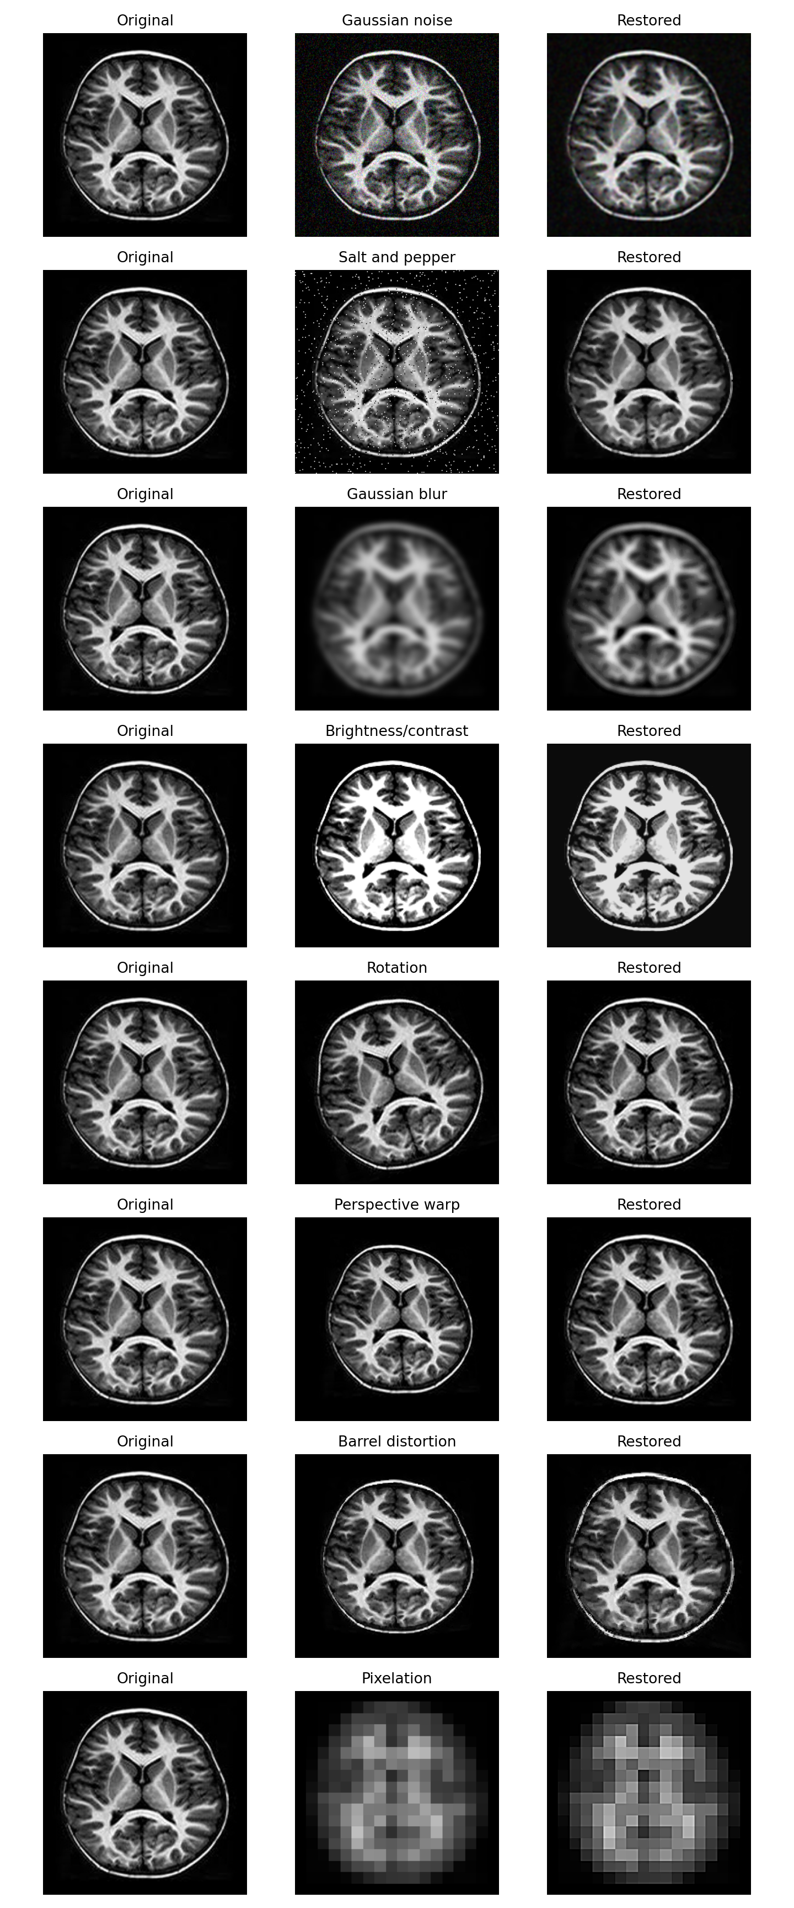
SHARED DISTORTION AND RESTORATION
Brain MRI robustness
Restoration is a common pre-processing improvement used before evaluation.
Noise is reduced, blur is sharpened, and intensity changes are normalized.
Gaussian noise: smoothing + unsharp mask.
Salt-and-pepper: median filtering.
Gaussian blur: unsharp masking.
Brightness/contrast: autocontrast and contrast normalization.
06

Slide 7
Task 1
Super-resolution
Downsample x2, reconstruct, and measure image fidelity with PSNR.

Slide 8
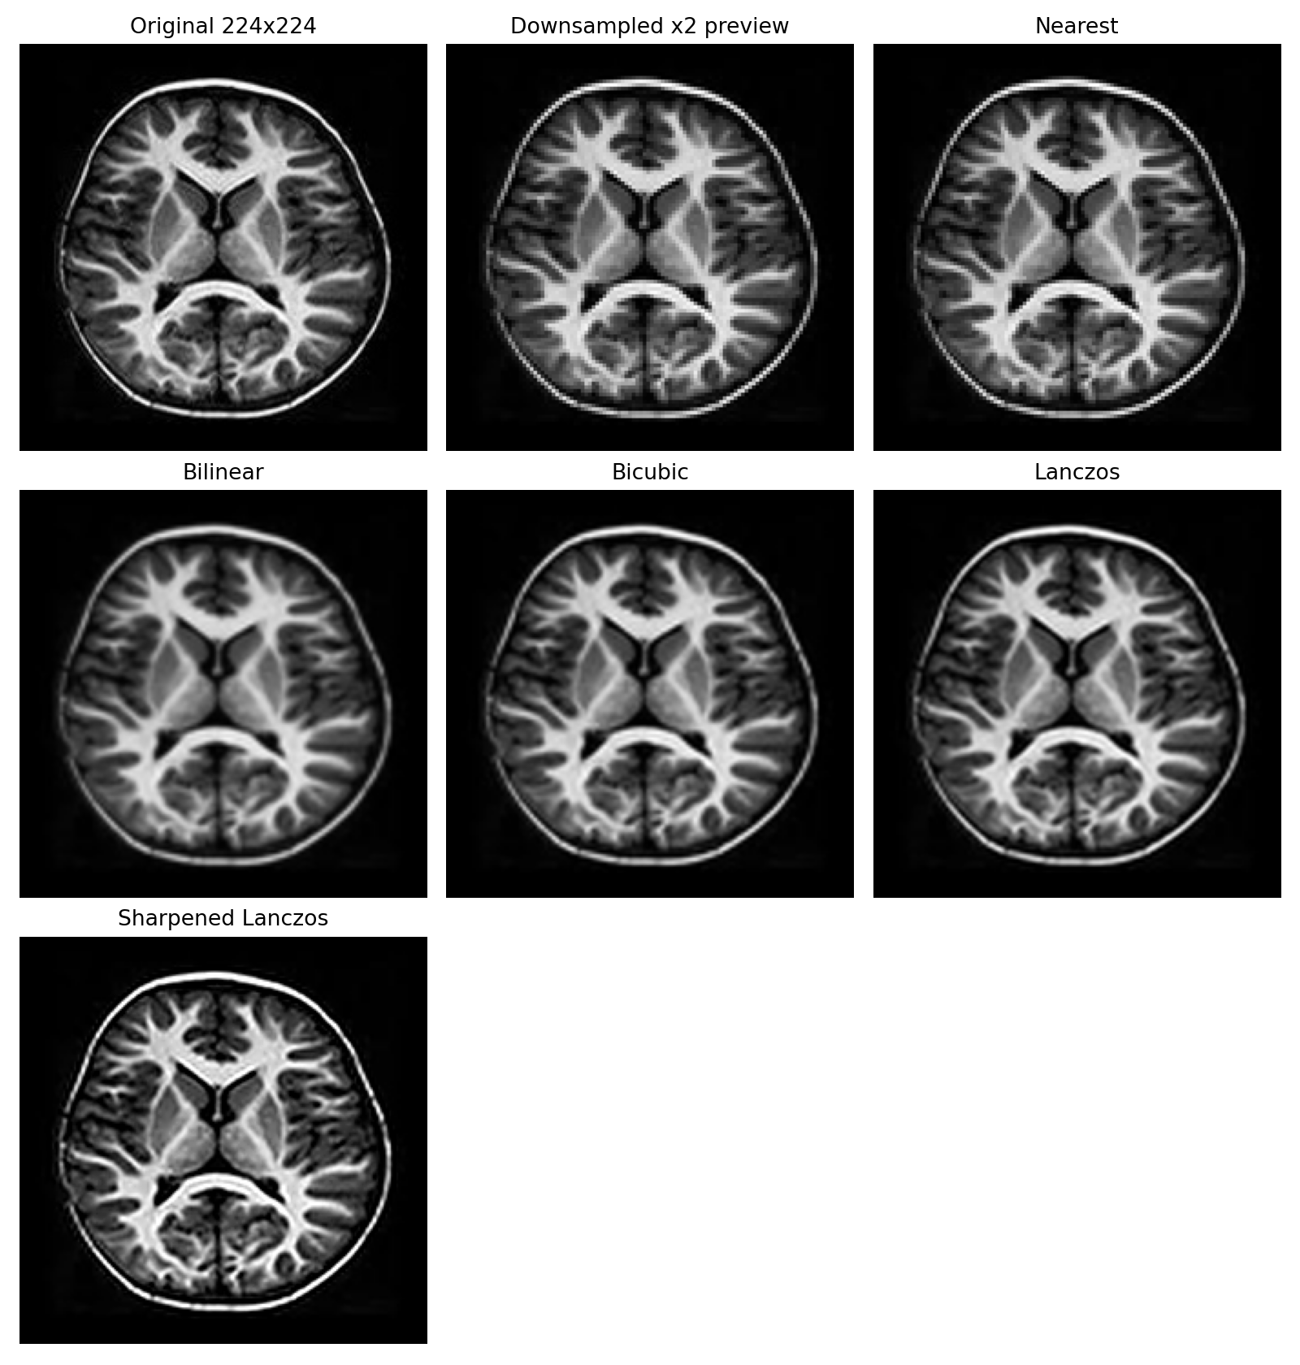
TASK 1 | CLEAN SUPER-RESOLUTION
Brain MRI robustness
Lanczos gives the strongest clean PSNR on the selected MRI image.
Sharpened_lanczos is used in the SNR/level experiments to compare distorted and restored images.
29.62
Best clean PSNR: Lanczos
26.87
Sharpened_lanczos PSNR
98.38
Best reconstruction score
08

Slide 9
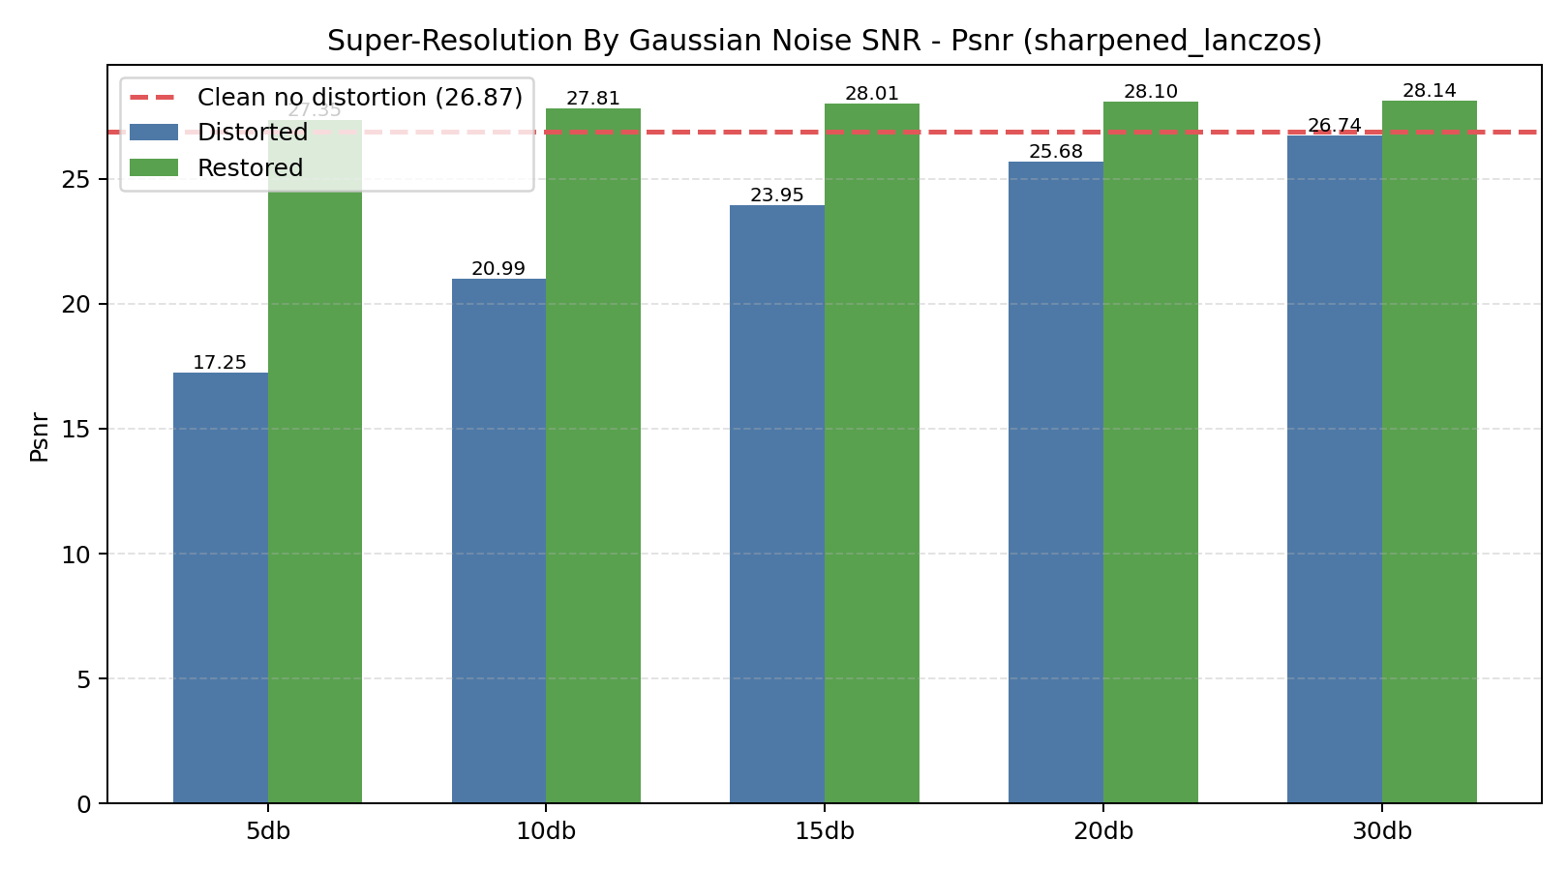
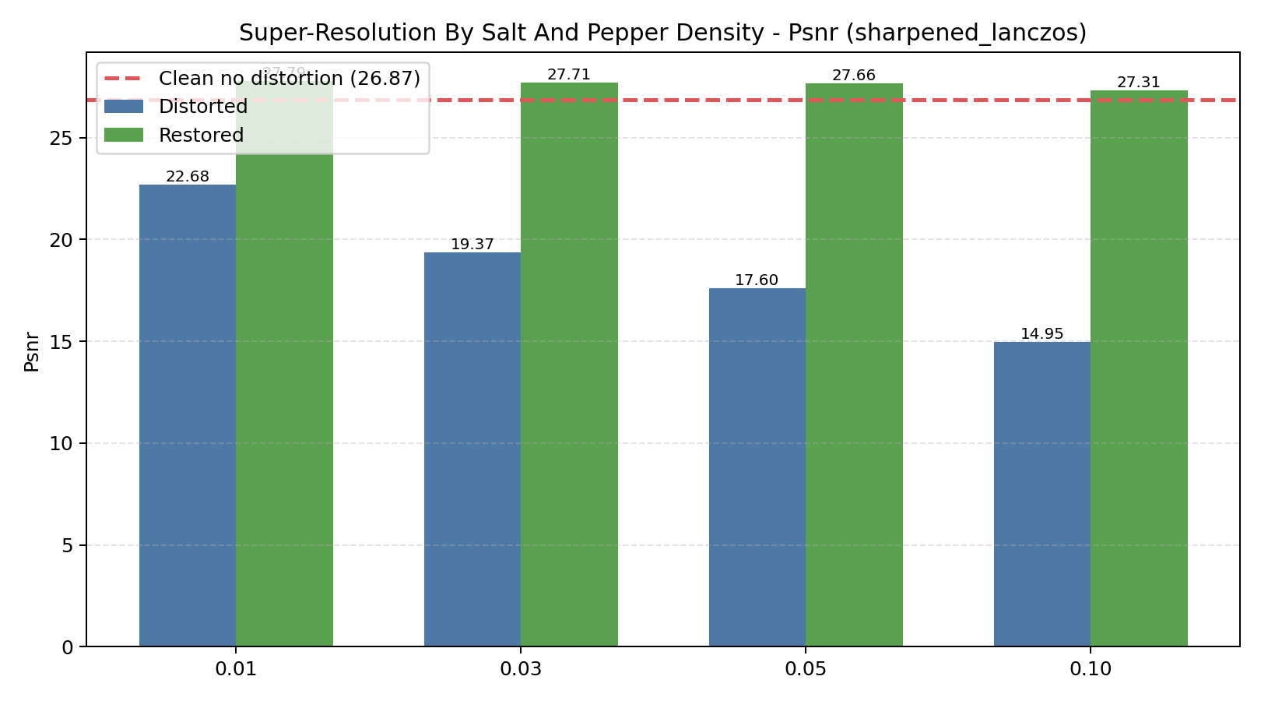
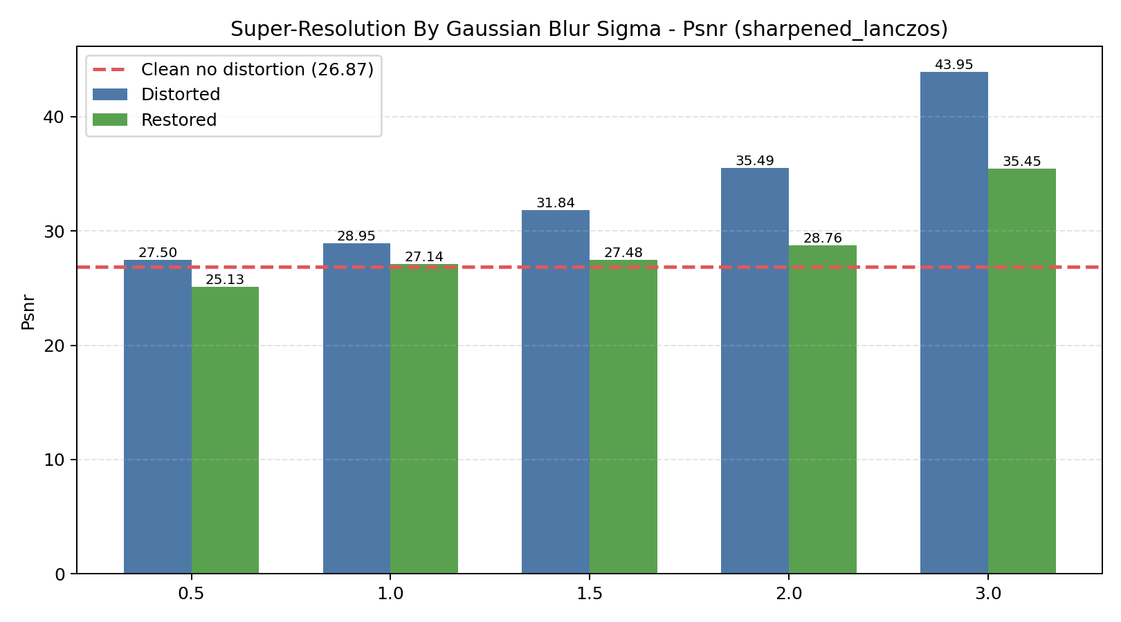
TASK 1 | DISTORTED SUPER-RESOLUTION
Brain MRI robustness
Restored inputs usually recover PSNR before sharpened_lanczos reconstruction.
Each graph includes a dashed clean baseline.
Main metric: PSNR. Restoration helps most when noise can be reduced without destroying structure. Severe salt-and-pepper is the hardest setting.
09

Slide 10
Task 2
CNN tumor classification
Classify Data 1 images as tumor or no_tumor, then test robustness.

Slide 11
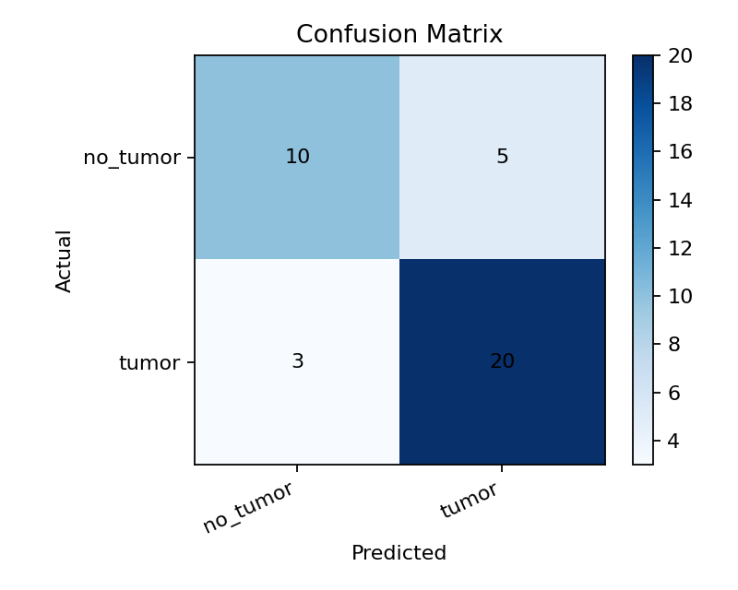
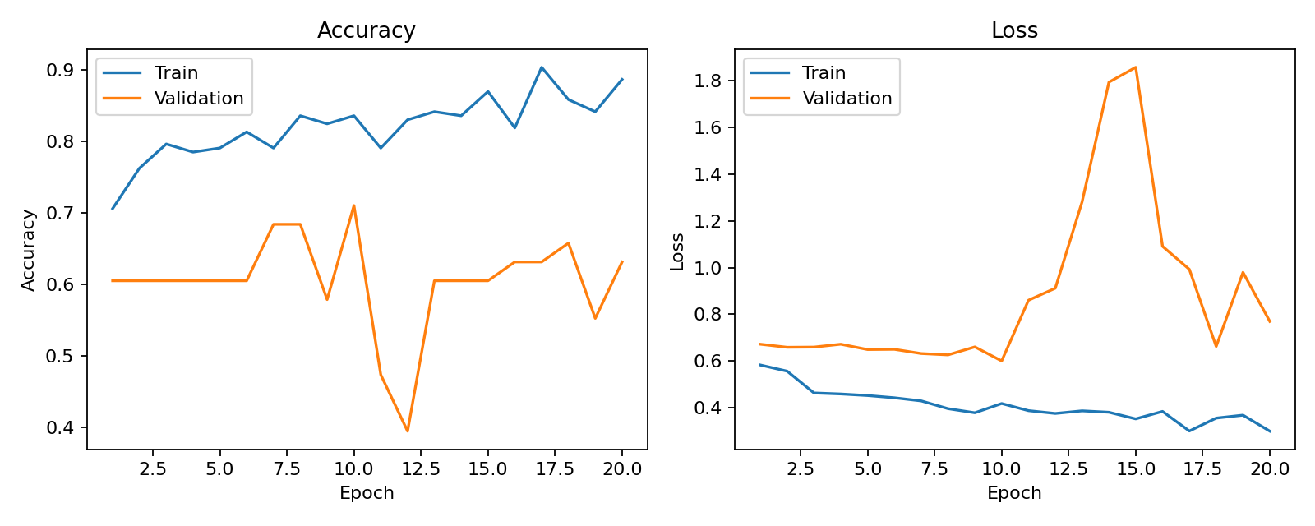
TASK 2 | BASIC CNN
Brain MRI robustness
The basic CNN reaches 78.95% accuracy on clean Data 1 test images.
The confusion matrix shows actual labels as rows and predicted labels as columns.
78.95%
38
Basic CNN test accuracy
test images
11

Slide 12
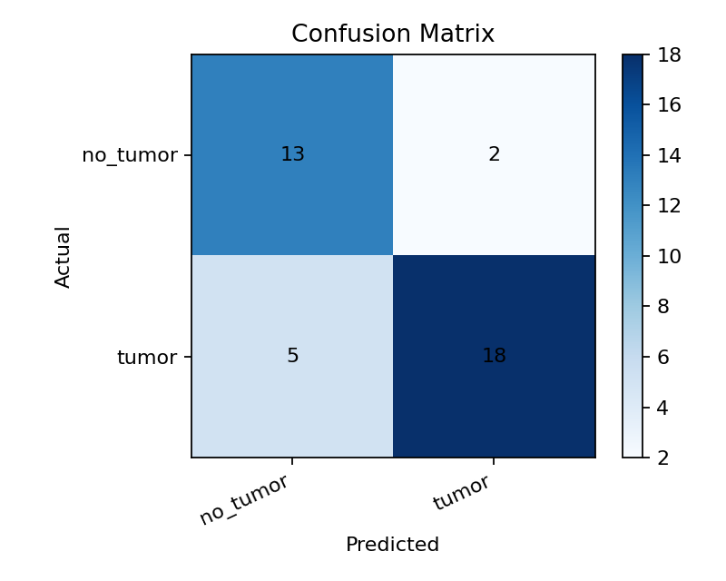
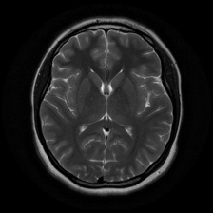
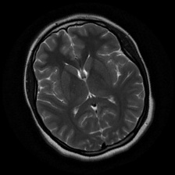
TASK 2 | AUGMENTATION
Brain MRI robustness
Rotation augmentation improved the CNN, but only by a small amount.
Because the dataset is small, augmentation adds examples; changing head position did not create a large gain.
81.58%
Augmented CNN accuracy
+2.63 pp
gain over basic CNN
Original
Augmented
12

Slide 13
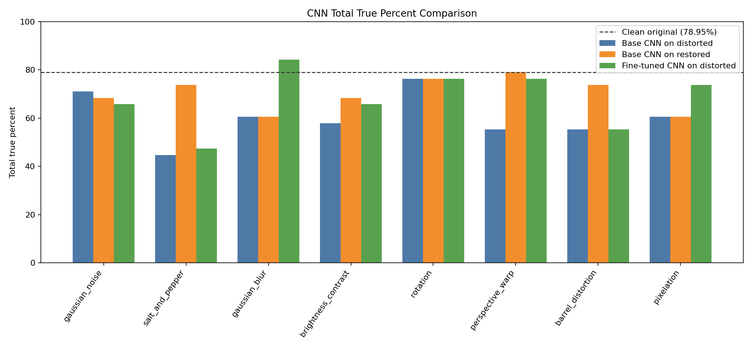
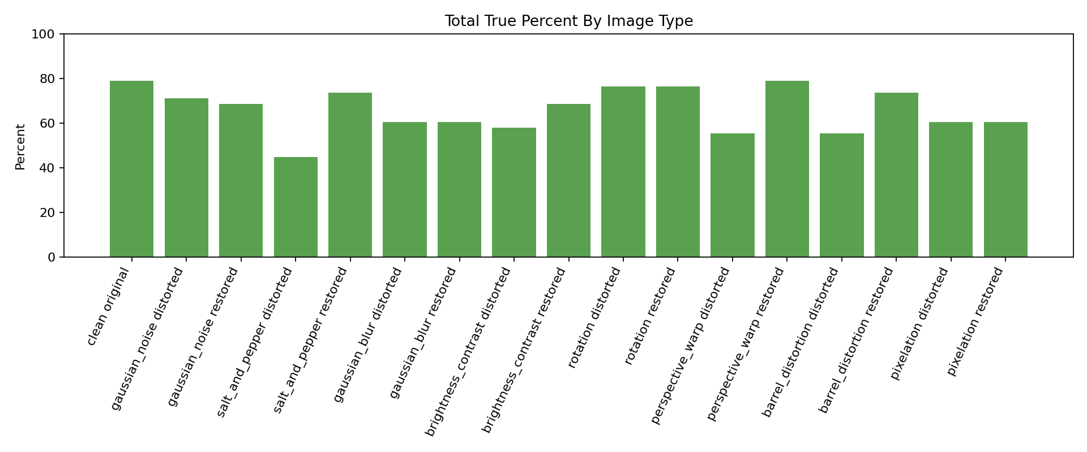
TASK 2 | RESTORATION AND FINE-TUNING
Brain MRI robustness
Fine-tuning and restoration are compared against the same clean CNN baseline.
Total true percent summarizes how many tumor/no-tumor predictions are correct.
Salt-and-pepper noise is the clearest CNN failure mode. Restoration recovers some cases; fine-tuning is the stronger model-level improvement.
13

Slide 14
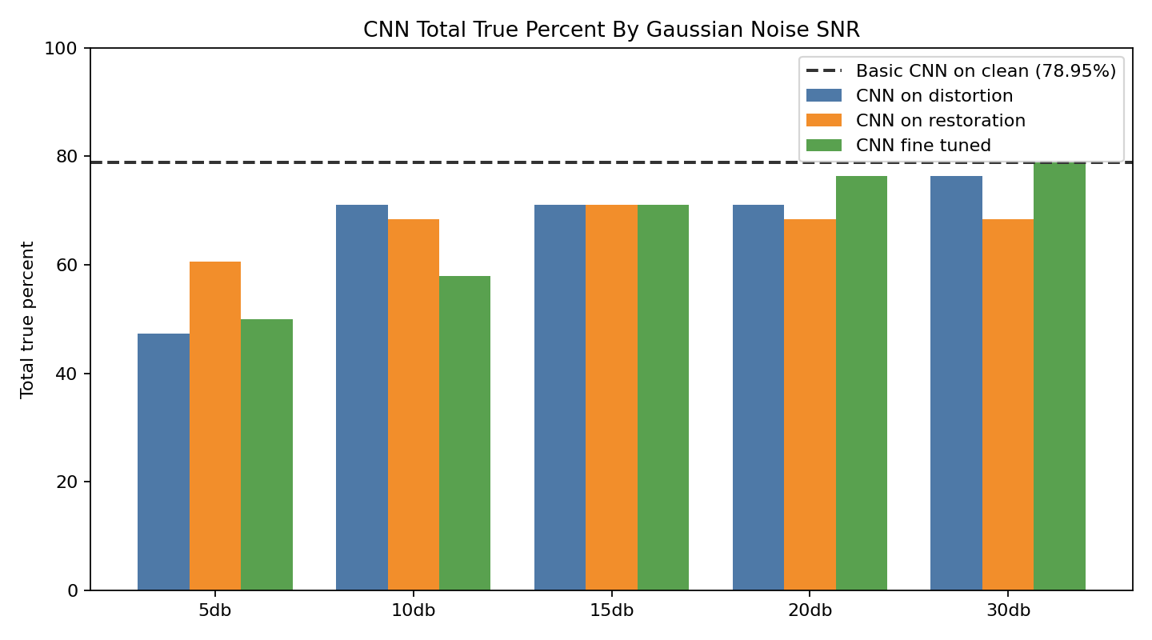
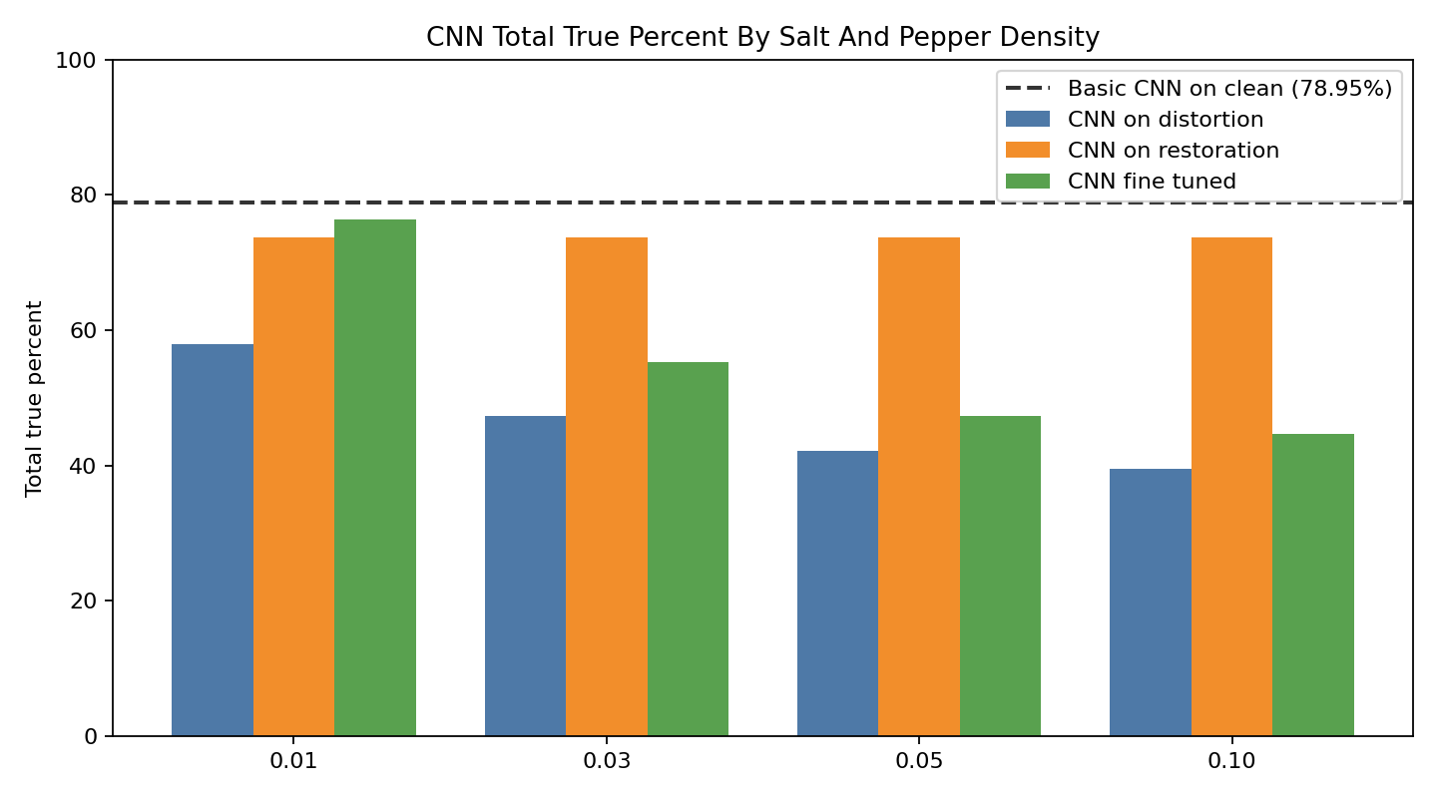
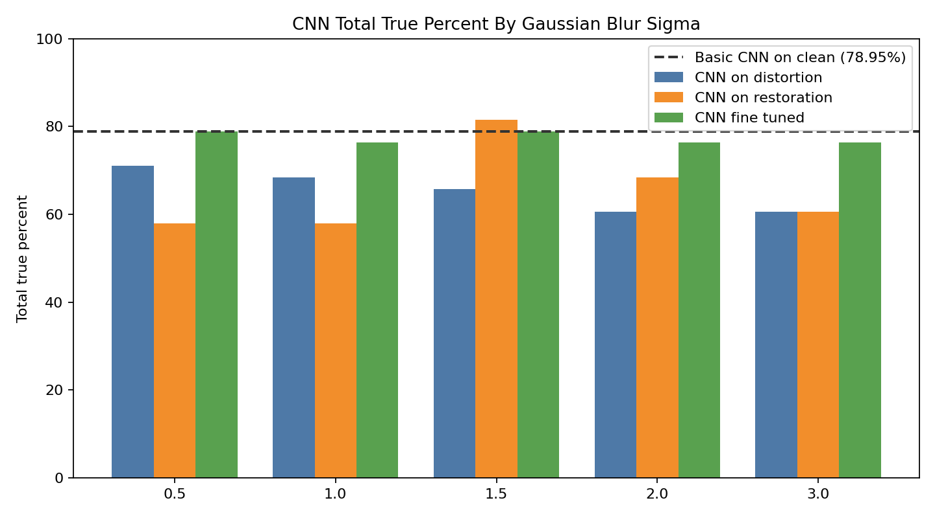
TASK 2 | CNN SNR AND LEVEL ANALYSIS
Brain MRI robustness
Separate distortion-level graphs show where classification begins to break.
The dashed line is the basic CNN on clean, non-distorted images.
Reading the graphs together separates distortion strength from model strategy: basic, restored, and fine-tuned.
14

Slide 15
Task 3
YOLO tumor segmentation
Use Data 2 masks so the model can mark tumor regions, not only classify the image.

Slide 16
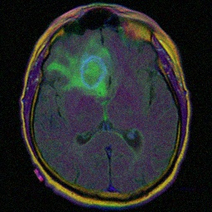
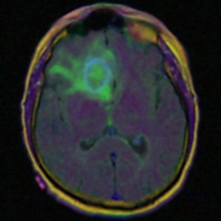
TASK 3 | SEGMENTATION EXAMPLES
Brain MRI robustness
YOLO output is evaluated as a mask prediction problem.
Clean, mask, distorted, and restored images show the full experiment path.
Clean
Mask
Distorted
Restored
16

Slide 17
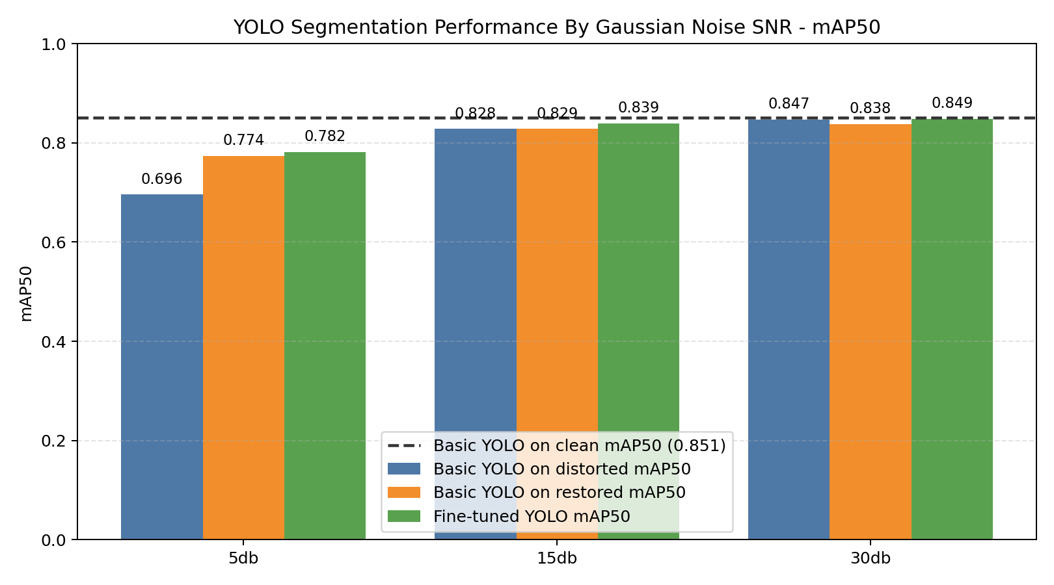
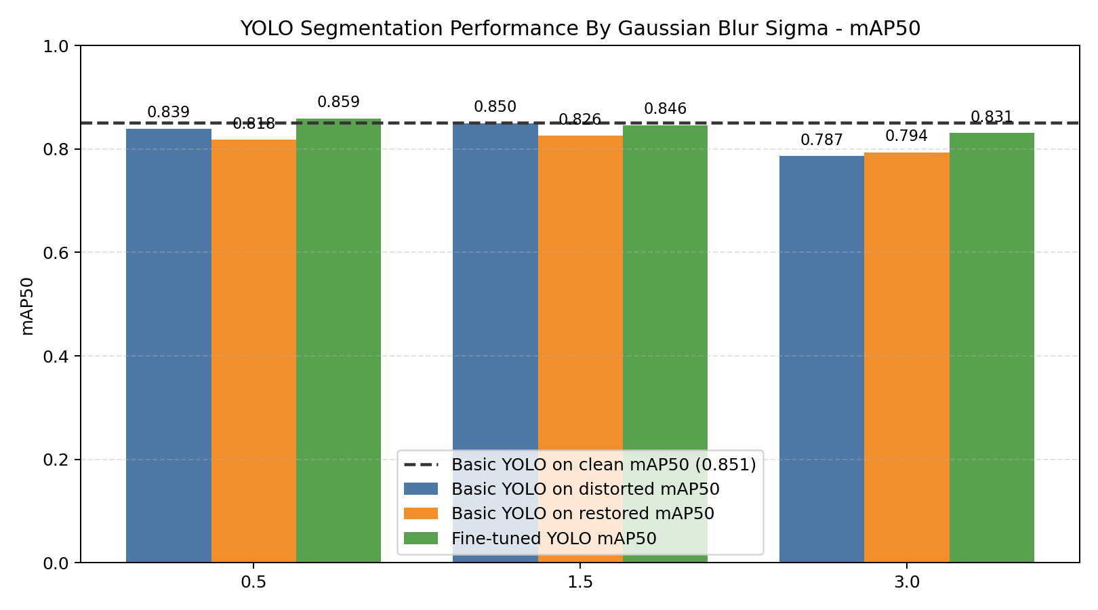
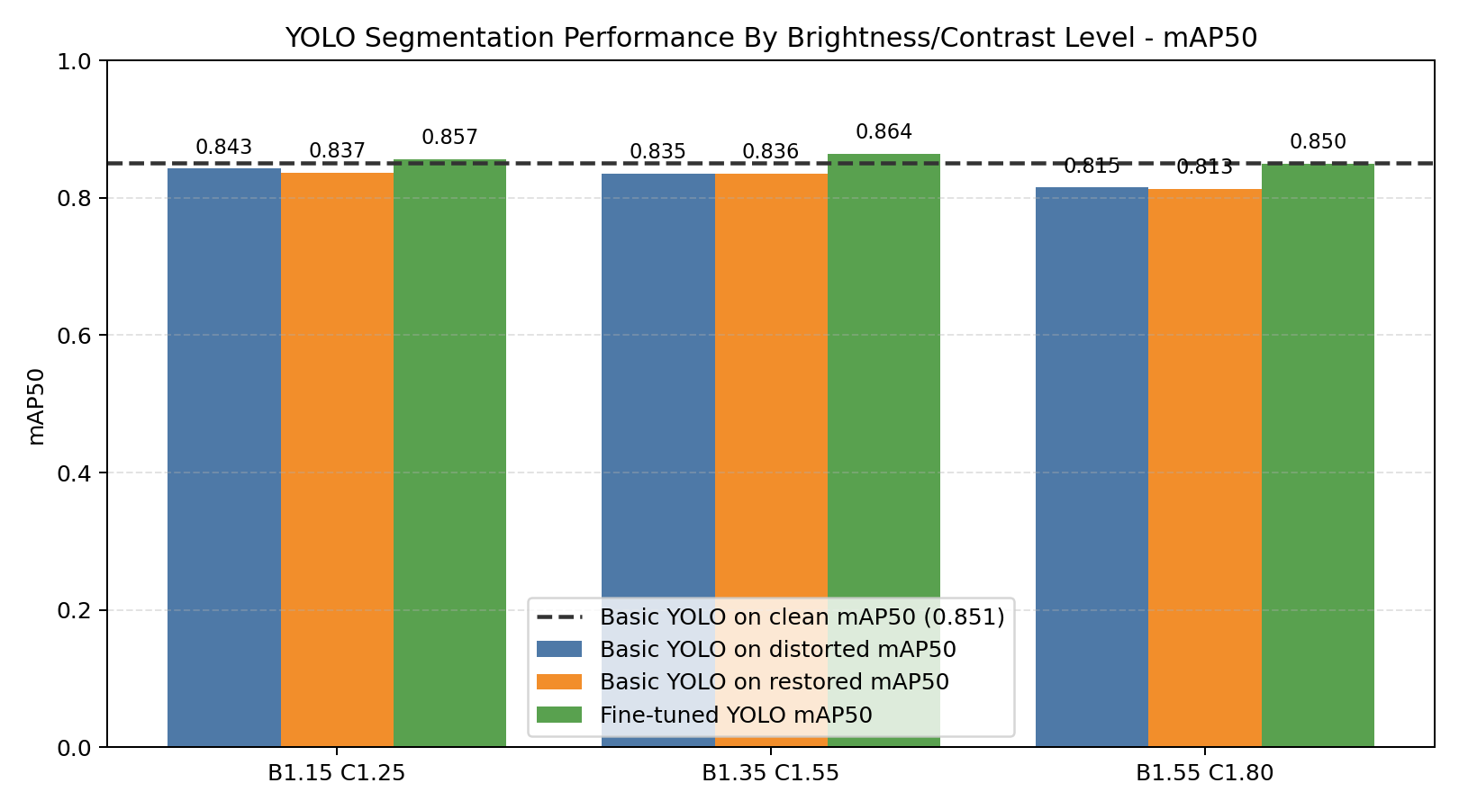
TASK 3 | YOLO MAP50
Brain MRI robustness
Clean YOLO is the reference line; distortion and fine-tuning reveal robustness.
mAP50 is shown separately for gaussian noise, blur, and brightness/contrast levels.
Main metric: mask mAP50. Fine-tuned YOLO models are trained on matching distorted data; restored images test pre-processing recovery.
17

Slide 18
Conclusion
Robustness should be measured across clean, distorted, restored, and fine-tuned settings.
Task 1 | Super-resolution
Best when image structure remains; restoration often raises PSNR before sharpened_lanczos.
Task 2 | CNN
Augmentation improved clean accuracy slightly; salt-and-pepper remains the hardest distortion.
Task 3 | YOLO
Mask training enables tumor marking; fine-tuning improves robustness on distorted data.
Main takeaway: restoration is useful, but for deep-learning tasks, distortion-aware fine-tuning is usually the stronger improvement.

