Slide 1
Digital Image Processing Applications
With: Dr Iman Elawady
Email Address: imanelawdy@karabuk.edu.tr

Slide 2
What to Expect
1) Learning basic digital image representation principals.
2) Ability to perform spatial and frequency domain analysis
3) Learning methods involving binary, gray scale and color image representations.
4) Gaining hands on experience in the use of Matlab and OpenCV.

Slide 3
Prerequisite:
-Matrix calculation;
-Signal processing;
-Programming in matlab.
Grading: Bonus:
Midterm exam 40% - Homework - Project
Final exam 60% - Participation and attendance
Resources
Digital Image Processing Using Matlab, Gonzalez & Richard E. Woods, Steven L. Eddins , Gatesmark Publishing, 2009
Gonzalez, R. C., & Woods, R. E. (2018). Digital Image Processing. Pearson. https://books.google.com.tr/books?id=0F05vgAACAAJ

Slide 4
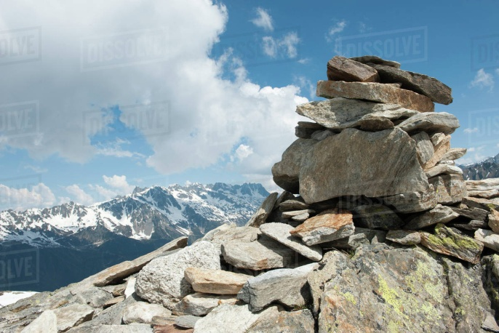
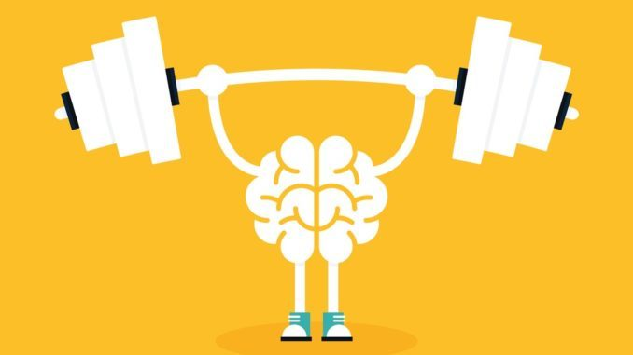
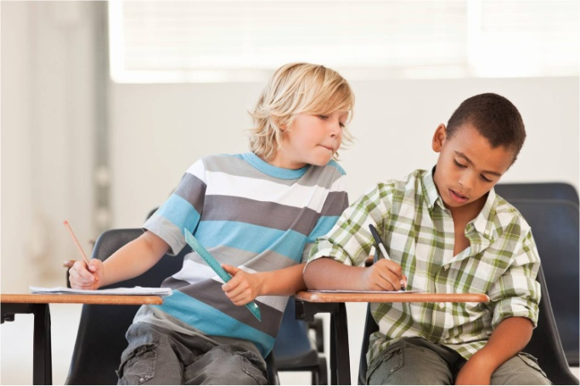
How to get the most out of this class
Revise your courses in the same day
(The big mountain is a group
of small rocks)
Solve problems as much as you can (exercise)
Do your homework by yourself
(Don't copy and paste from your classmates) I believe in your abilities

Slide 5
Class Rules
Your safety is so impotent so keep a distance between each other and wearing your masks please
Respect and civility in the class and when you are invited to speak
Since it is English program so we will use English in/out of our classes
Please avoid using your cell phones during our classes
If there is anything to discuss, raise your hand and share it with us (avoid privet talking or discussion of irrelevant topics)
Open minded to having fun and being positive !

Slide 6
Today's Agenda
What is a digital image
Characteristics of a digital image
Categories of digital images

Slide 7
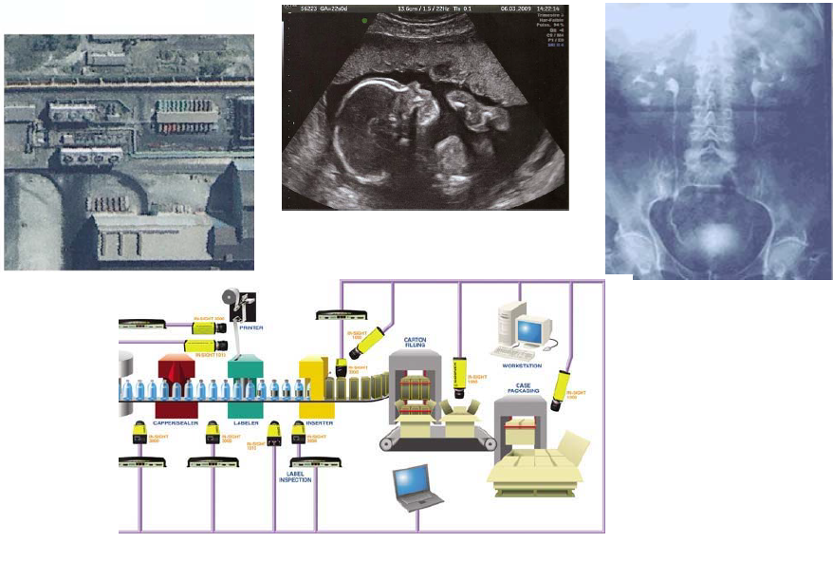
APPLICATION AREAS

Slide 8
Contents
Partition the image into homogeneous zones
Remote
diagnosis
Creation of
Database
Compression
Decompression
Input
image
Digitization
Pre-processing
Segmentation
Improve image quality (filtering)
Analog image
Digital image
Restoration
Interpretation
Correction
Decision
The domain expert who will make the decision

Slide 9
What is a digital image?
A digital image contains a finite number of points. These points are called pixels ( "picture element" , ie picture element).
Exemple

Slide 10
Characteristics of a digital image
Pixel
characterized by:
- his position
- his value

Slide 11
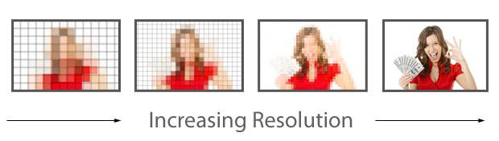
Resolution
On computer monitors, resolution is expressed as a number of pixels per unit of measurement (inch (2.54 cm) or centimeter). The word resolution is also used to designate the total number of pixels that can be displayed horizontally or vertically on a monitor; the larger this number, the better the resolution.

Slide 12
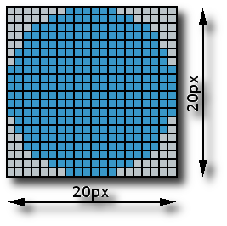
Dimension
It is the size of the image . It is in form of matrix whose elements are digital values that ​​represent the intensities (pixels). The number of rows in this matrix multiplied by the number of columns gives us the total number of pixels in the image

Slide 13
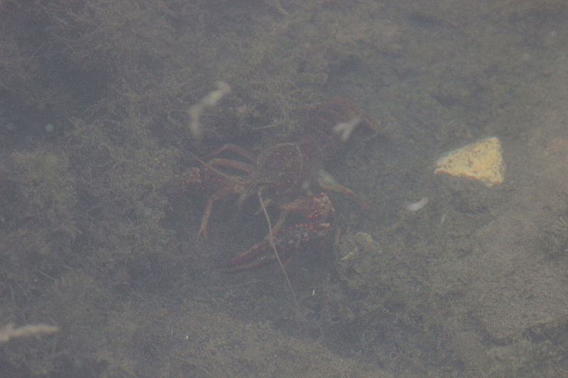
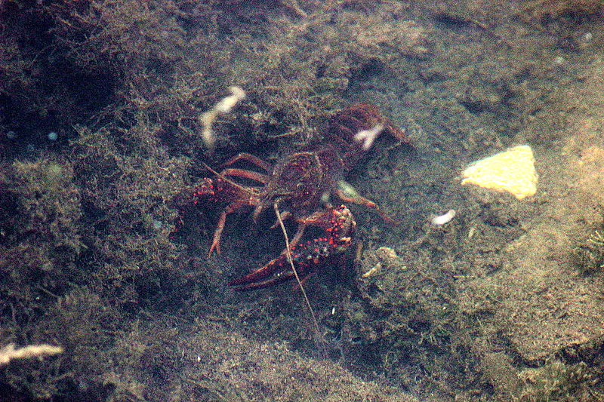

Contrast (dynamic)
Image with low contrast image with high contrast

Slide 14
Categories of digital images
Binary image
Grayscale image
Color image

Slide 15
Binary image
We have chosen a natural image of size 256x320.
What is the size of image : ………….?
What is the size of image file in memory:………….?

Slide 16
Grayscale image
We have chosen a natural image of size 256x320.
What is the size of image : ………….?
What is the size of image file in memory:………….?

Slide 17
Intensity Images
It is a grayscale image in which each element is real between 0 and 1 which represent the different gray levels.

Slide 18
Color image
We have chosen a natural image of size 256x320.
What is the size of image : ………….?
What is the size of image file in memory:………….?

Slide 19
Indexed color image
We have chosen a natural image of size 256x320.

Slide 20
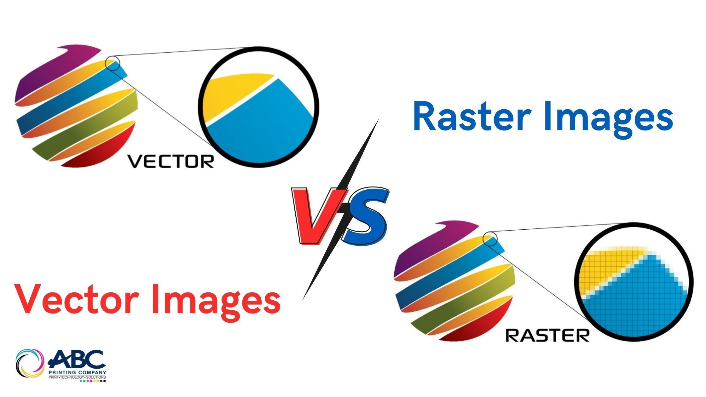
Raster vs Vector Images: What’s the Difference?
Raster and vectors are popular terms in graphic designing. But what are these? Raster images are made up of many tiny pixels, whereas vector images have formed using mathematical paths.

Slide 21
What is A Raster Image?
A raster image is a common term used in the field of computers and digital photography. A raster is sometimes also known as a bitmap image. It is represented in the form of a rectangular grid of pixels which are viewable using a bitmapped display. In raster-based imaging, it is easy to make smaller images. However, when it comes to increasing or decreasing the size and resolution, it is a bit challenging.

Slide 22
What is A Vector Image?
A vector image or graphic is defined and created on a plane by connecting lines and curves. It uses mathematical equations to form shapes. It creates a finer and more detailed image. You can see clear lines, points, and curve when you zoom in on the image. Vector graphics are used by all types of artists, design experts, and creative professionals. It makes creating illustrations, logos, and other types of designs for printing on big objects easy. You would have heard or observed many graphic designers talking about converting the images to vectors before printing.

Slide 23
Differences Between Vector and Raster Images
Raster graphics are made up of orderly arranged colored pixels to display any image whereas, vector graphics are composed of paths using a mathematical formula that is a vector that directs the route and shape.

Slide 24
Introduction to the MATLAB
MATLAB = Matrix Laboratory
“MATLAB is a high-level language and interactive environment that enables you to perform computationally intensive tasks faster than with traditional programming languages such as C, C++ and Fortran.” (www.mathworks.com)
MATLAB is an interactive, interpreted language that is designed for fast numerical matrix calculations.

Slide 25
Introduction to the MATLAB
MATLAB has become a standard computing tool for mathematics, engineering and other disciplines at universities.
MATLAB consists of toolboxes that provide specific results for applications in specific areas.
The image processing toolbox, which is one of them, consists of the sum of MATLAB functions (M-functions or M-files) developed for solving problems related to digital image processing.

Slide 26
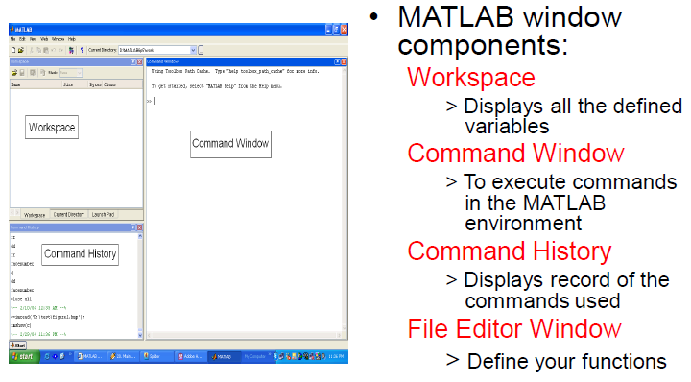
Introduction to the MATLAB

Slide 27
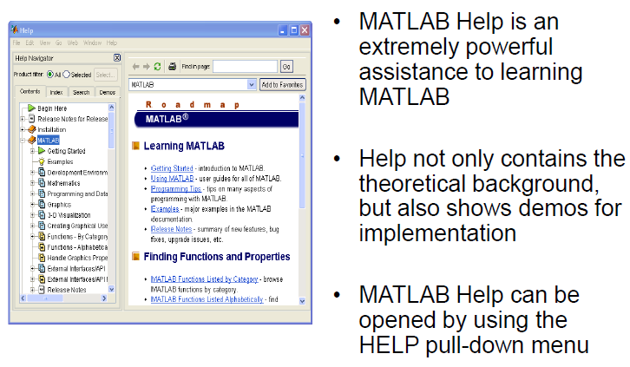
Introduction to the MATLAB

Slide 28
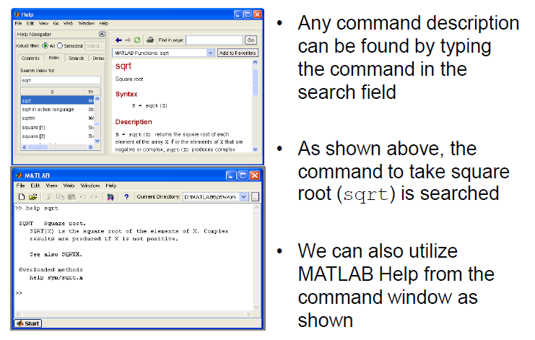
Introduction to the MATLAB

Slide 29
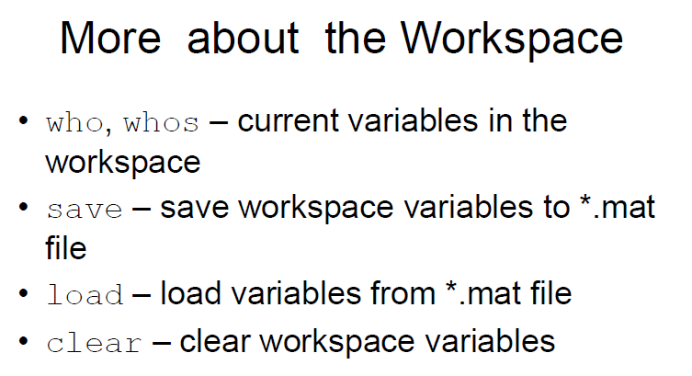
Introduction to the MATLAB

Slide 30
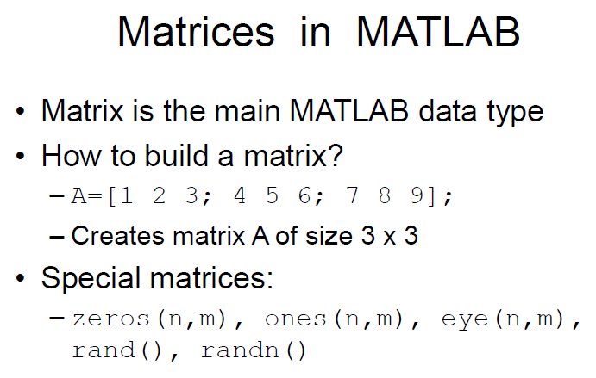
Introduction to the MATLAB

Slide 31
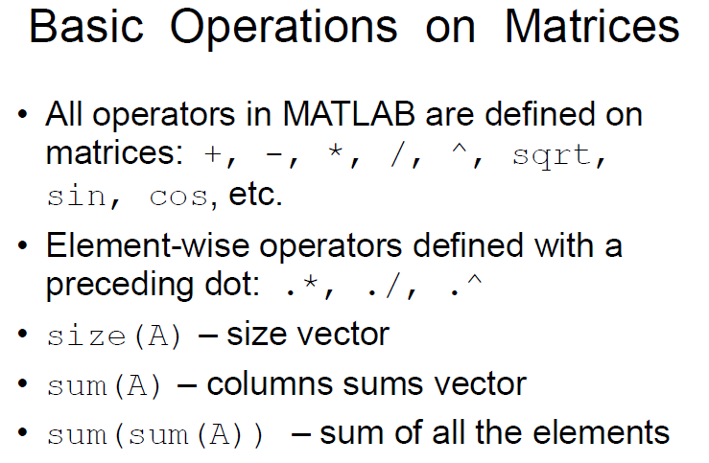
Introduction to the MATLAB

Slide 32
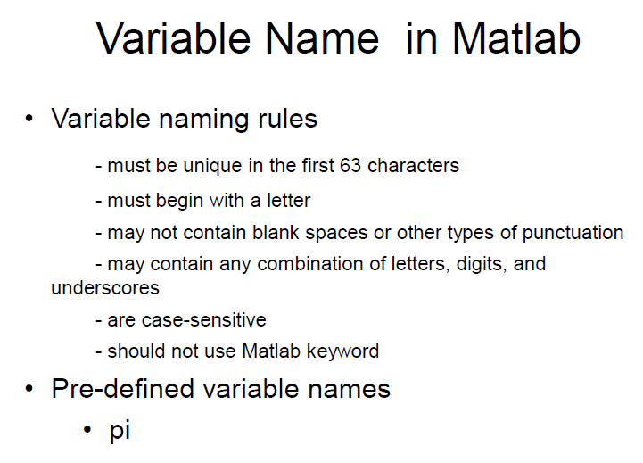
Introduction to the MATLAB

Slide 33
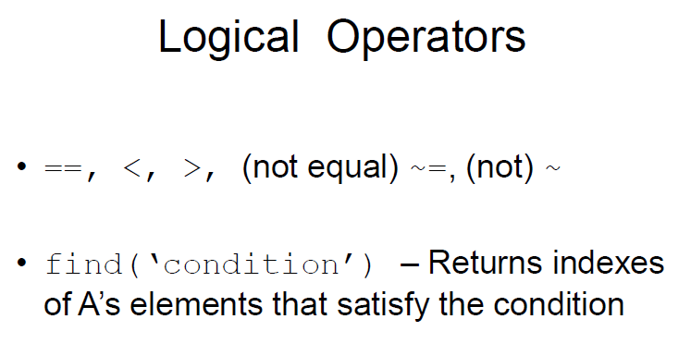
Introduction to the MATLAB

Slide 34
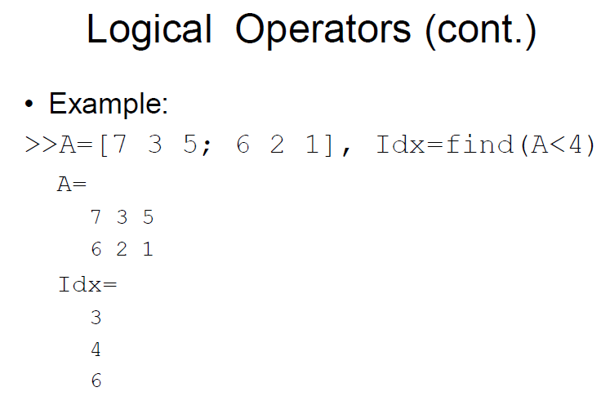
Introduction to the MATLAB

Slide 35
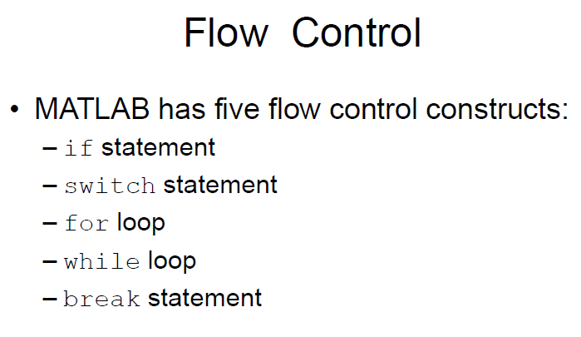
Introduction to the MATLAB

Slide 36
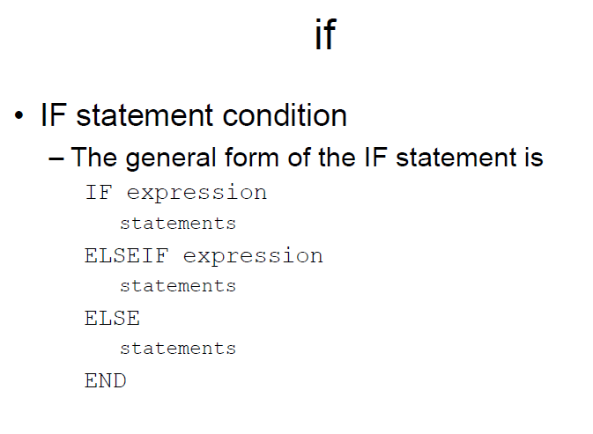
Introduction to the MATLAB

Slide 37
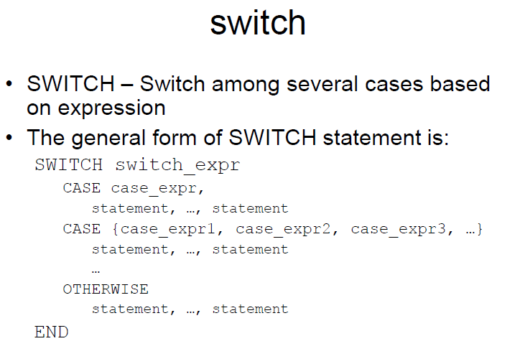
Introduction to the MATLAB

Slide 38
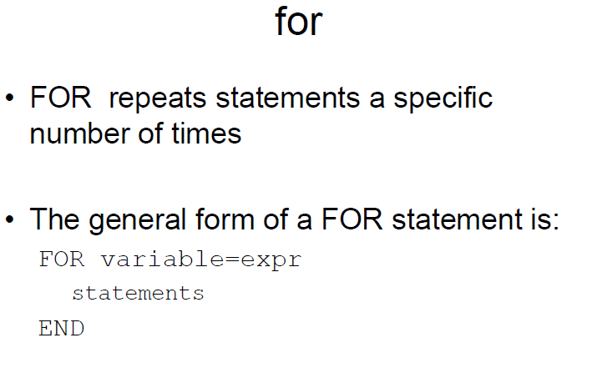
Introduction to the MATLAB

Slide 39
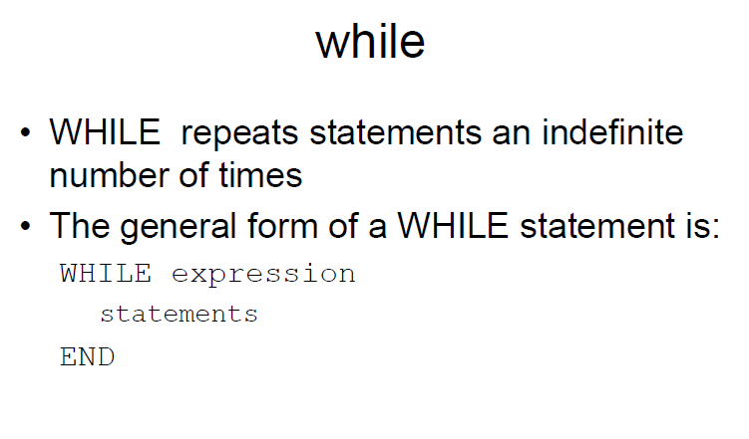
Introduction to the MATLAB

Slide 40
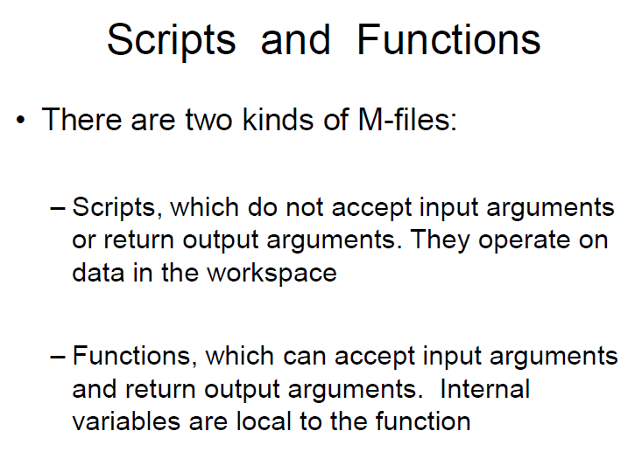
Introduction to the MATLAB

Slide 41
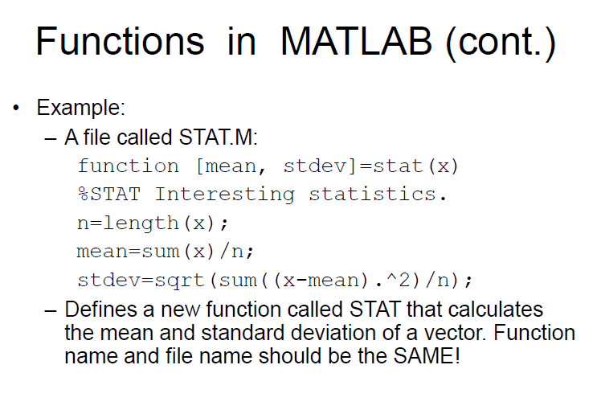
Introduction to the MATLAB

Slide 42
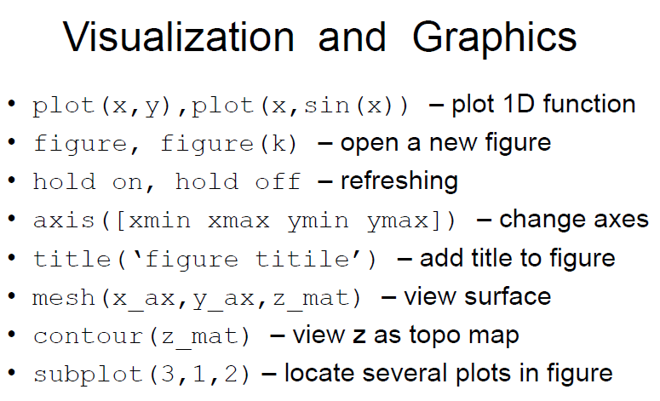
Introduction to the MATLAB

Slide 43
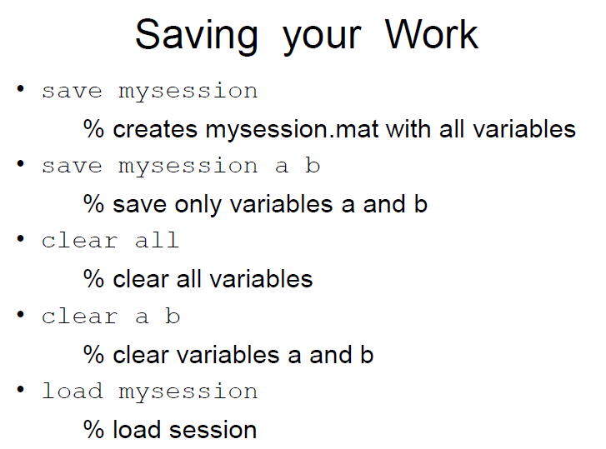
Introduction to the MATLAB

