Slide 1
Parallelizing Neural Networks

Slide 2
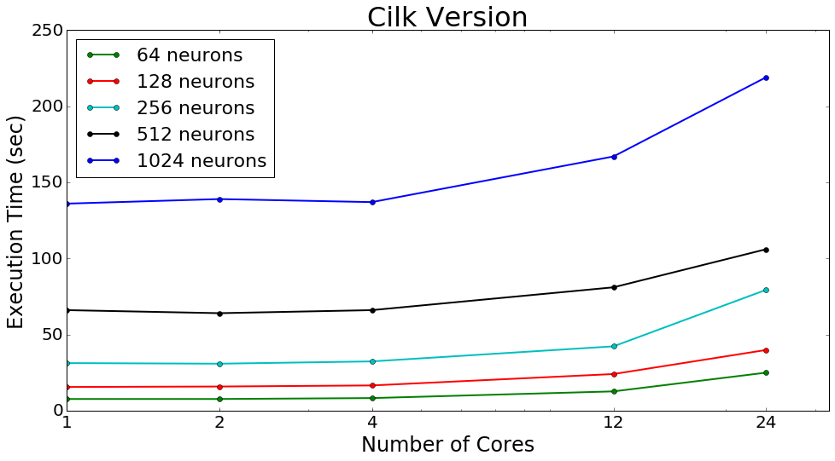

Slide 3
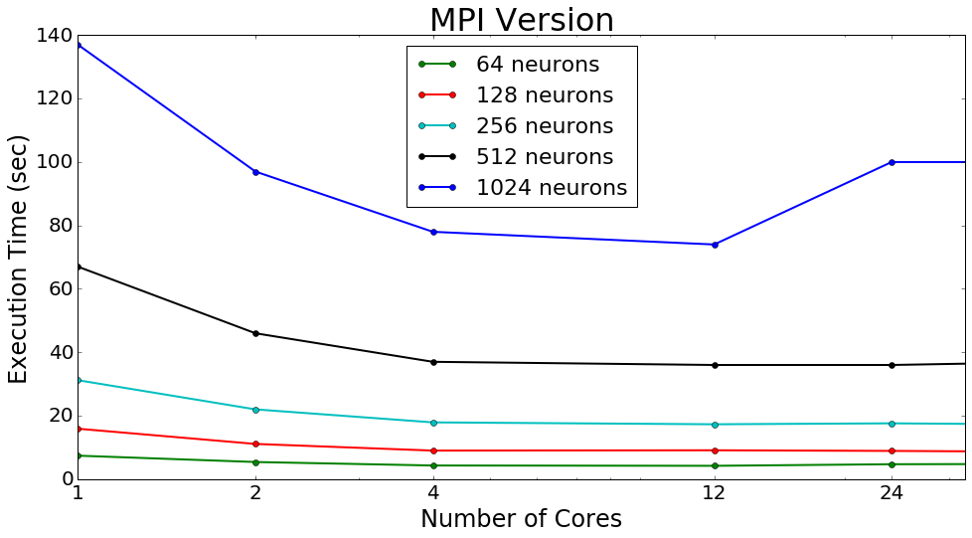

Slide 4
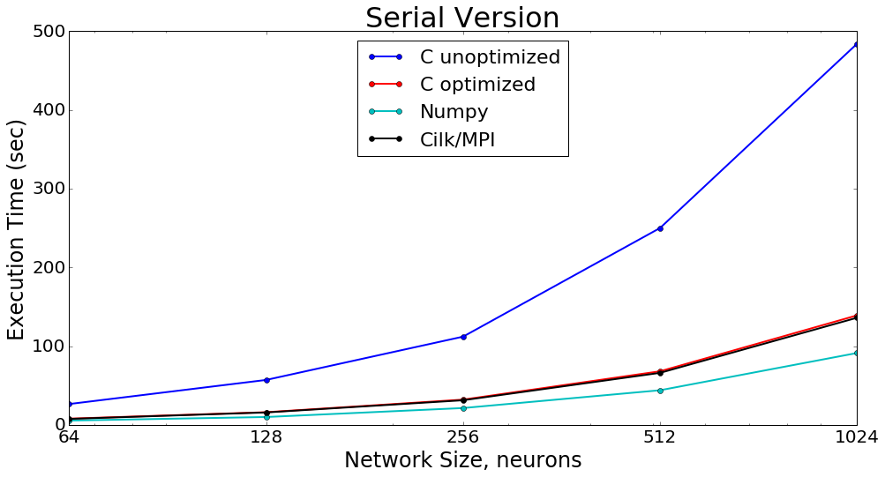

Slide 5
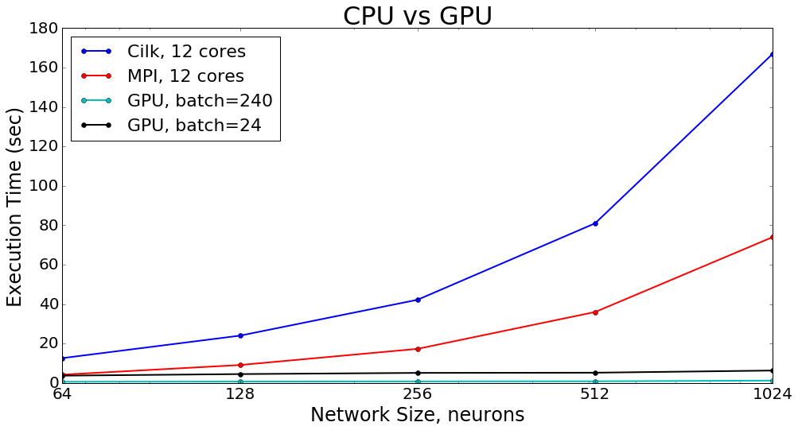
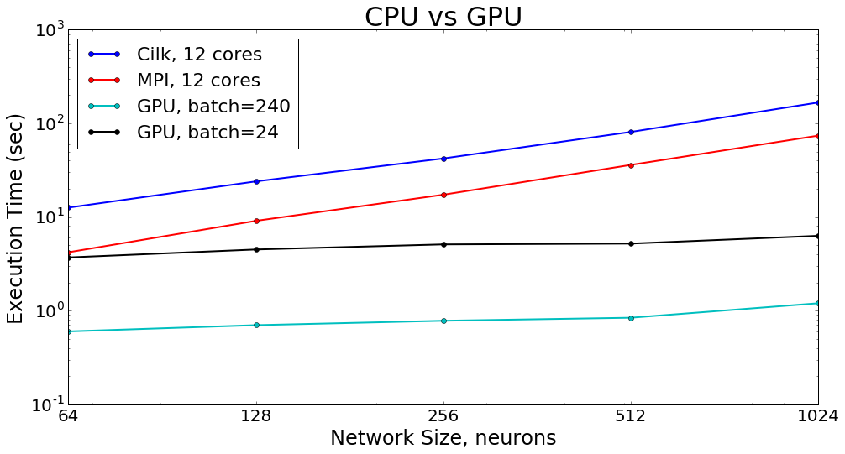

Slide 6
Profiling: Unoptimized C (gprof)
1 epoch of training, 128 neurons, batch = 240
% cumulative self self total
time seconds seconds calls s/call s/call name
91.12 65.47 65.47 1254 0.05 0.05 dot
3.77 68.18 2.71 _IO_vfscanf_internal
1.91 69.55 1.37 ____strtof_l_internal
0.56 69.95 0.40 __isoc99_fscanf
0.39 70.23 0.28 strlen
0.33 70.47 0.24 750 0.00 0.00 transpose
0.28 70.67 0.20 _int_malloc
0.24 70.84 0.17 1 0.17 0.17 load_mnist
0.19 70.98 0.14 252 0.00 0.00 ReLU_vec
0.17 71.10 0.12 250 0.00 0.00 update_parameters

Slide 7
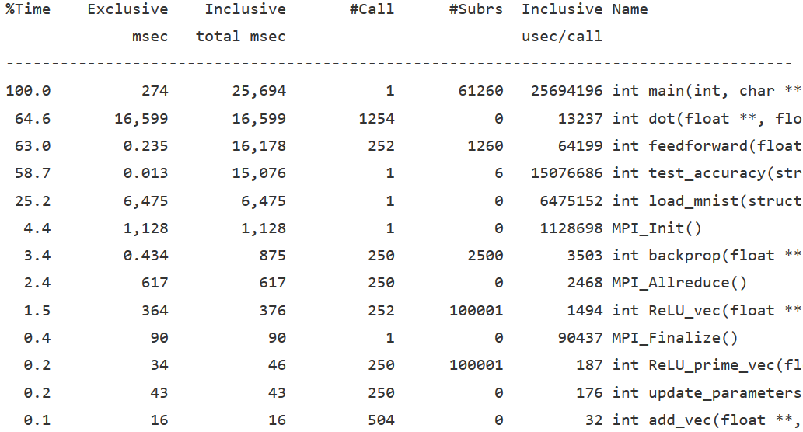
Profiling: MPI (Tau)

Slide 8
Profiling: Cilk (Cilkview)
Cilk Parallel Region(s) Statistics - Elapsed time: 0.165 seconds
1) Parallelism Profile
Work : 130,925,699,290 instructions
Span : 130,925,687,790 instructions
Burdened span : 130,929,437,790 instructions
Parallelism : 1.00
Burdened parallelism : 1.00
Number of spawns/syncs: 250
Average instructions / strand : 174,335,152
Strands along span : 250
Average instructions / strand on span : 523,702,751
Total number of atomic instructions : 1,830
Frame count : 500
Entries to parallel region : 250
2) Speedup Estimate
2 processors: 0.74 - 1.00
4 processors: 0.66 - 1.00
8 processors: 0.62 - 1.00
16 processors: 0.60 - 1.00
32 processors: 0.60 - 1.00
64 processors: 0.59 - 1.00
128 processors: 0.59 - 1.00
256 processors: 0.59 - 1.00

