Slide 1
AXIOM Manufacturing Group
Intelligent Manufacturing, Globally Delivered
Corporate Introduction 2025
Global Headquarters · Shanghai

Slide 2
01
About Us
02
Technology & R&D
03
Manufacturing System
04
Global Market Layout
CONTENTS
05
Product Portfolio
06
Core Advantages
AXIOM · 2025
07
Benchmark Cases
08
Future Roadmap

Slide 3
About us
- Founded in 2008, headquartered in Shanghai, a global intelligent manufacturing enterprise.
- 18,000+ employees worldwide; 1,200+ R\&D engineers.
- 12 smart factories across 3 continents; 6 global R\&D centers.
- Operations in 60+ countries; annual revenue exceeding USD 4.2B.
- Mission: "Empower industry with intelligence." Vision: "A smart factory in every key market by 2030."

Slide 4
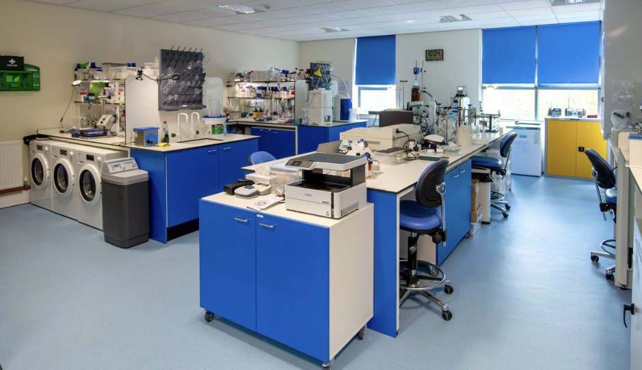
Technology & R\&D
- R\&D investment equals 11% of annual revenue — above the 10%-14% industry benchmark.
- 1,200+ R\&D engineers; 800+ granted patents; 6 global R\&D centers.
- Digital twin cuts product R\&D cycles by up to 60%; AI quality inspection reduces defect rates by 34%.
- Core tech: Industrial IoT, AI process optimization, edge computing, robotics, digital twin.
- Joint innovation with leading universities and national laboratories.

Slide 5
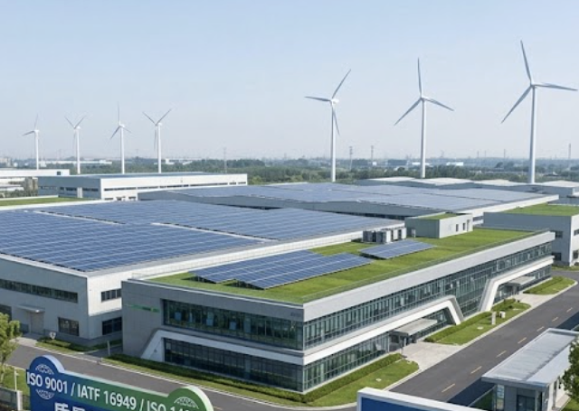
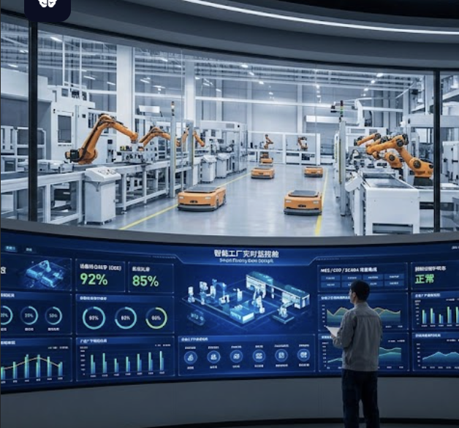
Manufacturing System
- 12 intelligent factories fully integrated with MES, ERP and SCADA systems.
- Overall Equipment Effectiveness (OEE) reaches 92%; automation rate 85%.
- Real-time data cockpit enables end-to-end visibility and predictive maintenance.
-
Green manufacturing: 40% renewable energy, zero-landfill target by 2030.
- Quality system certified to ISO 9001 / IATF 16949 / ISO 14001.

Slide 6
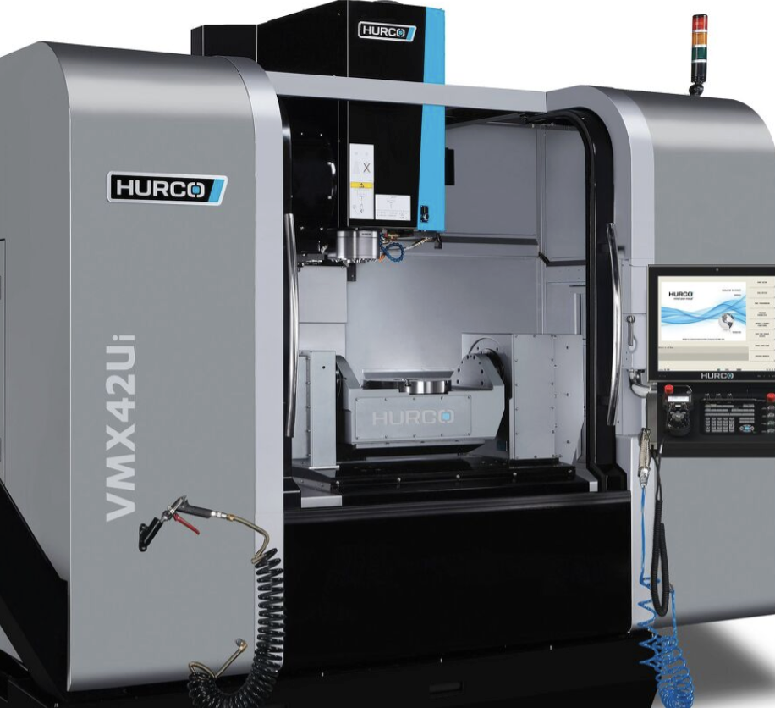
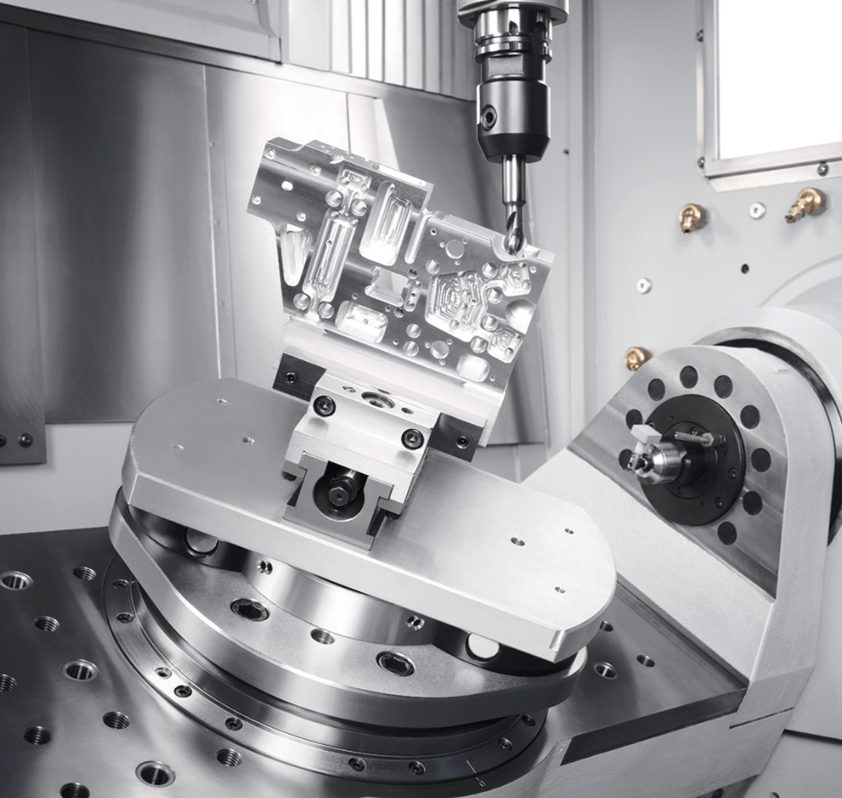
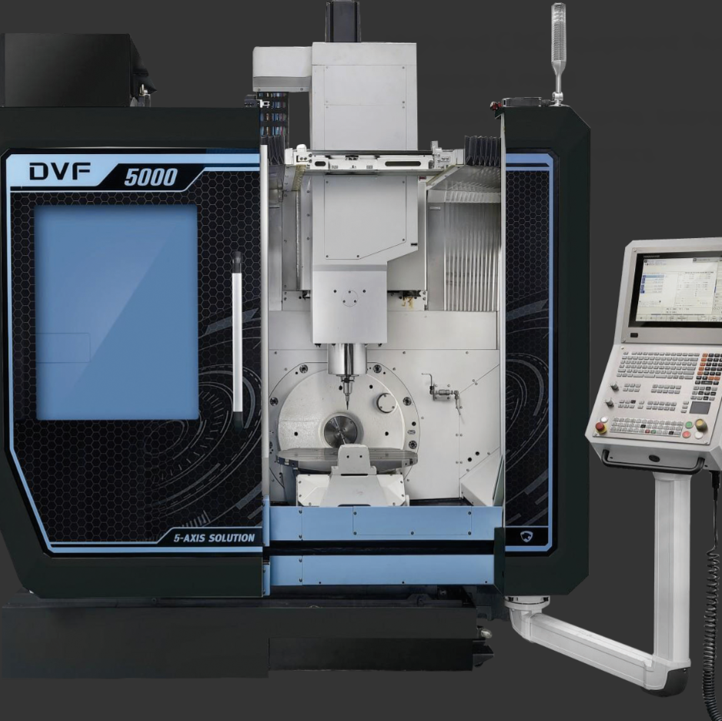
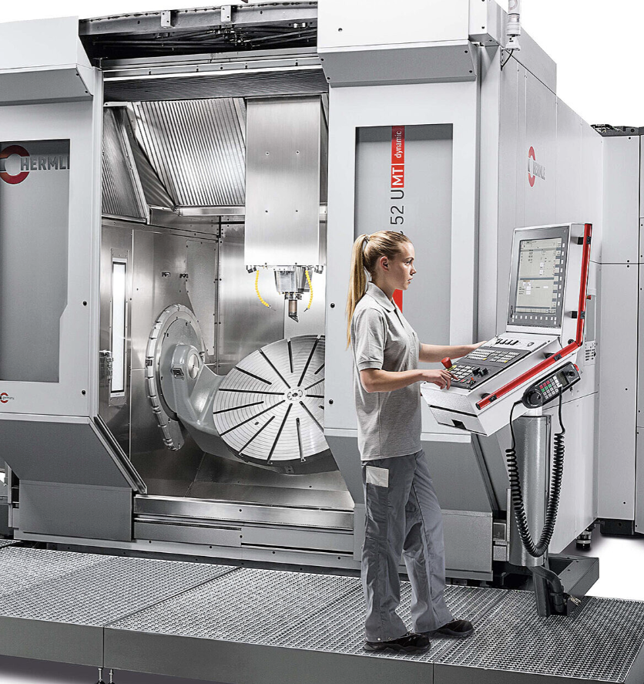
Product series
Smart Factory Solutions: MES/ERP integration, digital twin, turnkey lines
High-end CNC Equipment: five-axis machining centers for aerospace & mold.
Precision Components: tolerances within ±0.001 mm for automotive & electronics.
Each line backed by 24/7 global service and lifecycle support

Slide 7
Benchmark Cases
Proven Results Across Industries
Automotive
Global OEM
Aerospace
Tier-1 Supplier
Challenge
Challenge
Legacy line upgrade for higher throughput
Precision machining at large scale
Solution
Solution
Turnkey smart line with integrated MES
Five-axis CNC cells with in-line inspection
71→93%
−40%
14mo
±0.001mm
−34%
+12%
OEE
Downtime
Payback
Precision
Defects
Yield
New Energy
Storage
Outcome
Across Industries
Challenge
Challenge
Scaling battery module production
Faster time-to-market, lower cost, higher quality
Solution
Solution
Robotic welding plus AGV logistics line
Co-engineered smart manufacturing
−38%
−22%
−18%
3
100%
95%
Cycle Time
CO2
Cost
Industries
On-time
Satisfaction

Slide 8
Future Roadmap
Status
On Track
2025 – 2030 · Smart + Green
Scale AI & Twin
Launched
2025
2027
2029
2030
Digital transformation
Expand Factories
In progress
Capacity build-out
Green & Humanoid
Planned
Next wave
Global Ecosystem
Vision
Vision 2030
Smart Factories
Revenue Target
Renewable Energy
18 by 2027
USD 8B
50% by 2027

