Slide 1
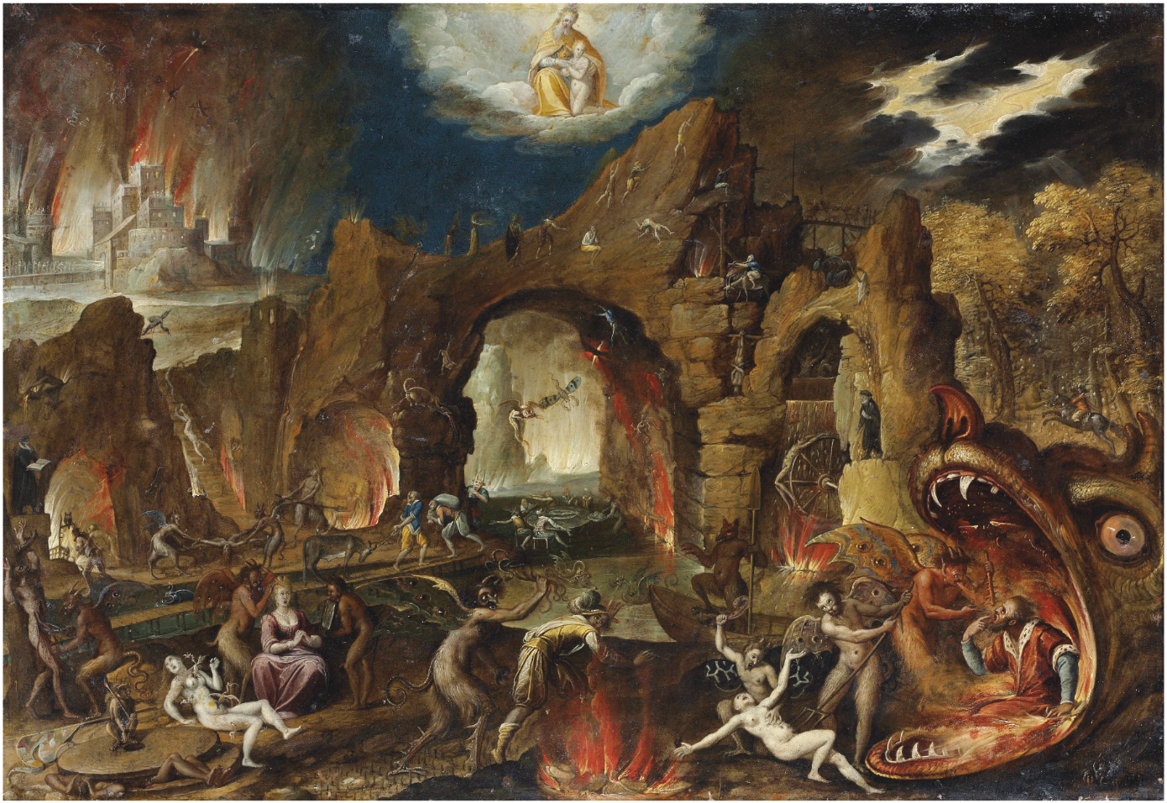
ESCAPE FROM TUTORIAL HELL
WITH
INDEPENDENT PROJECTS

Slide 2
BROUGHT TO YOU BY:
MICHAEL MEETS THE WEB

Slide 3
WHAT IS TUTORIAL HELL?

Slide 4
TUTORIAL HELL
Is a condition that effects beginning to intermediate developers.
Manefests as the belief that by learning just one more tool / technology / framework that a developer will become a “professional.”
Is closely linked to imposter syndrome.

Slide 5

SYMPTOMS
The mass consumption of one learning resource after another.
A portfolio that consists mainly of coursework and example projects.
The inability to remember previous course material as the developer moves on to newer content.

Slide 6
A (HIGHLY CONTRIVED) EXAMPLE

Slide 7

I’M LEARNING REACT

Slide 8
I’M LEARNING REACT-ROUTER

Slide 9

I’M LEARNING REDUX

Slide 10
I’M LEARNING STYLED COMPONENTS

Slide 11

NEW VERSON OF REACT?

Slide 12

OKAY, I’M LEARNING THE CONTEXT API

Slide 13
… AND HOOKS

Slide 14
… AND THE SUSPENSE API

Slide 15
GRAPHQL IS A THING NOW?

