Slide 1
Forecasting
Topics
Review of Forecasting
Story Pointing Best Practices

Slide 2
Forecasting
We start an initiative with two things
Date
List of things we want do
Date
Item 1
Item 2
Item 3
Item 4
….
Item n

Slide 3
Forecasting
There is one thing we want to know
How long will it take complete the list?
Due Date
Item 1
Item 2
Item 3
Item 4
….
Item n

Slide 4
Forecasting
Extensive research has been done on this and it is amazing difficult problem to solve
No perfect solution has been found
Some approaches have been shown statistically to be more effective than others
Due Date
Item 1
Item 2
Item 3
Item 4
….
Item n

Slide 5

Forecasting
Story Pointing
Is the practice of sizing work by comparison, not by estimating total time
When we size items we say that an item is X because when we compare to other items it is more / less effort
We still haven’t shown how this allows us to answer the question?

Slide 6
Forecasting
Forecasting based on Story Points
Team starts doing the work and we measure how many story points we complete over a fixed period of time...this is a velocity
Example
15 points completed within 2 weeks
We then add up the remaining story points and divide by the velocity. This gives us the total time.
Example
75 points remaining / 15 points => 5 (2 weeks) => 10 weeks
Due Date
Item 1 (13)
Item 2 (8)
Item 3 (5)
Item 4 (21)
….
Item n (X)
Oct 1
Oct 8
Oct 24
July 17

Slide 7
Forecasting
Backlog Refinements
Now that we have a forecast for how long it will take, we can:
Reset expectations
Innovate on better solutions
Change the date
...
Story Pointing Empowers Teams
Due Date
Item 1 (13)
Item 2 (8)
Item 3 (3)
Item 4 (21)
….
Item n (X)
Oct 1
Oct 4
Oct 24
Mar 31
Change the plan to meet the date

Slide 8
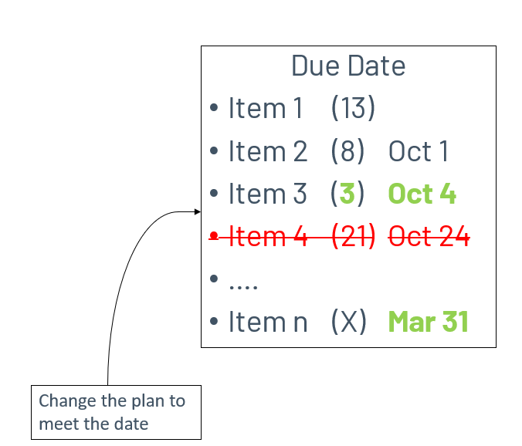
Forecasting
This is not once and done…this is a continuous process of backlog refinements
Estimates will change
New work will be identified
Our company will change
Markets will change
Life will happen
…

Slide 9
Story Pointing Best Practies
Do not spend much time on this - Timebox
It is an estimate
We will resize it again in future refinements when we know more
If we spend too much time … the estimates become less accurate
Some information now is better than perfect information later
Comparative Estimation
DO NOT REFERENCE OR THINK TIME
Think how much more or less work the story you are sizing is vs. other stories.
When sizing assume
The full scrum team is working on the story (swarming)...not just you
This is the only thing the team is doing...no other interruptions / priorities
There are no external team delays in the work

Slide 10
Story Pointing Best Practies
Do not change the story size once work has started
Use Spikes Correctly
Needed learning should be factored into all stories and estimates
Spikes are for the PO to help inform prioritization decisions
If the outcome of the spike will not impact PO priorities, it’s not a spike it is just learning that is part of a regular story.
Timebox spikes

